Slide 1
Neural Networks
Outline:
Introduction to Neural Networks
Perceptrons
Introduction to Backpropagation
Associative Memory: Hopfield Nets
Summary

Slide 2
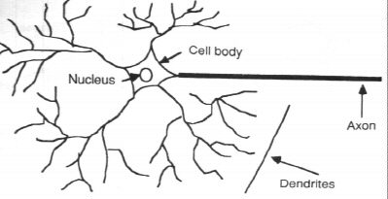
Introduction
A neural network can be defined as a model of reasoning based on the human brain. The brain consists of a densely interconnected set of nerve cells, or basic information-processing units, called neurons.
Neuron
- The cell that perform information processing in the brain.
- Neural Networks can be :
- Biological models
- Artificial models
- Desire to produce artificial systems capable of
sophisticated computations similar to the human brain.

Slide 3
Biological Neural Network
Synapse
Axon
Soma
Dendrites
A neuron consists of a cell body, soma, a number of fibers called dendrites, and a single long fiber called the axon. While dendrites branch into a network around the soma, the axon stretches out to the dendrites and somas of other neurons. The connections between neurons are realized in the synapses. Signals are propagated from one neuron to another by complex electrochemical reactions.

Slide 4
How the brain works
Each neuron receives inputs from other neurons
Some neurons also connect to receptors
Cortical neurons use spikes to communicate
The timing of spikes is important
The effect of each input line on the neuron is controlled by a synaptic weight
The weights can be
positive or negative
The synaptic weights adapt so that the whole network learns to perform useful computations
Recognizing objects, understanding language, making plans, controlling the body
Human brain has about 10¹¹ (10 billions) neurons. Each connected with other through (about) 10⁴ weights (interconnections).
A huge number of weights can affect the computation in a very short time. Much better bandwidth than Pentium Processor.

Slide 5
Human Brain
Properties of the brain
It can learn, reorganize itself from experience
It adapts to the environment
It is robust and fault tolerant

Slide 6
Human Brain vs. Computer
- Computers require hundreds of cycles to simulate
a firing of a neuron.
- The brain can fire all the neurons in a single step.
Parallelism
- Serial computers require billions of cycles to
perform some tasks but the brain takes less than
a second.
e.g. Face Recognition
Future Goal : Combine parallelism of the brain with the
switching speed of the computer.

Slide 7
Analogy between Biological and Artificial Neural Networks

Slide 8
Artificial Neural Networks (ANN)
A mathematical model to solve engineering problems
Group of highly connected neurons to realize compositions of non linear functions
Tasks
Classification
Discrimination
Estimation
Types of networks
Feed forward Neural Networks
Recurrent Neural Networks
An ANN system is characterized by
its ability to learn;
its dynamic capability;
its interconnectivity.

Slide 9
Artificial Neuron and Rosenblatt’s Single Layer Perceptron
A model of an artificial neuron.
Perceptron is the simplest form of a neural network. It consists of a single neuron with adjustable synaptic weights and a hard limiter activation function (threshold).

Slide 10
A schematic diagram for an 'electronic' neuron
Neuron x_{k}
x₁
Summing Junction
Activation Function
w_{k1}
Input Signals
Output Signal
x₂
w_{k2}
Σ
y_{k}
x₃
w_{k3}
b_{k}
x₄
w_{k4}
Notes:
There are three major types of activation functions reported in the literature:
Threshold Function: ϕ ( v ) = 1 if v ≥ 0 --> y_{k} = 1
ϕ ( v ) = 0 if v < 0 --> y_{k} = 0
The early pioneers of neural networks, William McCulloch and William Pitts, used threshold function to simulate the all-or-none behaviour.
Piecewise-Linear Function: ϕ ( v ) = 1 if v ≥ 1/2
ϕ ( v ) = v if +1/2 > v > −1/2
ϕ ( v ) = 0 if v ≤ −1/2
Piece-wise linear function can be considered as an approximation to a non-linear amplifier
Sigmoid Function: ϕ ( v ) = 1 / (1 + exp (-av)). ('a' is the slope parameter)
The sigmoid function is amongst the most commonly used activation function: ‘It is defined as a strictly increasing function that exhibits a graceful balance between linear and non-linear behaviour’. As the value of a increase from zero to infinity, the sigmoid function approximates more closely to the threshold function and when a = ∞then the sigmoid function becomes the threshold function. The key difference between the two functions is that whilst threshold function takes only two value 0 or 1, the sigmoid function takes all values in the interval {0,1}.
Sigmum Function: ϕ ( v ) = 1 if v >0
ϕ ( v ) = 0 if v = 0
ϕ ( v ) = -1 if v < 0
The sigmum function allows the modellers of neuronal systems to have an activation function which can take on values between {-1,+1}
(From Haykin 1999:13-14)

Slide 11
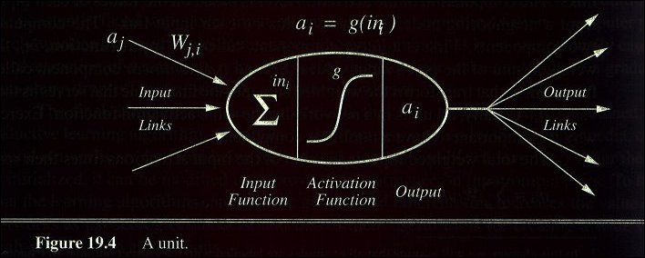
A Neuron Model

Slide 12
Perceptron’s Learning Algorithm
MSE (Minimum Squared Error) by Steepest Descent Minimization Procedure:
d = desired output for a sample
Step 1: Pick starting weight and choose a positive constant α (learning rate).
Step 2: Present samples 1 to N repeatedly to the classifier. For each pattern of input sample, compute D.
Step3: Update the weight w_{i} by for all i
Step4: Repeat steps2 and 3 until the weights cease to change significantly.

Slide 13
Activation Function
- Use different functions to obtain different models.
- 3 most common choices :
1) Step function
2) Sign function
3) Sigmoid function
- An output of 1 represents firing of a neuron down the
axon.

Slide 14
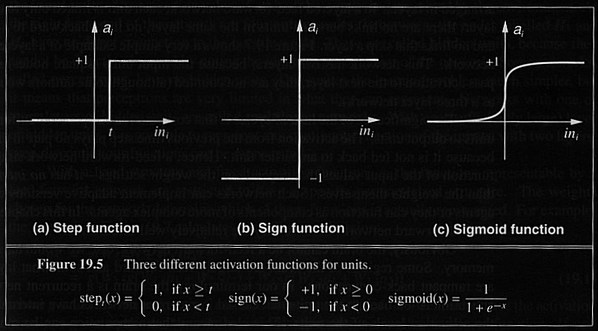
Activation Function

Slide 15
Binary threshold neurons
McCulloch-Pitts (1943):
First compute a weighted sum of the inputs from other neurons
Then send out a fixed size spike of activity if the weighted sum exceeds a threshold.
Maybe each spike is like the truth value of a proposition and each neuron combines truth values to compute the truth value of another proposition!
1
1 if
y
0 otherwise
0
z
threshold

Slide 16
Sigmoid neurons
These give a real-valued output that is a smooth and bounded function of their total input.
Typically they use the logistic function
They have nice derivatives which make learning easy.
1
0.5
0
0

Slide 17
Learning
The procedure that consists in estimating the parameters of neurons so that the whole network can perform a specific task
Types of learning
The supervised learning
The unsupervised learning
The Learning process (supervised)
Present the network a number of inputs and their corresponding outputs
See how closely the actual outputs match the desired ones
Modify the parameters to better approximate the desired outputs.

Slide 18
Learning
A neuron learns because it is adaptive.
SUPERVISED LEARNING: The connection strengths of a neuron are modifiable depending on the input signal receives, its output value and a pre-determined or desired response. The desired response is sometimes called teacher response. The difference between the desired response and the actual output is called the error signal.
UNSUPERVISED LEARNING: In some cases the teacher’s response is not available and no error signal is available to guide the learning. When no teacher’s response is available the neuron, if properly configured, will modify its weight based only on the input and/or output.
Zurada (1992:59-63)

Slide 19
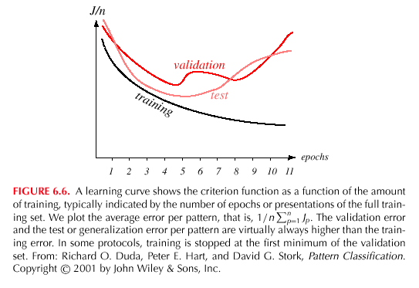

Slide 20
Unsupervised learning
Idea : group typical input data in function of resemblance criteria un-known a priori
Data clustering
No need of a teacher
The network finds itself the correlations between the data
Examples of such networks :
Kohonen self-organized feature maps (SOFM)

Slide 21
Learning Curves
Before training starts, the error on the training set is high; through the learning process, the error becomes smaller
The error per pattern depends on the amount of training data and the expressive power (such as the number of weights) in the network
The average error on an independent test set is always higher than on the training set, and it can decrease as well as increase
A validation set is used in order to decide when to stop training ; we do not want to overfit the network and decrease the power of the classifier generalization “we stop training at a minimum of the error on the validation set”

Slide 22
Rosenblatt’s Perceptrons
Rosenblatt’s perceptrons learn in presence of a teacher. The desired signal is denoted as d_{i} and the output as y_{i}. The error signal is denoted as e_{i} . The weights are modified in accordance with the perceptron learning rule; the weight change is denoted as Δw which is proportional to the error signal; c is a proportionality constant (learning rate):
Notes:
A fixed increment perceptron algorithm
Given: A classification problem with n input features (x₀,x₁, x₂, .....x_{n}) and 2 output classes.
Compute: A set of weights (w₀, ,w₁,.....w_{n}) that will cause a perceptron to fire whenever the input falls into the first output class.
An Algorithm
Step Action
1. Create a perceptron with n+1 inputs and n+1 weights, where the extra input x₀ is always set to 1.
2. Initialise the weights (w₀, ,w₁,.....w_{n}) to random real values.
3. Iterate thorough the training set, collecting all examples misclassified by the current set of weights.
4. If all examples are classified correctly, output the weights and quit.
Otherwise, compute the vector sum Σ of the misclassified input vectors, where each vector has the form (x₀,x₁, x₂, .....x_{n}). In creating the sum, add to Σ a vector x if x is an input for which the perceptron incorrectly fails to fire, but add vector -x if x is an input for which the perceptron incorrectly fires. Multiply the sum by a scale factor h
Modify the weights (w₀, ,w₁,.....w_{n}) by adding the elements of the vector Σ to them. GO TO STEP 3.

Slide 23
Rosenblatt’s Perceptrons
Consider the following set of training vectors x₁, x₂, and x₃, which are to be used in training a Rosenblatt's perceptron together with the weights etc. Show how the learning proceeds:
with the desired responses and weights initialized as:
Notes:
Learning cycles for the perceptron above. Note the initial weights are selected at random:
Step 1. Input is x₁ and the desired output is d₁:

Slide 24
Rosenblatt’s Perceptrons
Learning cycles for the perceptron above. Note the initial weights are selected at random:
Step 1. Input is x₁ and the desired output is d₁:
Correction in this step is necessary since d₁=-1 and the input of the perceptron in response to x₁ is 3.5; the error signal is r ≈ -1-1 = -2

Slide 25
Rosenblatt’s Perceptrons
Step 1 (contd). The updated weight vector is

Slide 26
Rosenblatt’s Perceptrons
Step 1 (contd). The updated weight vector is

Slide 27
Rosenblatt’s Perceptrons
Step 2. The updated weight vector w₂
Correction in this step is not necessary since d₂=-1 and the output of the perceptron in response to x₂ is sgn(-1.6)=-1 ; the error signal is r ≈ -1-(-1) = 0.

Slide 28
Rosenblatt’s Perceptrons
Step 3. Input is x₃ and the desired output is d₃:
Correction in this step is necessary since d₃=+1 and the output of the perceptron in response to x₃ is sgn(--2.1)=-1 ; the error signal is r ≈ -1-(-1) = 2.

Slide 29
Rosenblatt’s Perceptrons
Step 3 (contd). The updated weight vector is

Slide 30
Rosenblatt’s Perceptrons
Step 4. Input is x₁ and the desired output is d₁:
Correction in this step is necessary since d₁=-1 and the output of the perceptron in response to x₃ is sgn(0.9)=+1 ; the error signal is r ≈ -1-(1) = -2; recall that net₁ was 2.5 and r was –3.5

Slide 31
Rosenblatt’s Perceptron
A single layer perceptron can carry out a number can perform a number of logical operations which are performed by a number of computational devices.
The perceptron below performs the AND operation:
Notes:
The logical AND operation follows the following truth table. The table also shows the output of the activation function which includes the bias θ and has a negative connection strength.

Slide 32
Rosenblatt’s Perceptron
Definition of AND
x₂
(0,1)
(1,1)
Input |  | Output
X₁ | X₂ | Y
0 | 0 | 0
0 | 1 | 0
1 | 0 | 0
Decision line
x₁
(0,0)
(1,0)
Denotes 1
Denotes 0

Slide 33
Rosenblatt’s Perceptron
A single layer perceptron can carry out a number can perform a number of logical operations which are performed by a number of computational devices.
The perceptron below performs the OR operation:
Notes:
The logical OR operation follows the following truth table. The table also shows the output of the activation function which includes the bias θ and has a negative connection strength.

Slide 34
Rosenblatt’s Perceptron
Definition of OR
x
(0,1)
(1,1)
Input |  | Output
X₁ | X₂ | Y
0 | 0 | 0
0 | 1 | 1
1 | 0 | 1
1 | 1 | 1
Decision line
x₁
(0,0)
(1,0)
Denotes 1
Denotes 0

Slide 35
Rosenblatt’s Perceptron
Definition of XOR
x₂
(0,1)
(1,1)
Decision line #2
Input |  | Output
X₁ | X₂ | Y
0 | 0 | 0
0 | 1 | 1
1 | 0 | 1
1 | 1 | 0
Decision line #1
x₁
(0,0)
(1,0)
Denotes 1
Denotes 0

Slide 36
Rosenblatt’s Perceptron
A single layer perceptron can carry out a number can perform a number of logical operations which are performed by a number of computational devices.
However, the single layer perceptron cannot perform the exclusive-OR or XOR operation. The reason is that a single layer perceptron can only classify two classes, say C₁ and C₂, should be sufficiently separated from each other to ensure the decision surface consists of a hyperplane.
Linearly separable classes
Linearly non-separable classes
C₁
C₂
C₁
C₂
Notes:
In order to classify linearly non-separable classes, we have to use multi-layer perceptrons: In addition to an input and output layer, multi-layer perceptrons comprise one or more hidden layer(s). More of this later on in the lectures.

Slide 37
Rosenblatt’s Perceptron
The XOR ‘problem’
The simple perceptron cannot learn a linear decision surface to separate the different outputs, because no such decision surface exists.
Such a non-linear relationship between inputs and outputs as that of an XOR-gate are used to simulate vision systems that can tell whether a line drawing is connected or not, and in separating figure from ground in a picture.

Slide 38
Rosenblatt’s Perceptron
The XOR ‘problem’
For simulating the behaviour of an XOR-gate we need to draw elliptical decision surfaces that would encircle two ‘1’ outputs: A simple perceptron is unable to do so.
Solution? Employ two separate line-drawing stages.

Slide 39
Rosenblatt’s Perceptron
The XOR ‘solution’
The multilayer perceptron designed to solve the XOR problem has a serious problem.
The perceptron convergence theorem does not extend to multilayer perceptrons. The percpetron learning algorithm can adjust the weights between the inputs and oupts, but it cannot adjust weights between perceptrons.
For this we have to wait for the backpropagation learning algorithms.

Slide 40
Rosenblatt’s Perceptron
Multilayer Perceptron
The perceptron built around a single neuron is limited to performing pattern classification with only two classes (hypotheses). By expanding the output (computation) layer of perceptron to include more than one neuron, it is possible to perform classification with more than two classes, but the classes have to be separable.
Hidden layer
Inputs
Outputs

Slide 41
Back-propagation Algorithm: Supervised Learning
Backpropagation (BP) is amongst the ‘most popular algorithms for ANNs’: it has been estimated by Paul Werbos, the person who first worked on the algorithm in the 1970’s, that between 40% and 90% of the real world ANN applications use the BP algorithm. Werbos traces the algorithm to the psychologist Sigmund Freud’s theory of psychodynamics. Werbos applied the algorithm in political forecasting.
David Rumelhart, Geoffery Hinton and others applied the BP algorithm in the 1980’s to problems related to supervised learning, particularly pattern recognition.
The most useful example of the BP algorithm has been in dealing with problems related to prediction and control.
Notes:
From Paul Werbos (1995). ‘Backpropagation: Basics and New Developments’. In (Ed. ) Michael A Arbib. The Handbook of Brain Theory and Neural Networks. Cambridge (Mass., USA) & London: The MIT Press. pp134-139.

Slide 42
Back-propagation Algorithm
A a back-propagation neural network is a multi-layer network and the layers are fully connected, that is, every neuron in each layer is connected to every other neuron in the adjacent forward layer.
ΒASIC DEFINITIONS
Backpropagation is a procedure for efficiently calculating the derivatives of some output quantity of a non-linear system, with respect to all inputs and parameters of that system, through calculations proceeding backwards from outputs to inputs.
Backpropagation is any technique for adapting the weights or parameters of a nonlinear system by somehow using such derivatives or the equivalent.
According to Paul Werbos there is no such thing as a “backpropagation network”, he used an ANN design called a multilayer perceptron.

Slide 43
Back-propagation Algorithm
Paul Werbos provided a ‘rule for updating the weights of a multi-layered network undergoing supervised learning. It is the weight adaptation rule which is called back propagation.
Typically, a fully connected feed forward network is used to be trained using the BP algorithm: activation in such networks travels in a direction from the input to the output layer and the units in one layer are connected to every other unit in the next layer.
There are two sweeps of the fully connected network: forward sweep and backward sweep.
Notes:
From Robert Callan (1999). The Essence of Neural Networks. London: Prentice Hall Europe. Pp 33-35.

Slide 44
Back-propagation Algorithm
There are two sweeps of the fully connected network: forward sweep and backward sweep.
Forward Sweep: This sweep is similar to any other feed-forward ANN – the input stimuli is given to the network, the network computes the weighted average from all the input units and then passes the average through a squash (activation) function. The ANN generates an output subsequently.
The ANN may have a number of hidden layers, for example, the multi-net perceptron, and the output from each hidden layer becomes the input to the next layer forward.
Notes:
From Robert Callan (1999). The Essence of Neural Networks. London: Prentice Hall Europe. Pp 33-35.

Slide 45
Back-propagation Algorithm
There are two sweeps of the fully connected network: forward sweep and backward sweep.
Backwards Sweep: This sweep is similar to the forward sweep, except what is ‘swept’ are the error values. These values essentially are the differences between the actual output and a desired output.
The ANN may have a number of hidden layers, for example, the multi-net perceptron, and the output from each hidden layer becomes the input to the next layer forward.
In the backward sweep output unit sends errors back to the first proximate hidden layer which in turn passes it onto the next hidden layer. No error signal is sent to the input units.
Notes:
From Robert Callan (1999). The Essence of Neural Networks. London: Prentice Hall Europe. Pp 33-35.

Slide 46
Back-propagation Algorithm
A derivation of the BP algorithm
The error signal at the output of neuron k at the p^{th} training cycle is given as:
The instantaneous value of error energy for neuron k is
The total error energy E(p) can be computed by summing up the instantaneous energy over all the neurons in the output layer

Slide 47
Back-propagation Algorithm
Hidden layer (j)
Inputs
(i)
Outputs (k)
To derive the back-propagation learning law, let us consider the three-layer network shown in Fig. The indices, i,j,k, here refer to neurons in the input, hidden and output layers, respectively.

Slide 48
Back-propagation Algorithm
Input signals are propagated through the network from left to right, and error signals from right to left. The symbol w_{ij} denotes the weight for the connection between neuron i in the input layer and neuron j in the hidden layer, and the symbol w_{jk} the weight between neuron j in the hidden layer and neuron k in the output layer.
To propagate error signals, we start at the output layer and work backward to the hidden layer.
Hidden layer (j)
Inputs
(i)
Outputs (k)

Slide 49
Back-propagation Algorithm
Step 1: Initialize all the weights to small random values and choose a positive constant α (learning rate).
Step 2: Present samples 1 to N repeatedly to the classifier.
Forward sweep:
For each input sample, calculate the output of a hidden layer neuron at the p^{th} training cycle,
and also at the output layer,
Sigmoid function:

Slide 50
Back-propagation Algorithm
Step 3: Back-propagation step, Compute error signals at the output and the hidden layers,
Step 4: Update the weights. By the following MSE algorithm:
Step 5: Repeat steps 2 and 4 until the weights cease to change significantly.

Slide 51
Back-propagation Algorithm
Adaptive BPN: The Learning function depends on the total error

Slide 52
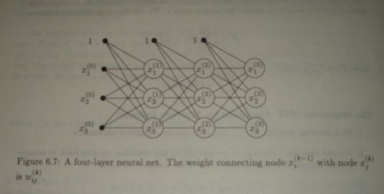
Back-propagation Algorithm

Slide 53
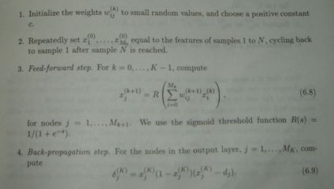
Back-propagation Algorithm

Slide 54
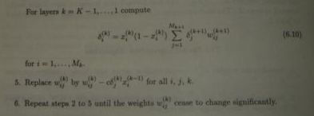
Back-propagation Algorithm

Slide 55
Hebbian Learning
DONALD HEBB, a Canadian psychologist, was interested in investigating PLAUSIBLE MECHANISMS FOR LEARNING AT THE CELLULAR LEVELS IN THE BRAIN. (Donald Hebb's (1949) The Organisation of Behaviour. New York: Wiley).
HEBB’s POSTULATE: When an axon of cell A is near enough to excite a cell B and repeatedly or persistently takes part in firing it, some growth process or metabolic changes take place in one or both cells such that A's efficiency as one of the cells firing B, is increased.

Slide 56
Hebbian Learning
Hebbian Learning laws Cause weight changes in response to events within a processing element that happen simultaneously. The learning laws in this category are characterized by their completely local - both in space and in time-character.
Notes:
Hebb's laws-proposals more precisely - indicate that associative learning, at the cellular level, which would result in an ENDURING modification in activity pattern of a spatially distributed "assembly of nerve cells".
A Hebbian synapse is a synapse that uses a time-dependent, highly local, and strongly interactive mechanism to increase synaptic efficiency as a function of the correlation between the pre-synaptic and post-synaptic activities.

Slide 57
Hebbian Learning
A simple form of Hebbian Learning Rule
where η is the so-called rate of learning and x and y are the input and output respectively.
This rule is also called the activity product rule.
Notes:
The activity product rule that governs simple Hebbian learning suggests that the repeated application of the input signal x_{j} leads to an increase in y_{k} and therefore exponential growth that finally drives the input-output connection (the synaptic connection) into saturation. At no point information will be stored in the synapse and the selectivity is lost. (Haykin 1999:57)

Slide 58
Hebbian Learning
A simple form of Hebbian Learning Rule
If there are "m" pairs of vectors,
to be stored in a network ,then the training sequence will change the weight-matrix, w, from its initial value of ZERO to its final state by simply adding together all of the incremental weight change caused by the "m" applications of Hebb's law:

Slide 59
Hebbian Learning
A worked example: Consider the Hebbian learning of three input vectors:
in a network with the following initial weight vector:
Notes:
The activation function f for the above network is given as the sgn function
Recall that in Hebbian learning weight change Δw is given as
Let η = 1. Now, we compute net⁽¹⁾:

Slide 60
Hebbian Learning
The worked example shows that with discrete f(net) and η = 1, the weight change involves ADDING or SUBTRACTING the entire input pattern vectors to and from the weight vectors respectively.
Consider the case when the activation function is a continuous one. For example, take the bipolar continuous activation function:
Notes:
Consider the Hebbian learning example discussed above but instead of the bipolar binary function:
we will use a bipolar continuous function with λ=1:

Slide 61
Hebbian Learning
The worked example shows that with bipolar continuous activation function indicates that the weight adjustments are tapered for the continuous function but are generally in the same direction:
Vector | Discrete Bipolar f(net) | Continuous Bipolar f(net)
x⁽¹⁾ | 1 | 0.905
x⁽²⁾ | -1 | -0.077
x⁽³⁾ | -1 | -0.932
Notes:
Consider the Hebbian learning example discussed above but instead of the bipolar binary function:
we will use a bipolar continuous function with λ=1:

Slide 62
Hopfield Network
The Hopfield network consists of a set of N interconnected neurons which update their activation values asynchronously and independently of other neurons.
All neurons are both input and output neurons. The activation values are binary (+1, -1)

Slide 63
Hopfield Network

Slide 64
Hopfield Network
The state of the system is given by the activation values y = (y _{k} ).
The net input s _{k} (t +1) of a neuron k at cycle (t +1) is a weighted sum

Slide 65
Hopfield Network
A threshold function is applied to obtain the output

Slide 66
Hopfield Network
A neuron k in the net is stable at time t I.e.
A state is state if all the neurons are stable

Slide 67
Hopfield Networks
If w_{jk} = w_{kj} the behavior of the system can be described with an energy function
This kind of network has stable limit points

Slide 68
Hopfield net. applications
A primary application of the Hopfield network is an associative memory.
The states of the system corresponding with the patterns which are to be stored in the network are stable.
These states can be seen as `dips' in energy space.

Slide 69
Hopfield Networks
It appears, however, that the network gets saturated very quickly, and that about 0.15N memories can be stored before recall errors become severe.

Slide 70
Hopfield Networks
Input
Stable
state
State
state

Slide 71
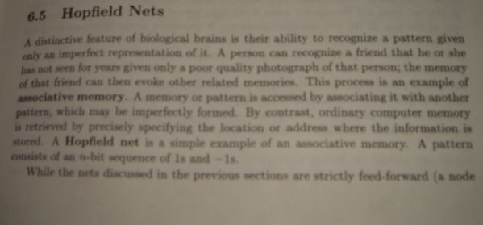
Hopfield Nets

Slide 72
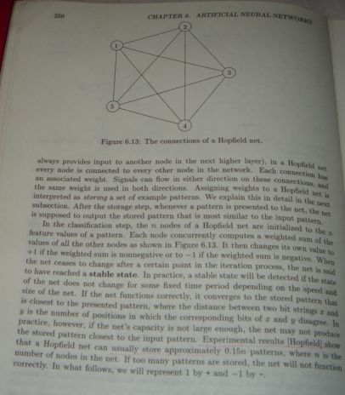
Hopfield Nets

Slide 73
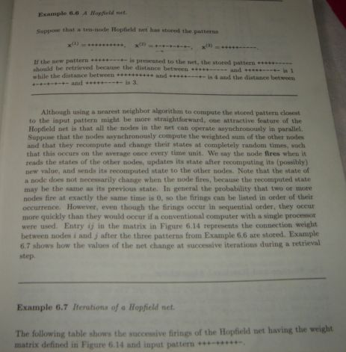
Hopfield Nets

Slide 74
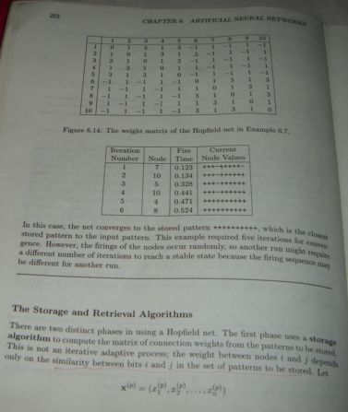
Hopfield Nets

Slide 75
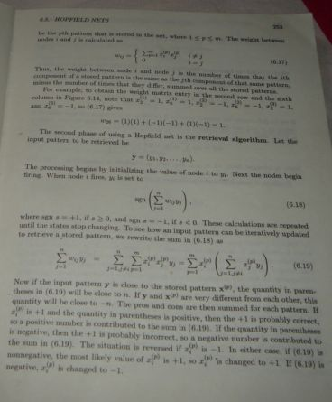
Hopfield Nets

Slide 76
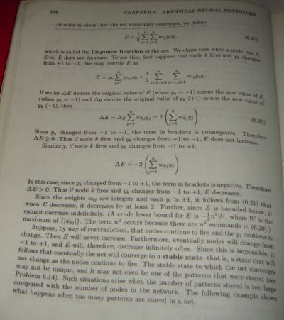
Hopfield Nets

Slide 77
Neural Net Summary
ANN is used in variety of applications:
Pattern recognition
Fault diagnosis
Monitoring patients in medical settings
Character recognition
Fraud detection
Adaptive filtering
and so on

Slide 78
Problems
(a) Define the weight adaptation rule described in the neural networks’ literature as back-propagation in terms of the two patterns of computation used in the implementation of the rule: the forward and backward pass.
(b) Consider a multi-layer feed forward network with a 2-2-1 architecture:
1
3
5
2
4
This network is to be trained using the back propagation rule on input pattern x ,
and a target output, d of 0.9.
Perform a complete forward- and backward-pass computation using the input x and the target d for one cycle. Compute the outputs of the hidden layer neurons 3 and 4 and for the output neuron 5. Compute the error for the output node and for the hidden nodes.

Slide 79
Examples
4. (a) A self-organising map has been trained with an input consisting of eight Gaussian clouds with unit variance but difference centres located at eight points around a cube: (0,0,0,0,0,0,0,0), (4,0,0,0,0,0,0,0) … (0,4,4,0,0,0,0,0) (Figure 1). This 3-dimensional input structure was represented by a two dimensional lattice of 10 by 10 neurons output layer of a Kohenen self-organising map (SOM). Table 1 shows the feature map.
8
7
1
2
3
4
5
6
7
8
9
10
6
6
6
6
5
5
5
5
5
5
1
6
6
6
5
5
5
5
5
5
1
2
5
6
6
7
6
8
8
8
5
5
1
1
3
7
7
7
7
8
8
8
5
1
1
4
7
7
7
7
8
8
8
4
1
1
5
7
7
7
7
8
8
4
4
1
1
6
6
7
7
7
7
4
4
4
4
1
7
4
3
2
2
2
3
3
3
4
4
4
1
8
2
2
2
3
3
3
3
4
4
4
9
2
2
2
3
3
3
3
4
4
4
10
1
2
Table 1: Feature Map provided by an SOM
Fig. 1: Input Pattern

Slide 80
Examples
(a) cont. Do you think that an SOM has classified the Gaussian clouds correctly? Draw the clusters out in the feature map. What conclusions can be drawn from the statement that ‘SOM algorithm preserves the topological relationship that exist in the input space’?
(b) A self-organised feature map (SOFM) with three input units and four output units is to be trained using the four training vectors:
The initial weight matrix is:
The initial radius is zero and the learning rate η is set to 0.5. Calculate the weight changes during the first cycle through the training data taking the training vectors in the order given above.

Slide 81
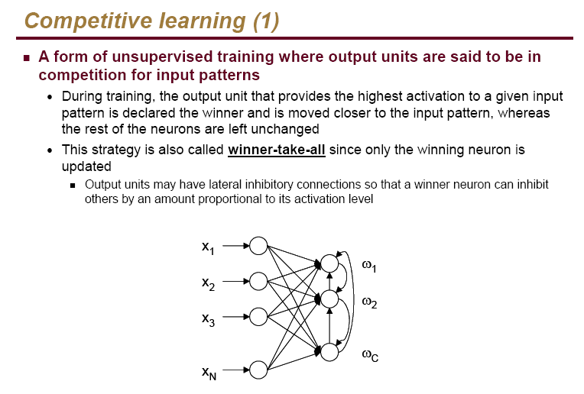

Slide 82
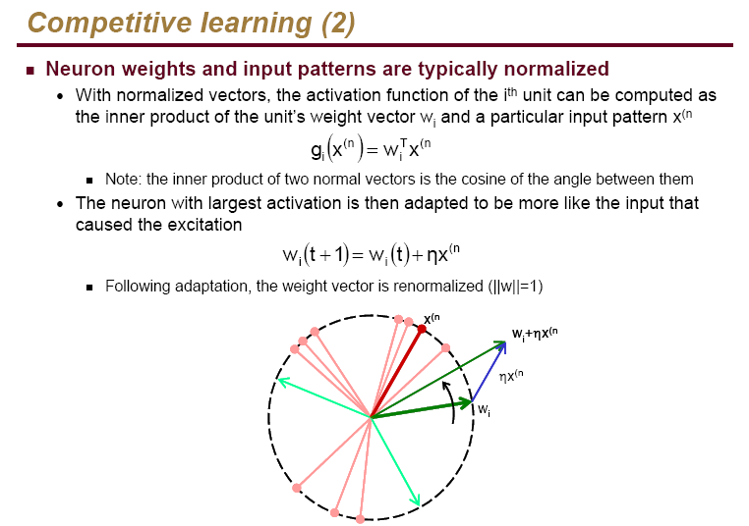

Slide 83
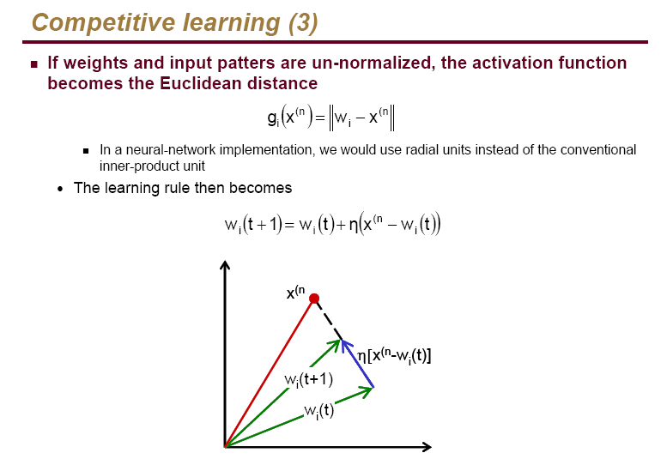

Slide 84
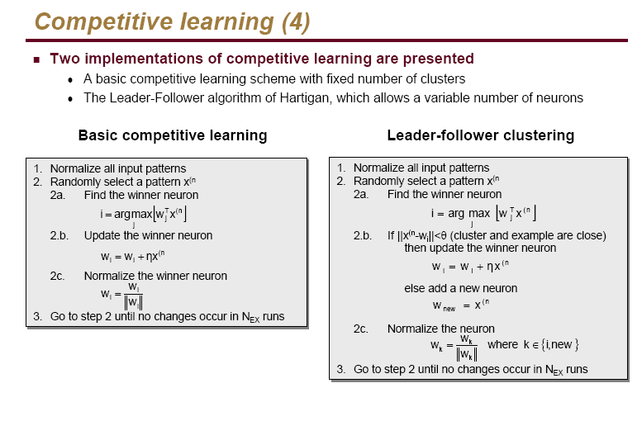

Slide 86
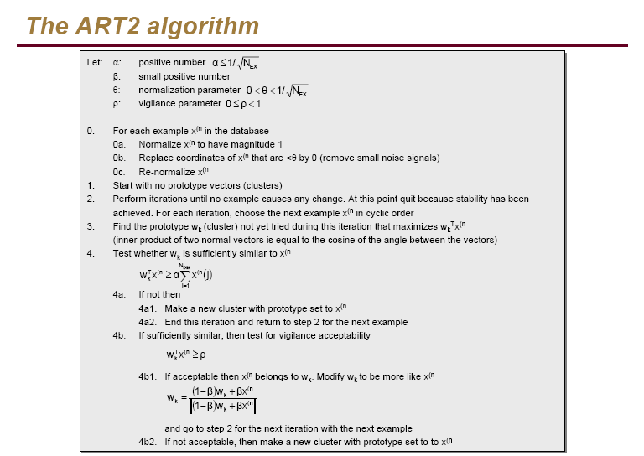

Slide 87
