Slide 1
Outline
Intelligent Agents (IA) and Environments
Rationality
Task Environments
Environment Types
IA Types
Summary

Slide 2
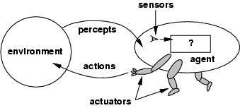
Intelligent Agents
An agent is anything that can be viewed as perceiving its environment through sensors and acting upon that environment through actuators.
Human agent: eyes, ears, and other organs for sensors and hands, legs, mouth, and other body parts for actuators.
Robotic agent: cameras and infrared range finders for sensors and various motors for actuators.
Software agent: Keystrokes, file contents, and network packets as sensors and displaying on the screen, writing files, and sending network packets as actuators.

Slide 3
Intelligent Agents and Environments
The agent function maps from percept histories to actions:
[f: P* → A]
The agent program runs on the physical architecture to produce f
agent = architecture + program

Slide 4
Intelligent Agents and Artificial Intelligence
Human mind is a network of thousands or millions of agents working in parallel. To produce real artificial intelligence, we should build computer systems that also contain many agents and systems for arbitrating among the agents' competing results.

Slide 5
Rational Agents
Rational behavior: doing the right thing, which means maximization of goal achievement with the available information.
An agent is an entity that perceives and acts.
In brief, a rational agent shows the rational behavior, i.e., it does the right thing.
For each possible percept sequence, a rational agent should select an action that is expected to maximize its performance measure, given the evidence provided by the percept sequence and whatever built-in knowledge the agent has.
The course AI is about designing rational agents.
Computational limitations make perfect rationality unachievable.
→ design best program for given machine resources.

Slide 6
Rational Agents
An agent should strive to "do the right thing," based on what it can perceive and the actions it can perform. The right action is the one that will cause the agent to be most successful.
Performance measure: An objective criterion for success of an agent's behavior.

Slide 7
Rational Agents
Rationality indicates doing the right thing, which means maximization of goal achievement with the available information.
Rationality depends on the following four things:
The performance measure (evaluation of the behavior of the agent in an environment) that defines the criterion of success of an agent.
The agent’s prior knowledge of the environment.
The actions that the agent can perform.
The agent’s percept sequence to date.

Slide 8
Rational Agents
Rationality is distinct from omniscience (all-knowing with infinite knowledge)
Agents can perform actions in order to modify future percepts so as to obtain useful information (information gathering, exploration)
An agent is autonomous if its behavior is determined by its own experience (with ability to learn and adapt)

Slide 9
PEAS of Rational Agents
PEAS: Performance measure, Environment, Actuators, Sensors.
Must first specify the setting for intelligent agent design.
Consider, e.g., the task of designing an automated taxi driver:
Performance measure
Environment
Actuators
Sensors

Slide 10
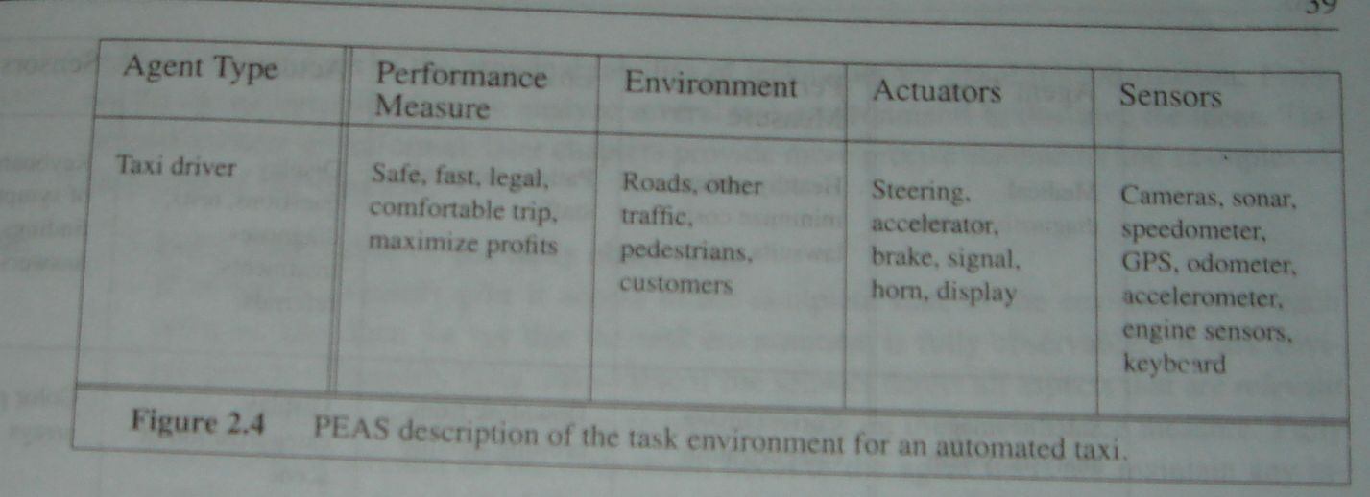
PEAS Description for an Automated Taxi

Slide 11
PEAS Descriptions
Agent Type | Performance Measure | Environment | Actuators | Sensors
Automated Taxi
Taxi driver | Safe, fast, legal, comfortable trip, maximize profit | Roads, other traffic, pedestrians, customers | Steering, accelerator, brake, signal horn, display | Cameras, sonar, speedometer, GPS, odometer, accelerometer, engine sensors, key board
Medical Diagnosis System
Medical diagnosis system | Healthy patient, minimize costs, lawsuits | Patient, hospital, staff | Display, questions, tests, diagnoses, treatments, referrals | Key board entry of symptoms, findings, patient’s answers

Slide 12
Task Environments
Task environments, which are essentially the problems to which rational agents are the solutions.
How to design a rational agent?
Sensors
percepts
Environment
?
Agent
actions
Effectors (actuators)

Slide 13
Environment Types
Fully observable (vs. partially observable): An agent's sensors give it access to the complete state of the environment at each point in time.
Deterministic (vs. stochastic): The next state of the environment is completely determined by the current state and the action executed by the agent. (If the environment is deterministic except for the actions of other agents, then the environment is strategic).
Episodic (vs. sequential): The agent's experience is divided into atomic "episodes" (each episode consists of the agent perceiving and then performing a single action), and the choice of action in each episode depends only on the episode itself.

Slide 14
Environment Types
Static (vs. dynamic): The environment is unchanged while an agent is deliberating. (The environment is semi-dynamic if the environment itself does not change with the passage of time but the agent's performance score does).
Discrete (vs. continuous): A limited number of distinct, clearly defined percepts and actions.
Single agent (vs. multiagent): A single agent operating by itself in an environment.

Slide 15
Environment Types
Chess with Chess without Taxi driving
a clock a clock
Fully observable Yes Yes No
Deterministic Strategic Strategic No
Episodic No No No
Static Semi Yes No
Discrete Yes Yes No
Single agent No No No
The environment type largely determines the agent design.
The real world’s characteristics are (of course) partially observable, stochastic, sequential, dynamic, continuous and multi-agent.

Slide 16

Towards Autonomous Vehicles
http://iLab.usc.edu
http://beobots.org

Slide 17
Interacting Agents
Collision Avoidance Agent (CAA)
Goals: Avoid running into obstacles
Percepts: Obstacle distance, velocity, trajectory
Sensors: Vision, proximity sensing
Effectors (Actuators): Steering Wheel, Accelerator, Brakes, Horn, Headlights
Actions: Steer, speed up, brake, blow horn, signal
(headlights)
Environment: Freeway

Slide 18
Interacting Agents
Lane Keeping Agent (LKA)
Goals: Stay in current lane
Percepts: Lane center, lane boundaries
Sensors: Vision
Effectors: Steering Wheel, Accelerator, Brakes
Actions: Steer, speed up, brake
Environment: Freeway

Slide 19
Conflict Resolution by Action (Selection of Agents in muli-agent environment)
Override: CAA overrides LKA
Arbitrate: if Obstacle is Close then CAA else LKA
Compromise: Choose action that satisfies both agents
Challenges: Doing the right thing

Slide 20
Behavior and performance of IAs
Perception (sequence) to Action Mapping: f : P* → A
Ideal mapping: specifies which actions an agent ought to take at any point in time
Description: Look-Up-Table, Closed Form, etc.
Performance measure: a subjective measure to characterize how successful an agent is (e.g., speed, power usage, accuracy, money, etc.)
(degree of) Autonomy: to what extent is the agent able to make decisions and take actions on its own?

Slide 21
Look up table (Collision Avoidance Agent (CAA))
Distance | Action
10 | No action
5 | Turn left 30 degrees
2 | Stop
obstacle
sensor
agent

Slide 22
How is an Agent different from other software?
Agents are autonomous, that is, they act on behalf of the user.
Agents contain some level of intelligence, from fixed rules to learning engines that allow them to adapt to changes in the environment.
Agents don't only act reactively, but sometimes also proactively.

Slide 23
How is an Agent different from other software?
Agents have social ability, that is, they communicate with the user, the system, and other agents as required.
Agents may also cooperate with other agents to carry out more complex tasks than they themselves can handle .
Agents may migrate from one system to another to access remote resources or even to meet other agents.

Slide 24
Agent types
Four basic kinds of intelligent agents:
Simple reflex agents responds directly what it percepts.
Model-based reflex agents maintain internal state to track aspects of the world that are not evident in the current percept.
For example: brake lights of vehicles at night.
Goal-based agents act to achieve their goals.
Goal information needed to make decisions
Utility-based agents try to maximize their own expected “happiness”
How well can the goal be achieved (degree of happiness)
What to do if there are conflicting goals?
Which goal should be selected if several can be achieved?
All agents can improve their performance through learning.

Slide 25
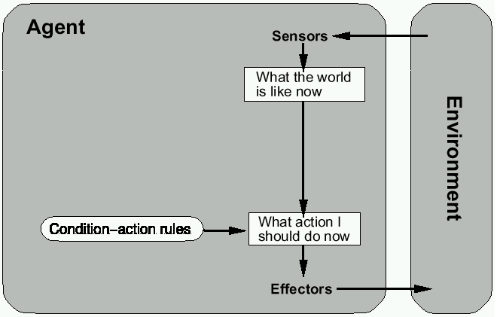
Simple Reflex Agents

Slide 26
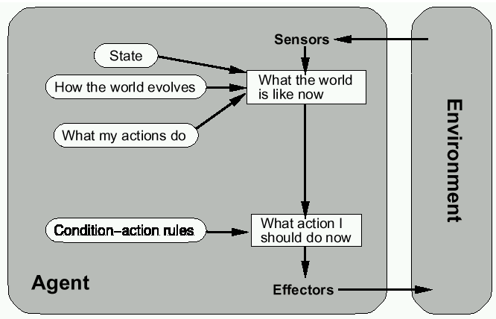
Model-Based Reflex Agents

Slide 27
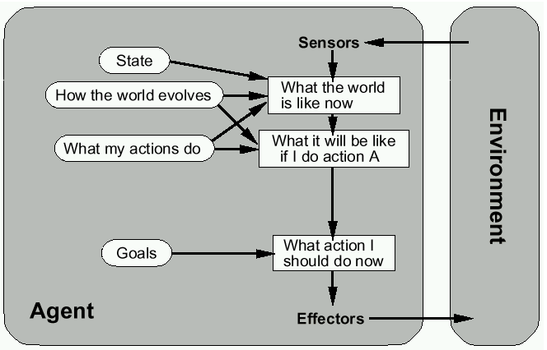
Goal-based agents

Slide 28
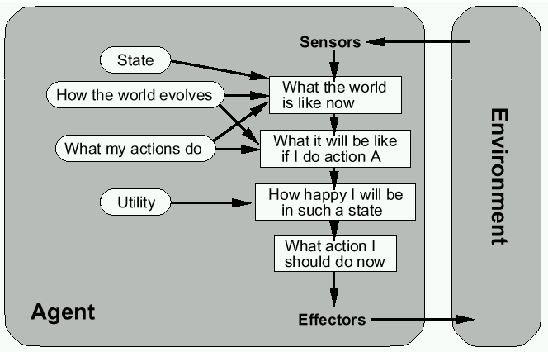
Utility-based agents

Slide 29
Summary
Intelligent Agents:
Anything that can be viewed as perceiving its environment through sensors and acting upon that environment through its effectors to maximize progress towards its goals.
Percepts, Actions, Goals, Environment
Described as a Perception (sequence) to Action Mapping:
f : P* → A
Using look-up-table, closed form, etc.
Rational Action: The action that maximizes the expected value of the performance measure given the percept sequence to date
Agent Types: Simple reflex, model-based reflex, goal-based, utility-based.

