Slide 1
Solving problems by searching
Uninformed or Blind Search

Slide 2
Outline
Problem-solving agents
Problem types
Problem formulation
Example problems
Basic search algorithms

Slide 3
Problem-solving agent
A simple Problem-solving agent is a goal-based agent. It decides what to do by finding different possible sequences of actions that lead to desirable states, and then choosing the best sequence.
This process of looking for such a sequence is called search. A search algorithm takes a problem as input and returns a solution in the form of an action sequence. Once a solution is found, the actions it recommends can be carried out. This is called the execution phase.
Thus “formulate, search, execute” is the main parts in designing an agent.

Slide 4
Problem-solving agent
A problem can be defined formally by four components:
Initial state
A description of the possible actions available to the agent
Goal test: determines whether a given state is a goal state.
Path cost: It assigns a numeric cost of each path.
Problem solving algorithm:
A solution to a problem is a path from initial state to a goal state.
Solution quality is measured by the path cost function, and an optimal
solution has the lowest path cost among all solutions.

Slide 5
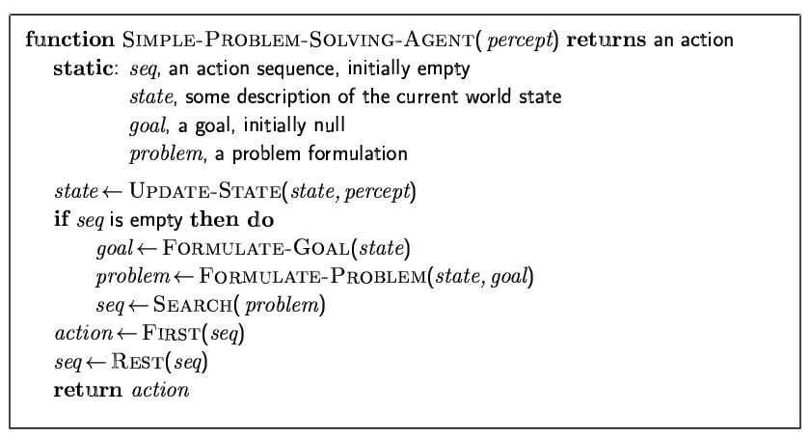
A simple problem-solving agent

Slide 6
Example Problem:Touring Holiday in Romania
The agent on holiday in Romania; currently in Arad
Have a nonrefundable flight ticket to fly out of Bucharest tomorrow
Formulate goal:
be in Bucharest and catch the flight
Formulate problem:
states: various cities
actions: drive between cities
Find solution:
sequence of cities, e.g., Arad, Sibiu, Fagaras, Bucharest

Slide 7
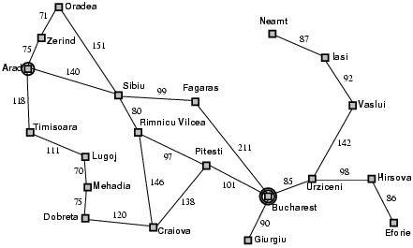
Road Map of Romania

Slide 8
Problem types
Deterministic, fully observable → single-state problem
Agent knows exactly which state it will be in; solution is a sequence
Non-observable → sensorless problem (conformant problem)
Agent may have no idea where it is; solution is a sequence
Nondeterministic and/or partially observable → contingency problem
percepts provide new information about current state
Unknown state space → exploration problem

Slide 9
Single-state problem formulation
A problem is defined by four items:
initial state e.g., "at Arad"
actions or successor function S(x) = set of action–state pairs
e.g., S(Arad) = {<Arad → Zerind, Zerind>, … }
goal test, can be
explicit, e.g., x = "at Bucharest"
implicit, e.g., Checkmate(x)
path cost (additive)
e.g., sum of distances, number of actions executed, etc.
c(x,a,y) is the step cost of taking action a to go from state x to state y, assumed to be ≥ 0
A solution is a sequence of actions leading from the initial state to a goal state

Slide 10
Selecting a state space
Real world is absurdly complex
→ state space must be abstracted for problem solving
(Abstract) state = set of real states
(Abstract) action = complex combination of real actions
e.g., "Arad → Zerind" represents a complex set of possible routes, detours, rest stops, etc.
For guaranteed realizability, any real state "in Arad“ must get to some real state "in Zerind"
(Abstract) solution =
set of real paths that are solutions in the real world
Each abstract action should be "easier" than the original problem

Slide 11
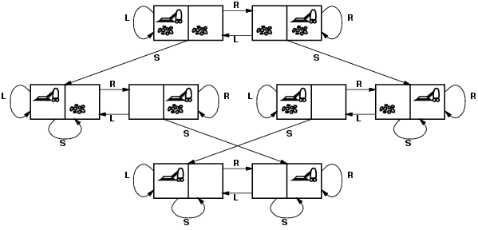
Vacuum world state space graph
states?
actions?
goal test?
path cost?

Slide 12
Vacuum world state space graph
states? integer dirt and robot location
actions? Left, Right, Suck
goal test? no dirt at all locations
path cost? 1 per action

Slide 13
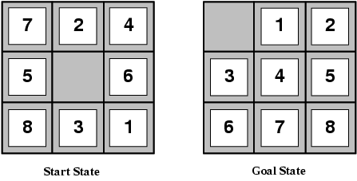
Example: The 8-puzzle
states?
actions?
goal test?
path cost?

Slide 14
Example: The 8-puzzle
states? locations of tiles
actions? move blank left, right, up, down
goal test? = goal state (given)
path cost? 1 per move
[Note: optimal solution of n-Puzzle family is NP-hard]

Slide 15
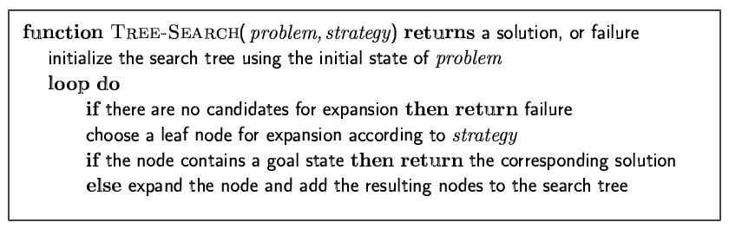
Searching for solutions
Tree search algorithm
An informal description of the general tree-search algorithm.

Slide 16
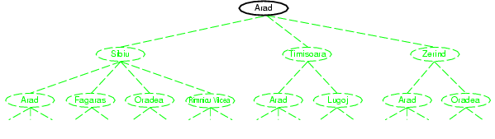
Tree search example (cont.)
The initial state

Slide 17
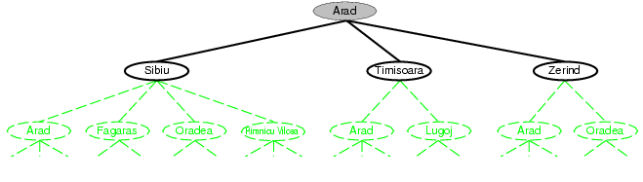
Tree search example (cont.)
After expanding Arad

Slide 18
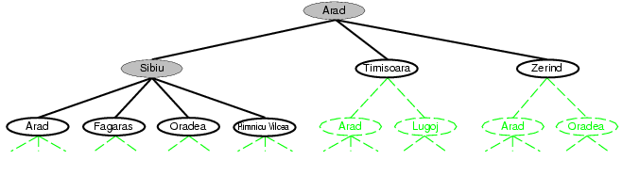
Tree search example (cont.)
After expanding Sibiu

Slide 19
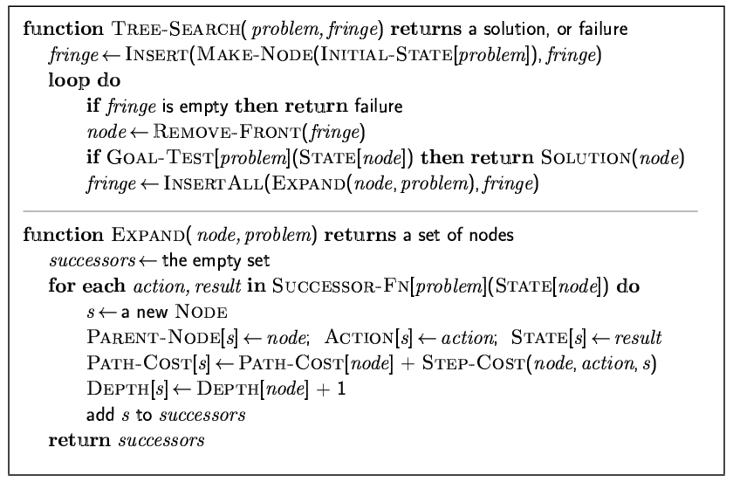
Implementation: general tree search
General tree search algorithm

Slide 20
Implementation: states vs. nodes
A state is a (representation of) a physical configuration
Nodes are the data structures from which the search tree is constructed. Each node has a parent, a state, and various bookkeeping fields, such as action, path cost, depth.
Depth represents the number of steps along the path from the initial state.
The Expand function creates new nodes, filling in the various fields and using the SuccessorFn of the problem to create the corresponding states.

Slide 21
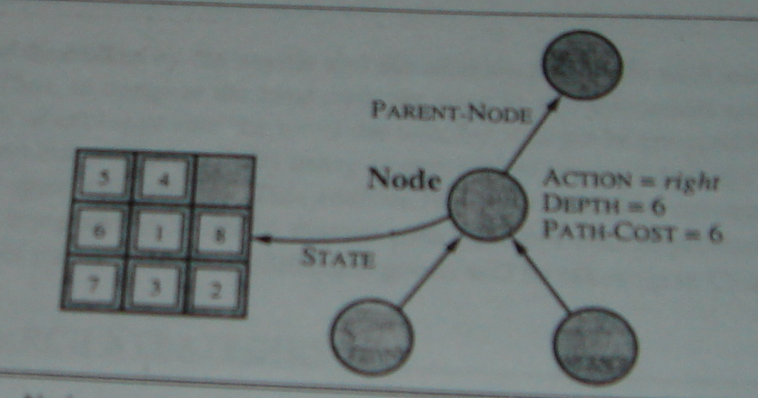
Implementation: states vs. nodes
Nodes are the data structures from which the search tree is constructed. Each node has a parent, a state, and various bookkeeping fields, such as action, path cost, depth. Arrows point from child to parent

Slide 22
Search strategies and their performance evaluation
A search strategy is defined by picking the order of node expansion
Search algorithm’s performances are evaluated in the following four ways:
completeness: Does it always find a solution if one exists?
time complexity: How long does it take to find a solution?
space complexity: How much memory is needed to perform the search? That means the maximum number of nodes in memory to perform the search.
optimality: Does it always find a least-cost solution?
Time and space complexity are measured in terms of
b: maximum branching factor of the search tree
d: depth of the least-cost solution
m: maximum depth of the state space (may be ∞)

Slide 23
Uninformed search strategies
Uninformed (blind) search strategies use only the information available in the problem definition. All they can do is generate successor and distinguish a goal state from a non-goal state.
Strategies that know whether one non-goal state is ‘more promising’ than another are called informed or heuristic search strategies.
Uninformed (blind) search strategies are of following:
Breadth-first search
Uniform-cost search
Depth-first search
Depth-limited search
Iterative deepening depth-first search

Slide 24
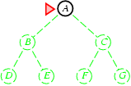
Breadth-first search
Expand shallowest unexpanded node
Implementation:
Root node is expanded first, then all the successors of the root node are expanded next, then their successors, and so on.
In general all the nodes are expanded at a given depth in the search tree before any nodes at the next level are expanded.
fringe is a FIFO (first-in-first-out) queue, i.e., new successors go at end

Slide 25
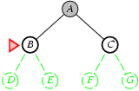
Breadth-first search
Expand shallowest unexpanded node
Implementation:
fringe is a FIFO queue, i.e., new successors go at end

Slide 26
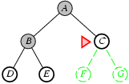
Breadth-first search
Expand shallowest unexpanded node
Implementation:
fringe is a FIFO queue, i.e., new successors go at end

Slide 27
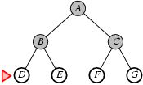
Breadth-first search
Expand shallowest unexpanded node
Implementation:
fringe is a FIFO queue, i.e., new successors go at end

Slide 28
Properties of breadth-first search
Complete? Yes (if b is finite)
Time? 1+b+b²+b³+… +b^{d} + b(b^{d}-1) = O(b^{d+1})
Space? O(b^{d+1}) (keeps every node in memory)
Optimal? Yes (if cost = 1 per step)
Space is the bigger problem (more than time)

Slide 29
Uniform-cost search
Expand least-cost unexpanded node
Implementation:
fringe = queue ordered by path cost
Equivalent to breadth-first if step costs all equal
Complete? Yes, if step cost ≥ ε
Time? # of nodes with g ≤ cost of optimal solution, O(b^{ceiling(C*/ ε)}) where C* is the cost of the optimal solution
Space? # of nodes with g ≤ cost of optimal solution, O(b^{ceiling(C*/ ε)})
Optimal? Yes – nodes expanded in increasing order of g(n)

Slide 30
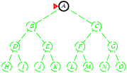
Depth-first search
Expand deepest unexpanded node
Implementation:
fringe = LIFO queue, i.e., put successors at front

Slide 31
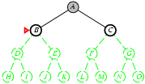
Depth-first search
Expand deepest unexpanded node
Implementation:
fringe = LIFO queue, i.e., put successors at front

Slide 32
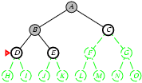
Depth-first search
Expand deepest unexpanded node
Implementation:
fringe = LIFO queue, i.e., put successors at front

Slide 33
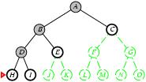
Depth-first search
Expand deepest unexpanded node
Implementation:
fringe = LIFO queue, i.e., put successors at front

Slide 34
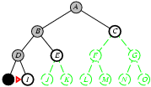
Depth-first search
Expand deepest unexpanded node
Implementation:
fringe = LIFO queue, i.e., put successors at front

Slide 35
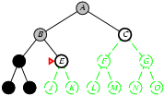
Depth-first search
Expand deepest unexpanded node
Implementation:
fringe = LIFO queue, i.e., put successors at front

Slide 36
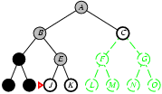
Depth-first search
Expand deepest unexpanded node
Implementation:
fringe = LIFO queue, i.e., put successors at front

Slide 37
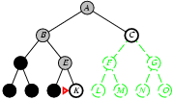
Depth-first search
Expand deepest unexpanded node
Implementation:
fringe = LIFO queue, i.e., put successors at front

Slide 38
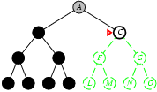
Depth-first search
Expand deepest unexpanded node
Implementation:
fringe = LIFO queue, i.e., put successors at front

Slide 39
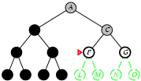
Depth-first search
Expand deepest unexpanded node
Implementation:
fringe = LIFO queue, i.e., put successors at front

Slide 40
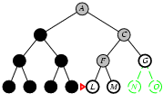
Depth-first search
Expand deepest unexpanded node
Implementation:
fringe = LIFO queue, i.e., put successors at front

Slide 41
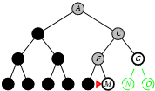
Depth-first search
Expand deepest unexpanded node
Implementation:
fringe = LIFO queue, i.e., put successors at front

Slide 42
Properties of depth-first search
Complete? No: fails in infinite-depth spaces, spaces with loops
Modify to avoid repeated states along path
→ complete in finite spaces
Time? O(b^{m}): terrible if m is much larger than d
but if solutions are dense, may be much faster than breadth-first
Space? O(bm), i.e., linear space!
Optimal? No
b: maximum branching factor of the search tree
d: depth of the least-cost solution
m: maximum depth of the state space (may be ∞)

Slide 43
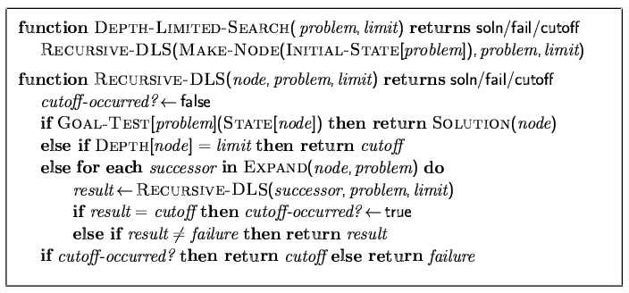
Depth-limited search
Depth-limited search = depth-first search with depth limit l,
i.e., nodes at depth l have no successors
Recursive implementation:

Slide 44
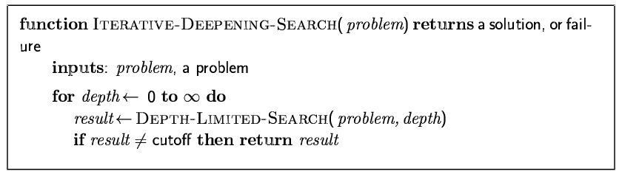
Iterative deepening depth-first search
Iterative deepening depth-first search find the best depth limit by gradually increasing the limit.

Slide 45
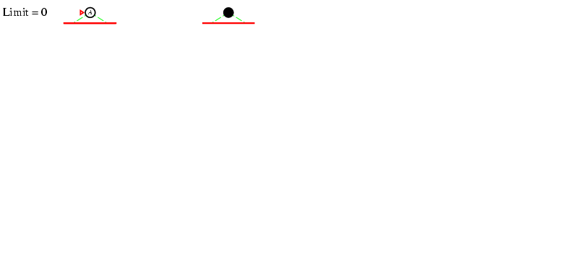
Iterative deepening search l =0

Slide 46
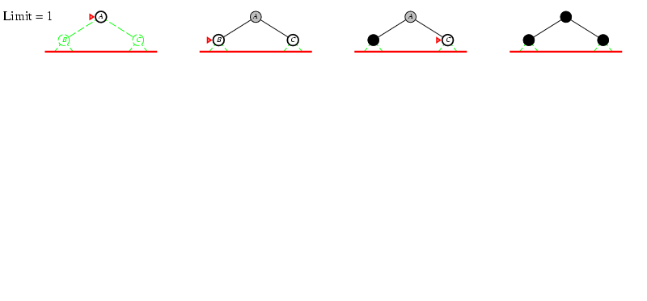
Iterative deepening search l =1

Slide 47
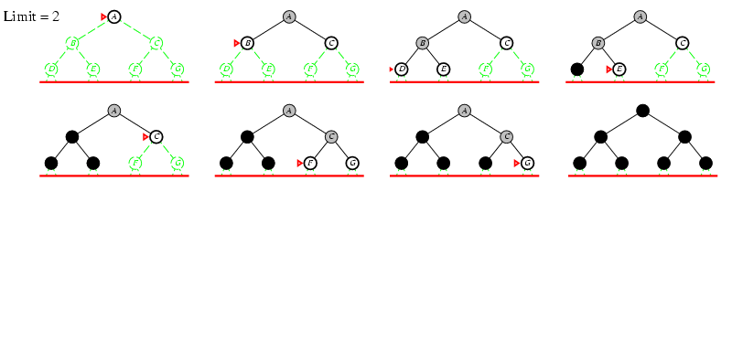
Iterative deepening search l =2

Slide 48
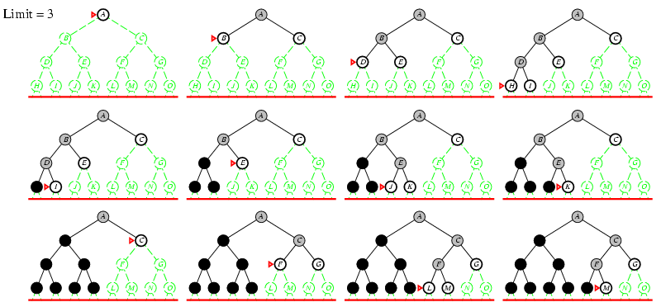
Iterative deepening search l =3

Slide 49
Iterative deepening search
Number of nodes generated in a depth-limited search to depth d with branching factor b:
N_{DLS} = b⁰ + b¹ + b² + … + b^{d-2} + b^{d-1} + b^{d}
Number of nodes generated in an iterative deepening search to depth d with branching factor b:
N_{IDS} = (d+1)b⁰ + d b^¹ + (d-1)b^² + … + 3b^{d-2} +2b^{d-1} + 1b^{d}
For b = 10, d = 5,
N_{DLS} = 1 + 10 + 100 + 1,000 + 10,000 + 100,000 = 111,111
N_{IDS} = 6 + 50 + 400 + 3,000 + 20,000 + 100,000 = 123,456
Overhead = (123,456 - 111,111)/111,111 = 11%

Slide 50
Properties of iterative deepening search
Complete? Yes
Time? (d+1)b⁰ + d b¹ + (d-1)b² + … + b^{d} = O(b^{d})
Space? O(bd)
Optimal? Yes, if step cost = 1

Slide 51
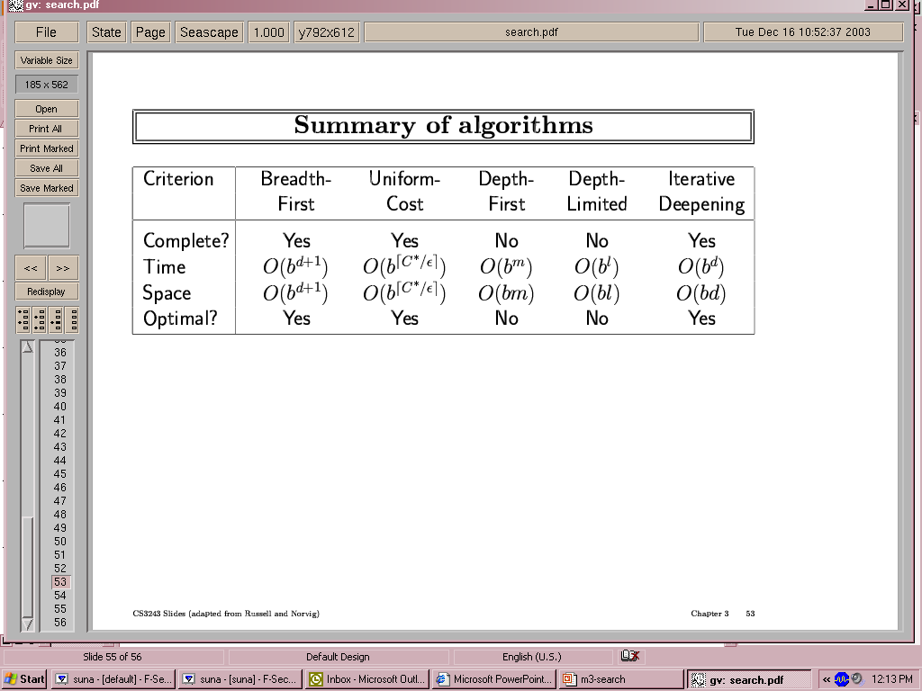
Summary of algorithms
Evaluation of search strategies. b is the branching factor; d is the depth of the shallowest solution; m is the maximum depth of the search tree; l is the depth limit.

Slide 52
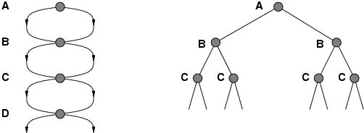
Repeated states
Failure to detect repeated states can turn a linear problem into an exponential one!

Slide 53
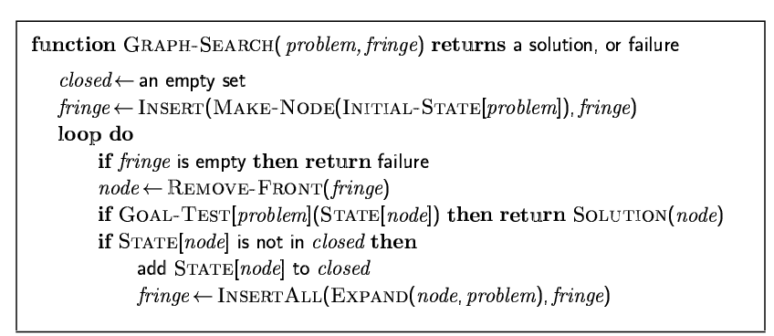
Graph search

Slide 54
Summary
Problem formulation usually requires abstracting away real-world details to define a state space that can feasibly be explored.
Variety of uninformed search strategies.
Iterative deepening search uses only linear space and not much more time than other uninformed algorithms.

Slide 55
Formal Big-O definition
Let f and g be functions. We say that f(x) is O(g(x)) if there are constants c and k such that
|f(x)| ≤ C |g(x)|
whenever x > k
Big- O notation expresses the upper bound of growth function.
Show that 30n+8 is O(n).
Show ∃c,k: ∀n>k: 30n+8 ≤ cn.
Let c=31, k=8. Assume n>k=8. Then cn = 31n = 30n + n > 30n+8, so 30n+8 < cn.
Show that n²+1 is O(n²).
Show ∃c,k: ∀n>k: n²+1 ≤ cn².
Let c=2, k=1. Assume n>1. Then cn² = 2n² = n²+n² > n²+1, or n²+1< cn².

Slide 56
Formal Big-Omega definition
Let f and g be functions. We say that f(x) is Ω(g(x)) if there are constants c and k such that
Big- Ω notation expresses the lower bound of growth function.
It is introduced by Donald Knuth in the 1970’s.

Slide 57
Formal Big-Theta definition
Let f and g be functions. We say that f(x) is Θ(g(x)) if f(x) is O(g(x)) and f(x) is Ω(g(x)).
Big-Θ notation expresses both an upper and a lower bound on the size of f(x) relative to a reference function g(x).
It is introduced by Donald Knuth in the 1970’s.

Slide 58
Names for some orders of growth
O(1) Constant
O(log_{c} n) Logarithmic (same order ∀c)
O(log^{c} n) Polylogarithmic
O(n) Linear
O(n^{c}) Polynomial (for any c)
O(c^{n}) Exponential (for c>1)
O(n!) Factorial
(With c a constant.)
f(x) is O(g(x)) if there are constants C and k such that
Big-O notation expresses the upper bound of growth function.

Slide 59
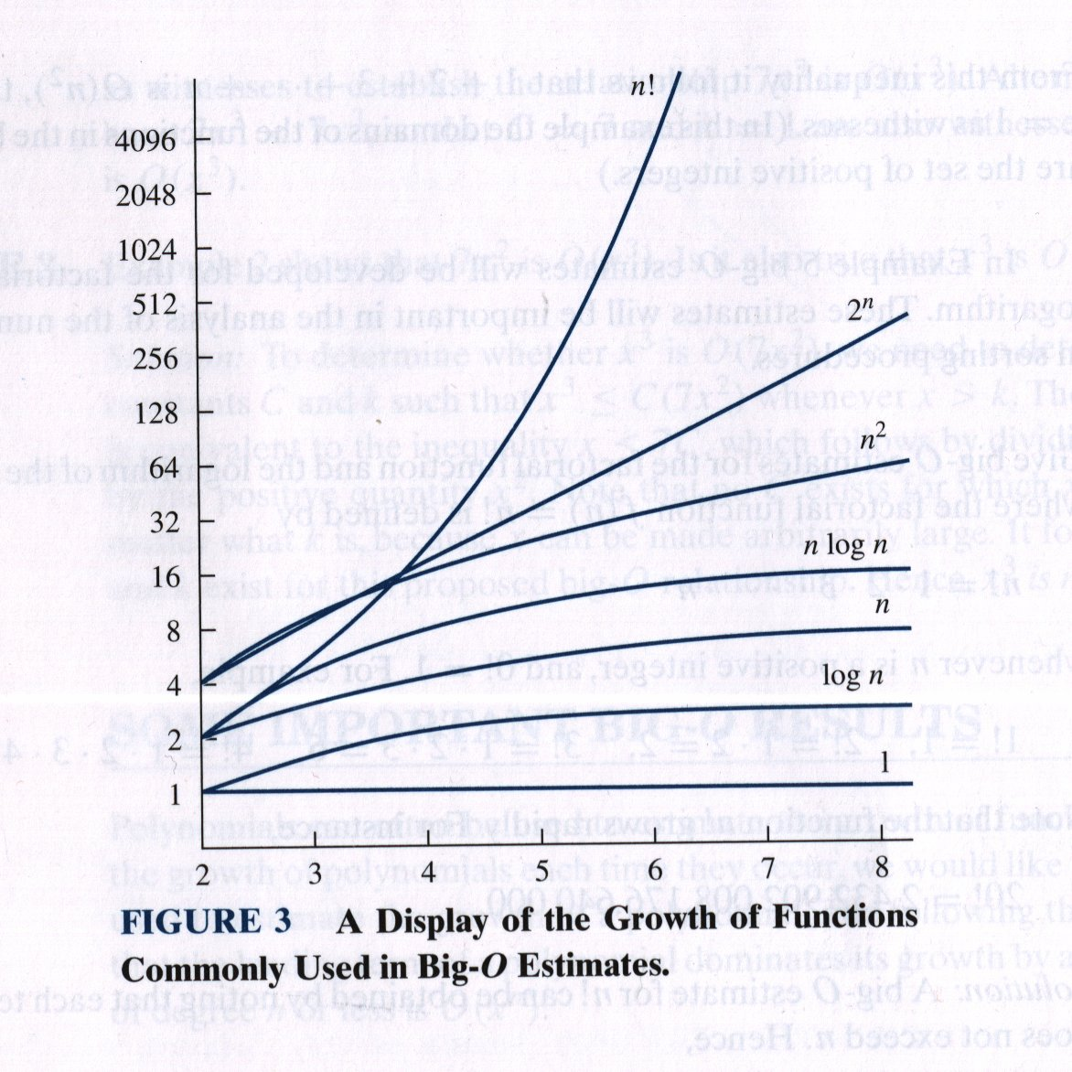
Function growth rates
Logarithmic scale!

Slide 60
Tractable vs. intractable
A problem or algorithm with at most polynomial time complexity is considered tractable (or feasible). P is the set of all tractable problems.
A problem or algorithm that has complexity greater than polynomial is considered intractable (or infeasible).
Note that n^{1,000,000} is technically tractable, but really very hard. n^{log log log n} is technically intractable, but easy. Such cases are rare though.

Slide 61
P vs. NP
Any term of the form n^{c}, where c is a constant, is a polynomial
Thus, any function that is O(n^{c}) is a polynomial-time function
2^{n}, n!, n^{n} are not polynomial (NP) functions
NP is the set of problems for which there exists a tractable algorithm for checking a proposed solution to tell if it is correct.
It is “widely believed” that there is no efficient solution to NP complete problems
If you could solve an NP complete problem in polynomial time, you would be showing that P = NP
We know that P⊆NP, but the most famous unproven conjecture in computer science is that this inclusion is proper.
i.e., that P⊂NP rather than P=NP.

