Slide 1
Compiler Design Introduction

Slide 2
Some rules & regulations
3 credit course
Online classes will be taken
You have to mute your microphone but when any question is asked you have to unmute it and then answer the question
Sometimes short exams will be taken at the end of the class, so you should be careful about the class lectures
An automated attendance will keep track of your joining and leaving the sessions and I will also sometimes/always take attendance, so you have to be physically present during the class
Try to take classes in a noise free environment where you can concentrate on your lecture
If you have to ask anything, I will give time at the end of the each class to ask me questions
You can also raise hands(Automated in zoom platform) or can message in the chat bar that you have question (In google meet platform) if you face any question during the lecture

Slide 3
References
I will try to provide slides for the classes
Also a recorded version for the class will be available
I will tell you the reference books or links (If required)
For the examination, try to follow the class lectures properly

Slide 4
Why compilers are required?
Programming languages are notations for describing computations to people and to machines.
The world as we know it depends on programming languages, because all the software running on all the computers was written in some programming language.
But, before a program can be run, it first must be translated into a form in which it can be executed by a computer.
The software systems that do this translation are called compilers.

Slide 5
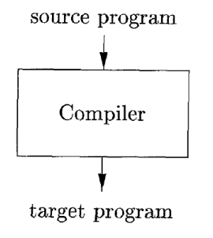
How a compiler works?

Slide 6
How a compiler works?
Simply stated, a compiler is a program that can read a program in one language — the source language — and translate it into an equivalent program in another language - the target language.
An important role of the compiler is to report any errors in the source program that it detects during the translation process.
Target program: If the target program is an executable machine-language program, it can then be called by the user to process inputs and produce outputs. (exe files)
A compiler can be called as language processor.

Slide 7
Interpreter
An interpreter is another common kind of language processor.
Instead of producing a target program as a translation, an interpreter appears to directly execute the operations specified in the source program on inputs supplied by the user.

Slide 8

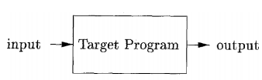
Can you guess??
Which one is compiler and which one is interpreter?

Slide 9
Advantages of Compiler and Interpreter
The machine-language target program produced by a compiler is usually much faster than an interpreter at mapping inputs to outputs.
An interpreter, however, can usually give better error diagnostics than a compiler, because it executes the source program statement by statement.
Can you tell why????

Slide 10
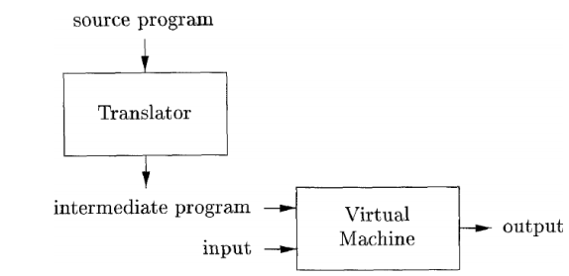
A hybrid Compiler
Java language processors combine compilation and interpretation.

Slide 11
How it works?
A Java source program may first be compiled into an intermediate form called bytecodes.
The bytecodes are then interpreted by a virtual machine.
A benefit of this arrangement is that bytecodes compiled on one machine can be interpreted on another machine, perhaps across a network.

Slide 12
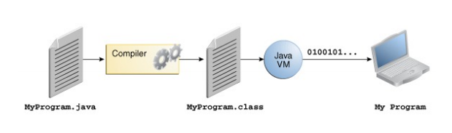
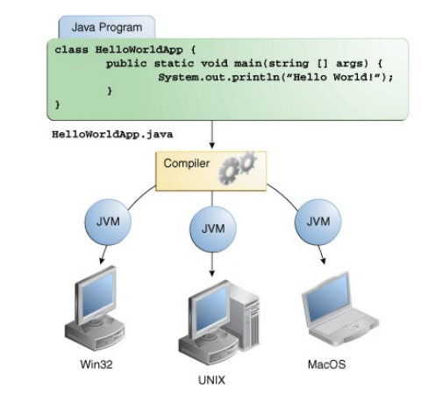

Slide 13
Structure of a Compiler
To translate text from one language to another, the tool must understand both the form, or syntax, and content, or meaning, of the input language.
It needs to understand the rules that govern syntax and meaning in the output language.
Finally, it needs a scheme for mapping content from the source language to the target language.

Slide 14
Structure of Compiler
The structure of a typical compiler derives from these simple observations.
The compiler has a front end to deal with the source language.
It has a back end to deal with the target language. Connecting the front end and the back end, it has a formal structure for representing the program in an intermediate representation(IR) whose meaning is largely independent of either language.
To improve the translation, a compiler often includes an optimizer that analyzes and rewrites that intermediate form.

Slide 15
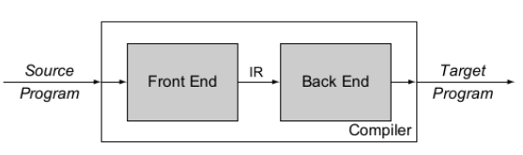
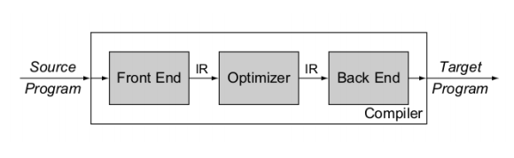
Structure of compiler
Without optimizer
With optimizer

Slide 16
Structure of compiler
Up to this point we have treated a compiler as a single box that maps a source program into a semantically equivalent target program.
If we open up this box a little, we see that there are two parts to this mapping:
analysis and
synthesis.
Notes:
The term syntax refers to grammatical structure whereas the term semantics refers to the meaning of the vocabulary symbols arranged with that structure. Systhesis: the combination of components or elements to form a connected whole.

Slide 17
Analysis part
It is often called the front end of the compiler
It breaks up the source program into constituent pieces and imposes a grammatical structure on them.
It then uses this structure to create an intermediate representation of the source program.
If the analysis part detects that the source program is either syntactically ill formed or semantically unsound, then it must provide informative messages, so the user can take corrective action.
The analysis part also collects information about the source program and stores it in a data structure called a symbol table, which is passed along with the intermediate representation to the synthesis part.

Slide 18
Synthesis Part
It is often called the back end of the compiler.
The synthesis part constructs the desired target program from the intermediate representation and the information in the symbol table.

Slide 19
Compilation process in more details
If we examine the compilation process in more detail, we see that it operates as a sequence of phases, each of which transforms one representation of the source program to another.
In practice, several phases may be grouped together, and the intermediate representations between the grouped phases need not be constructed explicitly.

Slide 20
What is symbol table?
It stores the information about the entire source program.
It is used by all the phases of the compiler.
It is a data structure.
Note: It will be discussed in detail in Lab class.

Slide 21
Optimization
The purpose of this optimization phase is to perform transformations on the intermediate representation, so that the back end can produce a better target program than it would have otherwise produced from an non-optimized intermediate representation.
Optimization is optional.

Slide 22
Phases of a compiler
Lexical Analyzer or scanner
Syntax Analyzer or parser
Semantic Analyzer
Intermediate Code generator
Code Optimizer
Code Generator
Can you guess among them which are front end, back end and intermediate representation?

Slide 23
Grouping of phases into passes
The phases deals with the logical organization of a compiler.
In an implementation, activities from several phases may be grouped together into a pass that reads an input file and writes an output file.
For example, the front-end phases of (lexical analysis, syntax analysis, semantic analysis), and intermediate code generation might be grouped together into one pass.
Code optimization might be an optional pass.
Then there could be a back-end pass consisting of code generation for a particular target machine.

Slide 24
Compiler Construction Tools
Some commonly used compiler-construction tools include
Parser generators that automatically produce syntax analyzers from a grammatical description of a programming language.
Scanner generators that produce lexical analyzers from a regular-expression description of the tokens of a language.
Syntax-directed translation engines that produce collections of routines for walking a parse tree and generating intermediate code.
Code-generator generators that produce a code generator from a collection of rules for translating each operation of the intermediate language into the machine language for a target machine.
Data-flow analysis engines that facilitate the gathering of information about how values are transmitted from one part of a program to each other part. Data-flow analysis is a key part of code optimization.
Compiler-construction toolkits that provide an integrated set of routines for constructing various phases of a compiler.

Slide 25


