Slide 1
Bottom Up Pasring

Slide 2
What is bottom up parsing?
Bottom-up parsing starts from the leaf nodes of a tree and works in upward direction till it reaches the root node.
Reverse of Top down parsing.
It will start from the input and end with the starting symbol of the grammar.

Slide 3
Shift-Reduce Parsing
Shift step: The shift step refers to the advancement of the input pointer to the next input symbol, which is called the shifted symbol. This symbol is pushed onto the stack. The shifted symbol is treated as a single node of the parse tree.
Reduce step : When the parser finds a complete grammar rule (RHS) and replaces it to (LHS), it is known as reduce-step.

Slide 4
LR Parser
The LR parser is a non-recursive, shift-reduce, bottom-up parser.
LR parsers are also known as LR(k) parsers, where L stands for left-to-right scanning of the input stream; R stands for the construction of right-most derivation in reverse, and k denotes the number of lookahead symbols to make decisions.

Slide 5
Difference between LL and LR
LL | LR
Does a leftmost derivation. | Does a rightmost derivation in reverse.
Starts with the root nonterminal on the stack. | Ends with the root nonterminal on the stack.
Ends when the stack is empty. | Starts with an empty stack.
Builds the parse tree top-down. | Builds the parse tree bottom-up.
Continuously pops a nonterminal off the stack, and pushes the corresponding right hand side. | Tries to recognize a right hand side on the stack, pops it, and pushes the corresponding nonterminal.
Expands the non-terminals. | Reduces the non-terminals.

Slide 6
Precedence and associativity
Operator precedence determines which operator is performed first in an expression with more than one operators with different precedence.
12 + 30 * 34
Here, multiplication sign(*) has higher precedence than addition sign (+).

Slide 7
Precedence and associativity
Operators Associativity is used when two operators of same precedence appear in an expression. Associativity can be either Left to Right or Right to Left.
For example: ‘*’ and ‘/’ have same precedence and their associativity is Left to Right, so the expression “100 / 10 * 10” is treated as “(100 / 10) * 10”.

Slide 8
Operator Precedence Parser
This is a bottom up parser.
For, learning bottom up parser, we will implement parse tree using operator parser.
For this, we have to know about operator grammar.
When a grammar can be called as operator grammar?
No null (epsilon) on the right hand side of the production rule.
No two adjacent variable.

Slide 9
Example of Operator Precedence Grammar
T → T+T | T*T | id
E → EAE | id A → + | *
S → SAS | id A → aSa | a
Number 1 is clearly operator grammar.
Number 2 & 3 are not operator grammar as they have adjacent variables like SAS and EAE. But, they can be converted to Operator grammar by simple substitution.

Slide 10
Converting to Operator Precedence Grammar
E → E + E | E * E | id (Substituting the value of A)
S → SaSaS | SaS | id (Substituting the value of A)
Now, these two are converted to operator grammar.

Slide 11
Steps of Operator Precedence Parser
Step 01: Check whether Operator precedence grammar or not.
Step 02: Create the relational table.
Step 03: Parse the given input string.
Step 04: Generate the parse tree.

Slide 12
Example
Grammar: E → E+E | E*E | id
Input String to parse: id + id * id
Step 01: Checking: The given grammar is Operator precedence grammar.

Slide 13
Step 02
For this we have know some basic rules.
$ has the lowest precedence.
Any variable (other than operators like a, b or c) has the highest precedence.
Between two variables (like id and id/ a and b) there is no precedence.
If it is left associative, then left operator has the highest precedence than right one. (reverse is true for right associative) Example: + > + , * > * for left association.
Between two $ terminals, there is no precedence. If this state comes then it is the accept(A) state.

Slide 14
Operator precedence relation table
 | id | + | * | $
id | _____ | > | > | >
+ | < | > | < | >
* | < | > | > | >
$ | < | < | < | Accept

Slide 15
Step 03
If < in relation then shift.
If > in relation then reduce.
If stack contains the starting symbol at the end, then accept state. That means matching.

Slide 16
Parsing the given input String
Stack | Relation | Input | Commnet
$ | < | id+id*id$ | Shift id
$id | > | +id*id$ | Reduce E→id
$E | < | +id*id$ | Shift +
$E+ | < | id*id$ | Shift id
$E+id | > | *id$ | Reduce E→id
$E+E | < | *id$ | Shift *
$E+E* | < | id$ | Shift id
$E+E*id | > | $ | Reduce E→id
$E+E*E | > | $ | Reduce E→E*E
$E+E | > | $ | Reduce E→E+E
$E | Accept | $

Slide 17
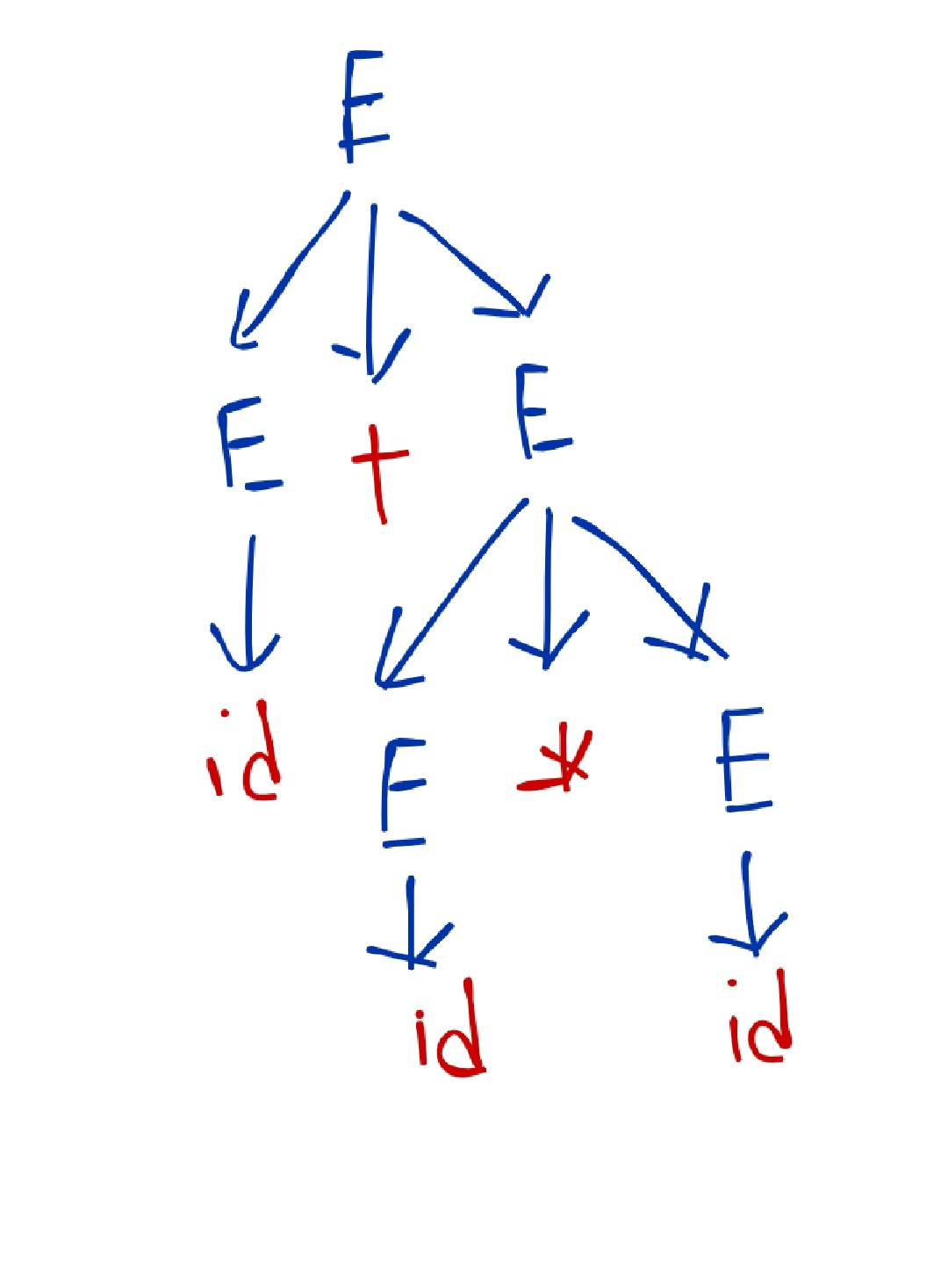
Step 04: Generate parse tree
Generate the tree following the reduce states in comment or following the stack(from bottom to up and expanding the right most non-terminal)

Slide 18
Another Version
To solve the problems, we can use another easier version to eliminate complexities.
Where we will use the relation signs beforehand and we will handle the part which will be in between < > these signs.
Easy to solve, less steps.

Slide 19
Practice Problems
For the same grammar,
id*id*id
Id*id+id
id+id+id
id+id
id*id
id*id+id*id

Slide 20
Practice problems
E → E+T | T T → T*V | V V → a | b |c | d
Input string: a+b*c*d

Slide 21
Practice Problem
E → E+T|T T → T*F|F F → id
Input String: id+id*id
E → E+E | E*E | id | (E)

Slide 22
Practice Problems
S → (L) | a L → L,S | S
Input String: (a,(a,a))
Relation Table/ Operator Precedence Table:
 | a | ( | ) | , | $
a |  | > | > | > | >
( | < | > | > | > | >
) | < | > | > | > | >
, | < | < | > | > | >
$ | < | < | < | < | Accept

Slide 23
Advantages of Operator precedence parser
The implementation is very easy and simple.
The parser is quite powerful for expressions in programming languages.

Slide 24
Disadvantages of Operator precedence parser
The handling of tokens known to have two different precedence becomes difficult.
Only small class of grammars can be parsed using this parser.

Slide 25
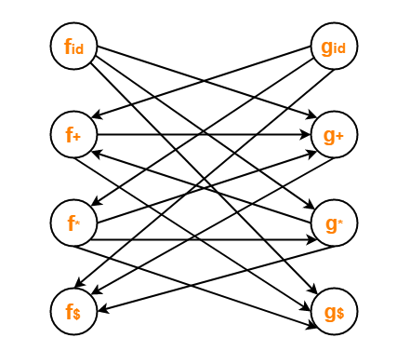
Graph representing the precedence function
The arrow will go from higher precedence to lower precedence.
Example: * > +
Then g* → f+
Graph of relation table of page: 14

Slide 26


