Slide 1
Semantic Analysis

Slide 2
Where Are We Now?
● Program is lexically well-formed:
● Identifiers have valid names.
● Strings are properly terminated. ● No unrecognised characters.
● Program is syntactically well-formed:
● Class declarations have the correct structure. ● Expressions are syntactically valid.
● Does this mean that the program is legal?

Slide 3
Semantic Analysis
A program which is lexically and syntactically correct does not guarantee that the program will have correct meaning.
To be compiled successfully, the meaning of the program should be correct too.
Example:
int a;
a = 3.1416;
The code snippet is lexically and syntactically correct. But it has a major problem is assigning the value in a. Though a is integer, a float is kept there.

Slide 4
What is the input and output of Semantic Analyzer?
As the immediate phase before semantic analyzer is parser or syntax analyzer, the input of semantic analyzer is parse tree. (theoretically)
The output of the semantic analyzer is also another parse tree but with additional properties/attributes.
Example: if any node of any parse tree has a terminal variable(a), the semantic analyzer will add the type of the variable as additional information or property.

Slide 5
Syntax Directed Translation (SDT)
Grammar + Semantic rules = SDT
In SDT, every non-terminals can get zero or more attributes/ additional properties depending on the pattern.
In semantic rule, the attribute can be a value like a string, number or memory location or anything. We can call these as attribute value.
Example: E → T
Then there are 2 non-terminals. So, they will have 0 or more attribute value. So, we can simply write as E.val = T.val.

Slide 6
Example: Grammar + Semantic rules
Grammar | Semantic Rules {Actions}
E → E + T | E.val := E.val + T.val
E → T | E.val := T.val /Print(T.val)
T → T * F | T.val := T.val * F.val
T → F | T.val := F.val
F → unit | F.val := unit.lexval (Though unit is a terminal it has a value. Why?)

Slide 7
Implementation of SDT
We have to generate the SDT along with the implementation of the parse tree which we can get from the parser or syntax analyzer.
For parse tree, we need a input string. Now, along with making a parse tree we are going implement the SDT with the help of the actions.
Example: Grammar of the page 6
Input string: 1+2*3

Slide 8
Example 01 (Grammar)
L → E E → E + T E → T T → T * F T → F F → ( E )
F → digit
print(E.val)/ L.val := E.val E.val := E.val + T.val E.val := T.val T.val := T.val * F.val T.val := F.val F.val := E.val F.val := digit.lexval

Slide 9
Input for parsing
9 + 5 +2
Production rules for parse tree generation:
L → E
E → E + T
E → E + T
E → T
T → F
F → digit

Slide 10
SDT (Parse Tree with attributes)
L
print(16)
E.val = 16
Semantic Rule
E.val = 14
T.val = 2
print(E.val) E.val := E.val + T.val E.val := T.val T.val := T.val * F.val T.val := F.val F.val := E.val F.val := digit.lexval
E.val = 9
T.val = 5
F.val = 2
T.val = 9
F.val = 5
F.val = 9
9
+
5
+
2

Slide 11
Example: Grammar + Semantic rules
Grammar | Semantic Rules {Actions}
S → E | {Print (E.val)}
E → E + E | {E.val = E.val + E.val}
E → E * E | {E.val = E.val * E.val}
E → (E) | {Print (E.val)}
E → A | {Print (A.val)}
A → A1 unit | {A.val = A1.val * 10 + unit.lexval}
A → unit | {A.val = unit.lexval}

Slide 12
Can you draw the SDT of the inputs?
String Given:
10 + 10
4 + 15
(4+6) * 14
(1 * 3)
2 * (23 * 34)

Slide 13
Attributes
Attribute values typically represent
Numbers (literal constants)
Strings (literal constants)
Memory locations, such as a frame index of a local variable or function argument
A data type for type checking of expressions
Scoping information for local declarations

Slide 14
Synthesized Versus Inherited Attributes
Production rule: A → BC
A.val is synthesized attribute of A.
A.val is inherited attribute of B. B.val = A.val
Again, C.val is also inherited attribute of B. B.val= C.val
As B is the children of A. So, that value is inherited to B.

Slide 15
Example
D → T L T → int
L → id
L is an identifier type. An important attribute of L would be its type to check its validity during semantic analyzing.
L.val = id.lexval , L.type = T.type is important attributes.
L.type is inherited attribute.
T.type = int is synthesized attribute.
L.val = id.lexval is also synthesized attribute.

Slide 16
S-Attributed Definitions
A syntax-directed definition that uses synthesized attributes exclusively is called an S-attributed definition (or S-attributed grammar).
Semantic actions are placed in rightmost place of RHS.

Slide 17
Example Attribute Grammar with Synthesized+Inherited Attributes
Production
Semantic Rule
D → T L T → int T → real L → L1 , id L → id
L.in := T.type T.type := ‘integer’ T.type := ‘real’ L1.in := L.in; L.val:=id.lexval L.val:=id.lexval

Slide 18
Acyclic Dependency Graphs for Attributed Parse Trees
A.a
A → X Y
A.a := f(X.x, Y.y)
X.x
Y.y
A.a
X.x := f(A.a, Y.y)
X.x
Y.y
A.a
Direction of value dependence
Y.y := f(A.a, X.x)
X.x
Y.y

Slide 19
Dependency Graphs with Cycles?
Edges in the dependency graph determine the evaluation order for attribute values
Dependency graphs cannot be cyclic
A.a
A.a := f(X.x) X.x := f(Y.y) Y.y := f(A.a)
X.x
Y.y
Error: cyclic dependence

Slide 20
Can you draw the parse tree?
real id, id, id

Slide 21
Evaluation order
Any topological sort of a dependency graph gives a valid evaluation order of the semantic rules.
Example:
You will get up from bed (A)
You will brush your teeth (B)
You will take breakfast (C)
You will watch the morning news on TV (D)
Go to office (E)

Slide 22
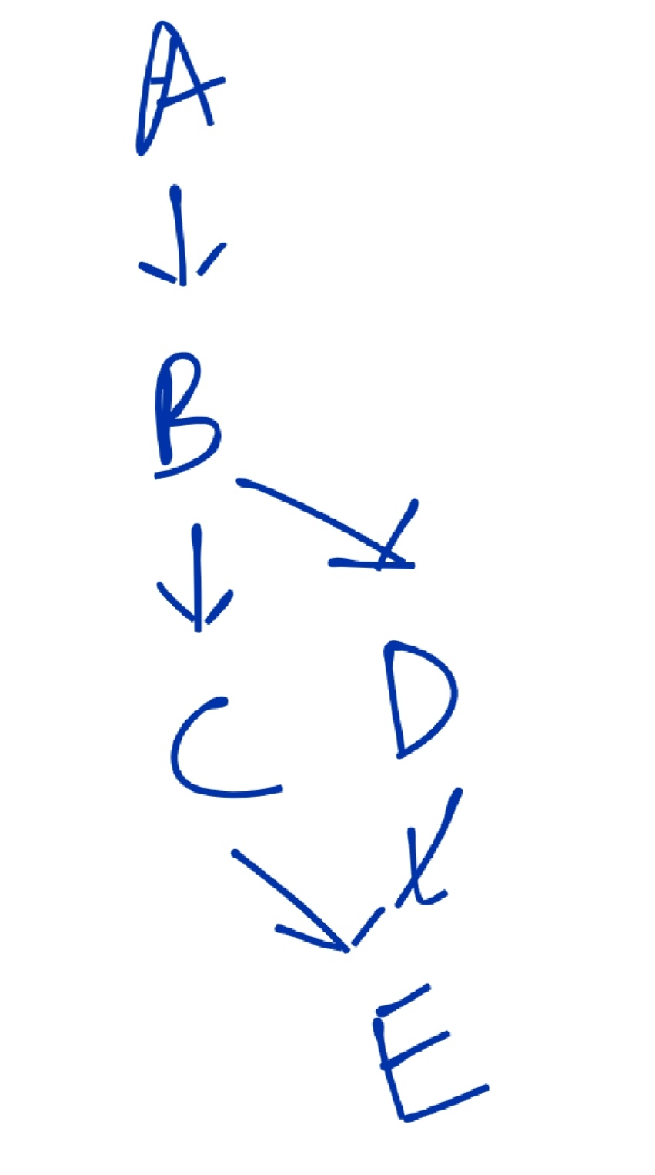
Order graph

Slide 23
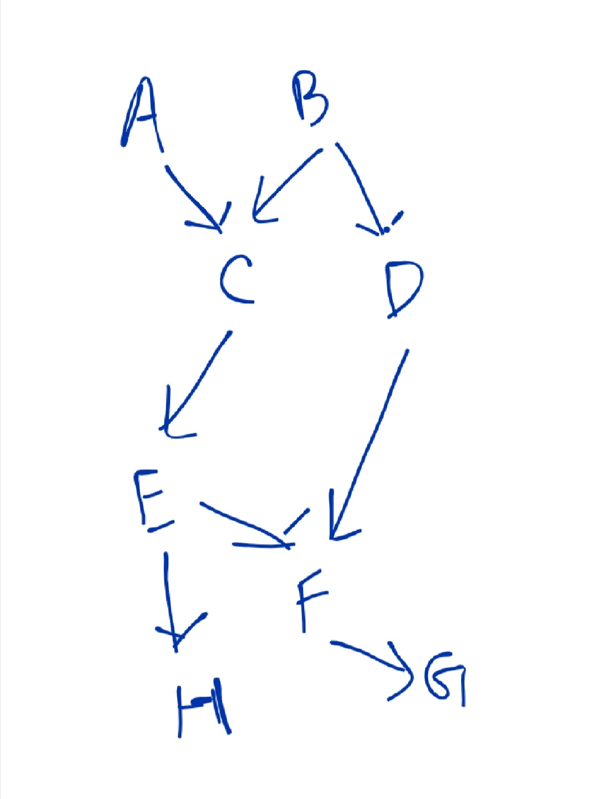
How to do topological sort?

Slide 24
How to do topological order?
Visited nodes:
Explored nodes:
Order: ABDCEFGH (may have different solutions)

Slide 25
Example Parse Tree with Topologically Sorted Actions
D
Topological sort: 1. Get id₁.entry 2. Get id₂.entry 3. Get id₃.entry
4. T₁.type=‘real’ 5. L₁.in=T₁.type 6. L3.val=id.lexval 7. L₂.in=L₁.in 8. L2.val=id.lexval 9. L₃.in=L₂.in 10. L.1val=id.lexval
T₁.type = ‘real’
4
5
L₁.in = ‘real’
6
real
7
L₂.in = ‘real’
8
,
3
id₃.entry
9
L₃.in = ‘real’
10
,
2
id₂.entry
1
id₁.entry
real id₁, id₂, id₃

Slide 26
Evaluation Methods
Parse-tree methods determine an evaluation order from a topological sort of the dependence graph constructed from the parse tree for each input. The previous example is of this method.
Rule-base methods the evaluation order is pre-determined from the semantic rules.
Oblivious methods the evaluation order is fixed and semantic rules must be (re)written to support the evaluation order (for example S-attributed definitions).

Slide 27
L-attributes Definitions
If an SDT uses both synthesized attributes and inherited attributes with a restriction that inherited attribute can inherit values from left siblings only, it is called as L-attributed SDT.
Semantic actions are placed anywhere in RHS.
A → XYZ {Y.S = A.S, Y.S = X.S, Y.S = Z.S }
The above example is not an L-attributed grammar since Y.S = A.S and Y.S = X.S are allowed but Y.S = Z.S violates the L-attributed SDT definition as attributed is inheriting the value from its right sibling.
If a definition is S-attributed, then it is also L-attributed but NOT vice-versa.

Slide 28
Example
P1: S -> MN {S.val= M.val + N.val} P2: M -> PQ {M.val = P.val * Q.val and P.val =Q.val}
Can you tell which production rule is S-attributed and which one is L-attributed?

Slide 29
Example
D → T { L.in := T.type } L T → int { T.type := ‘integer’ } T → real { T.type := ‘real’ } L → { L1.in := L.in } L1 , id { addtype(id.entry, L.in) } L → id { addtype(id.entry, L.in) }
The production rules are written in any place in the R.H.S of the production rule.
L-attributed grammar.

Slide 30
Replacing Inherited Attributes with Synthesized Lists
D → T L { for all id ∈ L.list : addtype(id.entry, T.type) } T → int { T.type := ‘integer’ } T → real { T.type := ‘real’ } L → L₁ , id { L.list := L₁.list + [id] } L → id { L.list := [id] }

Slide 31
After replacing the parse tree
D
T.type = ‘real’
L.list = [id₁,id₂,id₃]
real
L.list = [id₁,id₂]
,
id₃.entry
L.list = [id₁]
,
id₂.entry
id₁.entry

Slide 32
Concrete and Abstract Syntax Trees
A parse tree is called a concrete syntax tree.
An abstract syntax tree (AST) is defined by the compiler writer as a more convenient intermediate representation.

Slide 33
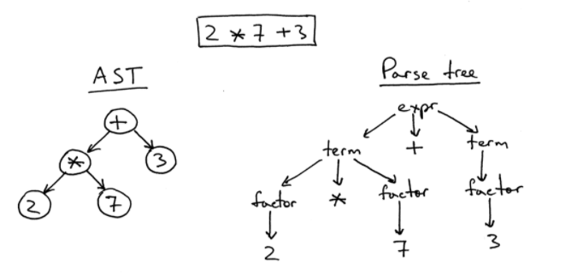
Examples of AST

Slide 34
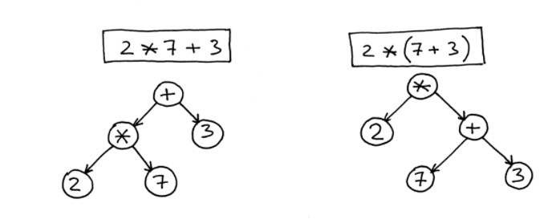
More examples

Slide 35
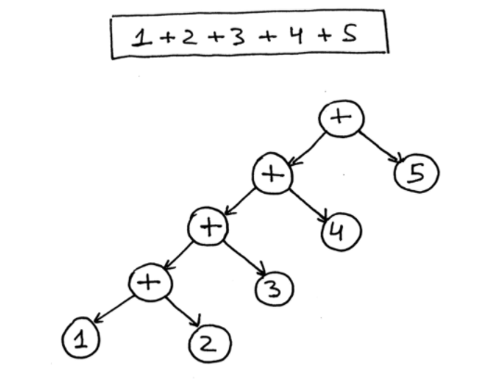
More examples

Slide 36


