Slide 1
Type Checking

Slide 2
Type Coercion
Type coercion is the automatic conversion of a datum from one data type to another within an expression. Coercion occurs because the datum is stored as one data type but its context requires a different data type.
Example In this statement, the constant 1 is an integer but its context requires a double value.
double x = 1;
This is implicit conversion. (Hidden) This will be handled internally.

Slide 3
Type Conversion
Type conversion (also sometimes known as type cast).
This is explicit.
int a;
a = (int) 10.5;

Slide 4
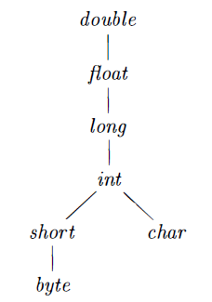
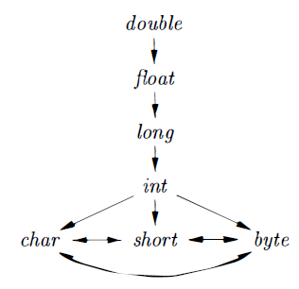
Widening and Narrowing
Widening
- Preserve information
Narrowing
- Lose information

Slide 5
Example of widening
byte i = 40; short j = i; int k = j; long l = k; float m = l; double n = m;

Slide 6
Example of narrowing
double d = 30.0; // Explicit casting is needed for below conversion float f = (float) d; long l = (long) f; int i = (int) l; short s = (short) i; byte b = (byte) s;

Slide 7
Static typing Vs. Dynamic typing
static typing means that variable types are checked at “compile-time”, or before the code is executed.
The variable types are checked at the run time are called as dynamic typing.
Statically typed languages check the types and look for type errors during compile time.
Dynamically typed languages check the types and look for type errors during runtime.
Another way to think about it: static typing means checking the types before running the program; dynamic typing means checking the types while running the program.

Slide 8
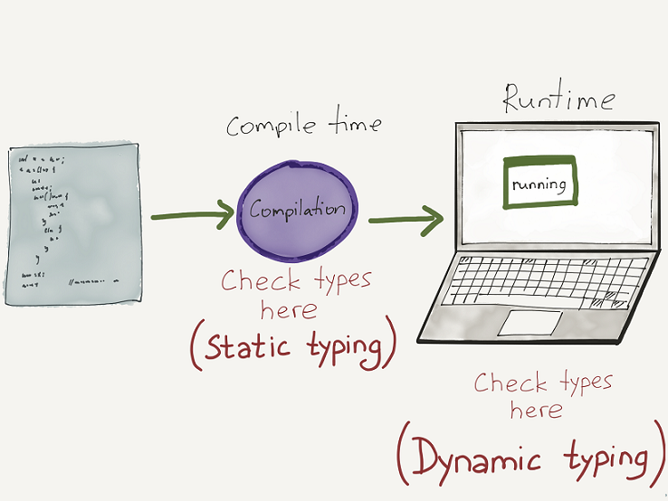
Static Vs. Dynamic typing

Slide 9
Weak Vs. Strong typing
‘4’ + 7 = ‘47’
4 * ‘7’ = 28
2 + true = 3
false – 3 = -3
Weakly typed language!
Implicitly convert the types.

Slide 10
Weak Vs. Strong typing
Example of strong type: python language
Example of weak type: JavaScript
How serious about the typing is defined by these types of typing.

Slide 11
Semantic checking
Type checking
int a[10], d;
d = d + a;
Uniqueness checking
Label names should be unique
Name-related checking
int func(int a, int a)
Flow of control checking
int func(int a, int b)
{ break; }

Slide 12
Can you tell?
Coercion and Conversion: which one is done by compiler and which one is by programmer?

Slide 14
Reference
https://en.hexlet.io/courses/intro_to_programming/lessons/types/theory_unit

