Slide 1
Stepper Motors
Md. Khairul Alam
UAP

Slide 2
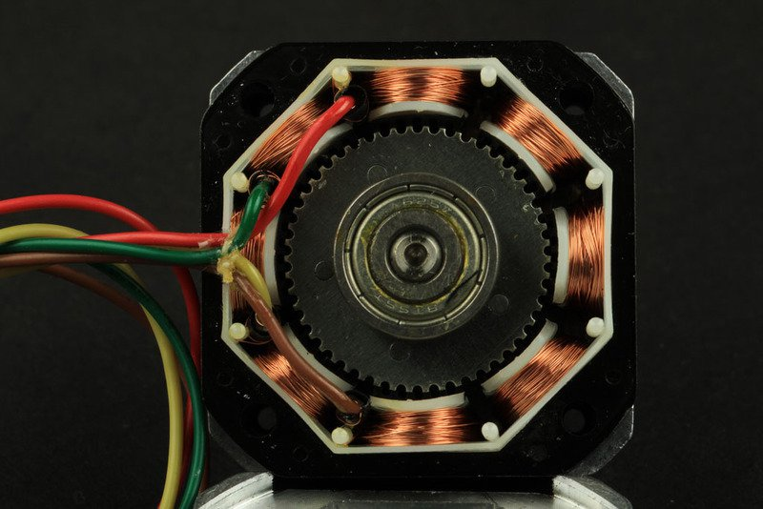

Slide 3
Stepper motors are DC motors that move in discrete steps. They have multiple coils that are organized in groups called "phases". By energizing each phase in sequence, the motor will rotate, one step at a time.
With a computer controlled stepping you can achieve very precise positioning and/or speed control. For this reason, stepper motors are the motor of choice for many precision motion control applications.

Slide 4
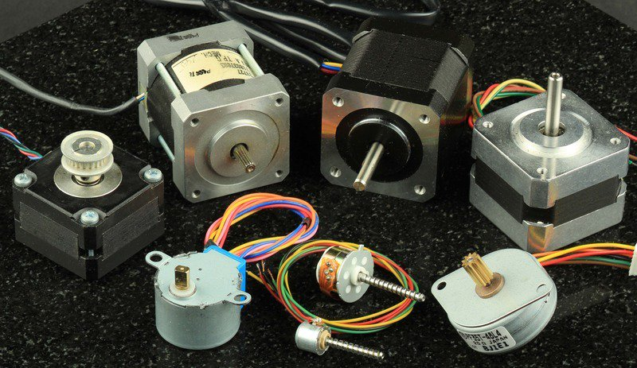

Slide 5
Advantages
High accuracy
Reliability
Holding torque
Load independent
No feedback
Rapid response to starting, stopping and reversing

Slide 6
Application
CNC machines
3D printers
Robotic
Computer printers, plotters, image scanners

Slide 7
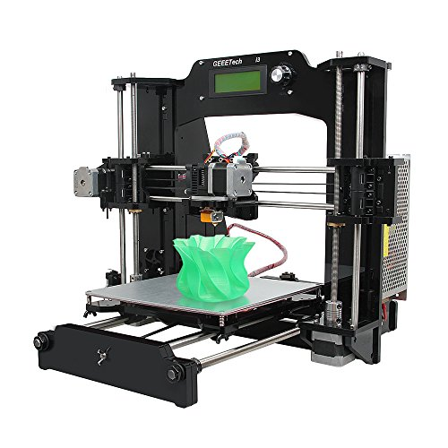

Slide 8
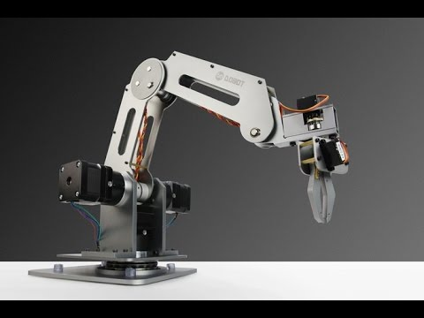

Slide 9
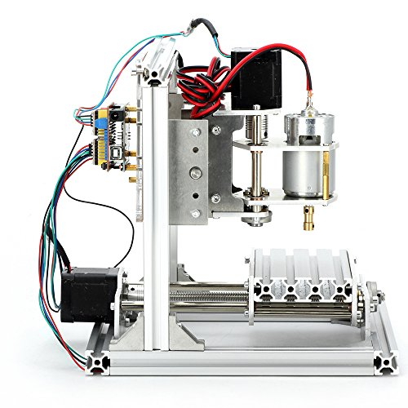

Slide 10
TYPES OF STEPPER MOTORS
Variable Reluctance Motor (VRM)
  Magnetic rotor
Permanent Magnet Stepper Motor (PMSM)
  Non-magnetic, geared rotor
Hybrid Stepper Motor (HSM)
  Magnetic, geared rotor

Slide 11
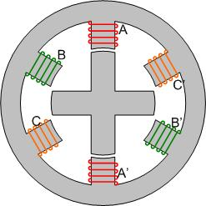
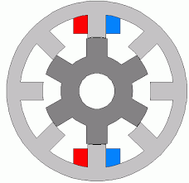

Slide 12
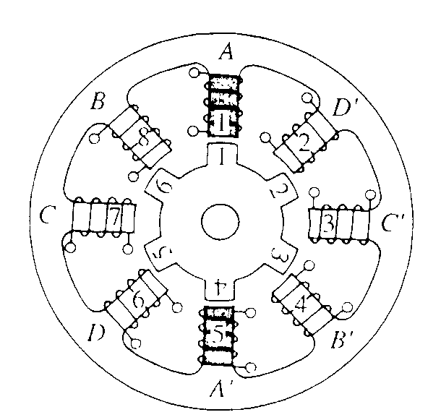
Variable-Reluctance Stepper Motor
Toothed Rotor and Toothed Stator
Principle of Operation:
Reluctance of the magnetic circuit formed by the rotor and stator teeth varies with the angular position of the rotor
Here, energize coils A and A’ (Phase A)
Rotor “steps” to align rotor teeth 1 and 4 with stator teeth 1 and 5

Slide 13
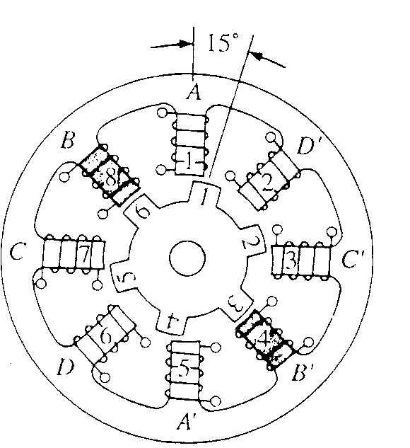
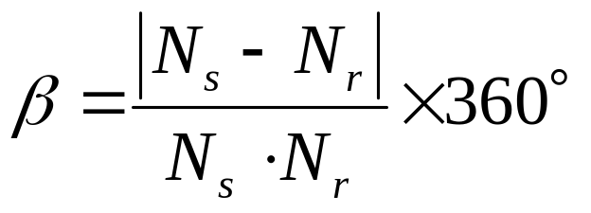
Variable-Reluctance Stepper Motor
Energize coils B and B’ (Phase B)
Rotor steps “forward”
Rotor teeth 3 and 6 align with Stator teeth 1 and 5
Let N_{s} = # of teeth on the stator
N_{r} = # of teeth on the rotor
β = Step Angle in space degrees

Slide 14
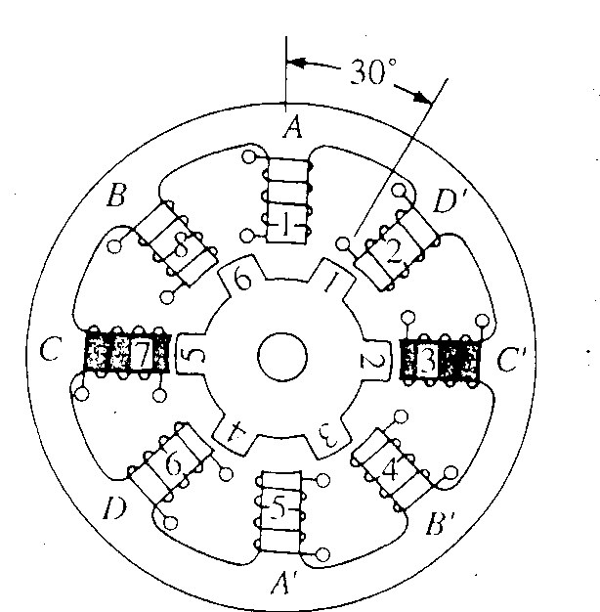
Variable-Reluctance Stepper Motor
Energize Phase C
Rotor steps forward another 15°

Slide 15
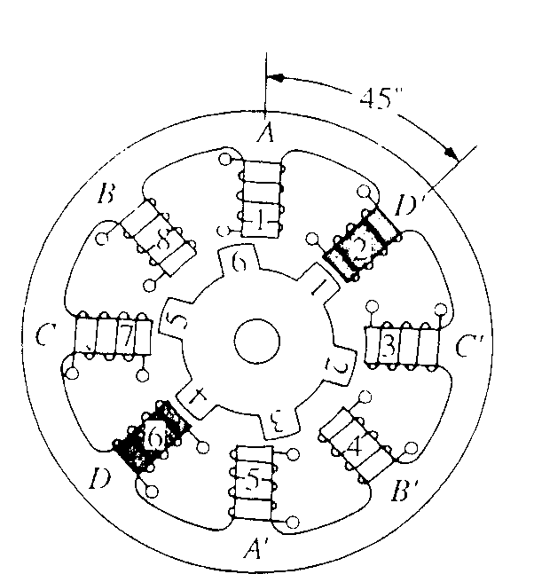
Variable-Reluctance Stepper Motor
Energize Phase D
Rotor steps forward another 15°

Slide 16
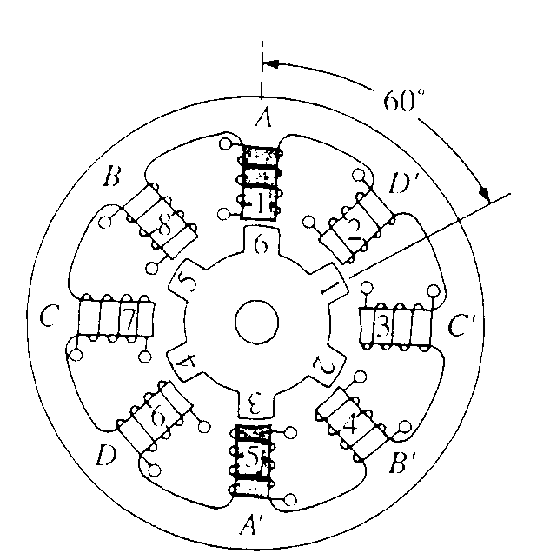
Variable-Reluctance Stepper Motor
Repeat the sequence
Energize Phase A
Rotor steps forward again

Slide 17
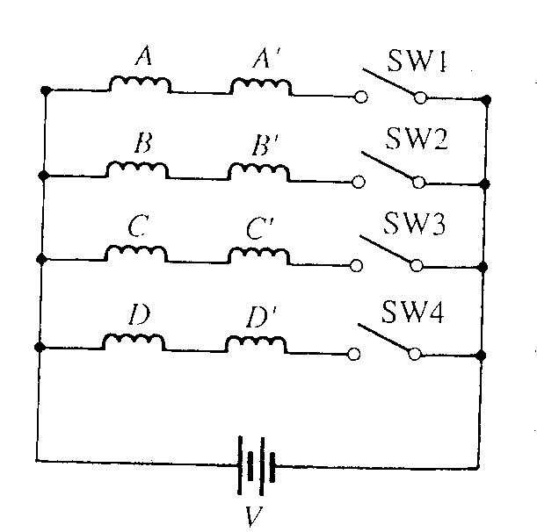
Variable-Reluctance Stepper Motor
Switching Circuit for the stepper motor
Close switches in order 1, 2, 3, and 4 to turn the rotor “clockwise”
Close switches in reverse order - 4, 3, 2, and 1 to change rotation to the opposite (counter-clockwise) direction

Slide 18
DIFFERENT MODES OF EXCITATION
Full step
Half step
Micro step

Slide 19
Stepper Motor Operation - Full Step Mode
Rotor and Stator
A₁
S
B₁
B₂
N
A₂

Slide 20
Stepper Motor Operation - Full Step Mode
N
Step 1a
A₁
high
Energize windings:
A₁ and B₁ high
A₂ and B₂ low
N
S
B₁
high
B₂
S
N
low
N
S
S
A₂
low

Slide 21
Stepper Motor Operation - Full Step Mode
N
Step 1b
A₁
high
Energize windings:
Rotor moves to align with net magnetic field
N
B₁
high
S
B₂
S
N
low
N
S
S
A₂
low

Slide 22
Stepper Motor Operation - Full Step Mode
S
Step 2a
A₁
low
Energize windings:
A₂ and B₁ high
A₁ and B₂ low
S
B₁
high
S
B₂
S
N
low
N
N
A₂
high
N

Slide 23
Stepper Motor Operation - Full Step Mode
S
Step 2b
A₁
low
Energize windings:
Rotor moves to align with net magnetic field
S
B₁
high
N
B₂
S
N
low
S
N
A₂
high
N

Slide 24
Stepper Motor Operation - Full Step Mode
S
Step 3a
A₁
low
Energize windings:
A₂ and B₂ high
A₁ and B₁ low
S
B₁
low
N
B₂
N
S
S
high
N
N
A₂
high

Slide 25
Stepper Motor Operation - Full Step Mode
S
Step 3b
A₁
low
Energize windings:
Rotor moves to align with net magnetic field
S
B₁
low
N
B₂
N
S
S
high
N
N
A₂
high

Slide 26
Stepper Motor Operation - Full Step Mode
N
Step 4a
A₁
high
Energize windings:
A₁ and B₂ high
A₂ and B₁ low
N
B₁
low
N
B₂
N
S
S
high
S
A₂
S
low

Slide 27
Stepper Motor Operation - Full Step Mode
N
Step 4b
A₁
high
Energize windings:
Rotor moves to align with net magnetic field
N
B₁
low
S
B₂
N
S
N
high
S
A₂
S
low

Slide 28
Stepper Motor Operation - Full Step Mode
N
Step 1a
A₁
high
Energize windings:
A₁ and B₁ high
A₂ and B₂ low
N
S
B₁
high
B₂
S
N
low
N
S
S
A₂
low

Slide 29
Stepper Motor Operation - Full Step Mode
N
Step 1b
A₁
high
Energize windings:
Rotor moves to align with net magnetic field
N
B₁
high
S
B₂
S
N
low
N
S
S
A₂
low

Slide 30
Stepper Motor Operation - Half Step Mode
Step 1a
Energize windings:
Just B₁ high
A₁, A₂ and B₂ low
A₁
low
B₁
high
B₂
S
S
S
N
N
low
N
A₂
low

Slide 31
Stepper Motor Operation - Half Step Mode
Step 1b
Energize windings:
Rotor moves to align with net magnetic field
Only 45 deg. rotation!
A₁
low
B₁
high
B₂
S
N
S
N
N
S
low
A₂
low

Slide 32
Stepper Motor Operation - Half Step Mode
Step 2a
S
Energize windings:
A₂ and B₁ high
A₁ and B₂ low
A₁
low
S
B₁
high
N
S
N
B₂
S
low
N
A₂
high
N

Slide 33
Stepper Motor Operation - Full Step Mode
Step 2b
S
Energize windings:
Rotor moves to align with net magnetic field
A₁
low
S
B₁
high
N
B₂
S
N
low
S
N
A₂
high
N

Slide 34
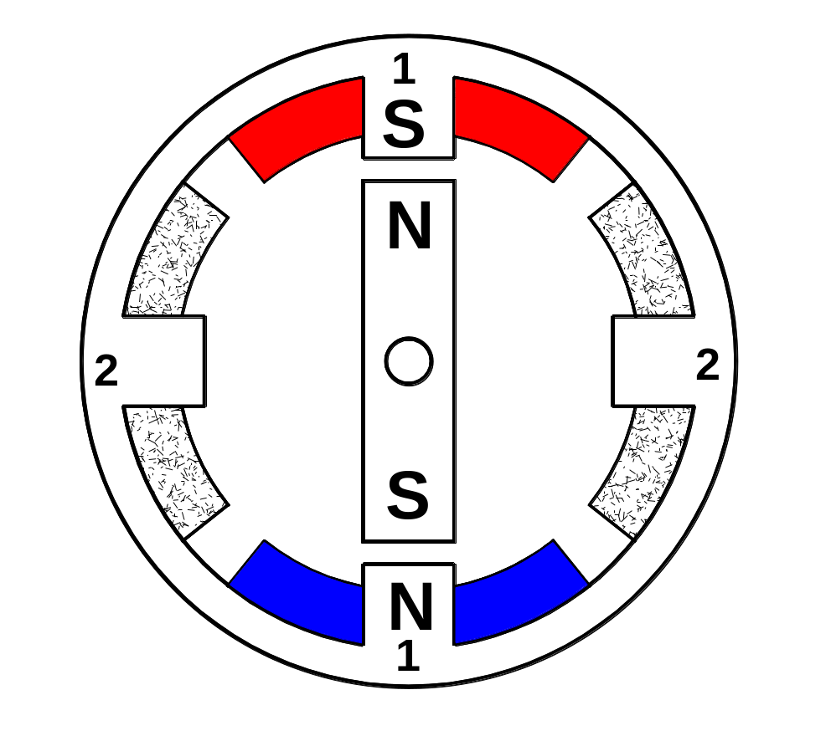
Cross Section of a Stepper Motor
Stators
Rotor

Slide 35
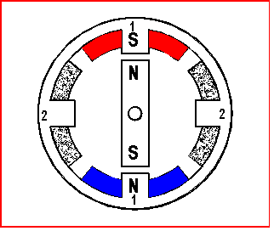
Full Step Operation
Four Steps per revolution i.e. 90 deg. steps.

Slide 36
Half Step Operation
Eight steps per. revolution i.e. 45 deg. steps.

Slide 37
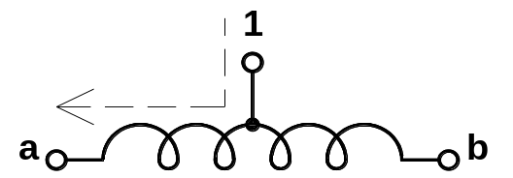
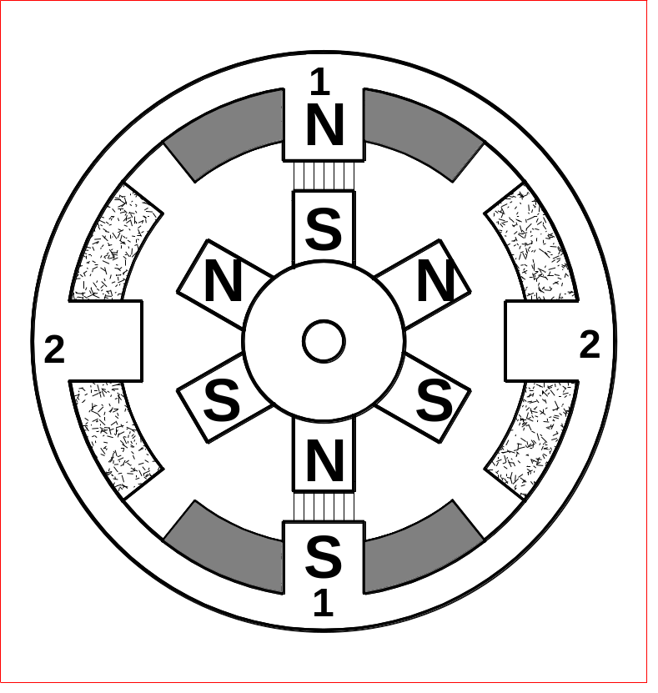
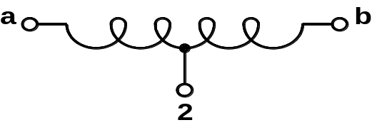
Winding number 1
One step
6 pole rotor
Winding number 2

Slide 38
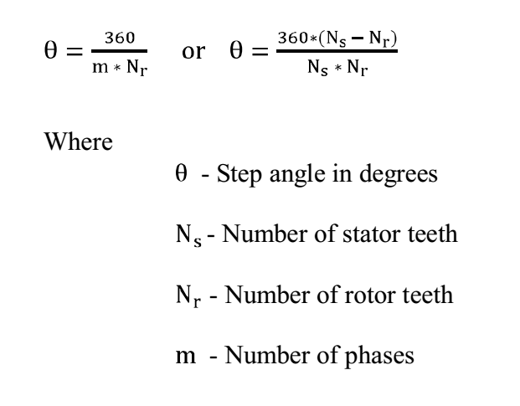

Slide 39
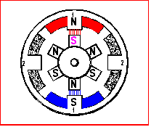
Six pole rotor, two electro magnets.
How many steps are required for one complete revolution?

Slide 40
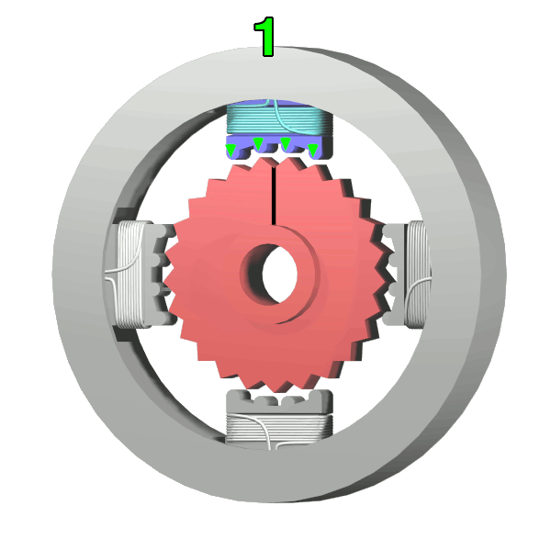
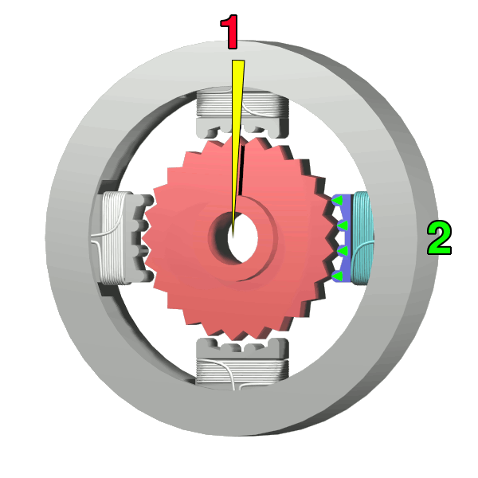
Practical Stepper motor operation
The top electromagnet (1) is turned on, attracting the nearest teeth of a gear-shaped iron rotor. With the teeth aligned to electromagnet 1, they will be slightly offset from electromagnet 2
The top electromagnet (1) is turned off, and the right electromagnet (2) is energized, pulling the nearest teeth slightly to the right. This results in a rotation of 3.6° in this example.

Slide 41
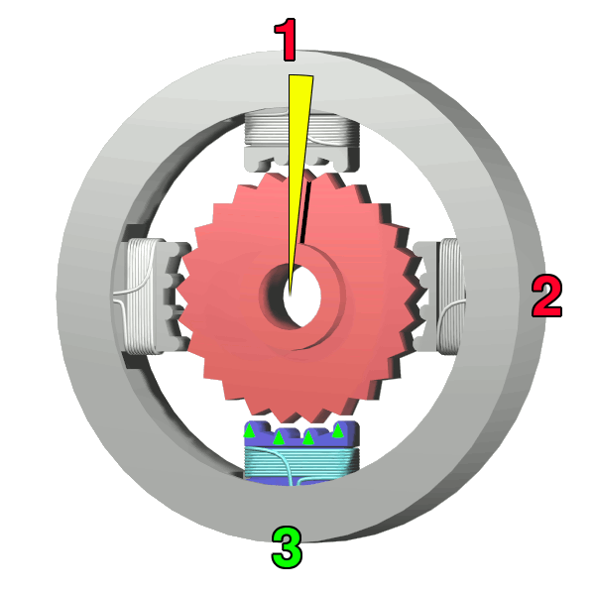
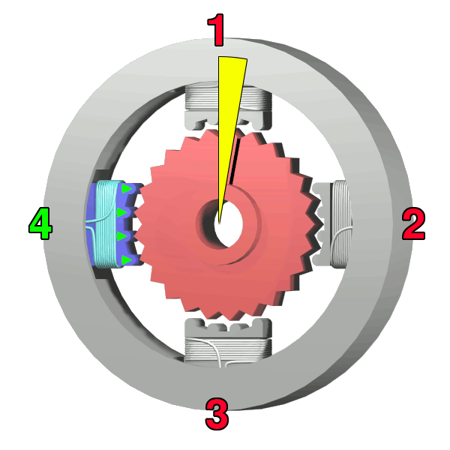
The bottom electromagnet (3) is energized; another 3.6° rotation occurs.
The left electromagnet (4) is enabled, rotating again by 3.6°. When the top electromagnet (1) is again enabled, the teeth in the sprocket will have rotated by one tooth position; since there are 25 teeth, it will take 100 steps to make a full rotation in this example.

Slide 42
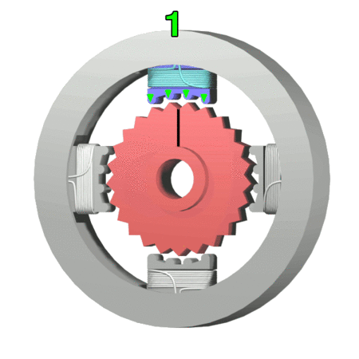

Slide 43
TYPES OF DRIVERS
Unipolar Driver
Bipolar Driver

Slide 44
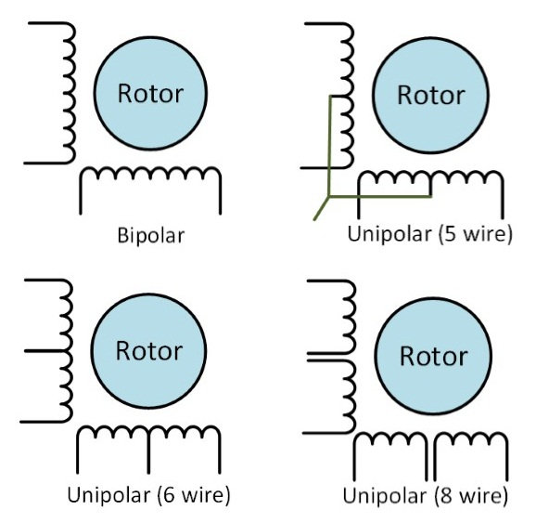

Slide 45
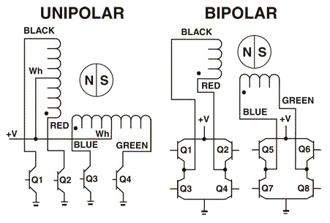

Slide 46
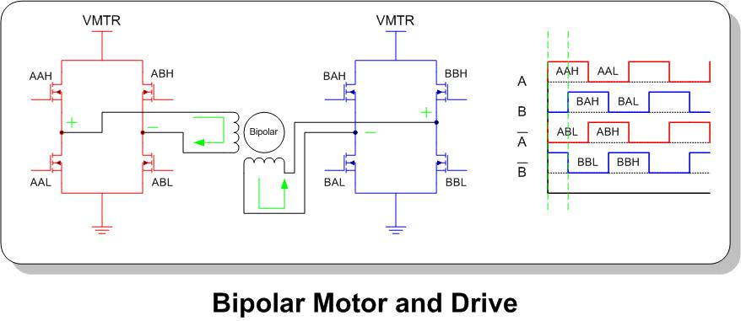

Slide 47
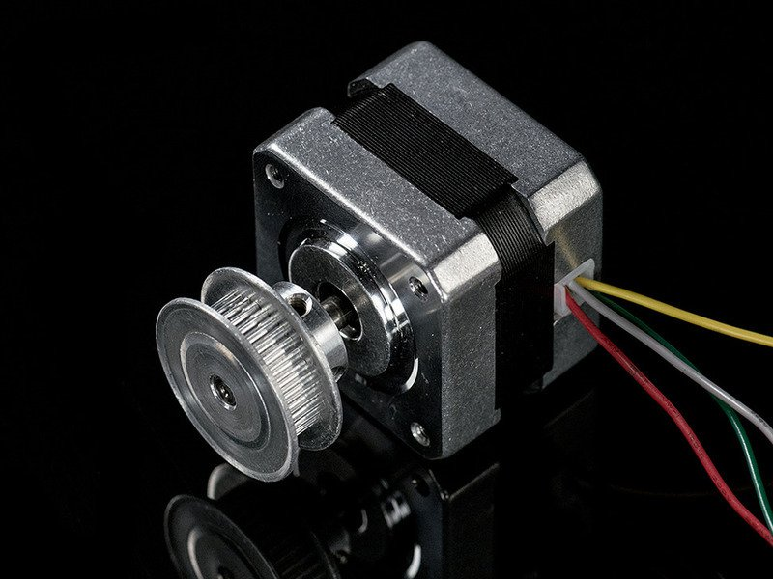

Slide 48
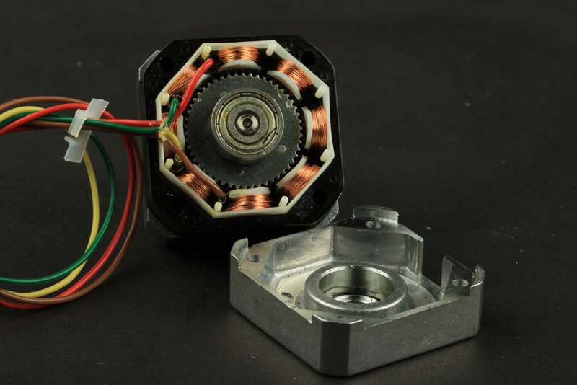

Slide 49
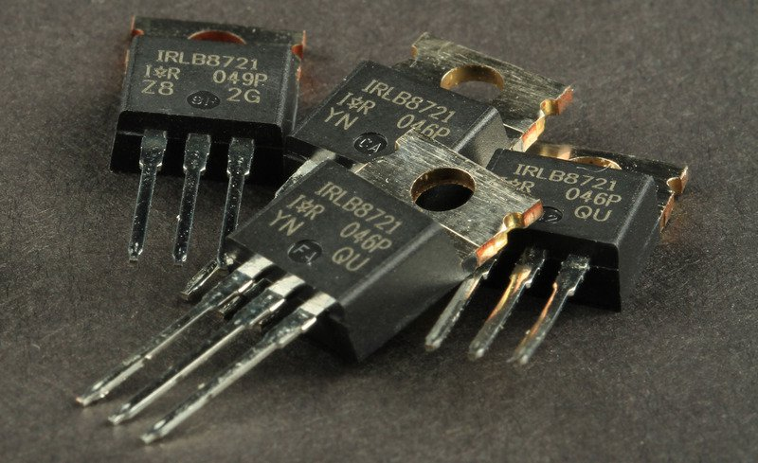

Slide 50
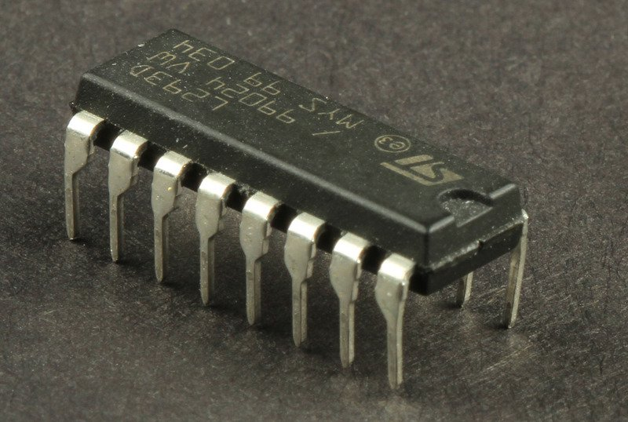

Slide 51
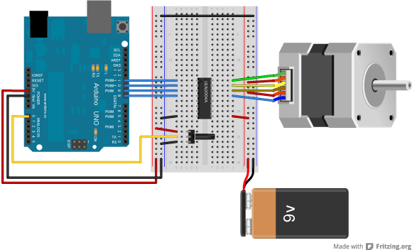

Slide 52
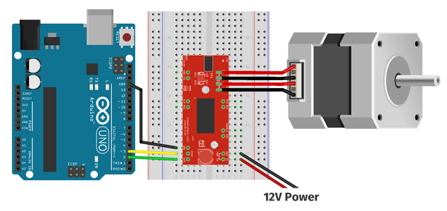

Slide 53
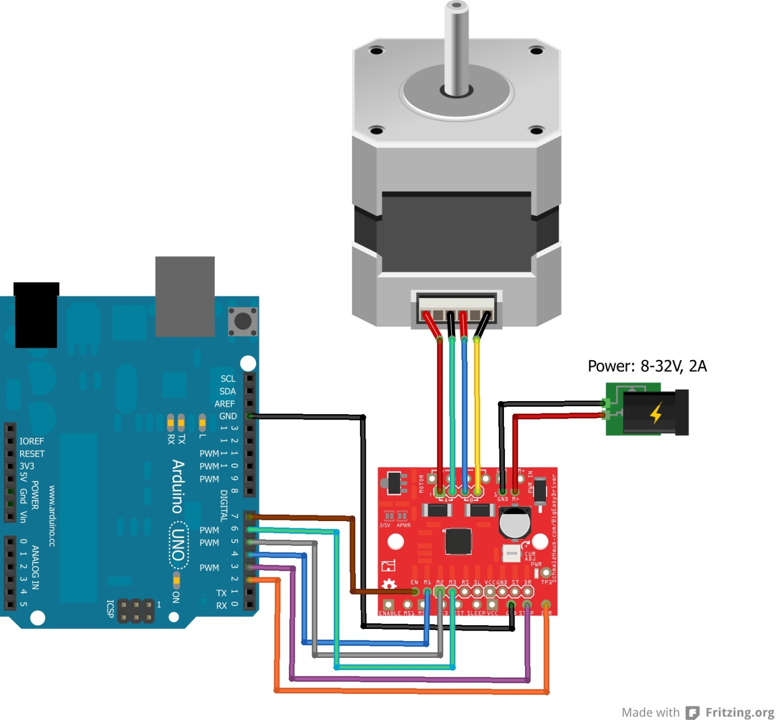

Slide 54
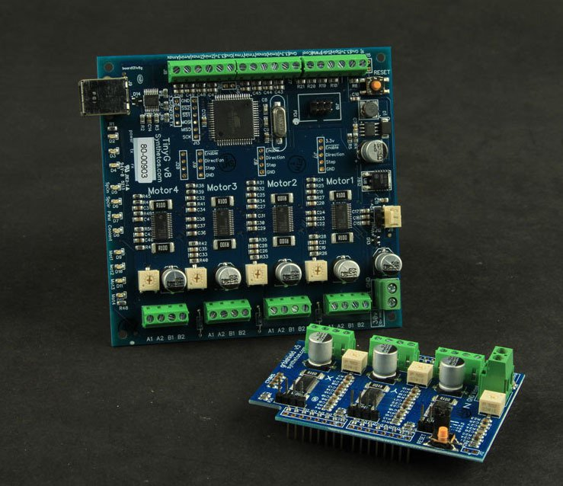

Slide 55
