Slide 1
Propositions
A proposition is a declarative sentence (that is, a sentence that declares a fact) that is either true or false, but not both.
EXAMPLE 1 All the following declarative sentences are propositions.
1. Washington, D.C., is the capital of the United States of America.
2. Toronto is the capital of Canada.
3. 1 + 1 = 2.
4. 2 + 2 = 3.
Propositions 1 and 3 are true, whereas 2 and 4 are false.

Slide 2
Some sentences that are not propositions are given in Example 2.
EXAMPLE 2 Consider the following sentences.
1. What time is it?
2. Read this carefully.
3. x + 1 = 2.
4. x + y = z.
Sentences 1 and 2 are not propositions because they are not declarative sentences. Sentences 3 and 4 are not propositions because they are neither true nor false. Note that each of sentences 3
and 4 can be turned into a proposition if we assign values to the variables.

Slide 3
We use letters to denote propositional variables. The truth value of a proposition is true, denoted by T, if it is a true proposition, and the truth value of a proposition is false, denoted by F, if it is a false proposition. The area of logic that deals with propositions is called the propositional calculus or propositional logic.
DEFINITION 1 Let p be a proposition. The negation of p, denoted by ￢p (also denoted by p), is the statement
“It is not the case that p.”
The proposition ￢p is read “not p.” The truth value of the negation of p, ￢p, is the opposite of the truth value of p.

Slide 4
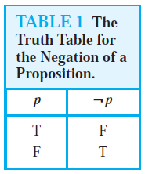
EXAMPLE 3 Find the negation of the proposition
“Michael’s PC runs Linux”
and express this in simple English.
Solution: The negation is
“It is not the case that Michael’s PC runs Linux.”
This negation can be more simply expressed as
“Michael’s PC does not run Linux.”
Table 1 displays the truth table for the negation of a proposition p.

Slide 5
DEFINITION 2 Let p and q be propositions. The conjunction of p and q, denoted by p ∧ q, is the proposition “p and q.” The conjunction p ∧ q is true when both p and q are true and is false otherwise.
EXAMPLE 4 Find the conjunction of the propositions p and q where p is the proposition “Rebecca’s PC has more than 16 GB free hard disk space” and q is the proposition “The processor in Rebecca’s PC runs faster than 1 GHz.”
Solution: The conjunction of these propositions, p∧q, is the proposition “Rebecca’s PC has more than 16 GB free hard disk space, and the processor in Rebecca’s PC runs faster than 1 GHz.” This conjunction can be expressed more simply as “Rebecca’s PC has more than 16 GB free hard disk space, and its processor runs faster than 1 GHz.”

Slide 6
DEFINITION 3 Let p and q be propositions. The disjunction of p and q, denoted by p ∨ q, is the proposition “p or q.” The disjunction p ∨ q is false when both p and q are false and is true otherwise.
EXAMPLE 5 What is the disjunction of the propositions p and q where p and q are the same propositions as in Example 5?
Solution: The disjunction of p and q, p ∨ q, is the proposition
“Rebecca’s PC has at least 16 GB free hard disk space, or the processor in Rebecca’s PC runs faster than 1 GHz.”

Slide 7
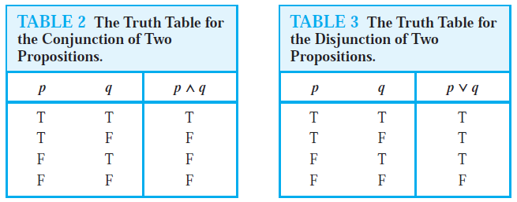

Slide 8
DEFINITION 4 Let p and q be propositions. The exclusive or of p and q, denoted by p ⊕ q, is the proposition that is true when exactly one of p and q is true and is false otherwise.
DEFINITION 5 Let p and q be propositions. The conditional statement p → q is the proposition “if p, then q.” The conditional statement p → q is false when p is true and q is false, and true otherwise. In the conditional statement p → q, p is called the hypothesis (or antecedent or premise) and q is called the conclusion (or consequence).

Slide 9
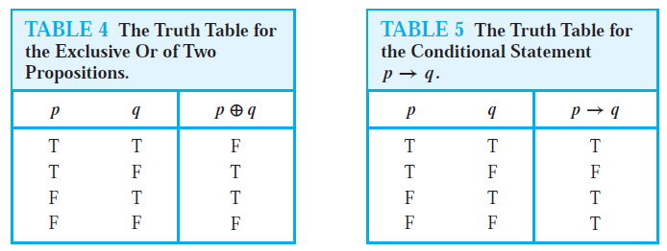

Slide 10
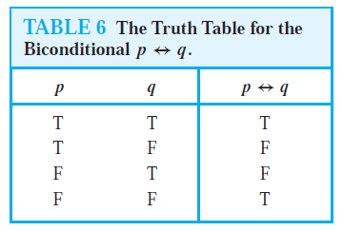
DEFINITION 6 Let p and q be propositions. The biconditional statement p ↔ q is the proposition “p if and only if q.” The biconditional statement p ↔ q is true when p and q have the same truth values, and is false otherwise. Biconditional statements are also called bi-implications.

Slide 11
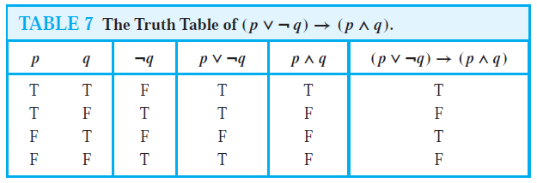
EXAMPLE 6 Construct the truth table of the compound proposition (p ∨￢q) → (p ∧ q).

Slide 12
Translating English Sentences
There are many reasons to translate English sentences into expressions involving propositional variables and logical connectives. In particular, English (and every other human language) is often ambiguous. Translating sentences into compound statements (and other types of logical expressions, which we will introduce later in this chapter) removes the ambiguity.

Slide 13
EXAMPLE 7 How can this English sentence be translated into a logical expression?
“You can access the Internet from campus only if you are a computer science major or you are not a freshman.”
Solution: Let a, c, and f represent “You can access the Internet from campus,” “You are a computer science major,” and “You are a freshman,” respectively. Noting that “only if” is one way a conditional statement can be expressed, this sentence can be represented as
a → (c ∨￢f ).

Slide 14
EXAMPLE 8 How can this English sentence be translated into a logical expression?
“You cannot ride the roller coaster if you are under 4 feet tall unless you are older than 16 years old.”
Solution: Let q, r, and s represent “You can ride the roller coaster,” “You are under 4 feet tall,” and “You are older than 16 years old,” respectively. Then the sentence can be translated to
(r ∧￢s)→￢q.
Of course, there are other ways to represent the original sentence as a logical expression, but the one we have used should meet our needs.

Slide 15
Propositional Equivalences
DEFINITION 1 A compound proposition that is always true, no matter what the truth values of the propositional variables that occur in it, is called a tautology. A compound proposition that is always false is called a contradiction. A compound proposition that is neither a tautology nor a contradiction is called a contingency.
EXAMPLE 9 We can construct examples of tautologies and contradictions using just one propositional variable. Consider the truth tables of p ∨￢p and p ∧￢p, shown in Table 1. Because p ∨￢p is always true, it is a tautology. Because p ∧￢p is always false, it is a contradiction.

Slide 16
Logical Equivalences
Compound propositions that have the same truth values in all possible cases are called logically equivalent. We can also define this notion as follows.
DEFINITION 2 The compound propositions p and q are called logically equivalent if p ↔ q is a tautology. The notation p ≡ q denotes that p and q are logically equivalent.

Slide 17
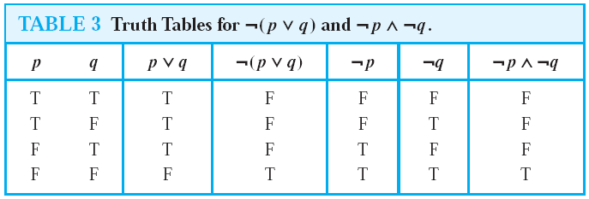
EXAMPLE 10 Show that ￢(p ∨ q) and ￢p ∧￢q are logically equivalent.
Solution: The truth tables for these compound propositions are displayed in Table 3. Because the truth values of the compound propositions ￢(p ∨ q) and ￢p ∧￢q agree for all possible combinations of the truth values ofp and q, it follows that ￢(p ∨ q) ↔ (￢p ∧￢q) is a tautology and that these compound propositions are logically equivalent.

Slide 18
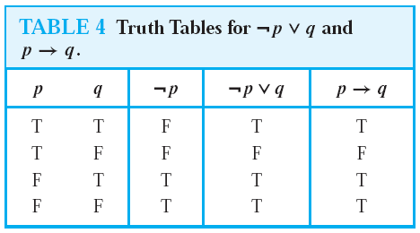
Show that p → q and ￢p ∨ q are logically equivalent.
Solution:We construct the truth table for these compound propositions in Table 4. Because the truth values of ￢p ∨ q and p → q agree, they are logically equivalent.

Slide 19
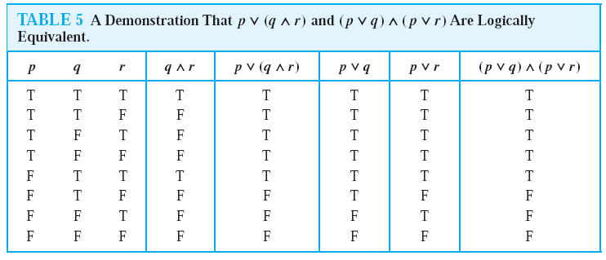
EXAMPLE 11 Show that p ∨ (q ∧ r) and (p ∨ q) ∧ (p ∨ r) are logically equivalent. This is the distributive law of disjunction over conjunction.

Slide 20
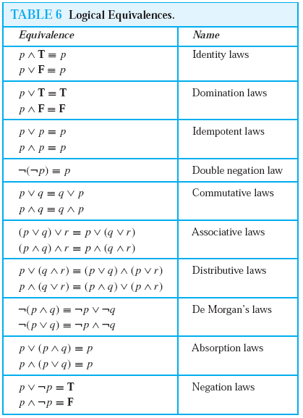
Table 6 contains some important equivalences. In these equivalences, T denotes the compound proposition that is always true and F denotes the compound proposition that is always false.

Slide 21
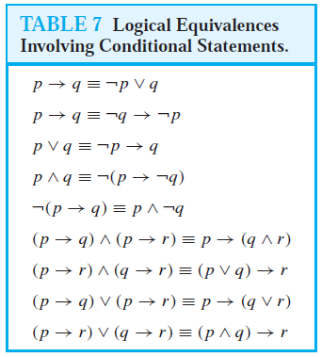

Slide 22
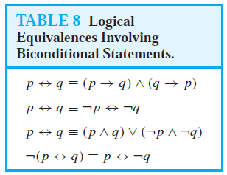

Slide 23
De Morgan’s laws:
￢(p₁ ∨ p₂ ∨ ・ ・ ・ ∨ p_{n}) ≡ (￢p₁ ∧￢p₂ ∧ ・・・ ∧ ￢p_{n})
And
￢(p1 ∧ p2 ∧ ・ ・ ・ ∧ pn) ≡ (￢p1 ∨￢p2 ∨ ・・・ ∨ ￢pn).

Slide 24
EXAMPLE 12 Show that ￢(p ∨ (￢p ∧ q)) and ￢p ∧￢q are logically equivalent by developing a series of logical equivalences.
Ans.
￢(p ∨ (￢p ∧ q)) ≡ ￢p ∧￢(￢p ∧ q) by De Morgan law
≡ ￢p ∧ [￢(￢p)∨￢q] by De Morgan law
≡ ￢p ∧ (p ∨￢q) by the double negation law
≡ (￢p ∧ p) ∨ (￢p ∧￢q) by the distributive law
≡ F ∨ (￢p ∧￢q) because ￢p ∧ p ≡ F
≡ (￢p ∧￢q) ∨F by the commutative law for disjunction
≡ ￢p ∧￢q by the identity law for F

Slide 25
EXAMPLE 13 Show that (p ∧ q) → (p ∨ q) is a tautology.
Solution: To show that this statement is a tautology, we will use logical equivalences to demonstrate that it is logically equivalent to T. (Note: This could also be done using a truth table.)
(p ∧ q) → (p ∨ q) ≡ ￢(p ∧ q) ∨ (p ∨ q) by Example 3
≡ (￢p ∨￢q) ∨ (p ∨ q) by De Morgan law
≡ (￢p ∨ p) ∨ (￢q ∨ q)
by the associative and commutative laws for disjunction
≡ T ∨ T
≡ T

Slide 26
Example-14
Let p be “It is cold” and let q be “It is raining”. Give a simple verbal sentence which describes each of the
following statements: (a) ￢p; (b) p ∧ q; (c) p ∨ q; (d) q ∨￢p.
In each case, translate ∧, ∨, and ∼ to read “and,” “or,” and “It is false that” or “not,” respectively, and then simplify
the English sentence.
(a) It is not cold. (c) It is cold or it is raining.
(b) It is cold and raining. (d) It is raining or it is not cold.

Slide 27
Example-15
Use the laws show that ￢(p ∧ q) ∨ (￢p ∧ q) ≡ ￢p.
Statement Reason
(1) ￢(p ∨ q) ∨ (￢p ∧ q) ≡ (￢p ∧￢q) ∨ (￢p ∧ q) DeMorgan’s law
(2) ≡ ￢p ∧ (￢q ∨ q) Distributive law
(3) ≡ ￢p ∧ T Complement law
(4) ≡ ￢p Identity law

Slide 28
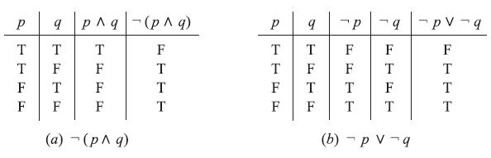
Example-16
Show that the propositions ￢(p ∧ q) and ￢p ∨￢q are logically equivalent.

