Slide 1
Rules of Inference

Slide 2
ARGUMENTS
DEFINITION 1 An argument in propositional logic is a sequence of propositions. All but the final proposition in the argument are called premises and the final proposition is called the conclusion. An argument is valid if the truth of all its premises implies that the conclusion is true.
An argument is an assertion that a given set of propositions P₁, P₂,… ,P_{n}, called premises, yields (has a consequence) another proposition Q, called the conclusion. Such an argument is denoted by,
P₁, P₂, . . . , P ┤Q
An argument P₁, P₂, . . . , P_{n} ┤ Q is said to be valid if Q is true whenever all the premises P₁, P₂, . . . , P_{n} are true.
An argument which is not valid is called fallacy.

Slide 3
Valid Arguments in Propositional Logic
Consider the following argument involving propositions (which, by definition, is a sequence of propositions):
“If you have a current password, then you can log onto the network.”
“You have a current password.”
Therefore,
“You can log onto the network.”
We would like to determine whether this is a valid argument. That is, we would like to determine whether the conclusion “You can log onto the network” must be true when the premises “If you have a current password, then you can log onto the network” and “You have a current password” are both true.

Slide 4
Before we discuss the validity of this particular argument, we will look at its form. Use p to represent “You have a current password” and q to represent “You can log onto the network.” Then, the argument has the form
p → q
P
∴ q
where ∴ is the symbol that denotes “therefore.”
The argument we obtain by substituting these values of p and q into the argument form is
“If you have access to the network, then you can change your grade.”
“You have access to the network.”
_______________________________________________________
∴ “You can change your grade.”

Slide 5
We know that when p and q are propositional variables, the statement ((p → q) ∧ p) → q is a tautology (shown in previous lecture). In particular, when both p → q and p are true, we know that q must also be true. We say this form of argument is valid because whenever all its premises (all statements in the argument other than the final one, the conclusion) are true, the conclusion must also be true.

Slide 6
Rules of Inference for Propositional Logic
We can always use a truth table to show that an argument form is valid. We do this by showing that whenever the premises are true, the conclusion must also be true.
However, this can be a tedious approach. For example, when an argument form involves 10 different propositional variables, to use a truth table to show this argument form is valid requires 2¹⁰ = 1024 different rows.
Fortunately, we do not have to resort to truth tables. Instead, we can first establish the validity of some relatively simple argument forms, called rules of inference.

Slide 7
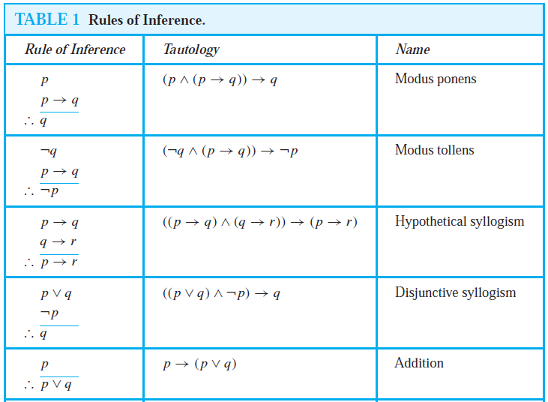

Slide 8
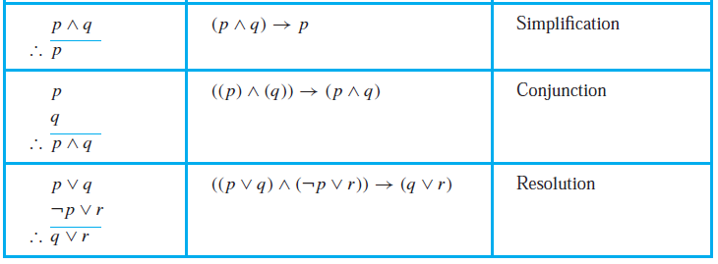

Slide 9
The tautology (p ∧ (p → q)) → q is the basis of the rule of inference called modus ponens. (Modus ponens is Latin for mode that affirms.) This tautology leads to the following valid argument form, which we have already seen in our initial discussion about arguments (where, as before, the symbol ∴ denotes “therefore”):
p
p → q
∴ q

Slide 10
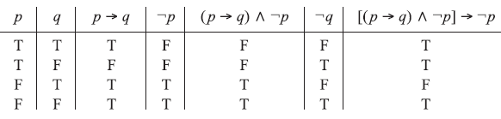
Example-1
Show that the following argument is a fallacy: p → q, ￢p ┤ ￢q.
Ans.
Construct the truth table for [(p → q)∧￢p] → ￢q as in Fig. below. Since the proposition [(p → q)∧￢p] → ￢q
is not a tautology, the argument is a fallacy. Equivalently, the argument is a fallacy since in the third line of the truth
table p → q and ￢p are true but ￢q is false.

Slide 11
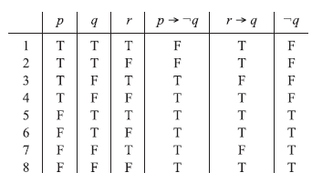
Example-2
Prove the following argument is valid: p →￢q, r → q, r ┤ ￢p.
Construct the truth table of the premises and conclusions as in Fig. below. Now, p → ￢q, r → q, and r are true simultaneously only in the fifth row of the table, where ￢p is also true. Hence the argument is valid

Slide 12

EXAMPLE 3 Consider the following argument:
S₁ : If a man is a bachelor, he is unhappy.
S₂ : If a man is unhappy, he dies young.
___________________________________________________________________
S : Bachelors die young
Here the statement S below the line denotes the conclusion of the argument, and the statements S₁ and S₂ above the line denote the premises. We claim that the argument S₁, S₂ ┤ S is valid. For the argument is of the form
p → q, q → r ┤ p → r
where p is “He is a bachelor,” q is “He is unhappy” and r is “He dies young;” this argument (Law of Syllogism) is valid.

Slide 13
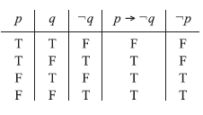
EXAMPLE 4
Determine the validity of the following argument:
If 7 is less than 4, then 7 is not a prime number.
7 is not less than 4.
-------------------------------------------------------------
∴ 7 is a prime number.
First translate the argument into symbolic form. Let p be “7 is less than 4” and q be “7 is a prime number.” Then the argument is of the form
p →￢q, ￢q ┤ q
Now, we construct a truth table as shown below. The above argument is shown to be a fallacy since, in the fourth line of the truth table, the premises p →￢q and ￢p are true, but the conclusion q is false.

Slide 14
EXAMPLE 5
Test the validity of the following argument:
If two sides of a triangle are equal, then the opposite angles are equal.
Two sides of a triangle are not equal.
------------------------------------------------------------
∴ The opposite angles are not equal.
First translate the argument into the symbolic form p → q, ￢p ┤ ￢q, where p is “Two sides of a triangle are equal” and q is “The opposite angles are equal.” By previous exampe-1, this argument is a fallacy.

Slide 15
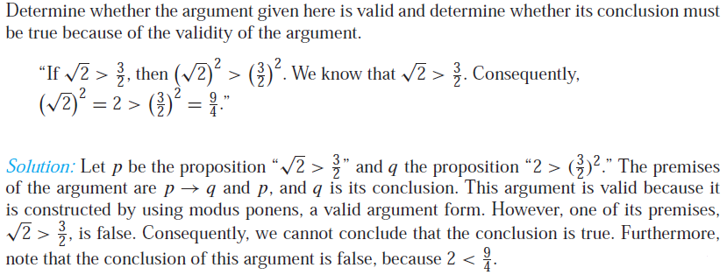
Example-6

Slide 16
EXAMPLE 7 State which rule of inference is the basis of the following argument: “It is below freezing now. Therefore, it is either below freezing or raining now.”
Solution: Let p be the proposition “It is below freezing now” and q the proposition “It is raining now.” Then this argument is of the form
p
∴ p ∨ q
This is an argument that uses the addition rule.
Rule

Slide 17
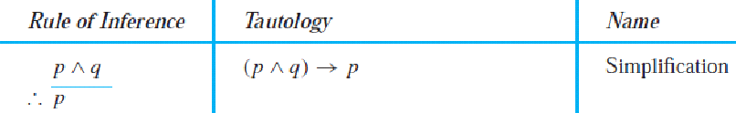
EXAMPLE 8 State which rule of inference is the basis of the following argument: “It is below freezing and raining now. Therefore, it is below freezing now.”
Solution: Let p be the proposition “It is below freezing now,” and let q be the proposition “It is raining now.” This argument is of the form
p ∧ q
∴ p
This argument uses the simplification rule.

Slide 18
EXAMPLE 9 State which rule of inference is used in the argument:
If it rains today, then we will not have a barbecue today. If we do not have a barbecue today, then we will have a barbecue tomorrow. Therefore, if it rains today, then we will have a barbecue tomorrow.
Solution: Let p be the proposition “It is raining today,” let q be the proposition “We will not have a barbecue today,” and let r be the proposition “We will have a barbecue tomorrow.” Then this argument is of the form
p → q
q → r
∴ p → r
Hence, this argument is a hypothetical syllogism.

Slide 19
EXAMPLE 10 Show that the premises “It is not sunny this afternoon and it is colder than yesterday,” “We will go swimming only if it is sunny,” “If we do not go swimming, then we will take a canoe trip,” and “If we take a canoe trip, then we will be home by sunset” lead to the conclusion “We will be home by sunset.”
Solution: Let p be the proposition “It is sunny this afternoon,” q the proposition “It is colder than yesterday,” r the proposition “We will go swimming,” s the proposition “We will take a canoe trip,” and t the proposition “We will be home by sunset.” Then the premises become ￢p ∧ q, r → p, ￢r → s, and s → t . The conclusion is simply t . We need to give a valid argument with premises ￢p ∧ q, r → p, ￢r → s, and s → t and conclusion t . We construct an argument to show that our premises lead to the desired conclusion as
follows.

Slide 20
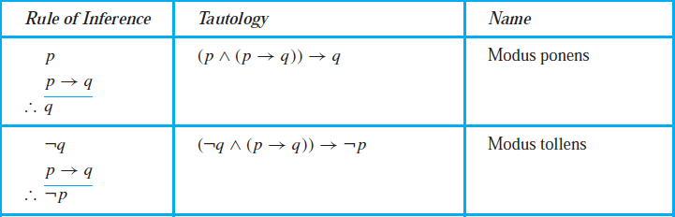

Step Reason
1. ￢p ∧ q Premise
2. ￢p Simplification using (1)
3. r → p Premise
4. ￢r Modus tollens using (2) and (3)
5. ￢r → s Premise
6. s Modus ponens using (4) and (5)
7. s → t Premise
8. t Modus ponens using (6) and (7)

Slide 21
Note that we could have used a truth table to show that whenever each of the four hypotheses is true, the conclusion is also true. However, because we are working with five propositional variables, p, q, r, s, and t , such a truth table would have 32 rows.

Slide 22
EXAMPLE 11 Show that the premises “If you send me an e-mail message, then I will finish writing the program,” “If you do not send me an e-mail message, then I will go to sleep early,” and “If I go to sleep early, then I will wake up feeling refreshed” lead to the conclusion “If I do not finish writing the program, then I will wake up feeling refreshed.”
Solution: Let p be the proposition “You send me an e-mail message,” q the proposition “I will finish writing the program,” r the proposition “I will go to sleep early,” and s the proposition “I Will wake up feeling refreshed.” Then the premises are p → q,￢p → r, and r → s. The desired conclusion is ￢q → s.We need to give a valid argument with premises p → q, ￢p → r, and r → s and conclusion ￢q → s. This argument form shows that the premises lead to the desired conclusion.

Slide 23
Step Reason
1. p → q Premise
2. ￢q →￢p Contrapositive of (1)
3. ￢p → r Premise
4. ￢q → r Hypothetical syllogism using (2) and (3)
5. r → s Premise
6. ￢q → s Hypothetical syllogism using (4) and (5)

Slide 24

EXAMPLE 12 Use resolution to show that the hypotheses “Jasmine is skiing or it is not snowing” and “It is snowing or Bart is playing hockey” imply that “Jasmine is skiing or Bart is playing hockey.”
Solution: Let p be the proposition “It is snowing,” q the proposition “Jasmine is skiing,” and r the proposition “Bart is playing hockey.”We can represent the hypotheses as ￢p ∨ q and p ∨ r, respectively. Using resolution, the proposition q ∨ r, “Jasmine is skiing or Bart is playing hockey,” follows.

Slide 25
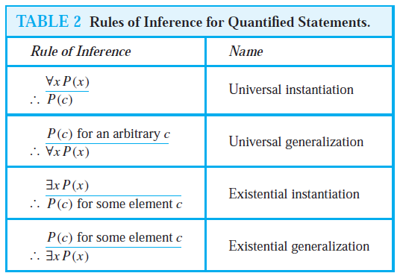
Rules of Inference for Quantified Statements
We have discussed rules of inference for propositions. We will nowdescribe some important rules of inference for statements involving quantifiers. These rules of inference are used extensively
in mathematical arguments, often without being explicitly mentioned.

Slide 26
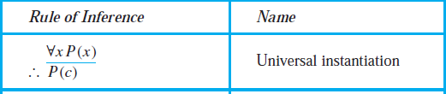
EXAMPLE 13 Show that the premises “Everyone in this discrete mathematics class has taken a course in computer science” and “Marla is a student in this class” imply the conclusion “Marla has taken a course in computer science.”
Solution: Let D(x) denote “x is in this discrete mathematics class,” and let C(x) denote “x has taken a course in computer science.” Then the premises are ∀x(D(x) → C(x)) and D(Marla). The conclusion is C(Marla). The following steps can be used to establish the conclusion from the premises.
Step Reason
1. ∀x(D(x) → C(x)) Premise
2. D(Marla)→C(Marla) Universal instantiation from (1)
3. D(Marla) Premise
4. C(Marla) Modus ponens from (2) and (3)

Slide 27
EXAMPLE 14: Show that the premises “A student in this class has not read the book,” and “Everyone in this class passed the first exam” imply the conclusion “Someone who passed the first exam has not read the book.”
Solution: Let C(x) be “x is in this class,” B(x) be “x has read the book,” and P(x) be “x passed the first exam.” The premises are ∃x(C(x)∧￢B(x)) and ∀x(C(x) → P(x)). The conclusion
is ∃x(P(x)∧￢B(x)). These steps can be used to establish the conclusion from the premises.
Step Reason
1. ∃x(C(x)∧￢B(x)) Premise
2. C(a)∧￢B(a) Existential instantiation from (1)
3. C(a) Simplification from (2)
4. ∀x(C(x) → P(x)) Premise
5. C(a) → P(a) Universal instantiation from (4)
6. P(a) Modus ponens from (3) and (5)
7. ￢B(a) Simplification from (2)
8. P(a)∧￢B(a) Conjunction from (6) and (7)
9. ∃x(P(x)∧￢B(x)) Existential generalization from (8)

Slide 28
Methods of Proving Theorems

Slide 29
Direct Proofs
A direct proof shows that a conditional statement p → q is true by showing that if p is true, then q must also be true, so that the combination p true and q false never occurs.
EXAMPLE 1 Give a direct proof of the theorem “If n is an odd integer, then n² is odd.”
By the definition of an odd integer, it follows that n = 2k + 1, where k is some integer. We want to show that n² is also odd. We can square both sides of the equation n = 2k + 1 to obtain a new equation that expresses n². When we do this, we find that n2 = (2k + 1)² = 4k2 + 4k + 1 = 2(2k² + 2k) + 1. By the definition of an odd integer, we can conclude that n² is an odd integer (it is one more than twice an integer). Consequently, we have proved that if n is an odd integer, then n² is an odd integer.

Slide 30
Proof by contraposition
Proofs by contraposition make use of the fact that the conditional statement p → q is equivalent to its contrapositive, ￢q →￢p. This means that the conditional statement p → q can be proved by
showing that its contrapositive, ￢q →￢p, is true.

Slide 31
EXAMPLE 2 Prove that if n is an integer and 3n + 2 is odd, then n is odd.
Solution: The first step in a proof by contraposition is to assume that the conclusion of the conditional statement “If 3n + 2 is odd, then n is odd” is false; namely, assume that n is even. Then, by the definition of an even integer, n = 2k for some integer k. Substituting 2k for n, we find that 3n + 2 = 3(2k) + 2 = 6k + 2 = 2(3k + 1). This tells us that 3n + 2 is even (because it is a multiple of 2), and therefore not odd. This is the negation of the premise of the theorem. Because the negation of the conclusion of the conditional statement implies that the hypothesis is false, the original conditional statement is true. Our proof by contraposition succeeded; we have proved the theorem “If 3n + 2 is odd, then n is odd.”

Slide 32
Proofs by Contradiction
Suppose we want to prove that a statement p is true. we can conclude that ￢p is false, which means that p is true.

Slide 33
Example-3
Prove that √2 is irrational by giving a proof by contradiction.
Solution: To start a proof by contradiction, we suppose that ￢p is true. Note that ￢p is the statement “It is not the case that √2 is irrational,” which says that √2 is rational. If √2 is rational, there exist integers a and b with √2 = a/b, where b ≠ 0 and a and b have no common factors (so that the fraction a/b is in lowest terms.) (Here, we are using the fact that every rational number can be written in lowest terms.)

Slide 34
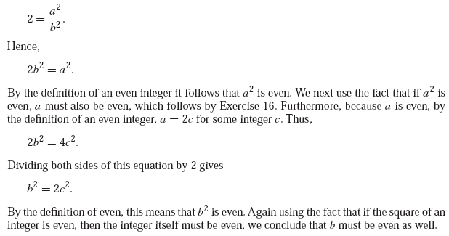

Slide 35
Note that the statement that √2 = a/b, where a and b have no common factors, means, in particular, that 2 does not divide both a and b. Because our assumption of ￢p leads to the contradiction that 2 divides both a and b and 2 does not divide both a and b, ￢p must be false. That is, the statement p, “√2 is irrational,” is true. We have proved that √2 is irrational.

Slide 36
EXHAUSTIVEPROOF Some theorems can be proved by examining a relatively small number of examples. Such proofs are called exhaustive proofs, or proofs by exhaustion because these proofs proceed by exhausting all possibilities. An exhaustive proof is a special type of proof by cases where each case involves checking a single example. We now provide some illustrations of exhaustive proofs.
EXAMPLE 1 Prove that (n + 1)³ ≥ 3^{n} if n is a positive integer with n ≤ 4.
Solution: We use a proof by exhaustion. We only need verify the inequality (n + 1)³ ≥ 3^{n} when n = 1, 2, 3, and 4. For n = 1, we have (n + 1)³ = 2³ = 8 and 3^{n} = 3¹ = 3; for n = 2, we have (n + 1)³ = 3³ = 27 and 3^{n} = 3² = 9; for n = 3, we have (n + 1)³ = 4³ = 64 and 3^{n} = 3³ = 27; and for n = 4, we have (n + 1)³ = 5³ = 125 and 3^{n} = 3⁴ = 81. In each of
these four cases, we see that (n + 1)³ ≥ 3^{n}. We have used the method of exhaustion to prove that (n + 1)³ ≥ 3^{n} if n is a positive integer with n ≤ 4.

