Slide 1
Graph and Tree

Slide 2
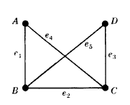
Basic Definitions
A graph G = (V ,E) consists of V , a nonempty set of vertices (or nodes) and E, a set of edges. Each edge has either one or two vertices associated with it, called its endpoints. An edge is said to connect its endpoints.
(i) V consists of vertices A, B, C, D. Therefore V={A, B, C, D}
(ii) E consists of edges e₁ = {A,B}, e₂ = {B,C}, e₃ = {C,D}, e₄ = {A,C}, e₅ = {B,D}.

Slide 3
A graph in which each edge connects two different vertices and where no two edges connect the same pair of vertices is called a simple graph.
graphs that have more than one edge connecting the same pair of vertices. Graphs that may have multiple edges connecting the same vertices are called multigraphs.
Graphs that may include loops, and possibly multiple edges connecting the same pair of vertices or a vertex to itself, are sometimes called pseudographs.

Slide 4
A directed graph (or digraph) (V ,E) consists of a nonempty set of vertices V and a set of directed edges (or arcs) E. Each directed edge is associated with an ordered pair of vertices. The directed edge associated with the ordered pair (u, v) is said to start at u and end at v.
When a directed graph has no loops and has no multiple directed edges, it is called a simple directed graph.
Directed graphs that may have multiple directed edges from a vertex to a second (possibly the same) vertex are used to model such networks. We called such graphs directed multigraphs.

Slide 5
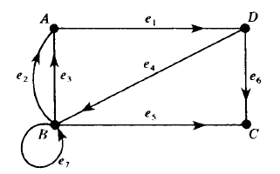
Consider the directed graph G pictured in Fig. below. It consists of four vertices, A, B, C, D, that is, V (G) = {A,B,C,D} and the seven following edges:
E(G) = {e₁, e₂, . . . , e₇} = {(A,D), (B, A), (B, A), (D,B), (B,C), (D,C), (B, B)}
The edges e₂ and e₃ are said to be parallel since they both begin at B and end at A. The edge e₇ is a loop since it begins and ends at B.

Slide 6
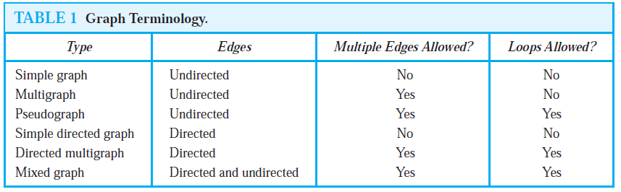

Slide 7
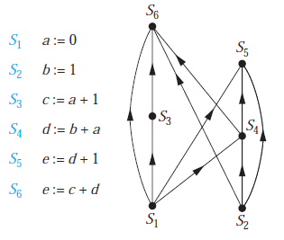
Precedence Graphs
Computer programs can be executed more rapidly by executing certain statements concurrently. It is important not to execute a statement that requires results of statements not yet executed. The dependence of statements on previous statements can be represented by a directed graph. Each statement is represented by a vertex, and there is an edge from one statement to a second statement if the second statement cannot be executed before the first statement. This resulting graph is called a precedence graph.
Example-1

Slide 8
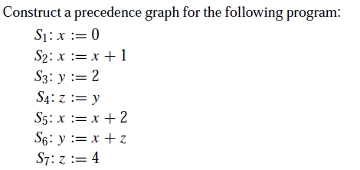
Ex-1

Slide 9
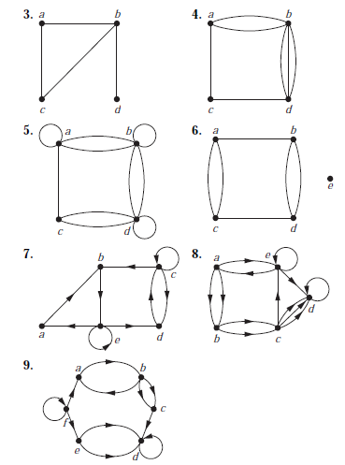
Exercises-2
determine whether the graph shown has directed or undirected edges, whether it has multiple edges, and whether it has one or more loops. Use your answers to determine the type of graph in Table 1 this graph is.

Slide 10
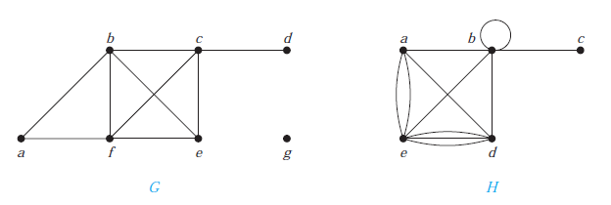
The degree of a vertex in an undirected graph is the number of edges incident with it, except that a loop at a vertex contributes twice to the degree of that vertex. The degree of the vertex v is denoted by deg(v).
Example-2
What are the degrees of the vertices in the graphs G and H displayed in Figure 1?
Solution: In G, deg(a) = 2, deg(b) = deg(c) = deg(f ) = 4, deg(d ) = 1, deg(e) = 3, and deg(g) = 0. H, deg(a) = 4, deg(b) = deg(e) = 6, deg(c) = 1, and deg(d ) = 5.

Slide 11
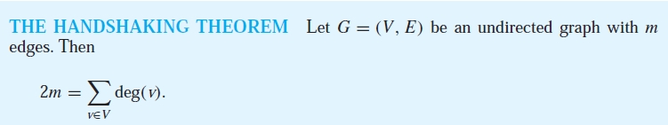
EXAMPLE 3
How many edges are there in a graph with 10 vertices each of degree six?
Solution: Because the sum of the degrees of the vertices is 6 ・ 10 = 60, it follows that 2m = 60 where m is the number of edges. Therefore, m = 30.

Slide 12
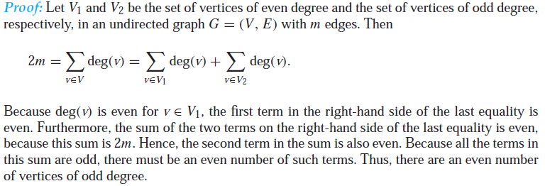
Theorem
An undirected graph has an even number of vertices of odd degree.

Slide 13
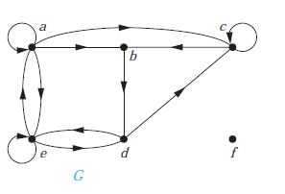
In a graph with directed edges the in-degree of a vertex v, denoted by deg⁻(v), is the number of edges with v as their terminal vertex. The out-degree of v, denoted by deg⁺(v), is the number of edges with v as their initial vertex. (Note that a loop at a vertex contributes 1 to both the in-degree and the out-degree of this vertex.)
EXAMPLE 4 Find the in-degree and out-degree of each vertex in the graph G with directed edges shown in Figure 2.
Solution: The in-degrees in G are deg⁻(a) = 2, deg⁻(b) = 2, deg⁻(c) = 3, deg⁻(d) = 2, deg⁻(e) = 3,
and deg⁻(f ) = 0.
The out-degrees are deg⁺(a) = 4, deg⁺(b) = 1, deg⁺(c) = 2,deg⁺(d) = 2, deg⁺(e) = 3, and deg⁺(f ) = 0.

Slide 14
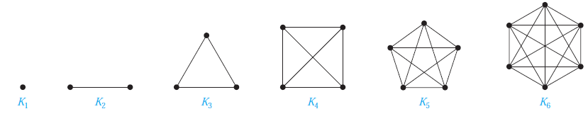
Some Special Simple Graphs
Complete Graphs
A complete graph on n vertices, denoted by Kn, is a simple graph that contains exactly one edge between each pair of distinct vertices. The graphs K_{n}, for n = 1, 2, 3, 4, 5, 6, are displayed in Figure below. A simple graph for which there is at least one pair of distinct vertex not connected by an edge is called noncomplete.

Slide 15
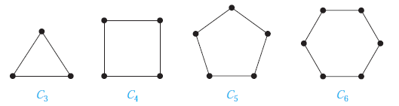
Cycles
A cycle C_{n}, n ≥ 3, consists of n vertices v₁, v₂, . . . , v_{n} and edges {v₁, v₂}, {v₂, v₃}, . . . , {v_{n−1}, v_{n}}, and {v_{n}, v₁}. The cycles C₃, C₄, C₅, and C₆ are displayed in Figure below.

Slide 16
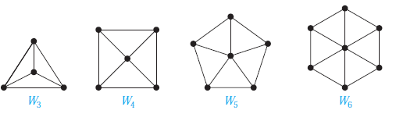
Wheels
We obtain a wheel W_{n} when we add an additional vertex to a cycle C_{n}, for n ≥ 3, and connect this new vertex to each of the n vertices in C_{n}, by new edges. The wheels W₃, W₄, W₅, and W₆ are displayed in Figure below.

Slide 17
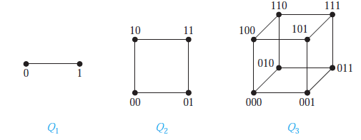
n-Cubes
An n-dimensional hypercube, or n-cube, denoted by Q_{n}, is a graph that has vertices representing the 2^{n} bit strings of length n. Two vertices are adjacent if and only if the bit strings that they represent differ in exactly one bit position. We display Q₁, Q₂, and Q₃ in Figure below.

Slide 18
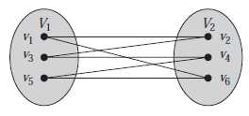
Bipartite
A simple graph G is called bipartite if its vertex set V can be partitioned into two disjoint sets V₁ and V₂ such that every edge in the graph connects a vertex in V₁ and a vertex in V₂ (so that no edge in G connects either two vertices in V₁ or two vertices in V₂). When this condition holds, we call the pair (V₁, V₂) a bipartition of the vertex set V of G.

Slide 19
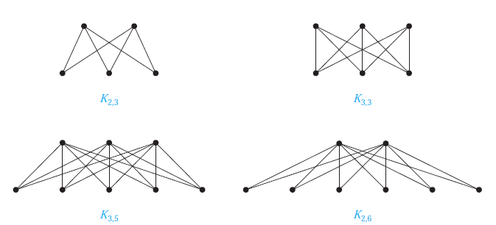
Complete Bipartite Graphs
A complete bipartite graph K_{m,n} is a graph that has its vertex set partitioned into two subsets of m and n vertices, respectively with an edge between two vertices if and only if one vertex is in the first subset and the other vertex is in the second subset. The complete bipartite graphs K_{2,3}, K_{3,3}, K_{3,5}, and K_{2,6} are displayed in Figure below.

Slide 20
A path or circuit of a graph is simple if it does not contain the same edge more than once.

Slide 21
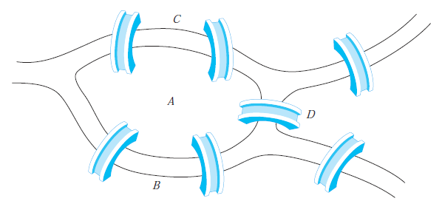
Euler Paths and Circuits
The town of Königsberg, Prussia (now called Kaliningrad and part of the Russian republic), was divided into four sections by the branches of the Pregel River.
The townspeople took long walks through town on Sundays. They wondered whether it was possible to start at some location in the town, travel across all the bridges once without crossing any bridge twice, and return to the starting point. The Swiss mathematician Leonhard Euler solved this problem.

Slide 22
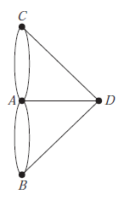
Euler studied this problem using the multigraph obtained when the four regions are represented by vertices and the bridges by edges. This multigraph is shown in Figure below.
The question becomes: Is there a simple circuit in this multigraph that contains every edge?

Slide 23
An Euler circuit in a graph G is a simple circuit containing every edge of G. An Euler path in G is a simple path containing every edge of G.
Theorem
A connected multigraph with at least two vertices has an Euler circuit if and only if each of its vertices has even degree.
Theorem
A connected multigraph has an Euler path but not an Euler circuit if and only if it has exactly two vertices of odd degree.

Slide 24
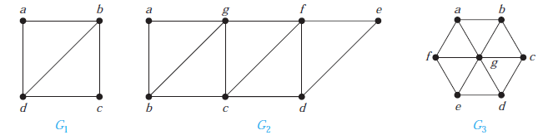
EXAMPLE 4
Which graphs shown in Figure below have an Euler path?
Solution:G₁ contains exactly two vertices of odd degree, namely, b and d. Hence, it has an Euler path that must have b and d as its endpoints. One such Euler path is d, a, b, c, d, b. Similarly,G₂ has exactly two vertices of odd degree, namely, b and d. So it has an Euler path that must have b and d as endpoints. One such Euler path is b, a, g, f, e, d, c, g, b, c, f, d. G3 has no Euler path because it has six vertices of odd degree.

Slide 25
Hamilton Paths and Circuits
A simple path in a graph G that passes through every vertex exactly once is called a Hamilton path, and a simple circuit in a graph G that passes through every vertex exactly once is called a Hamilton circuit.
DIRAC’S THEOREM
If G is a simple graph with n vertices with n ≥ 3 such that the degree of every vertex in G is at least n/2, then G has a Hamilton circuit.

Slide 26
TREE
A tree is a connected undirected graph with no simple circuits.
A rooted tree is a tree in which one vertex has been designated as the root and every edge is directed away from the root.

Slide 27
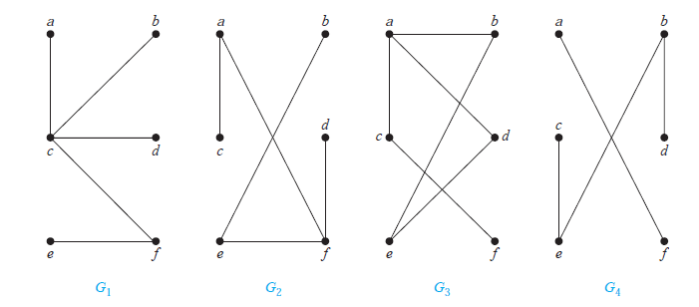
EXAMPLE 1
Which of the graphs shown in Figure below are trees?
Solution: G₁ and G₂ are trees, because both are connected graphs with no simple circuits. G₃ is not a tree because e, b, a, d, e is a simple circuit in this graph. Finally, G₄ is not a tree because it is not connected.

Slide 28
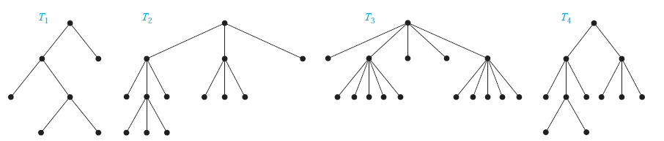
A rooted tree is called an m-ary tree if every internal vertex has no more than m children. The tree is called a full m-ary tree if every internal vertex has exactly m children. An m-ary tree with m = 2 is called a binary tree.
EXAMPLE 2
Are the rooted trees in Figure below full m-ary trees for some positive integer m?
Solution: T1 is a full binary tree because each of its internal vertices has two children. T2 is a full 3-ary tree because each of its internal vertices has three children. In T3 each internal vertex has five children, so T3 is a full 5-ary tree. T4 is not a full m-ary tree for any m because some of its internal vertices have two children and others have three children.

Slide 29
THEOREM
A full m-ary tree with i internal vertices contains n = mi + 1 vertices.
Proof:
Every vertex, except the root, is the child of an internal vertex. Because each of the i internal vertices has m children, there are mi vertices in the tree other than the root. Therefore, the tree contains n = mi + 1 vertices.

Slide 30
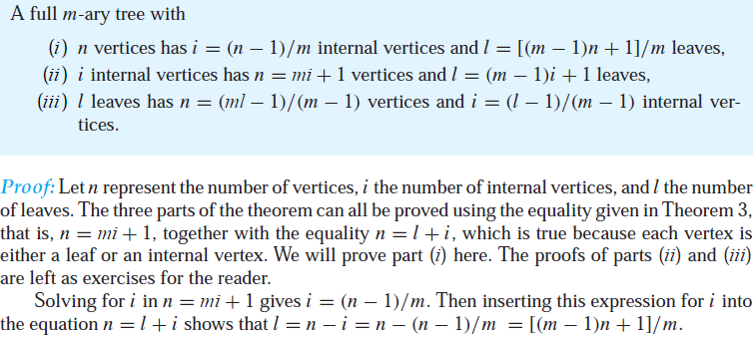
THEOREM

Slide 31
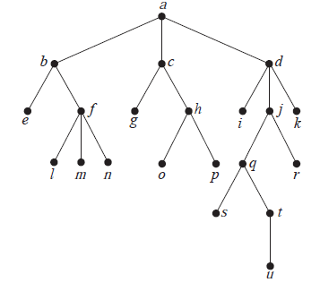
Example-3
a) Which vertex is the root?
b) Which vertices are internal?
c) Which vertices are leaves?
d) Which vertices are children of j?
e) Which vertex is the parent of h?
f ) Which vertices are siblings of o?
g) Which vertices are ancestors of m?
h) Which vertices are descendants of b?
3. a) a
b) a, b, c, d, f , h, j , q, t
c) e, g, i, k,l,m, n, o, p, r, s, u
d) q, r
e) c f) p g) f , b, a h) e, f , l,m, n

Slide 32
Example-4
How many edges does a tree with 10,000 vertices have?
Ans. e = v-1 = 9999
Example-5
Suppose 1000 people enter a chess tournament. Use a rooted tree model of the tournament to determine how many games must be played to determine a champion, if a player is eliminated after one loss and games are played until only one entrant has not lost.
Ans. The number of players =1000 = number of leaves of full binary tree.
The number of games = the number of internal vertices,
i = (l-1)/(m-1) = (1000-1)/(2-1) = 999

Slide 33
Example-6
How many vertices does a full 5-ary tree with 100 internal
vertices have?
Ans. Given, m = 5 and i =100.
For full m-ary tree, v = mi + 1 = 5 × 100 + 1 = 501.
Example-7
How many edges does a full binary tree with 1000 internal
vertices have?
Ans. m = 2, i =1000
v = mi + 1= 2001
e = v - 1 = 2000

Slide 34
Example-8
How many leaves does a full 3-ary tree with 100 vertices have?
m = 3, v = 100
l ={(m-1)v+1}/m = {(3-1) × 100 + 1}/3 = 201/3 = 67
A complete m-ary tree is a full m-ary tree in which every leaf is at the same level.

Slide 35
Example-9
How many vertices and how many leaves does a complete
m-ary tree of height h have?
Ans. The number of leaves = m^{h}
The number of vertices,
1 + m + m² + m³ +… … … + m^{h} = 1 × (m^{h+1}-1)/(m-1)
Example-10
How many edges are there in a forest of t trees containing
a total of n vertices?
Ans. n-t

Slide 36
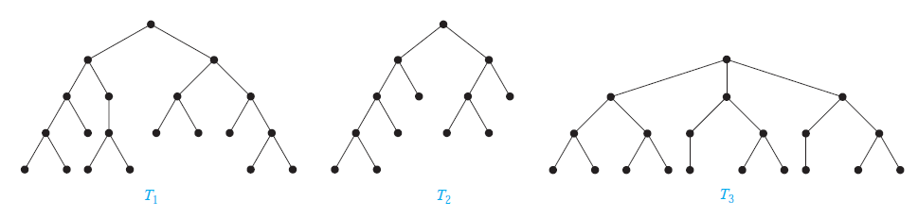
A rooted m-ary tree of height h is balanced if all leaves are at levels h or h − 1.
Example-11
Which of the rooted trees shown in Figure 14 are balanced?
Solution: T1 is balanced, because all its leaves are at levels 3 and 4. However, T2 is not balanced, because it has leaves at levels 2, 3, and 4. Finally, T3 is balanced, because all its leaves are at
level 3.

Slide 37
Tree Traversal
Procedures for systematically visiting every vertex of an ordered rooted tree are called traversal algorithms. We will describe three of the most commonly used such algorithms, preorder traversal, inorder traversal, and postorder traversal
Preorder traversal
Let T be an ordered rooted tree with root r. If T consists only of r, then r is the preorder traversal of T . Otherwise, suppose that T1, T2, . . . , Tn are the subtrees at r from left to right in T . The preorder traversal begins by visiting r. It continues by traversing T1 in preorder, then T2 in preorder, and so on, until Tn is traversed in preorder.

Slide 38
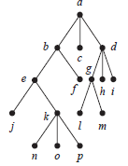
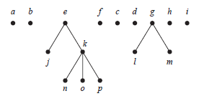
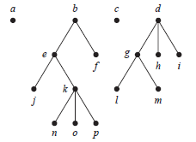


Slide 39
Inorder traversal
Let T be an ordered rooted tree with root r. If T consists only of r, then r is the inorder traversal of T . Otherwise, suppose that T1, T2, . . . , Tn are the subtrees at r from left to right. The inorder traversal begins by traversing T1 in inorder, then visiting r. It continues by traversing T2 in inorder, then T3 in inorder, . . . , and finally Tn in inorder.

Slide 40
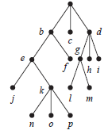
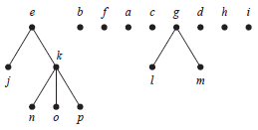
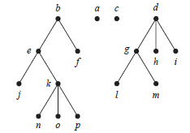


Slide 41
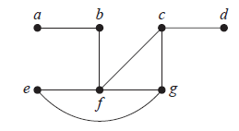
Spanning Trees
Let G be a simple graph. A spanning tree of G is a subgraph of G that is a tree containing every vertex of G.
Example-12
Find a spanning tree of the simple graph G shown in Figure below.

Slide 42
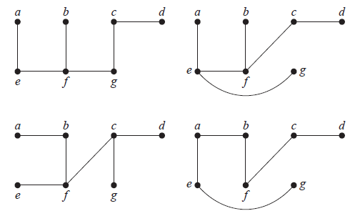
Ans. Some possible spanning tress are shown below

Slide 43
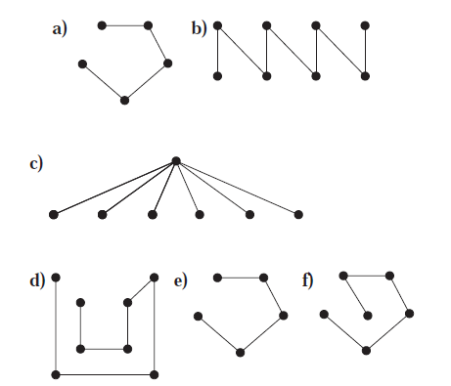
Example-13
Find a spanning tree for each of these graphs.
a) K₅ b) K_{4,4} c) K_{1,6} d) Q₃ e) C₅ f ) W₅

Slide 44
A minimum spanning tree in a connected weighted graph is a spanning tree that has the smallest possible sum of weights of its edges.
Prim’s Algorithm of minimum spanning tree
procedure Prim(G: weighted connected undirected graph with n vertices)
T := a minimum-weight edge
for i := 1 to n − 2
e := an edge of minimum weight incident to a vertex in T and not forming a
simple circuit in T if added to T
T := T with e added
return T {T is a minimum spanning tree of G}

Slide 45
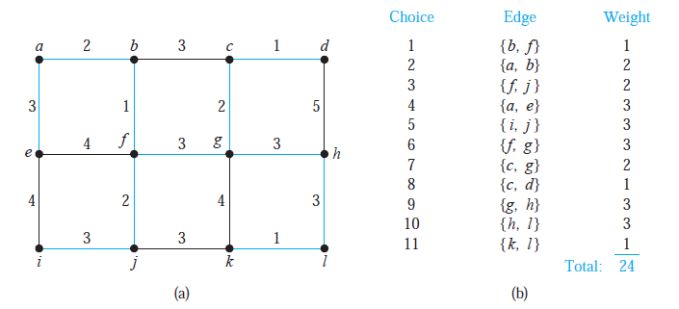
Example-14
Use Prim’s algorithm to find a minimum spanning tree in the graph shown in Figure 3.

Slide 46
Kruskal’s Algorithm of minimum spanning tree
procedure Kruskal(G: weighted connected undirected graph with n vertices)
T := empty graph
for i := 1 to n − 1
e := any edge in G with smallest weight that does not form a simple circuit
when added to T
T := T with e added
return T {T is a minimum spanning tree of G}

Slide 47
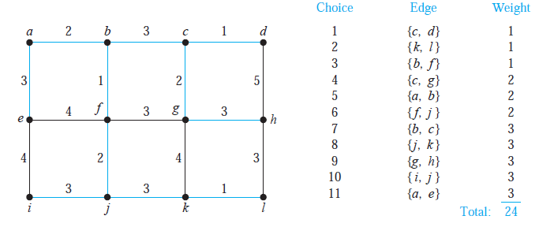
Example-15
Use Kruskal’s algorithm to find a minimum spanning tree in the weighted graph.

