Slide 1
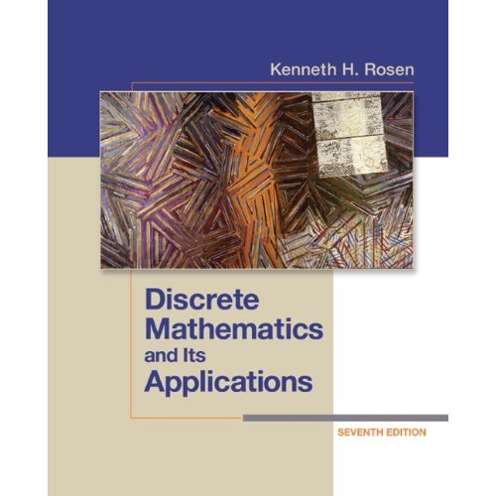
Textbook
Discrete Mathematics and Its Applications
by Kenneth H. Rosen, 7th edition, McGraw Hill

Slide 2
1.1 Propositional logic
Understand and construct correct mathematical arguments
Give precise meaning to mathematical statements
Rules are used to distinguish between valid (true) and invalid arguments
Used in numerous applications: circuit design, programs, verification of correctness of programs, artificial intelligence, etc.

Slide 3
Proposition
A declarative sentence that is either true or false, but not both.
Washington, D.C., is the capital of USA (Y)
1+1=2 (Y)
2+2=5 (F)
What time is it? (F)
Read this carefully (F)
x+y=2 (F)

Slide 4
Logical operators
Negation operator
Conjunction (and, ^)
Disjunction (or v )
Conditional statement →
Biconditional statement ←→
Exclusive Or

Slide 5
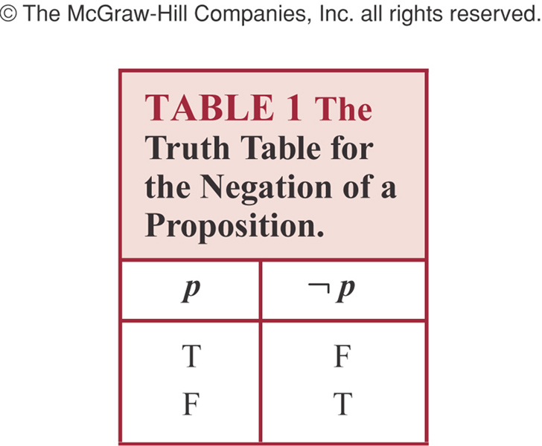
Negation

Slide 6
Example
“Today is Friday”
It is not the case that today is Friday
Today is not Friday
At least 10 inches of rain fell today in Miami
It is not the case that at least 10 inches of rain fell today in Miami
Less than 10 inches of rain fell today in Miami

Slide 7
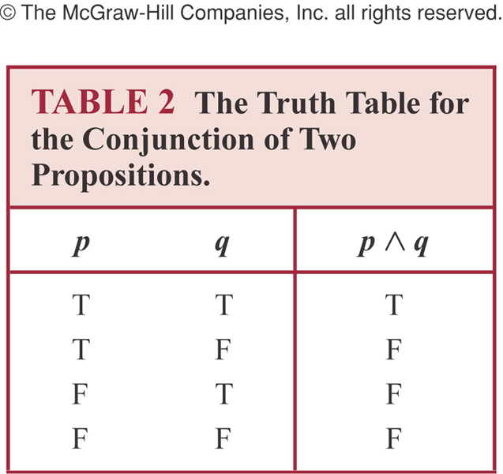
Conjunction
Conjunction: p ^ q is true when both p and q are true. False otherwise

Slide 8
Example
p: “Today is Friday”, q: “It is raining today”
p˄q “Today is Friday and it is raining today”
true: on rainy Fridays
false otherwise:
Any day that is not a Friday
Fridays when it does not rain

Slide 9

Disjunction
Disjunction: p v q is false when both p and q are false. True otherwise

Slide 10
Example
p ˅ q: “Today is Friday or it is raining today”
True:
Today is Friday
It is raining today
It is a rainy Friday
False
Today is not Friday and it does not rain
This is called→ INCLUSIVE OR

Slide 11
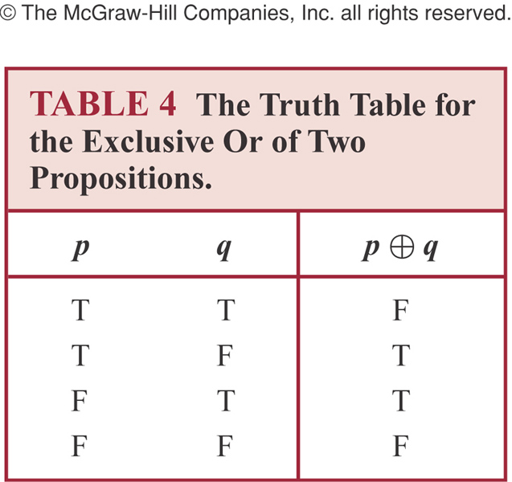

Exclusive or
Exclusive Or is true when exactly one
of p, q is true. False otherwise

Slide 12
INCLUSIVE Vs EXCLUSIVE OR

Slide 13
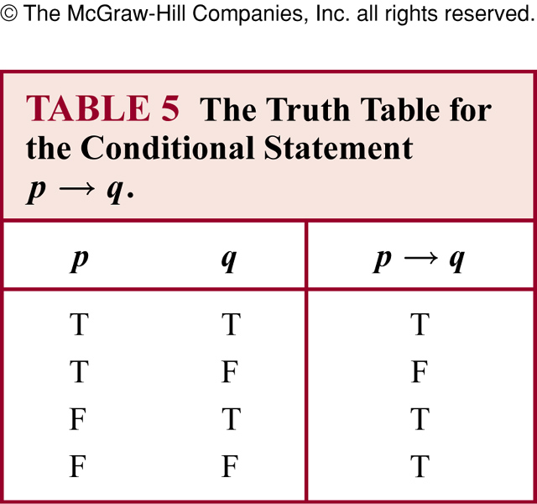
Conditional statement
Conditional Statement:
p is called the premise (or antecedent) and q is called the conclusion (or consequent)
p→ q is false when p is true and q is false. True otherwise

Slide 14
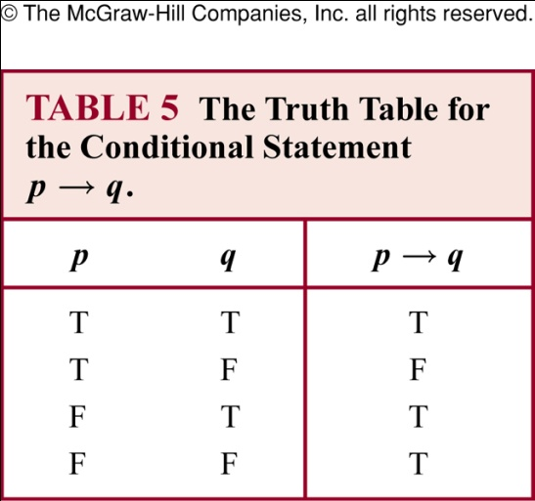
Conditional statement p→q
Also called an implication
if p, then q | p implies q
if p, q | p only if q
p is sufficient for q | a sufficient condition for q is p
q if p | q whenever p
q when p | q is necessary for p
a necessary condition for p is q q unless ┐ p Conditional Statement: p→q is false when p is true and q is false. True otherwise. | q follows from p

Slide 15
Sufficiency VS. Necessity
ANY IDEA?

Slide 16
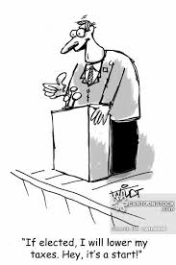
Example
ELECTED | LOWER TAXES | RESULT
T | T | T
T | F | F
F | ___ (T) | T
F | ___(F) | T

Slide 17
p→q
p only if q:
p cannot be true when q is not true
The statement is false if p is true but q is false
When p is false, q may be either true or false
Not to use “q only if p” to express p→q
q unless ┐ p
If ┐ p is false, then q must be true
The statement is false when p is true but q is false, but the statement is true otherwise

Slide 18
Example
If Maria learns discrete mathematics, then she will find a good job
Maria will find a good job when she learns discrete mathematics (q when p)
For Maria to get a good job, it is sufficient for her to learn discrete mathematics (sufficient condition for q is p)
Maria will find a good job unless she does not learn discrete mathematics (q unless not p)

Slide 19
Common mistake for p→q
Correct: p only if q
Mistake to think “q only if p”

Slide 20
Example
“If today is Friday, then 2+3=6”
The statement is true every day except Friday even though 2+3=6 is false

Slide 21
Converse, contrapositive and inverse
For conditional statement p→ q
Converse: q→ p
Contrapositive: ┐q → ┐ p
Inverse: ┐p → ┐ q
Contrapositive and conditional statements are equivalent (same truth value)
This is not true for Converse & Inverse

Slide 22
EXAMPLE:
The home team wins whenever it is raining
???

Slide 23
Example (Contd)
Converse: If the home team wins, then it is raining

Slide 24
Example(Contd.)
Contrapositive: If the home team does not win, then it is not raining.”

Slide 25
Example(Contd.)
Inverse: If it is not raining, then the home team does not win

Slide 26
Another Example
If you were Bill Gates, you would have had“কুটি কুটি টাকা”
What are he converse, contrapositive & inverse of above statement?

Slide 27
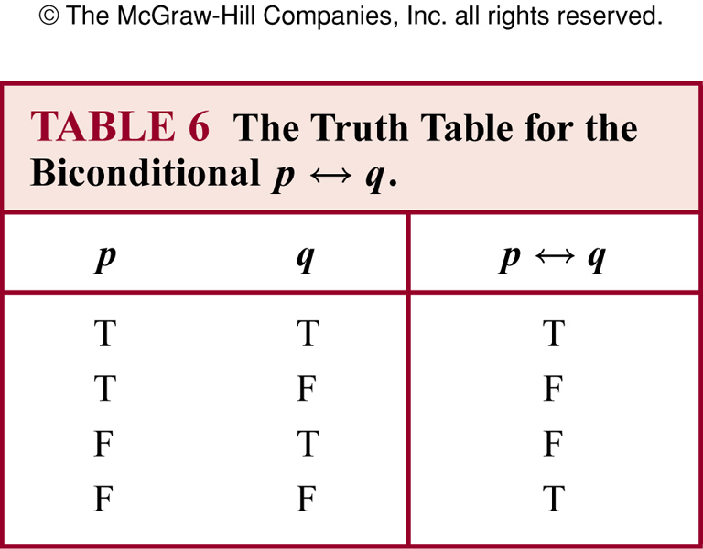
Biconditional statement
Biconditional Statement: “p if and only if q”
p ←→ q is true when p, q have the same truth value. False otherwise
Also known as bi-implications

Slide 28
Example
P: “you can take the flight”, q: “you buy a ticket”
P ←→ q: “You can take the flight if and only if you buy a ticket”
This statement is true
If you buy a ticket and take the flight
If you do not buy a ticket and you cannot take the flight

Slide 29
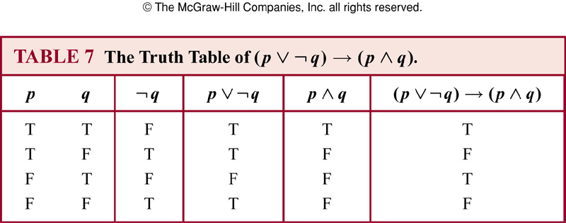
Truth table of compound propositions

Slide 30
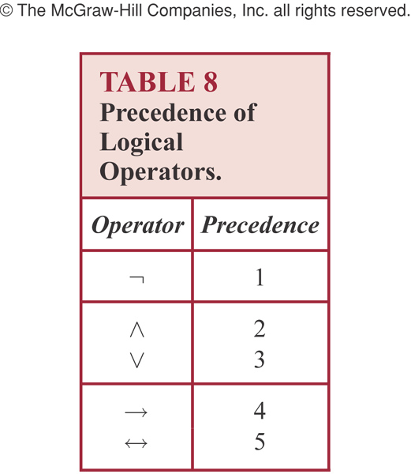
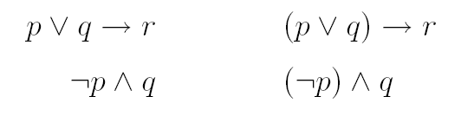
Precedence of logic operators

Slide 31
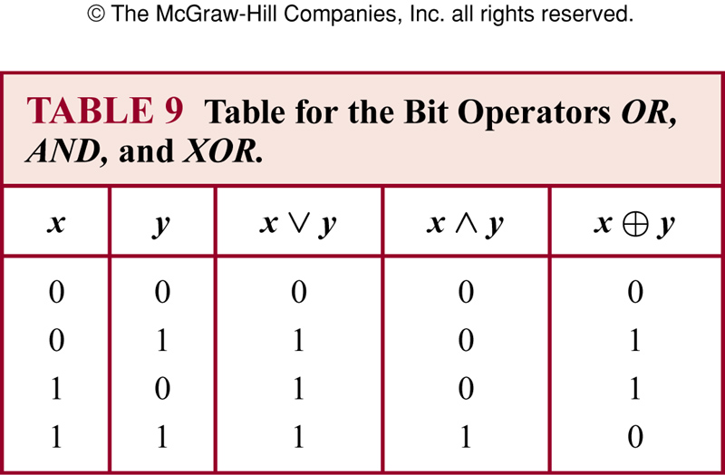
Bit operations

Slide 32
1.2 Translating English to logical expressions
Why?
English is often ambiguous and translating sentences into compound propositions removes the ambiguity
Using logical expressions, we can analyze them and determine their truth values
We can use rules of inferences to reason about them

Slide 33
Example
“ You can access the internet from campus only if you are a computer science major or you are not a freshman.
p : “You can access the internet from campus”
q : “You are a computer science major”
r : “You are freshmen”
p → ( q v ┐r )

Slide 34
System specification
Translating sentences in natural language into logical expressions is an essential part of specifying both hardware and software systems.
Consistency of system specification.
Example: Express the specification “The automated reply cannot be sent when the file system is full”

Slide 35

Example
Let p denote “The automated reply can be sent”
Let q denote “The file system is full”
The logical expression for the sentence “The automated reply cannot be sent when the file system is full” is

Slide 36
Example
Determine whether these system specifications are consistent:
1. The diagnostic message is stored in the buffer or it is retransmitted.
2. The diagnostic message is not stored in the buffer.
3. If the diagnostic message is stored in the buffer, then it is retransmitted.

Slide 37
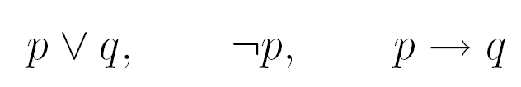
Example
Let p denote “The diagnostic message is stored in the buffer”
Let q denote “The diagnostic message is retransmitted”
The three specifications are

Slide 38
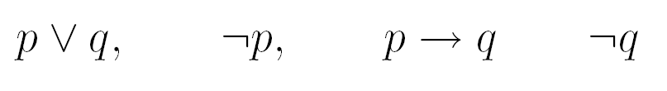
Example
If we add one more requirement “The diagnostic message is not retransmitted”
The new specifications now are
This is inconsistent! No truth values of p and q will make all the above statements true

Slide 39
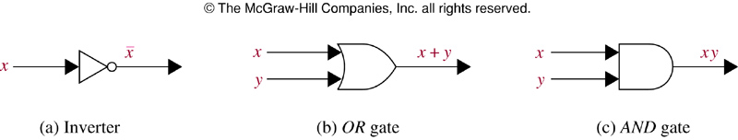
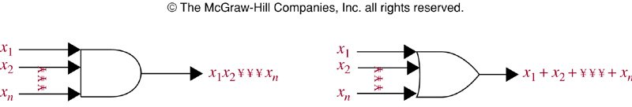
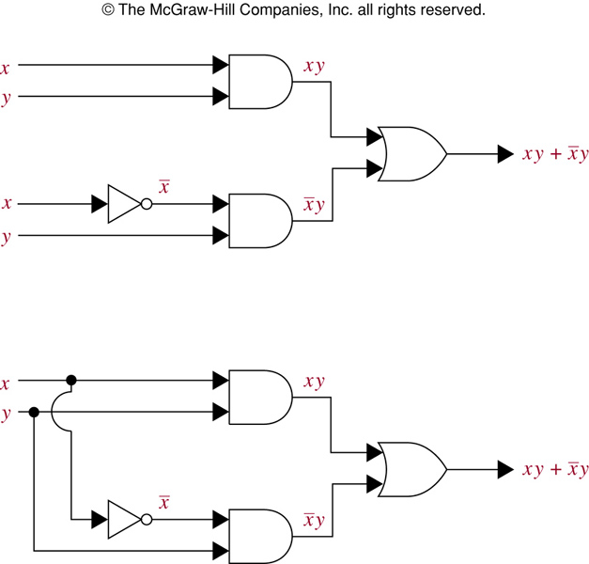
Logic gates
Courtesy
Ming-Hsuan Yang from University of California at Merced

