Slide 1
RELATION

Slide 2


Slide 3
Relation: সম্পর্ক, যেকোনো একটা সূত্র/নিয়ম/ rule মেনে যে সম্পর্ক তৈরী হয়।
Example: marital relation, square relation, < relation………
(a,b) : a is related to b

Slide 4
aRb=bRa-- always true/ always false/may or may not be true ???
aRb→bRa-- always true/ always false/may or may not be true ???
(remember → sign?)

Slide 5
Schaum’s (pg:24)+lecture
PRODUCT SETS R² = R × R denotes the usual 2-D space
Relation= subset of product set

Slide 6
Example of Relation
(1) Relation ≤ (less than or equal) on the set Z of integers.
(2) Set inclusion ⊆ on a collection C of sets.
(3) Relation ⊥ (perpendicular) on the set L of lines in the plane.
(4) Relation || (parallel) on the set L of lines in the plane.
(5) Relation | of divisibility on the set N of positive integers. (Recall x |y if there exists z such that x.z = y.)

Slide 7
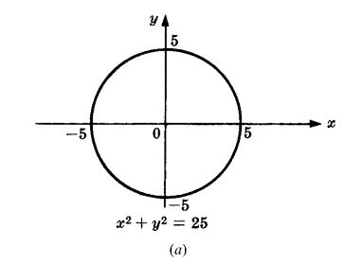
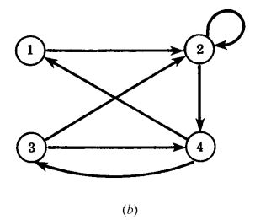
Pictorial example of Relation
(a) Relation on Infinite Set (b) Relation on Finite Set

Slide 8
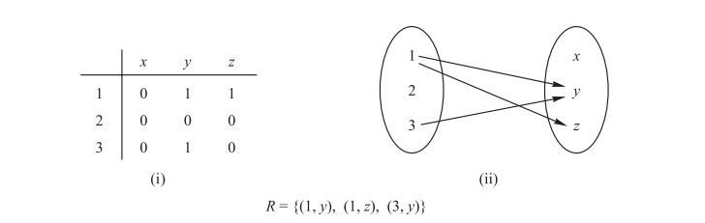
Contd…

Slide 9
Inverse Relation
R = {(1, y), (1, z), (3, y)}
R⁻¹ = {(y, 1), (z, 1), (y, 3)}

Slide 10
2.5 COMPOSITION OF RELATIONS (Schaum’s +lecture)
Remember “fog” “gof” from chapter “ফাঙ্কশন” (SSC, HSC) ?
They were composition of FUNCTIONS, similar idea is composition of RELATIONS.

Slide 11
Remember: AxB, BxA→ এগুলো set এ করে।
RoS, SoR→ এগুলো relation এ করে।
For set A: AxA= A²
For relation R: RoR= R²

Slide 12
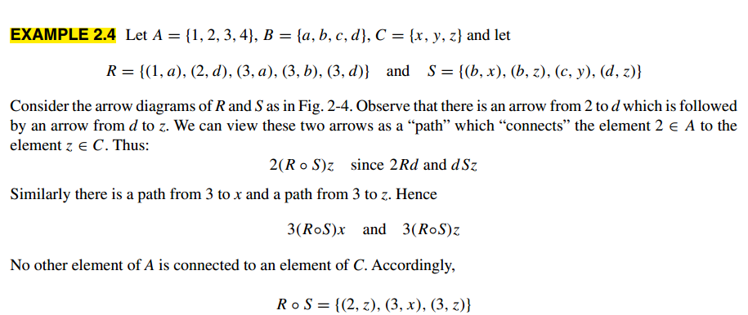
Composition of Relations (contd..)

Slide 13
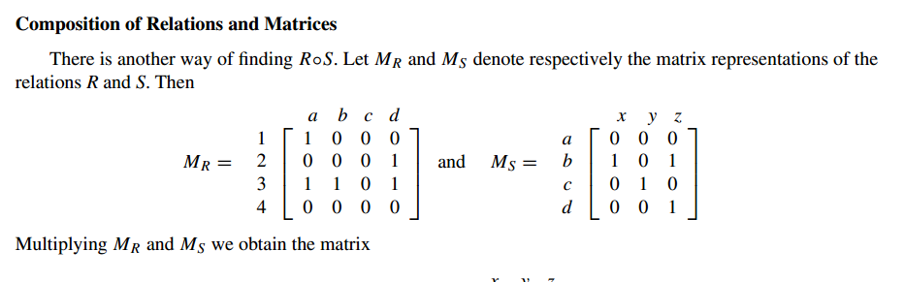
Can we do the same thing using matrix representation of relations?

Slide 14
2.6 TYPES OF RELATIONS (Schaum’s+Lecture)
We will discuss 3 types of relations:
1)Reflexive
2) Symmetric & Antisymmetric
3)Transitive

Slide 15
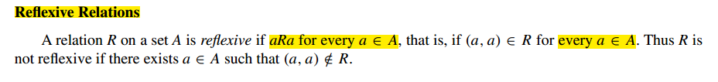
1) Reflexive Relation
নিজের সাথে নিজের যে relation
প্রত্যেক element এর জন্য (আমি,আমি) pair থাকতে হবে→তাহলেই reflexive হবে।

Slide 16
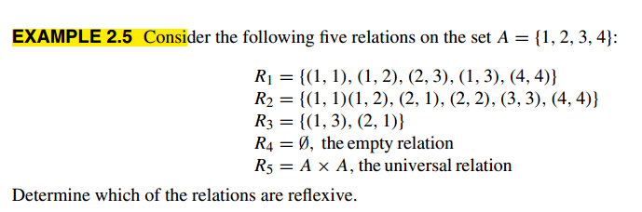
Check this

Slide 17
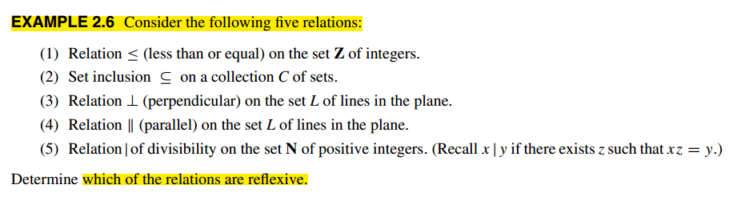
Check this again

Slide 18
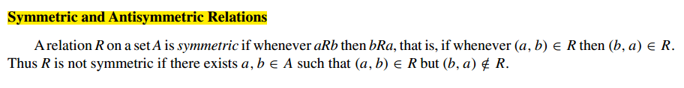
2) Symmetric & Antisymmetric Relations

Slide 19
Check this
Go to previous examples & check which of those are symmetric, which are antisymmetric
Are being symmetric and being antisymmetric negatives of each other?? (bonus 3 marks for proper explanation, 5 for explanation with examples ☺ )

Slide 20
Answer (1)
The relation ⊥ is symmetric since if line a is perpendicular to line b then b is perpendicular to a. Also,|| is symmetric since if line a is parallel to line b then b is parallel to line a. The other relations are not symmetric.

Slide 21
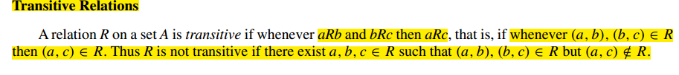
3) Transitive Relation
Check previous examples again for transitivity

Slide 22
Answer
The relations ≤, ⊆, and | are transitive.
⊥ is not.
And, parallel || ???

Slide 23
According to Euclidian Geometry no line is parallel to itself. So, what’s about transitivity?
Relation “parallel or equal to”– is it transitive?
(bonus 2+1)

Slide 24
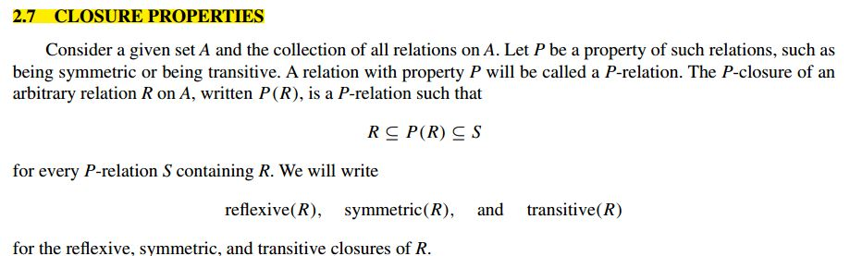
Closure
কিছু বুঝা যায়???

Slide 25
Closure
সর্বনিম্ন কীকী element add করে *অমুক* property টা নিয়ে আসা যায়– এটা চিন্তা করলেই হবে।
*অমুক* property= being reflexive/ transitive/ symmetric.

Slide 26
Example (Reflexive Closure)

Slide 27
Symmetric Closure
আর কাকে কাকে add করলে relation টা symmetric হবে।
Example: R={(1,2), (3,4)}
Symm(R)= ?
Can you tell the general rule?

Slide 28
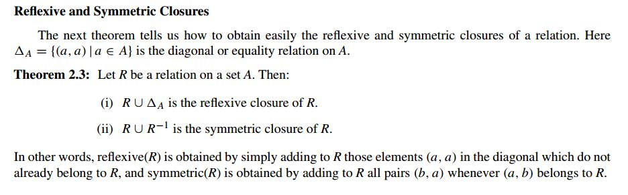
General Rule

Slide 29
Transitive Closure
Consider the relation R = {(1, 2), (2, 3), (3, 3)} on set A = {1, 2, 3}.
Find Transitive closure of R [transitive(R)]

Slide 30
Again
Consider the relation R = {(1, 2), (2, 3), (3, 1)} on set A = {1, 2, 3}.
Find Transitive closure of R [transitive(R)]
SEE lecture for details+ pg:31 (schaum’s pdf given) for “concrete” explanation

Slide 31



এত কষ্ট করে closure বের করে গেবনে কী প্লাম?

Slide 32
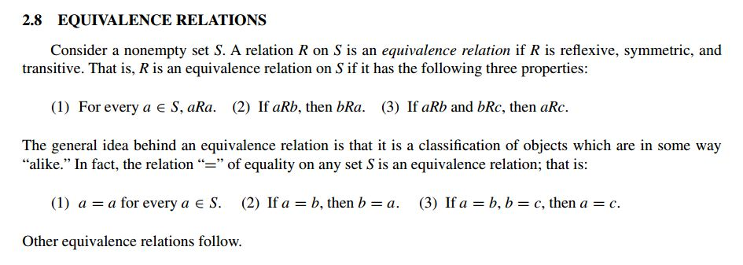
Equivalence Relation

Slide 33
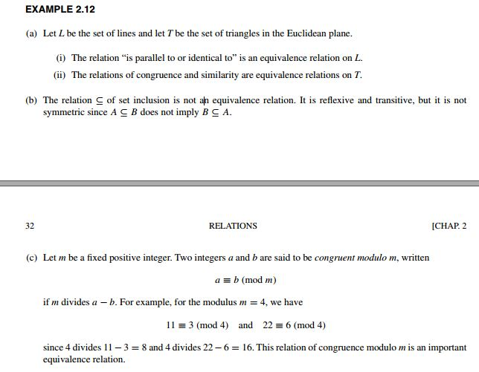
Practice

Slide 34
Equivalence Relations and Partitions
There is a relationship between these two.
This topic and rests can be omitted for now. We will come back again (if required)

