Slide 1
ICE–4101: Artificial Intelligence Lecture # 3
Instructor: M. Shamim Kaiser
Email: m.shamimkaiser@juniv.edu
Text phone: 01511932323

Slide 2
Problem solving
Problem solving in games such as SUDOKU which can be done by building an AI system to solve that particular problem.
To do this, one needs to define that problem statement first and than generating the solution by keeping the condition in mind.
Some of the most popularly used problem solving with the help of AI are: chess, travelling salesman problem, tower of Hanoi problem, water jug problem, N-queen problem.
In general, searching refers to as finding information one needs
Searching is the most commonly used techniques of problem solving in AI.

Slide 3
Process of solving a problem
Define the problem
Analyzing the problem
Identification of solution
Choosing the solution
Implementation

Slide 4
Properties of search algorithm
The essential properties of a search algorithm are:
Completeness: A search algorithm is said to be complete if it guarantees to return a solution for any random input
Optimality: A solution is found for an algorithm is guaranteed to be the best solution (lowest path cost.
Time complexity: Time complexity is a measure of time for an algorithm to complete its task.
Space Complexity: it is the maximum storage requirement at any point during the search as the complexity of the problem

Slide 5
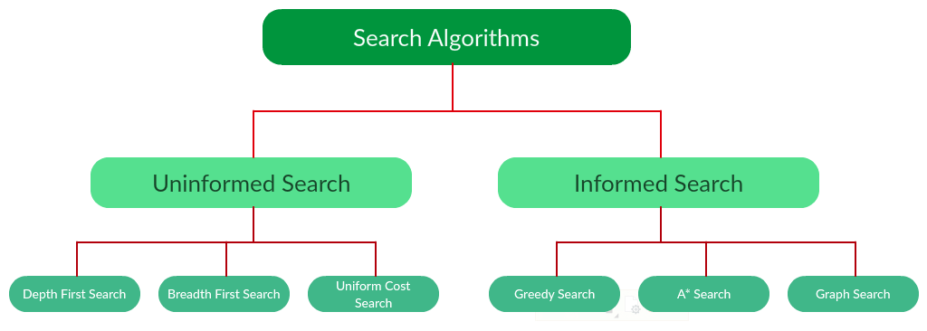
Types of Search Algorithm

Slide 6
Uninformed Search
The search algorithms in this section have no additional information on the goal node other than the one provided in the problem definition (that is, no domain knowledge).
The plans to reach the goal state from the start state differ only by the order and/or length of actions.
A class of general purpose algorithms that operates in a brute force way
The search space is explored without leveraging on any information on the problem
Also called blind search, or naïve search
Since the methods are generic they are intrinsically inefficient
The following uninformed search algorithms are:
Depth First Search
Breath First Search
Uniform Cost Search

Slide 7
Uninformed Search
E.g. Random Search
This method selects randomly a new state from the current one
If the goal state is reached, the search terminates
Otherwise the methods randomly select an other operator to move to the next state

Slide 8
Informed Search (Heuristic Search)
It uses domain knowledge, the problem information is available which can guide the search.
Informed search strategies can find a solution more efficiently than an uninformed search.
A heuristic is a way which might not always be guarantee for the best solution but guaranteed to find a good solution in reasonable time.
It can solve much complex problem which could not be solved in another way.

Slide 9
Each of these algorithms will have:
A problem graph, containing the start node S and the goal node G.
A strategy, describing the manner in which the graph will be traversed to get to G .
A fringe, which is a data structure used to store all the possible states (nodes) that you can go from the current states.
A tree, that results while traversing to the goal node.
A solution plan, which the sequence of nodes from S to G.

Slide 10
Breadth First Search
Breadth-First Search (BFS) begins at the root node and explore level-wise al the branches
BFS is complete
If there is a solution, BFS will found it
BFS is optimal
The solution found is guaranteed to be the shortest path possible
The algorithm can be implemented with a First In First Out (FIFO) stack

Slide 11
Breadth-First Search: Algorithm
Algorithm BFS(s): s start node
0. Initialize a Q with s;
v = Pop(Q); // BFS is Queue based algorithm
If v is “goal” return success;
mark node v as visited; // configurations generated before,
// not done in “tree” search mode
4. operate on v; // e.g., evaluate if it is the goal node, then return
5. for each node w accessible from node v do
6. if w is not marked as visited then // with generate-&-test may not be time consuming
7. Push w at the back of Q;
end for;
End algorithm.

Slide 12
Advantages:
it will provide a solution if any solution exists.
If there are more than one solution for a given problem then BFS will provide minimal solution which requires the least number of steps.
Disadvantages
It requires lots of memory since each level of the tree must be saved into memory to expand the next level
It needs lots of time if the solution is far from the root node.

Slide 13
Example
A
Level 0
B
C
Level 1
D
E
F
G
Level 2
H
I
J
Level 3
K
Level 4

Slide 14
Time complexity
T(b)=1+b²+b³+…+b^{d}=O(b^{d}), d= depth of shallowest solution
Space Complexity
S(b)=O(b^{d}), b is a number of node at every state
Completeness
It is complete

Slide 15
Depth First Search
Uninformed Search Technique
Stack (LIFO)
Deepest node
Incomplete
Not optimal
Time complexity
ACGFBED
A
B
C
D
E
F
G
A
B
C
F
B
E
D
B
E
D

Slide 16
Depth First Search
It is a recursive algorithm for traversing a tree or graph data structure.
It is called DFS as it starts from the root and follows each path to its greatest depth node before moving to the next level
It uses a stack data structure for its implementation
The process is similar to BFS algorithm
Advantages
It requires very less memory as it only need to store a stack of the nodes on the path from root nods to the current node.
It takes less time to reach to its goal node

Slide 17
Disadvantage
There is the possibility that many states keep re-occurring and there is no guarantee of finding the solution.
It goes for deep down searching and sometimes it may go to the infinite loop.

Slide 18
S
Level 0
A
H
Complete
Level 1
B
C
I
J
Level 2
D
E
G
K
Level 3
T(n)=1+n²+n³+…+n^{m}=O(n^{m})
m=max depth of any
Level 4

Slide 19
BFS vs DFS
BFS:
Memory intensive: ALL children are to be stored from all levels ☹
At least all nodes of the last level are to be stored, and that grows fast too!
Also, you cannot do the above if the path from start node to goal is needed!
If goal exists, BFS is guaranteed to find it: complete algorithm
(systematically finds it, level by level) ☺
If goal is nearby (at a low level), BFS quickly finds it ☺
Memory intensive, all nodes in memory ☹
Queue for implementation
DFS:
Infinite search is possible, in the worst case ☹
May get stuck on an infinite depth in a branch,
Even if the goal may be at a low level on a different branch
Linear memory growth, depth-wise ☺ WHY?
but, go to the point number 1 above 🡪 memory may explode for large depth!
Stack for implementation (equivalent to recursive implementation)

Slide 20
BFS vs DFS
Time complexity: Worst case for both, all nodes searched: O(b^{d}) where b is the branching factor and d is the depth of the goal
Memory:
BFS O(b^{d}) remember all nodes
DFS O(bd), only one set of children at each level, up to goal
depth
But the depth may be very high, up to infinity ☹
DFS <forgets> previously explored branches ☺
Goal

Slide 21
Depth Limited Search (DLS):
To avoid infinite search of DFS
Stop DFS at a fixed depth l, no mater what
Goal, may NOT be found: Incomplete Algorithm
If goal depth d > l
Why DLS? To avoid getting stuck at infinite (read: large) depth
Time: O(b^{l}), Memory: O(bl)
Goal

Slide 22
Iterative Deepening Search (IDS)
Repeatedly stop DFS at a fixed depth l (i.e., DLS), AND
If goal is not found,
then RESTART from start node again, with l = l+1
Complete Algorithm
Goal <<will>> be found when l = = d, goal depth
Isn’t repetition very expensive?
Time: O(b¹ +b² +b³ + .. b^{d} ) = O(b^{d+1}), as opposed to O(b^{d}),
For b=10, d=5, this is 111,000 to 123,450 increase, 11%
Memory:
IDS vs DFS: same O(bd)
IDS vs BFS: O(bd) vs O(b^{d})

Slide 23
BFS vs DFS
Visiting a vertex
Exploration of vertex
5
4
7
6
1
2
3

Slide 24
BFS vs DFS
Visiting a vertex
Exploration of vertex
5
4
7
6
1
2
3
BFS: 1, 2, 4, 5, 7, 3, 6
DFS: 1, 2, 3, 6, 7, 4, 5

Slide 25
BFS vs DFS
1
Initial
2
3
4
5
6
7
Goal
BFS: 1, 2, 3, 4, 5, 6, 7
DFS: 1, 2, 4, 5, 3, 6, 7
Level order
Pre order

Slide 26
BFS vs DFS
Initial
6
Goal
1
5
4
2
7
8
3
10
9

Slide 27
BFS vs DFS
Queue
Initial
6
Goal
1
4
2
3
5
8
7
10
1
5
9
6
4
2
7
Queue
Initial Step: 1
8
1
2
4
3
5
3
9
6
Result
10
9
1, 2, 8, 5, 7, 3, 6, 10, 9, 6
1, 4, 2, 3, 5, 8, 7, 10, 9, 6

Slide 28
Bidirectional Search
Two simultaneous search from initial node to goal and backward from the goal to initial, stopping when two meet
Time complexity 2(b^{d/2})
Space Complexity O(b^{d})
Complete if BFS is used
May or may Not in DFS is used
7
2
4
5
6
9
1
Start
Goal
3
8

Slide 29
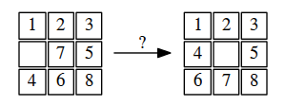
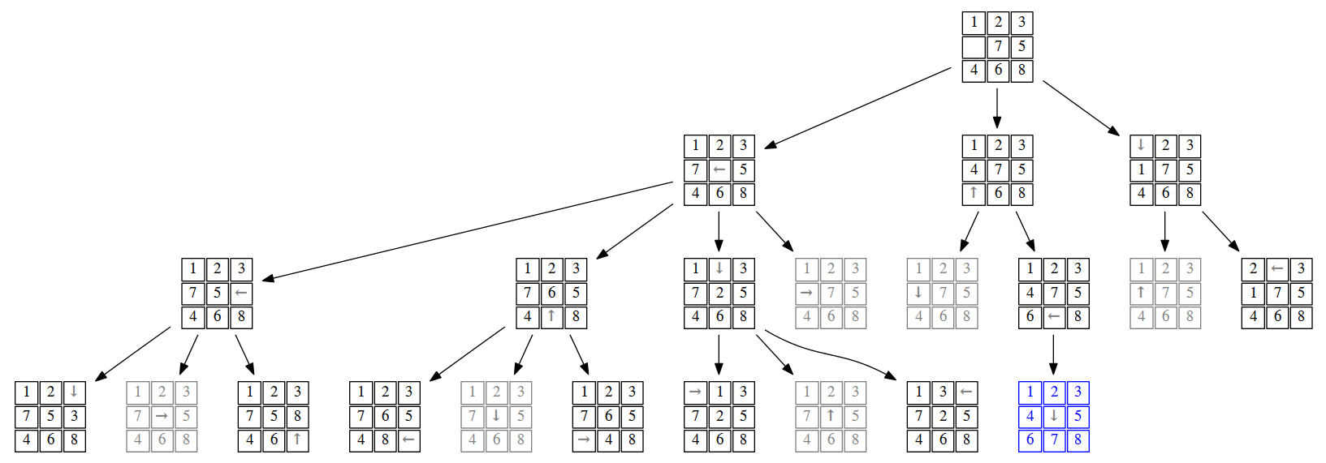
8 Puzzle problem
Blind search (uninformed): BFS
O(bd), Worst case=3²⁰
4 moves: UP DOWN LEFT and RIGHT
Branch 3
4X2+4X3+4X1=2.6=3

