Slide 1
ICE–4101: Artificial Intelligence Lecture # 4: Heuristic Search
Instructor: M. Shamim Kaiser
Email: shamimkaiser@gmail.com
Skype: shamimkaiser
Text phone: 01511932323

Slide 2
Heuristic
A heuristic is a method that
might not always find the best solution
but is guaranteed to find a good solution in reasonable time.
By sacrificing completeness it increases efficiency.
Useful in solving tough problems which
could not be solved any other way.
solutions take an infinite time or very long time to compute.
The classic example of heuristic search methods is the travelling salesman problem.

Slide 3
Manhatten distance: The distance between two points measured along axes at right angles. In a plane with p₁ at (x₁, y₁) and p₂ at (x₂, y₂), it is |x₁ - x₂| + |y₁ - y₂|.
Euclidean distance: The straight line distance between two points. In a plane with p₁ at (x₁, y₁) and p₂ at (x₂, y₂), it is √((x₁ - x₂)² + (y₁ - y₂)²).

Slide 4
8 puzzle problem
H=3
Convent non-polynomial to polynomial
No guarantee of best solution
1 | 2 | 3
 | 4 | 6
7 | 5 | 8
1 | 2 | 3
4 | 5 | 6
7 | 8
Goal
UP
Down
Right
H=4
H=4
H=2
Find Heuristic value
No of misplaced tile
Is 3
 | 2 | 3
1 | 4 | 6
7 | 5 | 8
1 | 2 | 3
4 |  | 6
7 | 5 | 8
1 | 2 | 3
7 | 4 | 6
 | 5 | 8
H=3
H=3
H=3
H=1
1 | 2 | 3
4 | 6
7 | 5 | 8
1 | 2 | 3
4 | 5 | 6
7 |  | 8
1 | 2 | 3
 | 4 | 6
7 | 5 | 8
1 |  | 3
4 | 2 | 6
7 | 5 | 8
1 | 2 | 3
4 | 5 | 6
7 | 8

Slide 5
Heuristic Search methods Generate and Test Algorithm
It is a very simple algorithm that guarantees to find a solution if done systematically and there exist a solution.
It is like depth first search requires that complete solution be generated for testing
Algorithm:
1. Generate a possible solution
2. Test to see if this is the expected solution
3. If the solution has been found then quit else go to step 1
Properties of good generators
Non-redundant, Complete, Informed
Generate
Possible
Tester
Correct
Stop

Slide 6
Best First Search
A combination of depth first and breadth first searches.
Depth first is good because a solution can be found without computing all nodes and breadth first is good because it does not get trapped in dead ends.
The best first search allows us to switch between paths thus gaining the benefit of both approaches. At each step the most promising node is chosen.
If one of the nodes chosen generates nodes that are less promising it is possible to choose another at the same level and in effect the search changes from depth to breadth.
If on analysis these are no better then this previously unexpanded node and branch is not forgotten and the search method reverts to the descendants of the first choice and proceeds, backtracking as it were.

Slide 7
This process is very similar to steepest ascent, but in hill climbing once a move is chosen and the others rejected the others are never reconsidered whilst in best first they are saved to enable revisits if an impasse occurs on the apparent best path.
Also the best available state is selected in best first even its value is worse than the value of the node just explored whereas in hill climbing the progress stops if there are no better successor nodes.
The best first search algorithm will involve an OR graph which avoids the problem of node duplication and assumes that each node has a parent link to give the best node from which it came and a link to all its successors.

Slide 8
In this way if a better node is found this path can be propagated down to the successors. This method of using an OR graph requires 2 lists of nodes
OPEN is a priority queue of nodes that have been evaluated by the heuristic function but which have not yet been expanded into successors. The most promising nodes are at the front.
CLOSED are nodes that have already been generated and these nodes must be stored because a graph is being used in preference to a tree.

Slide 9
In order to find the most promising nodes a heuristic function is needed called f' where f' is an approximation to f and is made up of two parts g and h' where g is the cost of going from the initial state to the current node; g is considered simply in this context to be the number of arcs traversed each of which is treated as being of unit weight. h' is an estimate of the initial cost of getting from the current node to the goal state. The function f' is the approximate value or estimate of getting from the initial state to the goal state. Both g and h' are positive valued variables. Best First The Best First algorithm is a simplified form of the A* algorithm. From A* we note that f' = g+h' where g is a measure of the time taken to go from the initial node to the current node and h' is an estimate of the time taken to solution from the current node. Thus f' is an estimate of how long it takes to go from the initial node to the solution. As an aid we take the time to go from one node to the next to be a constant at 1.

Slide 10
Best First Search Algorithm:
1. Let OPEN be the priority queue containing initial state
Loop
2. If OPEN is empty return failure
3. Node🡨 Remove –First (OPEN)
4. If node is a GOAL
5. Then return the Path from initial to Node
6. Else generate all successors of node and put the newly generated node into OPEN according to their f values
7.End Loop

Slide 11
Example
7
Straight line distance
A-G=40
B-G=32
C-G=25
D-G=35
E-G=19
F-G=17
H-G=10
BFS focused on heuristic value only
A
11
D
14
25
B
C
10
--Greedy Method
--Complexity
Normally not exponential
And O(b^{m}) in worst case
8
F
15
E
10
20
9
H
G
Initial A
OPEN is not empty
Node A is goal state, NO
A is connected to B (32) C (25) and
D (35)
5. Remove C
6. C is connected to E (19), F(17), A is explored and put in CLOSE
7. 7 is connected to G, path is A to C to F to G
A
X
A | C | B | D
X
X
A | C | B | D | F | E

Slide 12
Beam Search Algorithm
This is extension to Best Search Algo
Take care of space complexity (Constant)
Beam width (B) is given by

Slide 13
Example
7
Straight line distance
A-G=40
B-G=32
C-G=25
D-G=35
E-G=19
F-G=17
H-G=10
BFS focused on heuristic value only
A
11
D
14
18
25
B
C
10
--Greedy Method
--Complexity
Normally not exponential
And O(b^{m}) in worst case
8
F
15
E
10
20
9
H
G
32
A
35
25
B
C
D
35
17
19
D
F
E
X
X
A | C | B | D | F | E
F is small and come first in the queue

Slide 14
Say beam value is 2
List based on best C<B<D, thus keep C and B in queue list, Do not keep D memory
Similarly, keep F and E in the list
Space Complexity is constant
Due to searching time complexity is less
This is not complete, but BSA is complete

Slide 15
Simple Hill Climbing Algorithm
Local search algorithm, greedy approach, no backtracking
A variant of DFS. It selects the locally optimal node to expand
Here the generate and test method is augmented by an heuristic function which measures the closeness of the current state to the goal state.
1. Evaluate the initial state if it is goal state quit otherwise current state is initial state.
2. Select a new operator for this state and generate a new state.
3.Evaluate the new state
if it is closer to goal state than current state make it current state
if it is no better ignore
4. If the current state is goal state or no new operators available, quit. Otherwise repeat from 2.

Slide 16
Algorithm
1.Evaluate the initial state
2.Loop until a solution is found or There are no operators left
Select and apply a new operator
Evaluate the new state
If good then quit
If better than current state then it is new current state

Slide 17
Example: 8 puzzle problem
Evaluation function f(n)=d(n)+w(n)
where d is the depth and w is the number of misplaced tiles in node n
1 | 2 | 3
5 | 6
7 | 8 | 4
1 | 2 | 3
5 | 8 | 6
 | 7 | 4
C=1+4=5
C=1+2=3
C=1+4=5
1 | 2 | 3
5 | 6 | 4
7 | 8
1 | 2 | 3
5 |  | 6
7 | 8 | 4
1 | 2
5 | 6 | 3
7 | 8 | 4
C=2+3=5
C=2+3=5
C=2+1=3
1 | 2 | 3
 | 5 | 6
7 | 8 | 4
1 | 2 | 3
5 | 8 | 6
7 |  | 4
1 |  | 3
5 | 2 | 6
7 | 8 | 4
C=3+0=3
C=3+2=5
1 | 2 | 3
5 | 8 | 6
 | 7 | 4
1 | 2 | 3
5 | 8 | 6
7 | 4

Slide 18
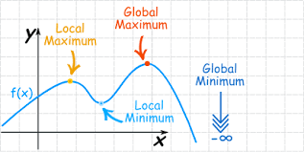
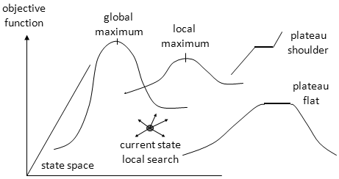
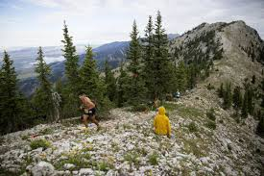
Limitation in Hill Climbing
Local Maximum
Plateau/Flat maximum
Ridge

Slide 19
A*
A* algorithm is a typical heuristic search algorithm, in which the heuristic function is an estimated shortest distance from the initial state to the closest goal state, and it equals to the traveled distance plus the predicted distance ahead. That is, f(n) = g(n) + h(n).

Slide 20
Algorithm
Create a search graph, G, consisting solely of the start node N1. Put N1 in a list called OPEN.
Create a list called CLOSED that is initially empty.
If OPEN is empty, exit with failure.
Select the first node on OPEN, remove it from OPEN, and put it on CLOSED. Call this node N.
If N is a goal node, exit successfully with the solution obtained by tracing a path along the pointers from N to N1 in G. (The pointers define a search tree and are established in step 7.)
Expand node N, generating the set, M, of its successors that are not already ancestors of N in G. Install these members of M as successors of N in G.
Establish a pointer to N from each of those members of M that were not already in G (i.e., not already on either OPEN or CLOSED). Add these members of M to OPEN. For each member, Mi, of M that was already on OPEN or CLOSED, redirect its pointer to N if the best path to Mi found so far is through N. For each member of M already on CLOSED, redirect the pointers of each of its descendants in G so that they point backward along the best paths found so far to these descendants.
Reorder the list OPEN in order of increasing f values. (Ties among minimal f values are resolved in favor of the deepest node in the search tree.)
Go to step 3

Slide 21
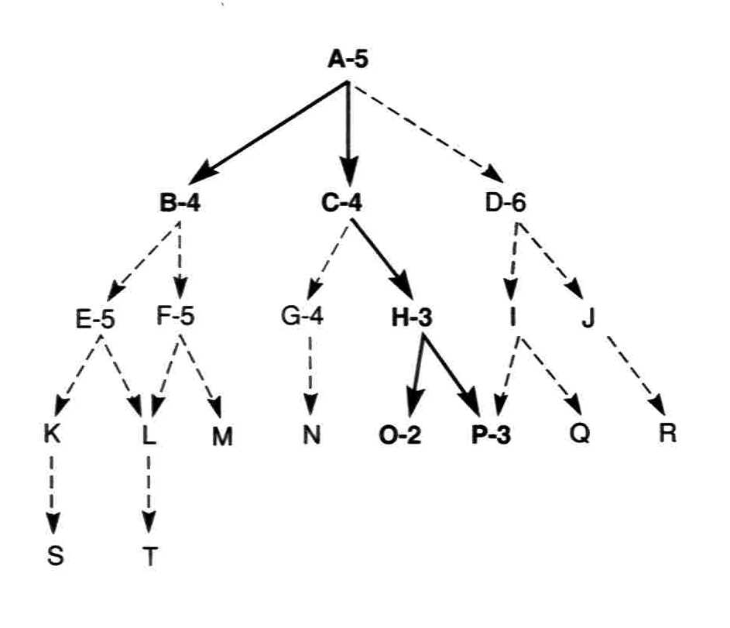
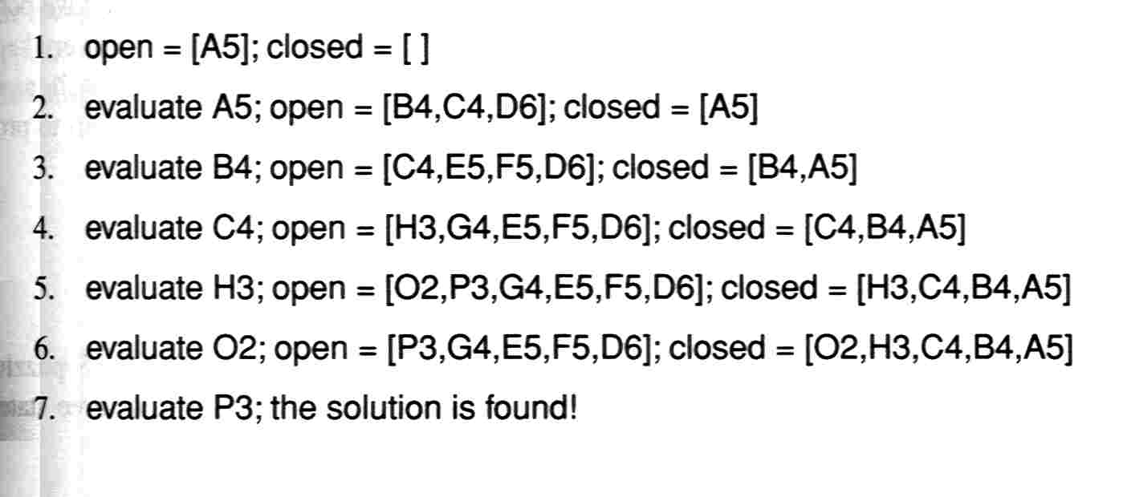

Slide 22
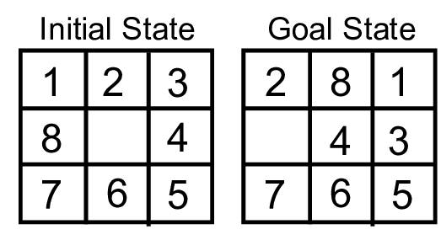
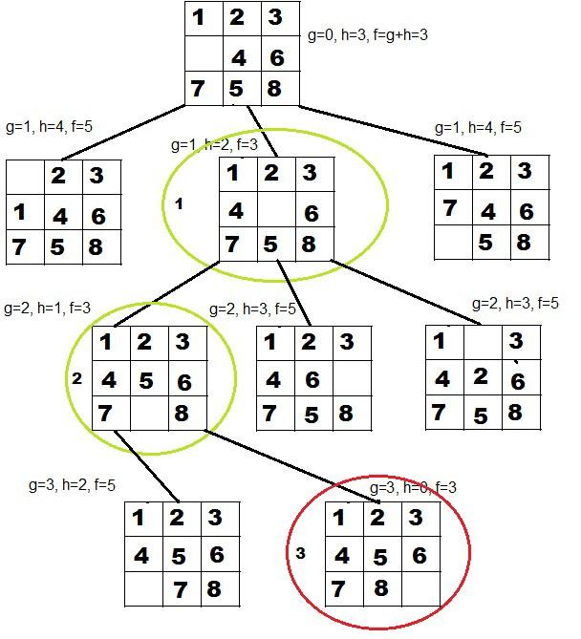
Cost function f(n)=d(n)+w(n)
g=actual cost from start node to n
h= estimation cost from n to goal node
TC=O(b^{d})=SC

Slide 23
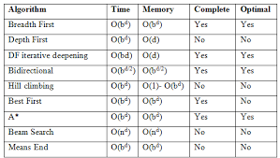
Comparison

