Slide 1
Architectural Model of Distributed System (System Architectural Style)
Dr. Risala T Khan
Professor
IIT, JU

Slide 2
System Architectural Style
System architectural styles cover the physical organization of components and processes over a distributed infrastructure.
They provide a set of reference models for the deployment of such systems and help engineers identify the major advantages and drawbacks of a given deployment and whether it is applicable for a specific class of applications.
In this section, we introduce two fundamental reference styles:
client/server and
peer-to-peer.

Slide 3
Client/Server Model
This architecture is very popular in distributed computing and is suitable for a wide variety of applications.
The client/server model features two major components: a server and a client.
These two components interact with each other through a network connection using a given protocol.
The communication is unidirectional: The client issues a request to the server, and after processing the request the server returns a response.
There could be multiple client components issuing requests to a server that is passively waiting for them.
Hence, the important operations in the client-server paradigm are request, accept (client side), and listen and response (server side).

Slide 4
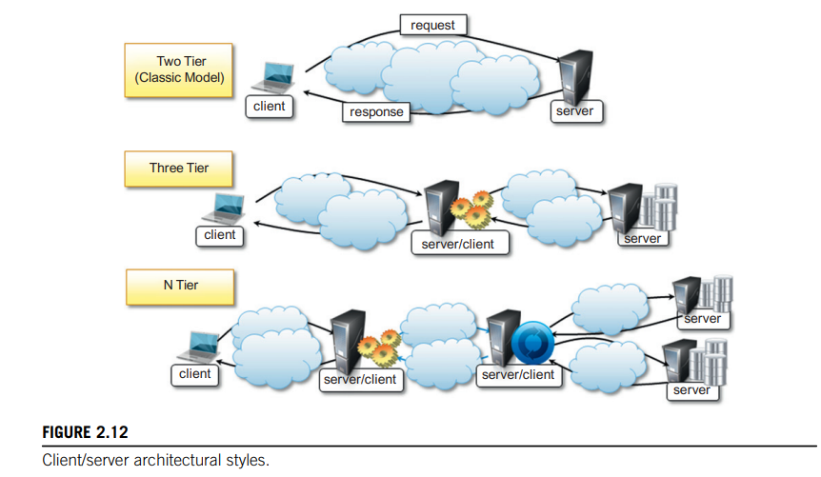

Slide 5
Cont..
In the client design we identify two major models:
• Thin-client model:
In this model, the load of data processing and transformation is put on the server side, and the client has a light implementation that is mostly concerned with retrieving and returning the data it is being asked for, with no considerable further processing.
Fat-client model
In this model, the client component is also responsible for processing and transforming the data before returning it to the user, whereas the server features a relatively light implementation that is mostly concerned with the management of access to the data
The three major components in the client-server model: presentation, application logic, and data storage.
In the thin-client model, the client embodies only the presentation component, while the server absorbs the other two.
In the fat-client model, the client encapsulates presentation and most of the application logic, and the server is principally responsible for the data storage and maintenance

Slide 6
Cont…
Presentation, application logic, and data maintenance can be seen as conceptual layers, which are more appropriately called tiers.
The mapping between the conceptual layers and their physical implementation in modules and components allows differentiating among several types of architectures, which go under the name of multitiered architectures.
Two major classes exist:
Two-tire architecture
Three-tire architecture

Slide 7
Two-Tier Architecture
This architecture partitions the systems into two tiers, which are located one in the client component and the other on the server.
The client is responsible for the presentation tier by providing a user interface;
The server concentrates the application logic and the data store into a single tier.
The server component is generally deployed on a powerful machine that is capable of processing user requests, accessing data, and executing the application logic to provide a client with a response.
This architecture is suitable for systems of limited size and suffers from scalability issues.
In particular, as the number of users increases the performance of the server might dramatically decrease.

Slide 8
Three-tier architecture/N-tier architecture:
The three-tier architecture separates the presentation of data, the application logic, and the data storage into three tiers.
This architecture is generalized into an N-tier model in case it is necessary to further divide the stages composing the application logic and storage tiers.
This model is generally more scalable than the two-tier one because it is possible to distribute the tiers into several computing nodes, thus isolating the performance bottlenecks.
At the same time, these systems are also more complex to understand and manage.
A classic example of three-tier architecture is constituted by a medium-size Web application that relies on a relational database management system for storing its data.
In this scenario, the client component is represented by a Web browser that embodies the presentation tier, whereas the application server encapsulates the business logic tier, and a database server machine (possibly replicated for high availability) maintains the data storage.
Application servers that rely on third-party (or external) services to satisfy client requests are examples of N-tiered architectures.

Slide 9
Peer-to-Peer
The peer-to-peer model, introduces a symmetric architecture in which all the components, called peers, play the same role and incorporate both client and server capabilities of the client/server model.
More precisely, each peer acts as a server when it processes requests from other peers and as a client when it issues requests to other peers.
Therefore, this model is quite suitable for highly decentralized architecture, which can scale better along the dimension of the number of peers.
The disadvantage of this approach is that the management of the implementation of algorithms is more complex than in the client/server model.
The most relevant example of peer-to-peer systems is constituted by file-sharing applications such as Gnutella, BitTorrent, and Kazaa.
To address an incredibly large number of peers, different architectures have been designed that divert slightly from the peer-to-peer model.
For example, in Kazaa not all the peers have the same role, and some of them are used to group the accessibility information of a group of peers.

Slide 10
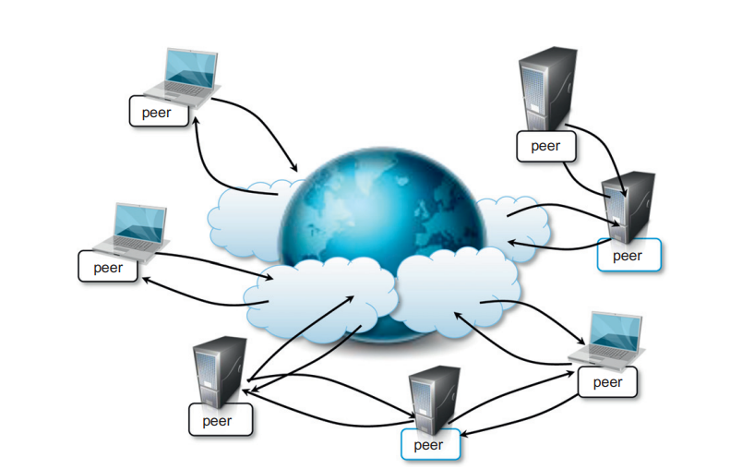

Slide 11
Software Agents (Definition)
A software agent is a computer program that acts for a user or other program in a relationship of agency.
Such "action on behalf of" implies the authority to decide which, if any, action is appropriate
An entity is a software agent if and only if it communicates correctly in an agent communication language. [Genesereth and Ketchpel, 1994]
Software agent is just the generic term for some sort of autonomous process capable of reacting to and initiating changes in its environment.
The key here is that it's autonomous, i.e., it is capable of making choices for the users(s) who have started it running.

Slide 12
Different Types of Agents
Collaborative Agent:
Is an agent that forms part of a multiagent system, in which agents seek to achieve some common goal through collaboration.
A typical application where collaborative agents could be used is: arranging a meeting.
Each attendee is represented by an agent that has access to that user’s personal agenda.
Considering all the individual constraints with respect to time, travel, place and so on, the separate agents would collaborate in setting up a meeting.
From the distributed system’s perspective: exactly which information is exchanged and how is processed is of less concern. Important is how communication takes place.
Notes:
d

Slide 13
Continue…
Mobile Agent:
A self-contained process that can autonomously migrate from host to host in order to perform its task on Internet.
The motto of Mobile Agents is:
move the computations to the data rather than the data to the computations

Slide 14
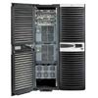
Why do we need mobile agents?
Client
Stock market
IBM: $20
Microsoft: $21
HP: $22
Customer
buy / sell stocks
transfer
information
Stock
server
implement
Client
transfer
information
Intelligent
Agent
buy / sell
stocks
send agent
Client
…
implement
buy / sell stocks
Mobile
Intelligent
Agent
dispatch
receive agent
…
Carry the result
Notes:
We defined the scenario, such that a customer wants to trade his stocks in the remote stock market through the Internet. The remote stock market is indicated by a stock server, with maintains all the stock information.
Choice 1: sit in front of the client machine, logon to the website of the stock market, monitor the latest stock prices and pick up the right moment for trading.
Disadvantage: need to sit there the whole day.
Network connection between the client machine and the stock server need to be active all the time.
Network traffic is heavy because the stock prices need to be updated instantly.
Choice 2: implement an intelligent agent, and let the agent monitor the stock market for the customer.
Disadvantages: the network connection still needs to be keep active all the time.
Disadvantages: the network traffic for instant stock prices updating remains the same.
Choice 3: implement an mobile intelligent agent, which can be delivered to the remote server. Therefore the missions of stock trading can be fulfilled on the remote stock server. This agent will be sent back to the client machine carrying the trade results after finishing all the operations.
Advantages: the network connection only need to be available during the periods of agent sending and returning back, which makes the entire system more reliable.
Advantages: the network traffic will become much less. Because the network resources are only charged for delivering the mobile intelligent agent, which normally will be just a small piece of code (few k bytes).
This example shows that the mobile agent system does give us some benefits when it is used in particular situations.

Slide 15
Why do we need mobile agents?
We defined the scenario, such that a customer wants to trade his stocks in the remote stock market through the Internet. The remote stock market is indicated by a stock server, with maintains all the stock information.
Choice 1: sit in front of the client machine, logon to the website of the stock market, monitor the latest stock prices and pick up the right moment for trading.
Disadvantage: need to sit there the whole day.
Network connection between the client machine and the stock server need to be active all the time.
Network traffic is heavy because the stock prices need to be updated instantly.
Choice 2: implement an intelligent agent, and let the agent monitor the stock market for the customer.
Disadvantages: the network connection still needs to be keep active all the time.
Disadvantages: the network traffic for instant stock prices updating remains the same.

Slide 16
Why do we need mobile agents?
Choice 3: implement an mobile intelligent agent, which can be delivered to the remote server. Therefore the missions of stock trading can be fulfilled on the remote stock server. This agent will be sent back to the client machine carrying the trade results after finishing all the operations.
Advantages: the network connection only need to be available during the periods of agent sending and returning back, which makes the entire system more reliable.
Advantages: the network traffic will become much less. Because the network resources are only charged for delivering the mobile intelligent agent, which normally will be just a small piece of code (few k bytes).
This example shows that the mobile agent system does give us some benefits when it is used in particular situations.

Slide 17
Different Types of Agents (Continue…)
Interface Agent:
Are agents that assist an end user in the use of one or more applications.
An interface agent has learning capabilities.
The more often it interacts with the user, the better its assistance become.
For example: special interface agent exists that actively seek to bring buyers and sellers together.
Information Agent:
The main function of these agents is to manage information from many different sources.
Managing information includes ordering, filtering, collating and so on.
For example: an e-mail agent may be capable of filtering unwanted mail from its owner’s mailbox or automatically distributing incoming mail into appropriate subject-specific mailboxes.

Slide 18
Software Agents in Distributed Systems
Property | Common to all agents? | Description
Autonomous | Yes | Can act on its own
Reactive | Yes | Responds timely to changes in its environment
Proactive | Yes | Initiates actions that affects its environment
Communicative | Yes | Can exchange information with users and other agents
Continuous | No | Has a relatively long lifespan
Mobile | No | Can migrate from one site to another
Adaptive | No | Capable of learning
Some important properties by which different types of agents can be distinguished.

Slide 19
Variants of Client Sever Model
SYSTEM MODEL
Network computers Applications run on a desktop computer local to the user. The operating systems and application software for desktop computers typically require much of the active code and data to be located on a local disk. But for the case of Network Computers: It downloads its operating system and any application software needed by the user from a remote file server. Applications are run locally but the file are managed by a remote file server. Network applications such as a Web browser can also be run. Since all the application data and code is stored by a file server, the user may migrate from one network computer to other.

Slide 20
Design Requirements for distributed architectures
SYSTEM MODEL
Performance Issues Performance issues arises from the limited processing and communication capacities of computers. Following parameters are the matrices to measure the performance of a system. Responsiveness Users of interactive applications require a fast and consistent response of interaction; but client program often need to access shared resources. When a remote service is invoked, the speed at which the response is generated is determined not just by the load and performance of the server and the network but also by delays in all the software components involved. E.g. a web browser can access the cached pages faster than the non-cached pages.

Slide 21
Design Requirements for distributed architectures
Throughput
Throughput is the rate at which the computation is done.
The ability of a distributed system to perform work for all its users is affected by processing speeds at clients and servers and by data transfer rate.
Data that is located on a remote server must be transferred from the server process to the client process, passing through several software layers in both computers. The throughput of the intervening software layers is important as well as that of the network.

Slide 22
Design Requirements for distributed architectures
Load Balancing:
One of the purposes of distributed systems is to enable applications and service processes to proceed concurrently without competing for the same resources and to exploit the available computational resources.
For example, the ability to run applets on client computers removes load form the web server, enabling it to provide a better service.

Slide 23
Design Requirements for distributed architectures
SYSTEM MODEL
Quality of service The ability of systems to meet deadlines. It depends on availability of the necessary computing and network resources at the appropriate time. This implies a requirement for the system to provide guaranteed computing and communication resources that are sufficient to enable applications to complete each task on time. E.g. the task of displaying a frame of video The networks commonly used today, for example to browse the Web, may have good performance characteristics, but when they are heavily loaded their performance degrades significantly----in no way can they be said to provide QoS.

Slide 24
Design Requirements for distributed architectures(Q0S)
SYSTEM MODEL
The main properties of the quality of the service are: Reliability Security Performance Adaptability Reliability & Security issues are critical in the design of most computer systems. They are strongly related to two of the fundamental models: the failure model and the security model Adaptability is to meet changing system configurations and resource availability. Performance indicates responsiveness and computational throughput.

Slide 25
Design Requirements for distributed architectures(QoS)
SYSTEM MODEL
Use of caching and replication Distributed systems overcome the performance issues by the use of data replication and caching. Dependability issues Dependability is the requirement in most application domain. Dependability of computer systems is defined as: Correctness The development of techniques for checking or ensuring the correctness of distributed and concurrent programs is the subject of much current and recent research. Security Security is locating sensitive data and other resources only in computers that can be secured effectively against attack. E.g. a hospital database Fault tolerance Dependable applications should continue to function in the presence of faults in hardware, software, and networks. Reliability is achieved by redundancy.

Slide 26
Models for Inter Process Communication (IPC)
Distributed systems are composed of a collection of concurrent processes interacting with each other by means of a network connection.
Therefore, IPC is a fundamental aspect of distributed systems design and implementation.
IPC is used to either exchange data and information or coordinate the activity of processes.
There are several different models in which processes can interact with each other; these map to different abstractions for IPC.
Among the most relevant that we can mention are shared memory, remote procedure call (RPC), and message passing

Slide 27
Message-based communication (IPC Reference Model)
The abstraction of message has played an important role in the evolution of the models and technologies enabling distributed computing.
A distributed system is “one in which components located at networked computers communicate and coordinate their actions only by passing messages.”
The term message, in this case, identifies any discrete amount of information that is passed from one entity to another.
It encompasses any form of data representation that is limited in size and time.

Slide 28
Different Message-based Communication
Message passing:
This paradigm introduces the concept of a message as the main abstraction of the model.
The entities exchanging information explicitly encode in the form of a message the data to be exchanged.
The structure and the content of a message vary according to the model.
Examples of this model are the Message-Passing Interface (MPI) and OpenMP.
Remote procedure call (RPC):
This paradigm extends the concept of procedure call beyond the boundaries of a single process, thus triggering the execution of code in remote processes.
In this case, underlying client/server architecture is implied.
A remote process hosts a server component, thus allowing client processes to request the invocation of methods, and returns the result of the execution.
Messages, automatically created by the RPC implementation, convey the information about the procedure to execute along with the required parameters and the return values.
The use of messages within this context is also referred as marshaling of parameters and return values.

Slide 29
Different Message-based Communication(Cont…)
Distributed objects:
This is an implementation of the RPC model for the object-oriented paradigm and contextualizes this feature for the remote invocation of methods exposed by objects.
Each process registers a set of interfaces that are accessible remotely.
Client processes can request a pointer to these interfaces and invoke the methods available through them.
The underlying runtime infrastructure is in charge of transforming the local method invocation into a request to a remote process and collecting the result of the execution.
The communication between the caller and the remote process is made through messages.
Examples of distributed object infrastructures are Common Object Request Broker Architecture (CORBA), Component Object Model (COM, DCOM, and COM1), Java Remote Method Invocation (RMI), and .NET Remoting

Slide 30
Different Message-based Communication (Cont…)
Distributed agents and active objects.
In this model the objects have their own control thread, which allows them to carry out their activity.
These models often make explicit use of messages to trigger the execution of methods, and a more complex semantics is attached to the messages.
Web services:
Web service technology provides an implementation of the RPC concept over HTTP, thus allowing the interaction of components that are developed with different technologies.
A Web service is exposed as a remote object hosted on a Web server, and method invocations are transformed in HTTP requests, packaged using specific protocols such as Simple Object Access Protocol (SOAP) or Representational State Transfer (REST).

Slide 31
Technologies for distributed computing (Remote Procedure Call)
RPC is the fundamental abstraction enabling the execution of procedures on client’s request.
RPC allows extending the concept of a procedure call beyond the boundaries of a process and a single memory address space.
The called procedure and calling procedure may be on the same system or they may be on different systems in a network.
The concept of RPC has been discussed since 1976 and completely formalized by Nelson and Birrell in the early 1980s.
From there on, it has not changed in its major components.
Even though it is a quite old technology, RPC is still used today as a fundamental component for IPC in more complex systems

Slide 32
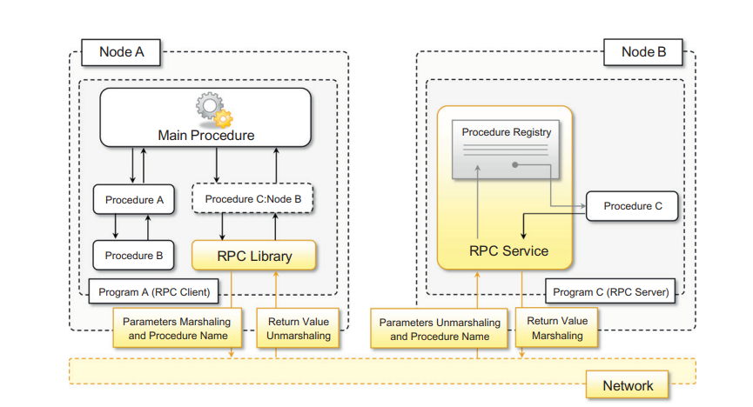
RPC (Cont…)
Figure illustrates the major components that enable an RPC system.
The system is based on a client/server model.
The server process maintains a registry of all the available procedures that can be remotely invoked and listens for requests from clients that specify which procedure to invoke, together with the values of the parameters required by the procedure.
The calling process thread remains blocked until the procedure on the server process has completed its execution and the result (if any) is returned to the client.

Slide 33
RPC (Cont…)
An important aspect of RPC is marshaling, which identifies the process of converting parameter and return values into a form that is more suitable to be transported over a network through a sequence of bytes.
The term unmarshaling refers to the opposite procedure.
Marshaling and unmarshaling are performed by the RPC runtime infrastructure, and the client and server user code does not necessarily have to perform these tasks.
The RPC runtime, on the other hand, is not only responsible for parameter packing and unpacking but also for handling the request-reply interaction that happens between the client and the server process in a completely transparent manner.

Slide 34
Therefore, developing a system using RPC for IPC consists of the following steps:
Design and implementation of the server procedures that will be exposed for remote invocation.
Registration of remote procedures with the RPC server on the node where they will be made available.
Design and implementation of the client code that invokes the remote procedure(s)
RPC has been a dominant technology for IPC for quite a long time, and several programming languages and environments support this interaction pattern in the form of libraries and additional packages.
For instance, RPyC is an RPC implementation for Python. There also exist platform independent solutions such as XML-RPC and JSON-RPC, which provide RPC facilities over XML and JSON, respectively

Slide 35
Remote Procedure Calls (1)
A remote procedure call occurs in the following steps:
The client procedure calls the client stub in the normal way.
The client stub builds a message and calls the local operating system.
The client’s OS sends the message to the remote OS.
The remote OS gives the message to the server stub.
The server stub unpacks the parameters and calls the server.
The server does the work and returns the result to the stub.
The server stub packs it in a message and calls its local OS.
The server’s OS sends the message to the client’s OS.
The client’s OS gives the message to the client stub.
The stub unpacks the result and returns to the client.

Slide 36
Technologies for distributed computing (Distributed object frameworks)
Distributed object frameworks extend object-oriented programming systems by allowing objects to be distributed across a heterogeneous network and provide facilities so that they can coherently act as though they were in the same address space.
Distributed object frameworks use the basic mechanism introduced with RPC and extend it to enable the remote invocation of object methods and to keep track of references to objects made available through a network connection.
Remote Method Invocation (RMI) is an API that allows an object to invoke a method on an object that exists in another address space, which could be on the same machine or on a remote machine.
Through RMI, an object running in a JVM present on a computer (Client-side) can invoke methods on an object present in another JVM (Server-side).
RMI creates a public remote server object that enables client and server-side communications through simple method calls on the server object.

Slide 37
Stub Object:
The stub object on the client machine builds an information block and sends this information to the server.
The block consists of:
An identifier of the remote object to be used
Method name which is to be invoked
Parameters to the remote JVM

Slide 38
Skeleton Object:
The skeleton object passes the request from the stub object to the remote object.
It performs the following tasks
It calls the desired method on the real object present on the server.
It forwards the parameters received from the stub object to the method.

Slide 39
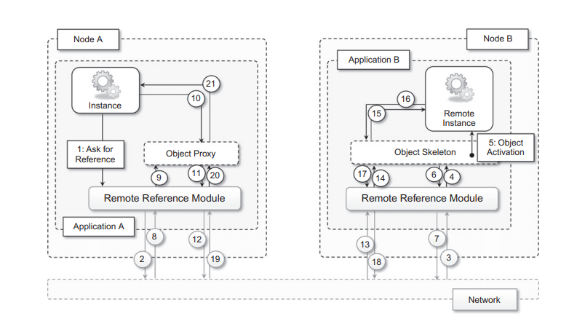
Distributed object frameworks give the illusion of interaction with a local instance while invoking remote methods.
This is done by a mechanism called a stub skeleton.
Figure gives an overview of how this infrastructure works.
Proxy and skeleton always constitute a pair:
the server process maintains the skeleton component, which is in charge of executing the methods that are remotely invoked, while the client maintains the proxy component, allowing its hosting environment to remotely invoke methods through the proxy interface.

Slide 40
The transparency of remote method invocation is achieved using one of the fundamental properties of object-oriented programming: inheritance and subclassing.
Both the proxy and the active remote object expose the same interface, defining the set of methods that can be remotely called.

Slide 41
On the client side, a runtime object published by the server is generated.
This object translates the local method invocation into an RPC call for the corresponding method on the remote active object.
On the server side, whenever an RPC request is received, it is unpacked and the method call is dispatched to the skeleton that is paired with the client that issued the request.
Once the method execution on the server is completed, the return values are packed and sent back to the client, and the local method call on the proxy returns.

Slide 42
Working of RMI in Java
The communication between client and server is handled by using two intermediate objects: Stub object (on client side) and Skeleton object (on server-side)
These are the steps to be followed sequentially to implement Interface as defined below as follows:
Defining a remote interface
Implementing the remote interface
Creating Stub and Skeleton objects from the implementation class using rmic (RMI compiler)
Start the rmi registry
Create and execute the server application program
Create and execute the client application program.

Slide 43
1. defining a remote interface
The first thing to do is to create an interface that will provide the description of the methods that can be invoked by remote clients.
This interface should extend the Remote interface and the method prototype within the interface should throw the RemoteException.
NB: A RemoteException is the common superclass for a number of communication-related exceptions that may occur during the execution of a remote method call. Each method of a remote interface, an interface that extends java.rmi.Remote, must list RemoteException in its throws clause.

Slide 44
// Creating a Search interface (Code)
import java.rmi.*;
public interface Search extends Remote
{
// Declaring the method prototype
public String query(String search) throws RemoteException;
}

Slide 45
2. Implementing the remote interface
The next step is to implement the remote interface.
To implement the remote interface, the class should extend to UnicastRemoteObject class of java.rmi package.
Also, a default constructor needs to be created to throw the java.rmi.RemoteException from its parent constructor in class.

Slide 46
// Java program to implement the Search interface
import java.rmi.*;
import java.rmi.server.*;
public class SearchQuery extends UnicastRemoteObject
implements Search
{
// Default constructor to throw RemoteException
// from its parent constructor
SearchQuery() throws RemoteException
{
super();
}
// Implementation of the query interface
public String query(String search)
throws RemoteException
{
String result;
if (search.equals("Reflection in Java"))
result = "Found";
else
result = "Not Found";
return result;
}
}

Slide 47
3. Creating Stub and Skeleton objects from the implementation class using rmic (RMI compiler)
The rmic tool is used to invoke the rmi compiler that creates the Stub and Skeleton objects.
Its prototype is rmic class name.
For above program the following command need to be executed at the command prompt
rmic SearchQuery.

Slide 48
4. Create and execute the server application program
Start the registry service by issuing the following command at the command prompt start rmiregistry

Slide 49
5. Create and execute the server application program
The next step is to create the server application program and execute it on a separate command prompt.
The server program uses createRegistry method of LocateRegistry class to create rmiregistry within the server JVM with the port number passed as an argument.
The rebind method of Naming class is used to bind the remote object to the new name.

Slide 50
// Java program for server application
import java.rmi.*;
import java.rmi.registry.*;
public class SearchServer
{
public static void main(String args[])
{
try
{
// Create an object of the interface
// implementation class
Search obj = new SearchQuery();
// rmiregistry within the server JVM with
// port number 1900
LocateRegistry.createRegistry(1900);
// Binds the remote object by the name
// geeksforgeeks
Naming.rebind("rmi://localhost:1900"+
"/geeksforgeeks",obj);
}
catch(Exception ae)
{
System.out.println(ae);
}
}
}

Slide 51
6. Create and execute the client application program.
The last step is to create the client application program and execute it on a separate command prompt .
The lookup method of the Naming class is used to get the reference of the Stub object.

Slide 52
6. // Java program for client application
import java.rmi.*;
public class ClientRequest
{
public static void main(String args[])
{
String answer,value="Reflection in Java";
try
{
// lookup method to find reference of remote object
Search access =
(Search)Naming.lookup("rmi://localhost:1900"+"/geeksforgeeks");
answer = access.query(value);
System.out.println("Article on " + value + " " + answer+" at GeeksforGeeks");
}
catch(Exception ae)
{
System.out.println(ae);
}
}
}

Slide 53
Common object request broker architecture (CORBA)
CORBA is a specification introduced by the Object Management Group (OMG) for providing cross platform and cross-language interoperability among distributed components.
The specification was originally designed to provide an interoperation standard that could be effectively used at the industrial level.
The current release of the CORBA specification is version 3.0 and currently the technology is not very popular, mostly because the development phase is a considerably complex task and the interoperability among components developed in different languages has never reached the proposed level of transparency.
A fundamental component in the CORBA architecture is the Object Request Broker (ORB), which acts as a central object bus.
A CORBA object registers the interface it is exposing in the ORB, and clients can obtain a reference to that interface and invoke methods on it.
The ORB is responsible for returning the reference to the client and managing all the low-level operations required to perform the remote method invocation
CORBA is not supported by Microsoft, which instead has developed its own distributed object management architecture called DCOM

Slide 54
How it Works
In a CORBA environment, programs request services through an object request broker (ORB), which allows components of distributed applications to find each other and communicate without knowing where applications are located on the network or what kind of interface they use.
ORBs are the middleware that enable client and server programs to establish sessions with each other, independent of their location on the network or their programming interface.
The process of a client invoking a call to an application programming interface (API) on a server object is transparent.
The client issues the call, which is intercepted by the ORB.
The ORB takes the call and is responsible for locating a server object that is able to implement the request.
Once it has located such an object, the ORB invokes the object’s method and passes it any parameters submitted by the client.
The results are then returned to the client.
ORBs communicate among themselves using the General Inter-ORB Protocol (GIOP) or the Internet Inter-ORB Protocol (IIOP) so that any ORB can fulfill any client request on the network.

Slide 55
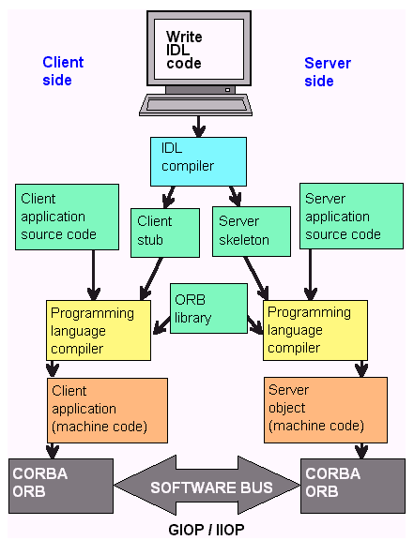
To simplify cross-platform interoperability, interfaces are defined in Interface Definition Language (IDL), which provides a platform-independent specification of a component.
An IDL specification is then translated into a stub-skeleton pair by specific CORBA compilers that generate the required client (stub) and server (skeleton) components in a specific programming language.
These templates are completed with an appropriate implementation in the selected programming language.
This allows CORBA components to be used across different runtime environment by simply using the stub and the skeleton that match the development language used.

