Slide 1
Data Mining
Chapter 6
Association Analysis: Advance Concepts
Introduction to Data Mining, 2nd Edition
by
Tan, Steinbach, Karpatne, Kumar

Slide 2
Data Mining Association Analysis: Advanced Concepts
Extensions of Association Analysis to Continuous and Categorical Attributes and Multi-level Rules

Slide 3
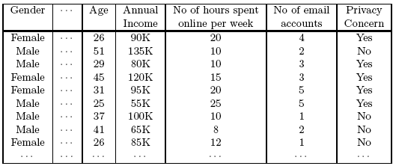
Continuous and Categorical Attributes
How to apply association analysis to non-asymmetric binary variables?
Example of Association Rule:
{Gender=Male, Age ∈ [21,30)} → {No of hours online ≥ 10}

Slide 4
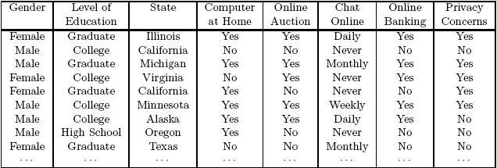
Handling Categorical Attributes
Example: Internet Usage Data
{Level of Education=Graduate, Online Banking=Yes} → {Privacy Concerns = Yes}

Slide 5
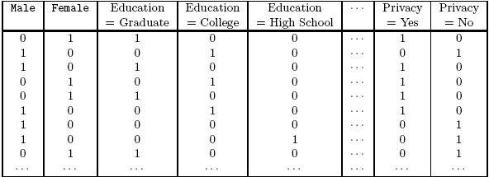
Handling Categorical Attributes
Introduce a new “item” for each distinct attribute-value pair

Slide 6
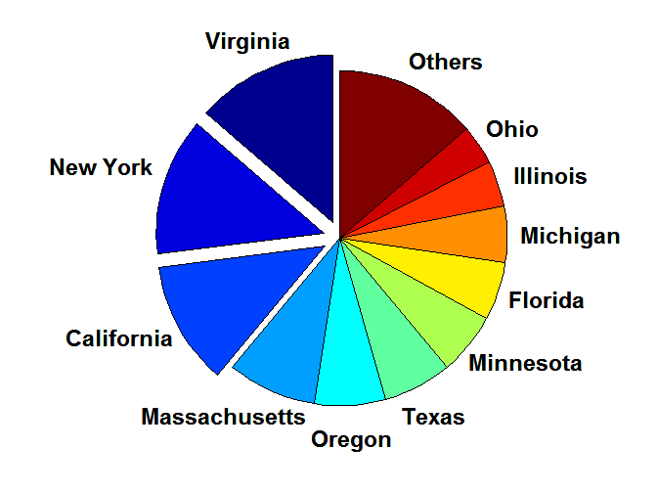
Handling Categorical Attributes
Some attributes can have many possible values
Many of their attribute values have very low support
Potential solution: Aggregate the low-support attribute values

Slide 7
Handling Categorical Attributes
Distribution of attribute values can be highly skewed
Example: 85% of survey participants own a computer at home
Most records have Computer at home = Yes
Computation becomes expensive; many frequent itemsets involving the binary item (Computer at home = Yes)
Potential solution:
discard the highly frequent items
Use alternative measures such as h-confidence
Computational Complexity
Binarizing the data increases the number of items
But the width of the “transactions” remain the same as the number of original (non-binarized) attributes
Produce more frequent itemsets but maximum size of frequent itemset is limited to the number of original attributes

Slide 8
Handling Continuous Attributes
Different methods:
Discretization-based
Statistics-based
Non-discretization based
minApriori
Different kinds of rules can be produced:
{Age∈[21,30), No of hours online∈[10,20)} → {Chat Online =Yes}
{Age∈[15,30), Covid-Positive = Yes} → Full_recovery

Slide 9

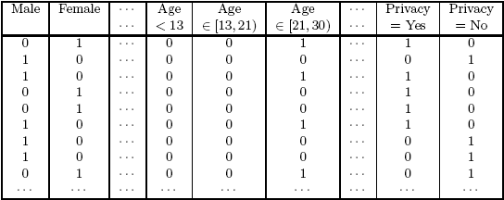
Discretization-based Methods

Slide 10
Discretization-based Methods
Unsupervised:
Equal-width binning
Equal-depth binning
Cluster-based
Supervised discretization
<1 2 3> <4 5 6> <7 8 9>
<1 2 > <3 4 5 6 7 > < 8 9>
Continuous attribute, v
₁
₂
₃
₄
₅
₆
₇
₈
₉
Chat Online = Yes
0
0
20
10
20
0
0
0
0
Chat Online = No
150
100
0
0
0
100
100
150
100
bin₁
bin₂
bin₃

Slide 11

Discretization Issues
Interval width

Slide 12
Discretization Issues
Interval too wide (e.g., Bin size= 30)
May merge several disparate patterns
Patterns A and B are merged together
May lose some of the interesting patterns
Pattern C may not have enough confidence
Interval too narrow (e.g., Bin size = 2)
Pattern A is broken up into two smaller patterns
Can recover the pattern by merging adjacent subpatterns
Pattern B is broken up into smaller patterns
Cannot recover the pattern by merging adjacent subpatterns
Some windows may not meet support threshold

Slide 13
Discretization: all possible intervals
Number of intervals = k
Total number of Adjacent intervals = k(k-1)/2
Execution time
If the range is partitioned into k intervals, there are O(k²) new items
If an interval [a,b) is frequent, then all intervals that subsume [a,b) must also be frequent
E.g.: if {Age ∈[21,25), Chat Online=Yes} is frequent, then {Age ∈[10,50), Chat Online=Yes} is also frequent
Improve efficiency:
Use maximum support to avoid intervals that are too wide

Slide 14
Statistics-based Methods
Example:
{Income > 100K, Online Banking=Yes} → Age: μ=34
Rule consequent consists of a continuous variable, characterized by their statistics
mean, median, standard deviation, etc.
Approach:
Withhold the target attribute from the rest of the data
Extract frequent itemsets from the rest of the attributes
Binarize the continuous attributes (except for the target attribute)
For each frequent itemset, compute the corresponding descriptive statistics of the target attribute
Frequent itemset becomes a rule by introducing the target variable as rule consequent
Apply statistical test to determine interestingness of the rule

Slide 15
Statistics-based Methods
Frequent Itemsets:
Association Rules:
{Male, Income > 100K}
{Income < 30K, No hours ∈[10,15)}
{Income > 100K, Online Banking = Yes}
….
{Male, Income > 100K} → Age: μ = 30
{Income < 40K, No hours ∈[10,15)} → Age: μ = 24
{Income > 100K,Online Banking = Yes} → Age: μ = 34
….

Slide 16
Statistics-based Methods
How to determine whether an association rule interesting?
Compare the statistics for segment of population covered by the rule vs segment of population not covered by the rule:
A ⇒ B: μ versus A ⇒ B: μ’
Statistical hypothesis testing:
Null hypothesis: H0: μ’ = μ + Δ
Alternative hypothesis: H1: μ’ > μ + Δ
Z has zero mean and variance 1 under null hypothesis

Slide 17
Statistics-based Methods
Example:
r: Covid-Postive & Quick_Recovery=Yes → Age: μ=23
Rule is interesting if difference between μ and μ’ is more than 5 years (i.e., Δ = 5)
For r, suppose n1 = 50, s1 = 3.5
For r’ (complement): n2 = 250, s2 = 6.5
For 1-sided test at 95% confidence level, critical Z-value for rejecting null hypothesis is 1.64.
Since Z is greater than 1.64, r is an interesting rule

Slide 18
Min-Apriori
Document-term matrix:
Example:
W1 and W2 tends to appear together in the same document

Slide 19
Min-Apriori
Data contains only continuous attributes of the same “type”
e.g., frequency of words in a document
Potential solution:
Convert into 0/1 matrix and then apply existing algorithms
lose word frequency information
Discretization does not apply as users want association among words based on how frequently they co-occur, not if they occur with similar frequencies

Slide 20
Min-Apriori
How to determine the support of a word?
If we simply sum up its frequency, support count will be greater than total number of documents!
Normalize the word vectors – e.g., using L₁ norms
Each word has a support equals to 1.0
Normalize

Slide 21
Min-Apriori
New definition of support:
Example:
Sup(W1,W2)
= .33 + 0 + .4 + 0 + 0.17
= 0.9

Slide 22
Anti-monotone property of Support
Example:
Sup(W1) = 0.4 + 0 + 0.4 + 0 + 0.2 = 1
Sup(W1, W2) = 0.33 + 0 + 0.4 + 0 + 0.17 = 0.9
Sup(W1, W2, W3) = 0 + 0 + 0 + 0 + 0.17 = 0.17

Slide 23
Concept Hierarchies

Slide 24
Multi-level Association Rules
Why should we incorporate concept hierarchy?
Rules at lower levels may not have enough support to appear in any frequent itemsets
Rules at lower levels of the hierarchy are overly specific
e.g., following rules are indicative of association between milk and bread
skim milk → white bread,
2% milk → wheat bread,
skim milk → wheat bread, etc.
Rules at higher level of hierarchy may be too generic
e.g., electronics → food

Slide 25
Multi-level Association Rules
How do support and confidence vary as we traverse the concept hierarchy?
If σ(X1 ∪ Y1) ≥ minsup, and X is parent of X1, Y is parent of Y1 then σ(X ∪ Y1) ≥ minsup, σ(X1 ∪ Y) ≥ minsup σ(X ∪ Y) ≥ minsup
If conf(X1 ⇒ Y1) ≥ minconf, then conf(X1 ⇒ Y) ≥ minconf

Slide 26
Multi-level Association Rules
Approach 1:
Extend current association rule formulation by augmenting each transaction with higher level items
Original Transaction: {skim milk, wheat bread}
Augmented Transaction: {skim milk, wheat bread, milk, bread, food}
Issues:
Items that reside at higher levels have much higher support counts
if support threshold is low, too many frequent patterns involving items from the higher levels
Increased dimensionality of the data

Slide 27
Multi-level Association Rules
Approach 2:
Generate frequent patterns at highest level first
Then, generate frequent patterns at the next highest level, and so on
Issues:
I/O requirements will increase dramatically because we need to perform more passes over the data
May miss some potentially interesting cross-level association patterns

Slide 28
Data Mining Association Analysis: Advanced Concepts
Sequential Patterns

Slide 29
Examples of Sequence
Sequence of different transactions by a customer at an online store:
< {Digital Camera,iPad} {memory card} {headphone,iPad cover} >
Sequence of initiating events causing the nuclear accident at 3-mile Island: (http://stellar-one.com/nuclear/staff_reports/summary_SOE_the_initiating_event.htm)
< {clogged resin} {outlet valve closure} {loss of feedwater} {condenser polisher outlet valve shut} {booster pumps trip} {main waterpump trips} {main turbine trips} {reactor pressure increases}>
Sequence of books checked out at a library:
<{Fellowship of the Ring} {The Two Towers} {Return of the King}>

Slide 30
Sequential Pattern Discovery: Examples
In telecommunications alarm logs,
Inverter_Problem:
(Excessive_Line_Current) (Rectifier_Alarm) --> (Fire_Alarm)
In point-of-sale transaction sequences,
Computer Bookstore:
(Intro_To_Visual_C) (C++_Primer) --> (Perl_for_dummies,Tcl_Tk)
Athletic Apparel Store:
(Shoes) (Racket, Racketball) --> (Sports_Jacket)

Slide 31
Sequence Data
Sequence Database | Sequence | Element (Transaction) | Event (Item)
Customer | Purchase history of a given customer | A set of items bought by a customer at time t | Books, diary products, CDs, etc
Web Data | Browsing activity of a particular Web visitor | A collection of files viewed by a Web visitor after a single mouse click | Home page, index page, contact info, etc
Event data | History of events generated by a given sensor | Events triggered by a sensor at time t | Types of alarms generated by sensors
Genome sequences | DNA sequence of a particular species | An element of the DNA sequence | Bases A,T,G,C
Element (Transaction)
Event (Item)
E1 E2
E1 E3
E2
E2
E3 E4
Sequence

Slide 32
Sequence Data
Sequence Database:
Sequence ID
Timestamp
Events
Sequence A:
A
10
2, 3, 5
A
20
6, 1
A
23
1
B
11
4, 5, 6
B
17
2
Sequence B:
B
21
7, 8, 1, 2
B
28
1, 6
C
14
1, 8, 7
Sequence C:

Slide 33
Sequence Data vs. Market-basket Data
Sequence Database:
Market- basket Data
Customer
Date
Items bought
Events
2, 3, 5
1,6
1
4,5,6
2
1,2,7,8
1,6
1,7,8
A
10
2, 3, 5
A
20
1,6
A
23
1
B
11
4, 5, 6
B
17
2
B
21
1,2,7,8
B
28
1, 6
C
14
1,7,8

Slide 34
Sequence Data vs. Market-basket Data
Sequence Database:
Market- basket Data
Customer
Date
Items bought
Events
2, 3, 5
1,6
1
4,5,6
2
1,2,7,8
1,6
1,7,8
A
10
2, 3, 5
A
20
1,6
A
23
1
B
11
4, 5, 6
B
17
2
B
21
1,2,7,8
B
28
1, 6
C
14
1,7,8

Slide 35
Formal Definition of a Sequence
A sequence is an ordered list of elements
s = < e₁ e₂ e₃ … >
Each element contains a collection of events (items)
e_{i} = {i₁, i₂, …, i_{k}}
Length of a sequence, |s|, is given by the number of elements in the sequence
A k-sequence is a sequence that contains k events (items)
<{a,b} {a}> has a length of 2 and it is a 3-sequence

Slide 36
Formal Definition of a Subsequence
A sequence t: <a₁ a₂ … a_{n}> is contained in another sequence s: <b₁ b₂ … b_{m}> (m ≥ n) if there exist integers i₁ < i₂ < … < i_{n} such that a₁ ⊆ b_{i1} , a₂ ⊆ b_{i2}, …, a_{n} ⊆ b_{in}
Illustrative Example:
s: b₁ b₂ b₃ b₄ b₅
t: a₁ a₂ a₃
t is a subsequence of s if a₁⊆ b_{2,} a₂⊆ b_{3,} a₃⊆ b_{5.}
Data sequence | Subsequence | Contain?
< {2,4} {3,5,6} {8} > | < {2} {8} >
< {1,2} {3,4} > | < {1} {2} >
< {2,4} {2,4} {2,5} > | < {2} {4} >
<{2,4} {2,5} {4,5}> | < {2} {4} {5} >
<{2,4} {2,5} {4,5}> | < {2} {5} {5} >
<{2,4} {2,5} {4,5}> | < {2, 4, 5} >
Yes
No
Yes
No
Yes
No

Slide 37
Sequential Pattern Mining: Definition
The support of a subsequence w is defined as the fraction of data sequences that contain w
A sequential pattern is a frequent subsequence (i.e., a subsequence whose support is ≥ minsup)
Given:
a database of sequences
a user-specified minimum support threshold, minsup
Task:
Find all subsequences with support ≥ minsup

Slide 38
Sequential Pattern Mining: Example
Minsup = 50%
Examples of Frequent Subsequences:
< {1,2} > s=60%
< {2,3} > s=60%
< {2,4}> s=80%
< {3} {5}> s=80%
< {1} {2} > s=80%
< {2} {2} > s=60%
< {1} {2,3} > s=60%
< {2} {2,3} > s=60%
< {1,2} {2,3} > s=60%

Slide 39


Sequence Data vs. Market-basket Data
Sequence Database:
Market- basket Data
Customer
Date
Items bought
Events
2, 3, 5
1,6
1
4,5,6
2
1,2,7,8
1,6
1,7,8
A
10
2, 3, 5
A
20
1,6
A
23
1
B
11
4, 5, 6
B
17
2
B
21
1,2,7,8
B
28
1, 6
C
14
1,7,8
{2} -> {1}
(1,8) -> (7)

Slide 40
Extracting Sequential Patterns
Given n events: i₁, i₂, i₃, …, i_{n}
Candidate 1-subsequences:
<{i₁}>, <{i₂}>, <{i₃}>, …, <{i_{n}}>
Candidate 2-subsequences:
<{i₁, i₂}>, <{i₁, i₃}>, …,
<{i₁} {i₁}>, <{i₁} {i₂}>, …, <{i_{n}} {i_{n}}>
Candidate 3-subsequences:
<{i₁, i₂ , i₃}>, <{i₁, i₂ , i₄}>, …,
<{i₁, i₂} {i₁}>, <{i₁, i₂} {i₂}>, …,
<{i₁} {i₁ , i₂}>, <{i₁} {i₁ , i₃}>, …,
<{i₁} {i₁} {i₁}>, <{i₁} {i₁} {i₂}>, …

Slide 41
Extracting Sequential Patterns: Simple example
()
Given 2 events: a, b
Candidate 1-subsequences:
<{a}>, <{b}>.
Candidate 2-subsequences:
<{a} {a}>, <{a} {b}>, <{b} {a}>, <{b} {b}>, <{a, b}>.
Candidate 3-subsequences:
<{a} {a} {a}>, <{a} {a} {b}>, <{a} {b} {a}>, <{a} {b} {b}>,
<{b} {b} {b}>, <{b} {b} {a}>, <{b} {a} {b}>, <{b} {a} {a}>
<{a, b} {a}>, <{a, b} {b}>, <{a} {a, b}>, <{b} {a, b}>
(a)
(b)
(a,b)
Item-set patterns

Slide 42
Generalized Sequential Pattern (GSP)
Step 1:
Make the first pass over the sequence database D to yield all the 1-element frequent sequences
Step 2:
Repeat until no new frequent sequences are found
Candidate Generation:
Merge pairs of frequent subsequences found in the (k-1)th pass to generate candidate sequences that contain k items
Candidate Pruning:
Prune candidate k-sequences that contain infrequent (k-1)-subsequences
Support Counting:
Make a new pass over the sequence database D to find the support for these candidate sequences
Candidate Elimination:
Eliminate candidate k-sequences whose actual support is less than minsup

Slide 43
Candidate Generation
Base case (k=2):
Merging two frequent 1-sequences <{i₁}> and <{i₂}> will produce the following candidate 2-sequences: <{i₁} {i₁}>, <{i₁} {i₂}>, <{i₂} {i₂}>, <{i₂} {i₁}> and <{i_{1,} i₂}>. (Note: <{i₁}> can be merged with itself to produce: <{i₁} {i₁}>)
General case (k>2):
A frequent (k-1)-sequence w₁ is merged with another frequent (k-1)-sequence w₂ to produce a candidate k-sequence if the subsequence obtained by removing an event from the first element in w₁ is the same as the subsequence obtained by removing an event from the last element in w₂

Slide 44
Candidate Generation
Base case (k=2):
Merging two frequent 1-sequences <{i₁}> and <{i₂}> will produce the following candidate 2-sequences: <{i₁} {i₁}>, <{i₁} {i₂}>, <{i₂} {i₂}>, <{i₂} {i₁}> and <{i₁ i₂}>. (Note: <{i₁}> can be merged with itself to produce: <{i₁} {i₁}>)
General case (k>2):
A frequent (k-1)-sequence w₁ is merged with another frequent (k-1)-sequence w₂ to produce a candidate k-sequence if the subsequence obtained by removing an event from the first element in w₁ is the same as the subsequence obtained by removing an event from the last element in w₂
The resulting candidate after merging is given by extending the sequence w₁ as follows-
If the last element of w₂ has only one event, append it to w₁
Otherwise add the event from the last element of w₂ (which is absent in the last element of w₁) to the last element of w₁

Slide 45
Candidate Generation Examples
Merging w₁=<{1 2 3} {4 6}> and w₂ =<{2 3} {4 6} {5}> produces the candidate sequence < {1 2 3} {4 6} {5}> because the last element of w₂ has only one event
Merging w₁=<{1} {2 3} {4}> and w₂ =<{2 3} {4 5}> produces the candidate sequence < {1} {2 3} {4 5}> because the last element in w₂ has more than one event
Merging w₁=<{1 2 3} > and w₂ =<{2 3 4} > produces the candidate sequence < {1 2 3 4}> because the last element in w₂ has more than one event
We do not have to merge the sequences w₁ =<{1} {2 6} {4}> and w₂ =<{1} {2} {4 5}> to produce the candidate < {1} {2 6} {4 5}> because if the latter is a viable candidate, then it can be obtained by merging w₁ with < {2 6} {4 5}>

Slide 46
Candidate Generation: Examples (ctd)
Can <{a},{b},{c}> merge with <{b},{c},{f}> ?
Can <{a},{b},{c}> merge with <{b,c},{f}>?
Can <{a},{b},{c}> merge with <{b},{c,f}>?
Can <{a,b},{c}> merge with <{b},{c,f}> ?
Can <{a,b,c}> merge with <{b,c,f}>?
Can <{a}> merge with <{a}>?

Slide 47
Candidate Generation: Examples (ctd)
<{a},{b},{c}> can be merged with <{b},{c},{f}> to produce <{a},{b},{c},{f}>
<{a},{b},{c}> cannot be merged with <{b,c},{f}>
<{a},{b},{c}> can be merged with <{b},{c,f}> to produce <{a},{b},{c,f}>
<{a,b},{c}> can be merged with <{b},{c,f}> to produce <{a,b},{c,f}>
<{a,b,c}> can be merged with <{b,c,f}> to produce <{a,b,c,f}>
<{a}{b}{a}> can be merged with <{b}{a}{b}> to produce <{a},{b},{a},{b}>
<{b}{a}{b}> can be merged with <{a}{b}{a}> to produce <{b},{a},{b},{a}>

Slide 48
GSP Example

Slide 49
GSP Example

Slide 50
Timing Constraints (I)
{A B} {C} {D E}
x_{g}: max-gap
n_{g}: min-gap
m_{s}: maximum span
<= x_{g}
>n_{g}
<= m_{s}
x_{g} = 2, n_{g} = 0, m_{s}= 4
Data sequence, d | Sequential Pattern, s | d contains s?
< {2,4} {3,5,6} {4,7} {4,5} {8} > | < {6} {5} >
< {1} {2} {3} {4} {5}> | < {1} {4} >
< {1} {2,3} {3,4} {4,5}> | < {2} {3} {5} >
< {1,2} {3} {2,3} {3,4} {2,4} {4,5}> | < {1,2} {5} >
Yes
No
Yes
No

Slide 51
Mining Sequential Patterns with Timing Constraints
Approach 1:
Mine sequential patterns without timing constraints
Postprocess the discovered patterns
Approach 2:
Modify GSP to directly prune candidates that violate timing constraints
Question:
Does Apriori principle still hold?

Slide 52
Apriori Principle for Sequence Data
Suppose:
x_{g} = 1 (max-gap)
n_{g} = 0 (min-gap)
m_{s} = 5 (maximum span)
minsup = 60%
<{2} {5}> support = 40%
but
<{2} {3} {5}> support = 60%
Problem exists because of max-gap constraint
No such problem if max-gap is infinite

Slide 53
Contiguous Subsequences
s is a contiguous subsequence of w = <e₁>< e₂>…< e_{k}> if any of the following conditions hold:
s is obtained from w by deleting an item from either e₁ or e_{k}
s is obtained from w by deleting an item from any element e_{i} that contains at least 2 items
s is a contiguous subsequence of s’ and s’ is a contiguous subsequence of w (recursive definition)
Examples: s = < {1} {2} >
is a contiguous subsequence of < {1} {2 3}>, < {1 2} {2} {3}>, and < {3 4} {1 2} {2 3} {4} >
is not a contiguous subsequence of < {1} {3} {2}> and < {2} {1} {3} {2}>

Slide 54
Modified Candidate Pruning Step
Without maxgap constraint:
A candidate k-sequence is pruned if at least one of its (k-1)-subsequences is infrequent
With maxgap constraint:
A candidate k-sequence is pruned if at least one of its contiguous (k-1)-subsequences is infrequent

Slide 55
Timing Constraints (II)
x_{g}: max-gap
n_{g}: min-gap
ws: window size
m_{s}: maximum span
{A B} {C} {D E}
<= x_{g}
>n_{g}
<= ws
<= m_{s}
x_{g} = 2, n_{g} = 0, ws = 1, m_{s}= 5
Data sequence, d | Sequential Pattern, s | d contains s?
< {2,4} {3,5,6} {4,7} {4,5} {8} > | < {3,4,5}> | Yes
< {1} {2} {3} {4} {5}> | < {1,2} {3,4} > | No
< {1,2} {2,3} {3,4} {4,5}> | < {1,2} {3,4} > | Yes

Slide 56
Modified Support Counting Step
Given a candidate sequential pattern: <{a, c}>
Any data sequences that contain
<… {a c} … >, <… {a} … {c}…> ( where time({c}) – time({a}) ≤ ws) <…{c} … {a} …> (where time({a}) – time({c}) ≤ ws)
will contribute to the support count of candidate pattern

Slide 57
Other Formulation
In some domains, we may have only one very long time series
Example:
monitoring network traffic events for attacks
monitoring telecommunication alarm signals
Goal is to find frequent sequences of events in the time series
This problem is also known as frequent episode mining
E1
E2
E3
E4
E1
E2
E1
E2
E2 E4
E3 E5
E1
E2
E2
E3 E5
E1
E2
E3 E4
E3 E1
Pattern: <E1> <E3>

Slide 58
General Support Counting Schemes
Assume:
x_{g} = 2 (max-gap)
n_{g} = 0 (min-gap)
ws = 0 (window size)
m_{s} = 2 (maximum span)

Slide 59
Data Mining Association Analysis: Advanced Concepts
Subgraph Mining

Slide 60
Frequent Subgraph Mining
Extends association analysis to finding frequent subgraphs
Useful for Web Mining, computational chemistry, bioinformatics, spatial data sets, etc

Slide 61
Graph Definitions

Slide 62
Representing Transactions as Graphs
Each transaction is a clique of items

Slide 63
Representing Graphs as Transactions

Slide 64
Challenges
Node may contain duplicate labels
Support and confidence
How to define them?
Additional constraints imposed by pattern structure
Support and confidence are not the only constraints
Assumption: frequent subgraphs must be connected
Apriori-like approach:
Use frequent k-subgraphs to generate frequent (k+1) subgraphs
What is k?

Slide 65
Challenges…
Support:
number of graphs that contain a particular subgraph
Apriori principle still holds
Level-wise (Apriori-like) approach:
Vertex growing:
k is the number of vertices
Edge growing:
k is the number of edges

Slide 66
Vertex Growing

Slide 67
Edge Growing

Slide 68
Apriori-like Algorithm
Find frequent 1-subgraphs
Repeat
Candidate generation
Use frequent (k-1)-subgraphs to generate candidate k-subgraph
Candidate pruning
Prune candidate subgraphs that contain infrequent (k-1)-subgraphs
Support counting
Count the support of each remaining candidate
Eliminate candidate k-subgraphs that are infrequent
In practice, it is not as easy. There are many other issues

Slide 69
Example: Dataset

Slide 70
Example

Slide 71
Candidate Generation
In Apriori:
Merging two frequent k-itemsets will produce a candidate (k+1)-itemset
In frequent subgraph mining (vertex/edge growing)
Merging two frequent k-subgraphs may produce more than one candidate (k+1)-subgraph

Slide 72
Multiplicity of Candidates (Vertex Growing)

Slide 73
Multiplicity of Candidates (Edge growing)
Case 1: identical vertex labels

Slide 74
Multiplicity of Candidates (Edge growing)
Case 2: Core contains identical labels
Core: The (k-1) subgraph that is common between the joint graphs

Slide 75
Multiplicity of Candidates (Edge growing)
Case 3: Core multiplicity

Slide 76
Topological Equivalence

Slide 77
Candidate Generation by Edge Growing
Given:
Case 1: a ≠ c and b ≠ d

Slide 78
Candidate Generation by Edge Growing
Case 2: a = c and b ≠ d

Slide 79
Candidate Generation by Edge Growing
Case 3: a ≠ c and b = d

Slide 80
Candidate Generation by Edge Growing
Case 4: a = c and b = d

Slide 81
Graph Isomorphism
A graph is isomorphic if it is topologically equivalent to another graph

Slide 82
Graph Isomorphism
Test for graph isomorphism is needed:
During candidate generation step, to determine whether a candidate has been generated
During candidate pruning step, to check whether its (k-1)-subgraphs are frequent
During candidate counting, to check whether a candidate is contained within another graph

Slide 83
Graph Isomorphism
The same graph can be represented in many ways

Slide 84
Graph Isomorphism
Use canonical labeling to handle isomorphism
Map each graph into an ordered string representation (known as its code) such that two isomorphic graphs will be mapped to the same canonical encoding
Example:
Lexicographically largest adjacency matrix
String: 011011
Canonical: 111100

Slide 85
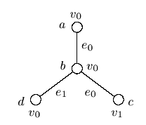
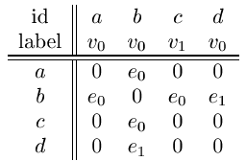
Example of Canonical Labeling (Kuramochi & Karypis, ICDM 2001)
Graph:
Adjacency matrix representation:

Slide 86
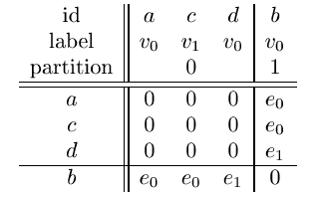
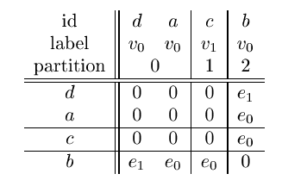
Example of Canonical Labeling (Kuramochi & Karypis, ICDM 2001)
Order based on vertex degree:
Order based on vertex labels:

Slide 87
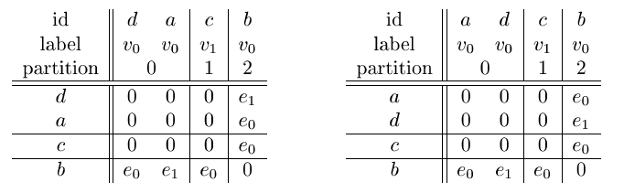
Example of Canonical Labeling (Kuramochi & Karypis, ICDM 2001)
Find canonical label:
0 0 0 e₁ e₀ e₀
>
0 0 0 e₀ e₁ e₀
(Canonical Label)

