Slide 1
Anomaly Detection
Lecture Notes for Chapter 9
Introduction to Data Mining, 2nd Edition
by
Tan, Steinbach, Karpatne, Kumar

Slide 2
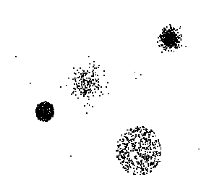
Anomaly/Outlier Detection
What are anomalies/outliers?
The set of data points that are considerably different than the remainder of the data
Natural implication is that anomalies are relatively rare
One in a thousand occurs often if you have lots of data
Context is important, e.g., freezing temps in July
Can be important or a nuisance
Unusually high blood pressure
200 pound, 2 year old

Slide 3
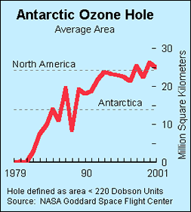
Importance of Anomaly Detection
Ozone Depletion History
In 1985 three researchers (Farman, Gardinar and Shanklin) were puzzled by data gathered by the British Antarctic Survey showing that ozone levels for Antarctica had dropped 10% below normal levels
Why did the Nimbus 7 satellite, which had instruments aboard for recording ozone levels, not record similarly low ozone concentrations?
The ozone concentrations recorded by the satellite were so low they were being treated as outliers by a computer program and discarded!
Source: http://www.epa.gov/ozone/science/hole/size.html

Slide 4
Causes of Anomalies
Data from different classes
Measuring the weights of oranges, but a few grapefruit are mixed in
Natural variation
Unusually tall people
Data errors
200 pound 2 year old
https://umn.zoom.us/my/kumar001

Slide 5
Distinction Between Noise and Anomalies
Noise doesn’t necessarily produce unusual values or objects
Noise is not interesting
Noise and anomalies are related but distinct concepts

Slide 6
Model-based vs Model-free
Model-based Approaches
Model can be parametric or non-parametric
Anomalies are those points that don’t fit well
Anomalies are those points that distort the model
Model-free Approaches
Anomalies are identified directly from the data without building a model
Often the underlying assumption is that the most of the points in the data are normal

Slide 7
General Issues: Label vs Score
Some anomaly detection techniques provide only a binary categorization
Other approaches measure the degree to which an object is an anomaly
This allows objects to be ranked
Scores can also have associated meaning (e.g., statistical significance)

Slide 8
Anomaly Detection Techniques
Statistical Approaches
Proximity-based
Anomalies are points far away from other points
Clustering-based
Points far away from cluster centers are outliers
Small clusters are outliers
Reconstruction Based

Slide 9
Statistical Approaches
Probabilistic definition of an outlier: An outlier is an object that has a low probability with respect to a probability distribution model of the data.
Usually assume a parametric model describing the distribution of the data (e.g., normal distribution)
Apply a statistical test that depends on
Data distribution
Parameters of distribution (e.g., mean, variance)
Number of expected outliers (confidence limit)
Issues
Identifying the distribution of a data set
Heavy tailed distribution
Number of attributes
Is the data a mixture of distributions?

Slide 10
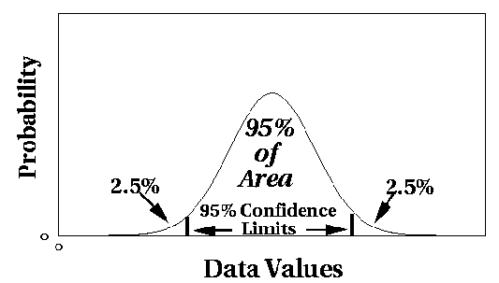
Normal Distributions
One-dimensional Gaussian
Two-dimensional Gaussian

Slide 11
Grubbs’ Test
Detect outliers in univariate data
Assume data comes from normal distribution
Detects one outlier at a time, remove the outlier, and repeat
H₀: There is no outlier in data
H_{A}: There is at least one outlier
Grubbs’ test statistic:
Reject H₀ if:

Slide 12
Statistically-based – Likelihood Approach
Assume the data set D contains samples from a mixture of two probability distributions:
M (majority distribution)
A (anomalous distribution)
General Approach:
Initially, assume all the data points belong to M
Let L_{t}(D) be the log likelihood of D at time t
For each point x_{t} that belongs to M, move it to A
Let L_{t+1} (D) be the new log likelihood.
Compute the difference, Δ = L_{t}(D) – L_{t+1} (D)
If Δ > c (some threshold), then x_{t} is declared as an anomaly and moved permanently from M to A

Slide 13
Statistically-based – Likelihood Approach
Data distribution, D = (1 – λ) M + λ A
M is a probability distribution estimated from data
Can be based on any modeling method (naïve Bayes, maximum entropy, etc.)
A is initially assumed to be uniform distribution
Likelihood at time t:

Slide 14
Strengths/Weaknesses of Statistical Approaches
Firm mathematical foundation
Can be very efficient
Good results if distribution is known
In many cases, data distribution may not be known
For high dimensional data, it may be difficult to estimate the true distribution
Anomalies can distort the parameters of the distribution

Slide 15
Distance-Based Approaches
The outlier score of an object is the distance to its kth nearest neighbor

Slide 16
One Nearest Neighbor - One Outlier
Outlier Score

Slide 17
One Nearest Neighbor - Two Outliers
Outlier Score

Slide 18
Five Nearest Neighbors - Small Cluster
Outlier Score

Slide 19
Five Nearest Neighbors - Differing Density
Outlier Score

Slide 20
Strengths/Weaknesses of Distance-Based Approaches
Simple
Expensive – O(n²)
Sensitive to parameters
Sensitive to variations in density
Distance becomes less meaningful in high-dimensional space

Slide 21
Density-Based Approaches
Density-based Outlier: The outlier score of an object is the inverse of the density around the object.
Can be defined in terms of the k nearest neighbors
One definition: Inverse of distance to kth neighbor
Another definition: Inverse of the average distance to k neighbors
DBSCAN definition
If there are regions of different density, this approach can have problems

Slide 22
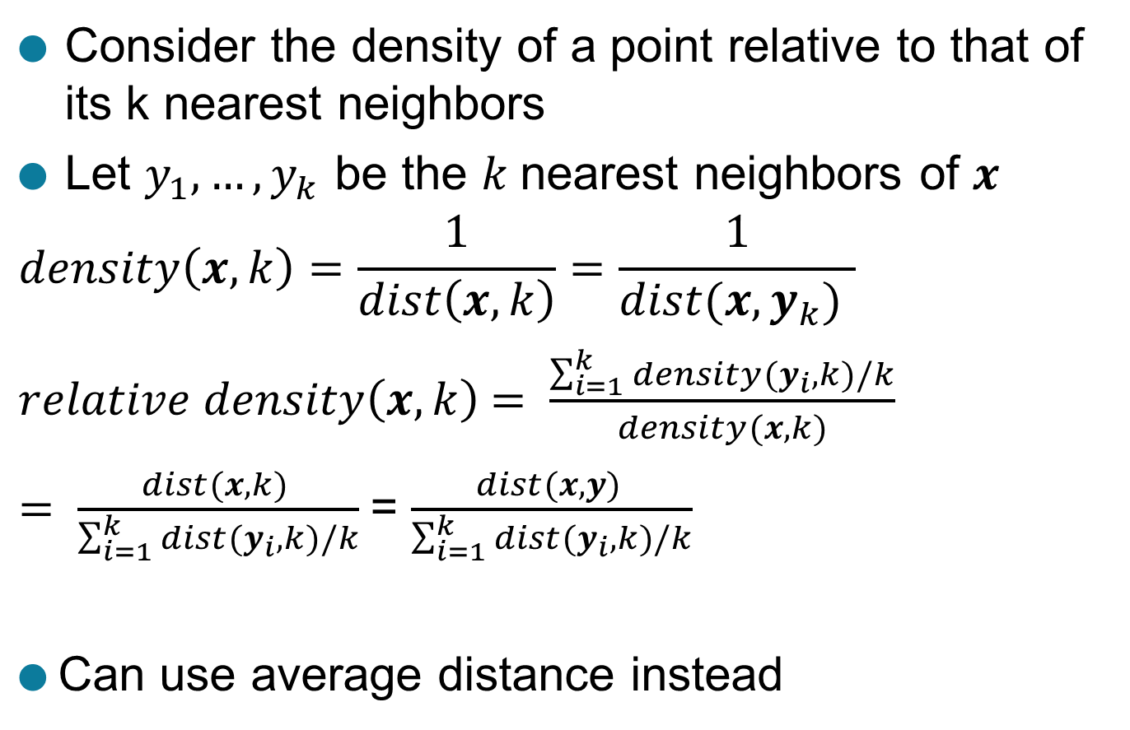
Relative Density
Consider the density of a point relative to that of its k nearest neighbors
Let $y_{1},…, y_{k}$ be the $k$nearest neighbors of $x$
$$density\left(x,k\right)=\frac{1}{dist\left(x,k\right)}=\frac{1}{dist(x,y_{k}) }$$
$relative density\left(x,k\right)$ $= \frac{\sum_{i=1}^{k}{density(y_{i},k)/k}}{density(x,k)}$
$= \frac{dist(x,k) }{\sum_{i=1}^{k}{dist(y_{i},k)/k}}$= $\frac{dist(x,y) }{\sum_{i=1}^{k}{dist(y_{i},k)/k}}$
Can use average distance instead

Slide 23
Relative Density Outlier Scores
Outlier Score

Slide 24
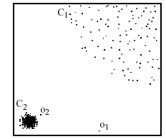
Relative Density-based: LOF approach
For each point, compute the density of its local neighborhood
Compute local outlier factor (LOF) of a sample p as the average of the ratios of the density of sample p and the density of its nearest neighbors
Outliers are points with largest LOF value
In the NN approach, p₂ is not considered as outlier, while LOF approach find both p₁ and p₂ as outliers
p₂
×
p₁
×

Slide 25
Strengths/Weaknesses of Density-Based Approaches
Simple
Expensive – O(n²)
Sensitive to parameters
Density becomes less meaningful in high-dimensional space

Slide 26
Clustering-Based Approaches
An object is a cluster-based outlier if it does not strongly belong to any cluster
For prototype-based clusters, an object is an outlier if it is not close enough to a cluster center
Outliers can impact the clustering produced
For density-based clusters, an object is an outlier if its density is too low
Can’t distinguish between noise and outliers
For graph-based clusters, an object is an outlier if it is not well connected

Slide 27
Distance of Points from Closest Centroids
Outlier Score

Slide 28
Relative Distance of Points from Closest Centroid
Outlier Score

Slide 29
Strengths/Weaknesses of Clustering-Based Approaches
Simple
Many clustering techniques can be used
Can be difficult to decide on a clustering technique
Can be difficult to decide on number of clusters
Outliers can distort the clusters

Slide 30
Reconstruction-Based Approaches
Based on assumptions there are patterns in the distribution of the normal class that can be captured using lower-dimensional representations
Reduce data to lower dimensional data
E.g. Use Principal Components Analysis (PCA) or Auto-encoders
Measure the reconstruction error for each object
The difference between original and reduced dimensionality version

Slide 31
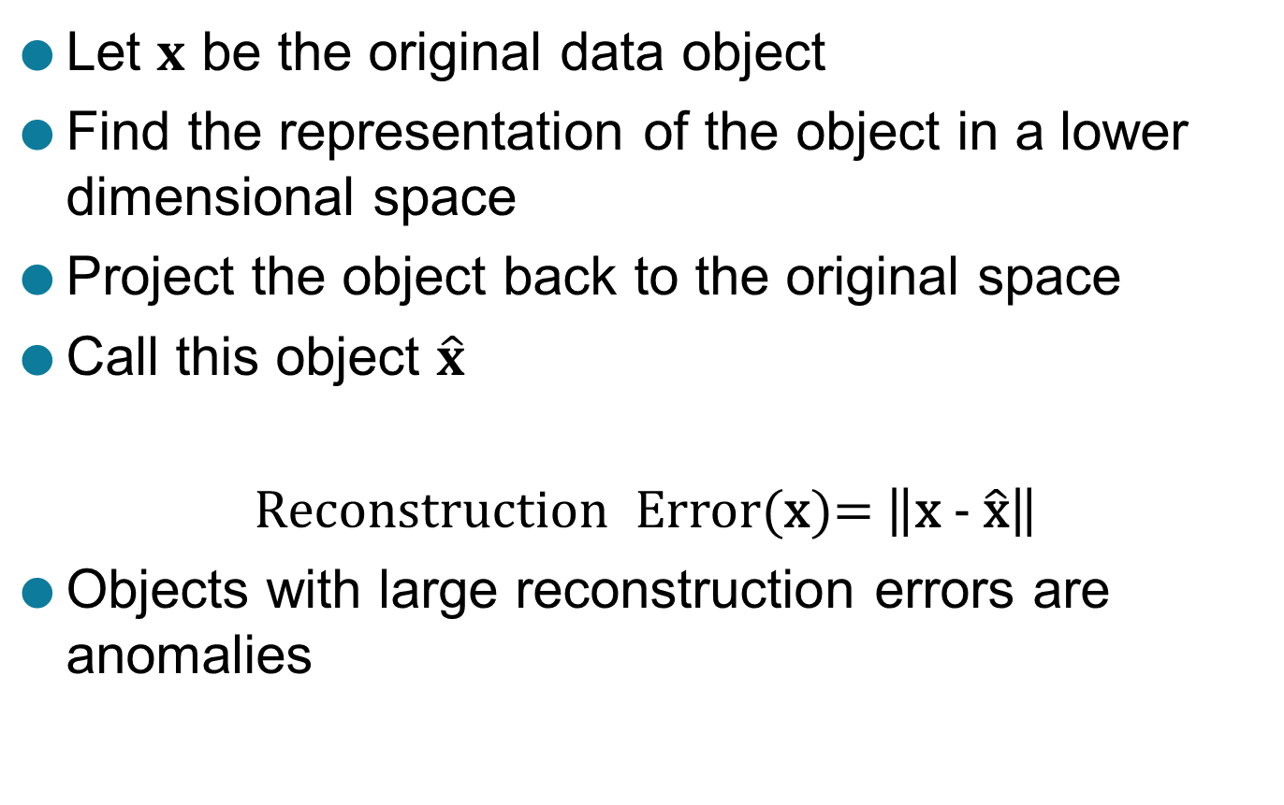
Reconstruction Error
Let $x$ be the original data object
Find the representation of the object in a lower dimensional space
Project the object back to the original space
Call this object $\hat{x}$
$$\text{Reconstruction} \text{Error}\text{(}\text{x}\text{)= }\left\|\text{x}\text{ − }\hat{\text{x}}\right\|$$
Objects with large reconstruction errors are anomalies

Slide 32
Reconstruction of two-dimensional data

Slide 33
Basic Architecture of an Autoencoder
An autoencoder is a multi-layer neural network
The number of input and output neurons is equal to the number of original attributes.

Slide 34
Strengths and Weaknesses
Does not require assumptions about distribution of normal class
Can use many dimensionality reduction approaches
The reconstruction error is computed in the original space
This can be a problem if dimensionality is high

Slide 35
One Class SVM
Uses an SVM approach to classify normal objects
Uses the given data to construct such a model
This data may contain outliers
But the data does not contain class labels
How to build a classifier given one class?

Slide 36
How Does One-Class SVM Work?
Uses the “origin” trick
Use a Gaussian kernel
Every point mapped to a unit hypersphere
Every point in the same orthant (quadrant)
Aim to maximize the distance of the separating plane from the origin

Slide 37
Two-dimensional One Class SVM

Slide 38

Equations for One-Class SVM
Equation of hyperplane
$φ$ is the mapping to high dimensional space
Weight vector is
$ν$ is fraction of outliers
Optimization condition is the following

Slide 39

Finding Outliers with a One-Class SVM
Decision boundary with $ν=0.1$

Slide 40

Finding Outliers with a One-Class SVM
Decision boundary with $ν=0.05 \text{and} ν=0.2$

Slide 41

Strengths and Weaknesses
Strong theoretical foundation
Choice of $ν$ is difficult
Computationally expensive

Slide 42
Information Theoretic Approaches
Key idea is to measure how much information decreases when you delete an observation
Anomalies should show higher gain
Normal points should have less gain

Slide 43
Information Theoretic Example
Survey of height and weight for 100 participants
Eliminating last group give a gain of 2.08 − 1.89 = 0.19

Slide 44
Strengths and Weaknesses
Solid theoretical foundation
Theoretically applicable to all kinds of data
Difficult and computationally expensive to implement in practice

Slide 45
Evaluation of Anomaly Detection
If class labels are present, then use standard evaluation approaches for rare class such as precision, recall, or false positive rate
FPR is also know as false alarm rate
For unsupervised anomaly detection use measures provided by the anomaly method
E.g. reconstruction error or gain
Can also look at histograms of anomaly scores.

Slide 46
Distribution of Anomaly Scores
Anomaly scores should show a tail

