Slide 1
Data Mining: Avoiding False Discoveries
Lecture Notes for Chapter 10
Introduction to Data Mining, 2nd Edition
by
Tan, Steinbach, Karpatne, Kumar

Slide 2
Outline
Statistical Background
Significance Testing
Hypothesis Testing
Multiple Hypothesis Testing

Slide 3
Motivation
An algorithm applied to a set of data will usually produce some result(s)
There have been claims that the results reported in more than 50% of published papers are false. (Ioannidis)
Results may be a result of random variation
Any particular data set is a finite sample from a larger population
Often significant variation among instances in a data set or heterogeneity in the population
Unusual events or coincidences do happen, especially when looking at lots of events
For this and other reasons, results may not replicate, i.e., generalize to other samples of data
Results may not have domain significance
Finding a difference that makes no difference
Data scientists need to help ensure that results of data analysis are not false discoveries, i.e., not meaningful or reproducible

Slide 4
Statistical Testing
Statistical approaches are used to help avoid many of these problems
Statistics has well-developed procedures for evaluating the results of data analysis
Significance testing
Hypothesis testing
Domain knowledge, careful data collection and preprocessing, and proper methodology are also important
Bias and poor quality data
Fishing for good results
Reporting how analysis was done
Ultimate verification lies in the real world

Slide 5
Probability and Distributions
Variables are characterized by a set of possible values
Called the domain of the variable
Examples:
True or False for binary variables
Subset of integers for variables that are counts, such as number of students in a class
Range of real numbers for variables such as weight or height
A probability distribution function describes the relative frequency with which the values are observed
Call a variable with a distribution a random variable

Slide 6
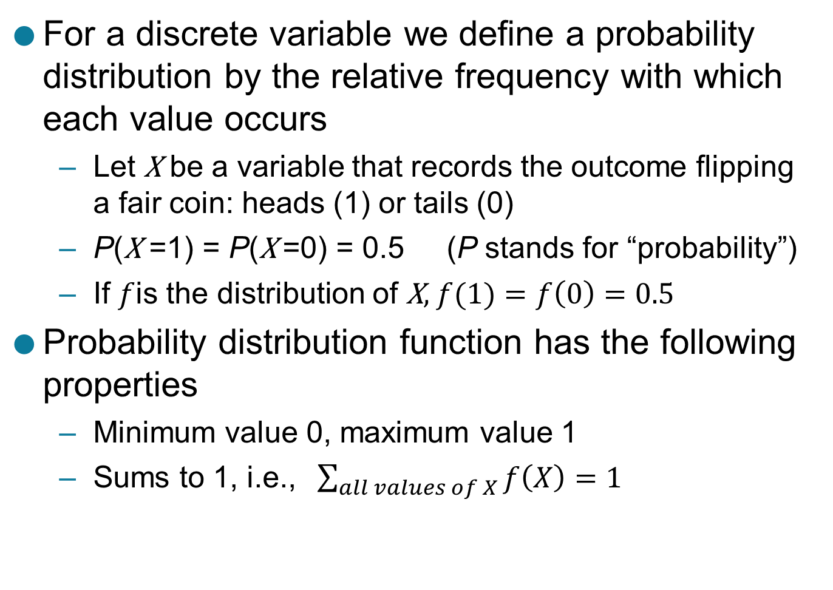
Probability and Distributions ..
For a discrete variable we define a probability distribution by the relative frequency with which each value occurs
Let X be a variable that records the outcome flipping a fair coin: heads (1) or tails (0)
P(X =1) = P(X =0) = 0.5 (P stands for “probability”)
If $f$is the distribution of X, $f(1)=f\left(0\right)=0.5$
Probability distribution function has the following properties
Minimum value 0, maximum value 1
Sums to 1, i.e., $\sum_{all values of X}{f\left(X\right)=1}$

Slide 7

Binomial Distribution
Number of heads in a sequence of n coin flips
Let R be the number of heads
R has a binomial distribution
$P\left(R=k\right)={ \left(\begin{matrix}n \\ k\end{matrix}\right)P\left(X=1\right)}^{k}{P\left(X=0\right)}^{n−k}$
What is $P\left(R=k\right)$ given n = 10 and $P\left(X=1\right)$=0.5 ?
k | P(R= k)
0 | 0.001
1 | 0.01
2 | 0.044
3 | 0.117
4 | 0.205
5 | 0.246
6 | 0.205
7 | 0.117
8 | 0.044
9 | 0.01
10 | 0.001

Slide 8
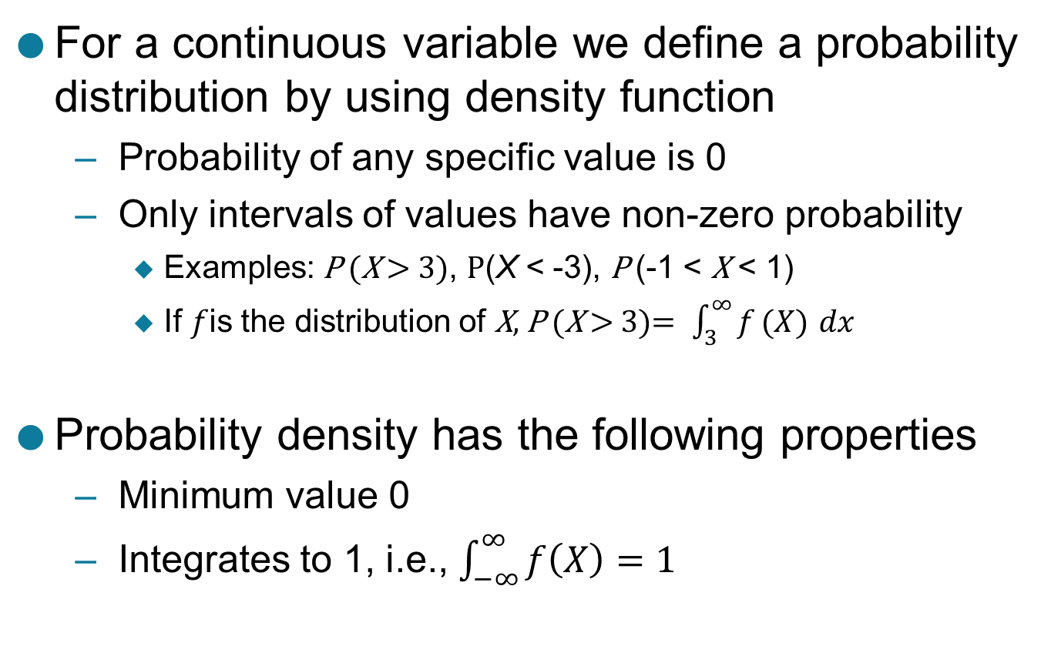
Probability and Distributions ..
For a continuous variable we define a probability distribution by using density function
Probability of any specific value is 0
Only intervals of values have non-zero probability
Examples: P (X > 3), P(X < -3), P (-1 < X < 1)
If $f$is the distribution of X, P (X > 3)$= \int_{3}^{∞}{f}(X)$ $dx$
Probability density has the following properties
Minimum value 0
Integrates to 1, i.e., $\int_{−∞}^{∞}{f\left(X\right)=1}$

Slide 9
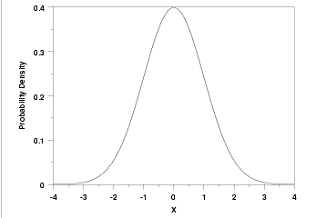
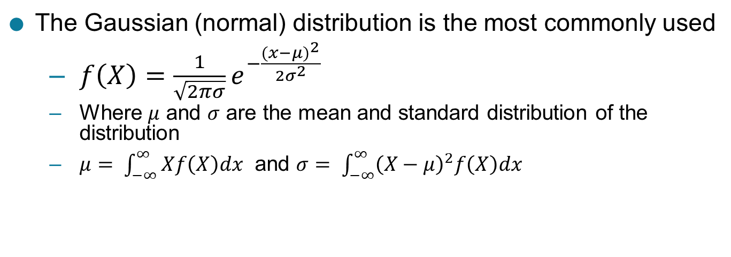
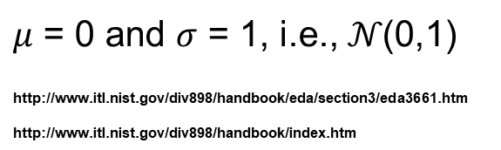
Gaussian Distribution
The Gaussian (normal) distribution is the most commonly used
$f\left(X\right)=\frac{1}{\sqrt{2πσ}}e^{−\frac{({x−μ)}^{2}}{2σ^{2}}}$
Where $μ$ and $σ$ are the mean and standard distribution of the distribution
$μ= \int_{−∞}^{∞}{Xf\left(X\right)dx}$ and $σ= \int_{−∞}^{∞}{{\left(X−μ\right)}^{2}f\left(X\right)dx}$
$μ$ = 0 and $σ$ = 1, i.e., $𝒩$(0,1)
http://www.itl.nist.gov/div898/handbook/eda/section3/eda3661.htm
http://www.itl.nist.gov/div898/handbook/index.htm

Slide 10
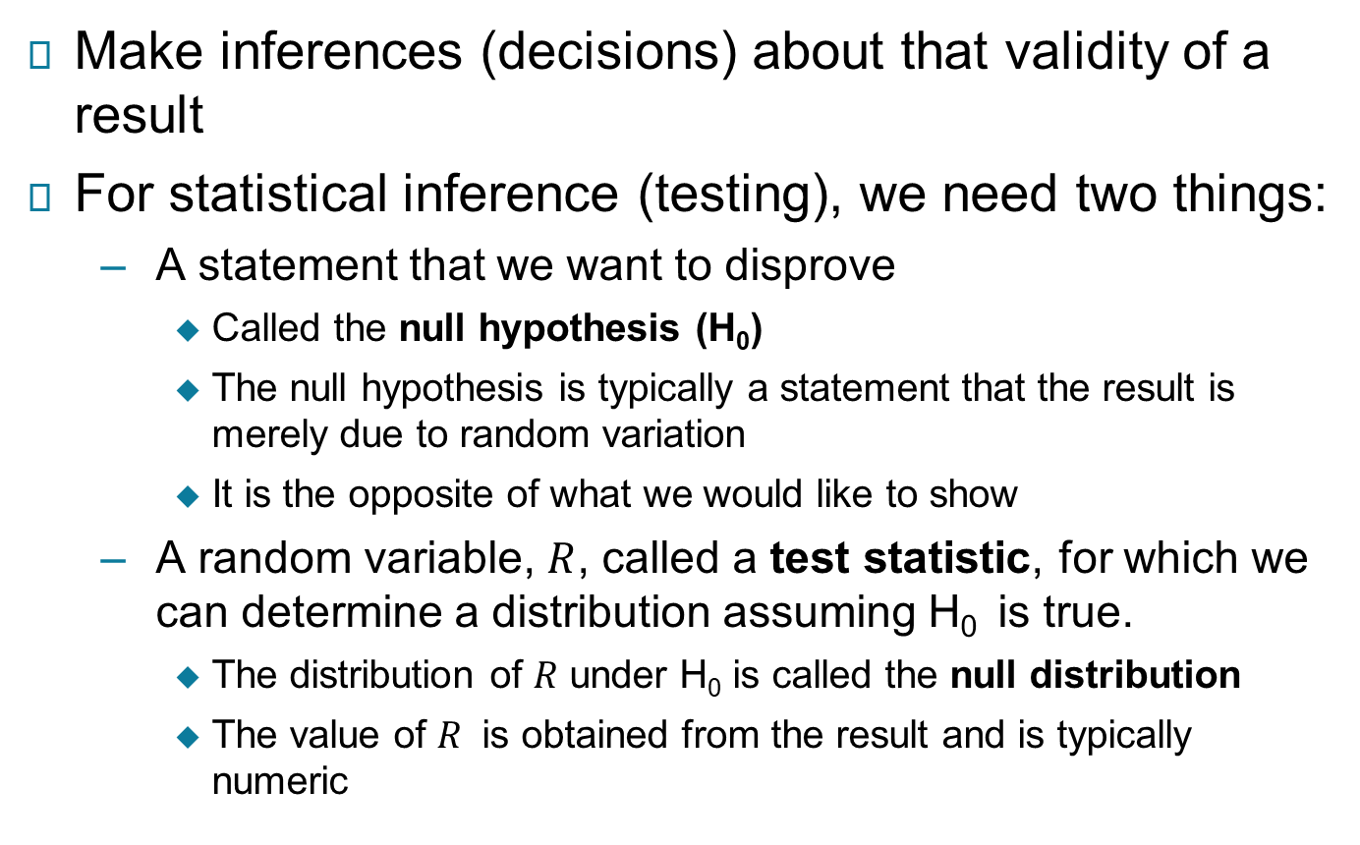
Statistical Testing
Make inferences (decisions) about that validity of a result
For statistical inference (testing), we need two things:
A statement that we want to disprove
Called the null hypothesis (H₀)
The null hypothesis is typically a statement that the result is merely due to random variation
It is the opposite of what we would like to show
A random variable, $R$, called a test statistic, for which we can determine a distribution assuming H₀ is true.
The distribution of $R$ under H₀ is called the null distribution
The value of $R$ is obtained from the result and is typically numeric

Slide 11
Examples of Null Hypotheses
A coin or a die is a fair coin or die.
The difference between the means of two samples is 0
The purchase of a particular item in a store is unrelated to the purchase of a second item, e.g., the purchase of bread and milk are unconnected
The accuracy of a classifier is no better than random

Slide 12
Significance Testing
Significance testing was devised by the statistician Fisher
Only interested in whether null hypothesis is true
Significance testing was intended only for exploratory analyses of the null hypothesis in the preliminary stages of a study
For example, to refine the null hypothesis or modify future experiments
For many years, significance testing has been a key approach for justifying the validity of scientific results
Introduced the concept of p-value, which is widely used and misused

Slide 13
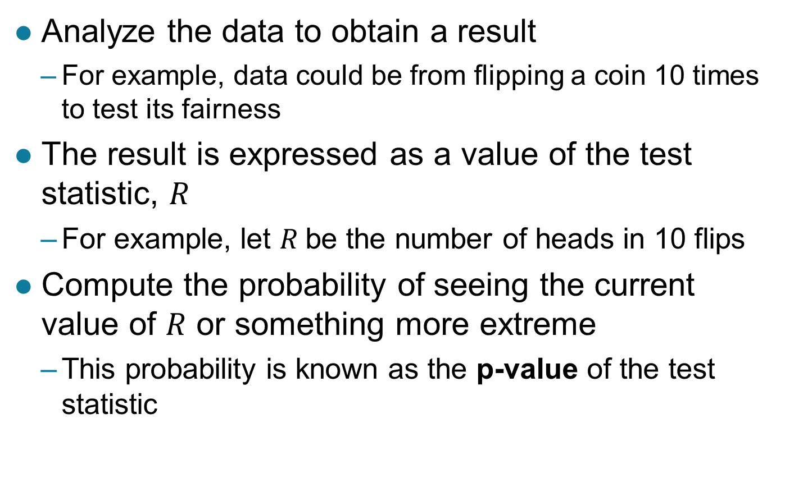
How Significance Testing Works
Analyze the data to obtain a result
For example, data could be from flipping a coin 10 times to test its fairness
The result is expressed as a value of the test statistic, $R$
For example, let $R$be the number of heads in 10 flips
Compute the probability of seeing the current value of $R$ or something more extreme
This probability is known as the p-value of the test statistic

Slide 14
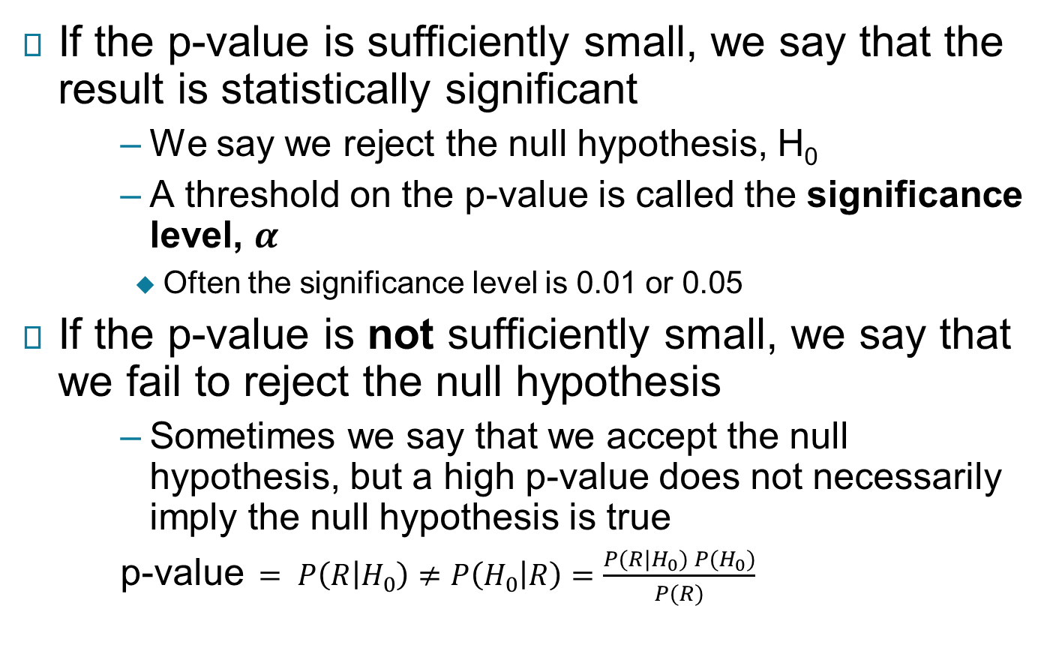
How Significance Testing Works …
If the p-value is sufficiently small, we say that the result is statistically significant
We say we reject the null hypothesis, H₀
A threshold on the p-value is called the significance level, $α$
Often the significance level is 0.01 or 0.05
If the p-value is not sufficiently small, we say that we fail to reject the null hypothesis
Sometimes we say that we accept the null hypothesis, but a high p-value does not necessarily imply the null hypothesis is true
p-value$= P\left(R | H_{0}\right)≠P\left(H_{0} | R\right)=\frac{P(R|H_{0}) P(H_{0})}{P(R)}$

Slide 15
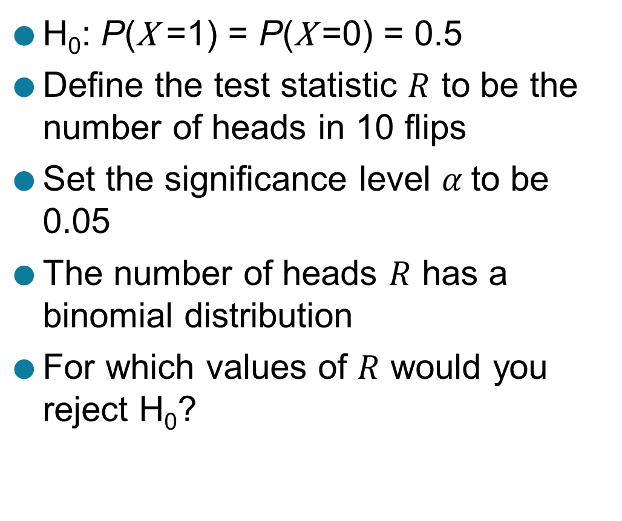
Example: Testing a coin for fairness
H₀: P(X =1) = P(X =0) = 0.5
Define the test statistic $R$ to be the number of heads in 10 flips
Set the significance level $α$to be 0.05
The number of heads $R$ has a binomial distribution
For which values of $R$ would you reject H₀?
k | P(S = k)
0 | 0.001
1 | 0.01
2 | 0.044
3 | 0.117
4 | 0.205
5 | 0.246
6 | 0.205
7 | 0.117
8 | 0.044
9 | 0.01
10 | 0.001

Slide 16
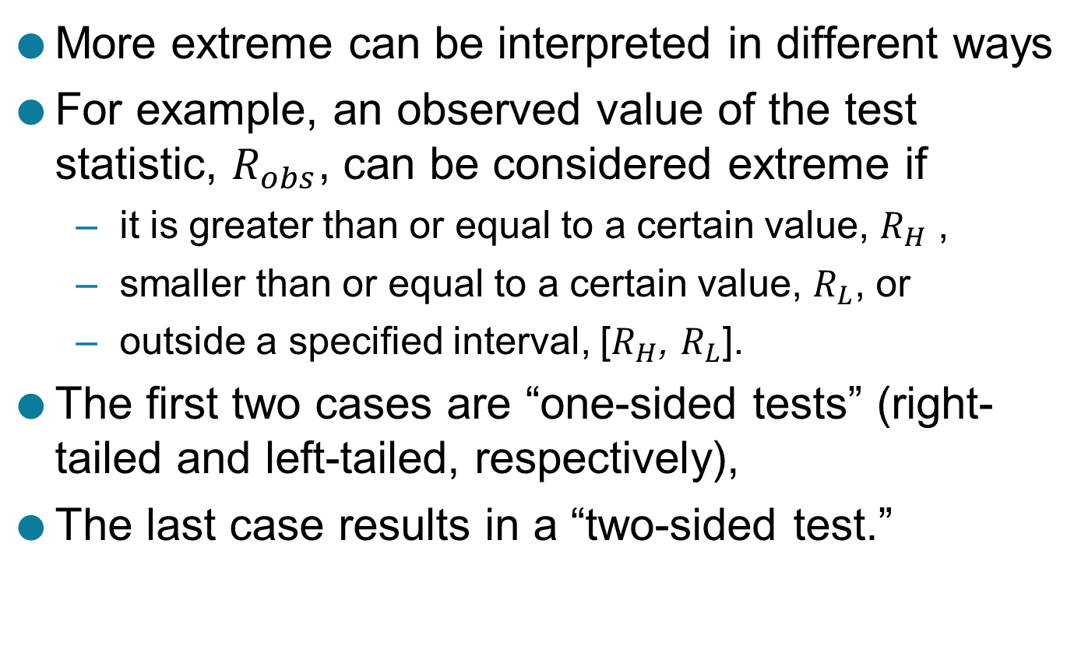
One-sided and Two-sided Tests
More extreme can be interpreted in different ways
For example, an observed value of the test statistic, $R_{obs}$, can be considered extreme if
it is greater than or equal to a certain value, $R_{H}$ ,
smaller than or equal to a certain value, $R_{L}$, or
outside a specified interval, [$R_{H}$, $R_{L}$].
The first two cases are “one-sided tests” (right-tailed and left-tailed, respectively),
The last case results in a “two-sided test.”

Slide 17
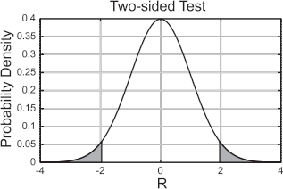
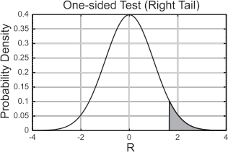
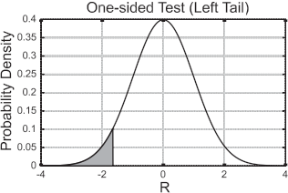

One-sided and Two-sided Tests …
Example of one-tailed and two tailed tests for a test statistic $R$ that is normally distributed for a roughly 5% significance level.
s

Slide 18
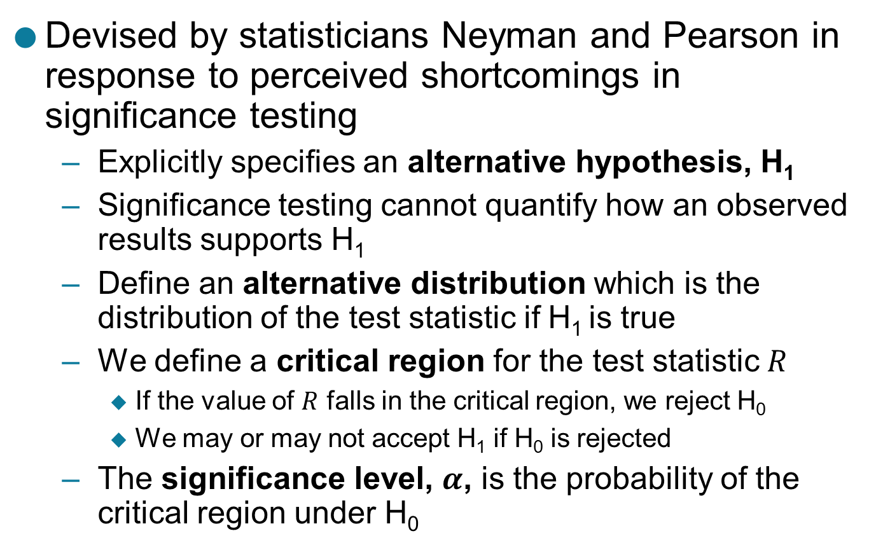
Neyman-Pearson Hypothesis Testing
Devised by statisticians Neyman and Pearson in response to perceived shortcomings in significance testing
Explicitly specifies an alternative hypothesis, H₁
Significance testing cannot quantify how an observed results supports H₁
Define an alternative distribution which is the distribution of the test statistic if H₁ is true
We define a critical region for the test statistic $R$
If the value of $R$ falls in the critical region, we reject H₀
We may or may not accept H₁ if H₀ is rejected
The significance level, $α$, is the probability of the critical region under H₀

Slide 19
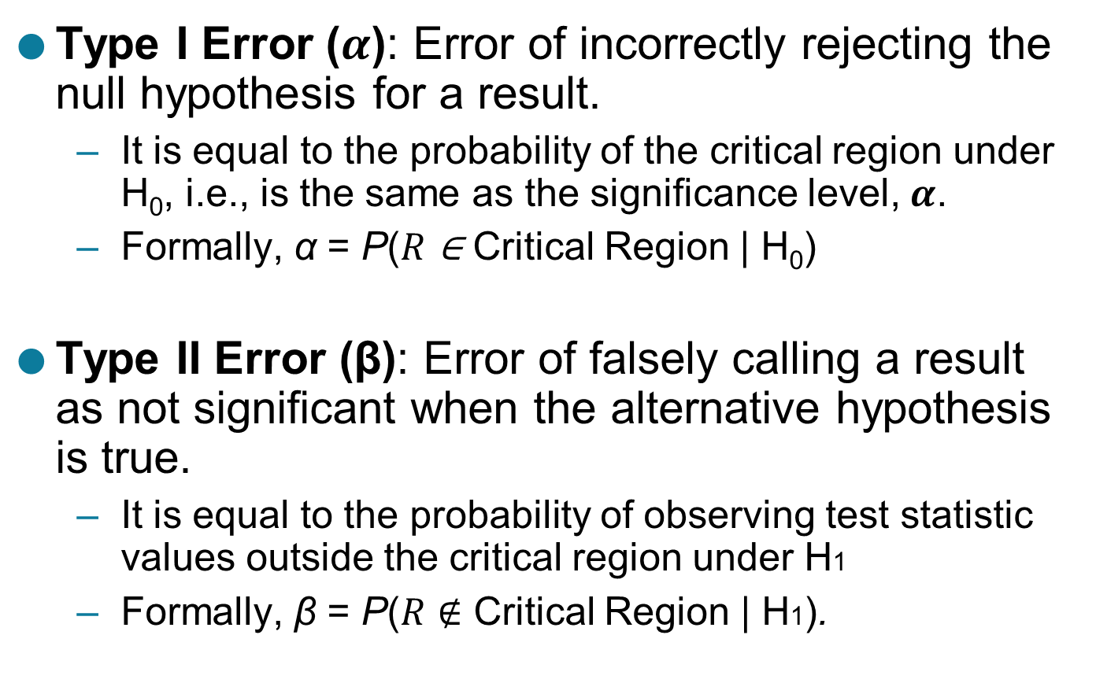
Hypothesis Testing …
Type I Error ($α$): Error of incorrectly rejecting the null hypothesis for a result.
It is equal to the probability of the critical region under H₀, i.e., is the same as the significance level, $α$.
Formally, α = P($R$ ∈ Critical Region | H₀)
Type II Error (β): Error of falsely calling a result as not significant when the alternative hypothesis is true.
It is equal to the probability of observing test statistic values outside the critical region under H1
Formally, β = P($R$ $∉$ Critical Region | H1).

Slide 20
Hypothesis Testing …
Power: which is the probability of the critical region under H₁, i.e., 1−β.
Power indicates how effective a test will be at correctly rejecting the null hypothesis.
Low power means that many results that actually show the desired pattern or phenomenon will not be considered significant and thus will be missed.
Thus, if the power of a test is low, then it may not be appropriate to ignore results that fall outside the critical region.

Slide 21
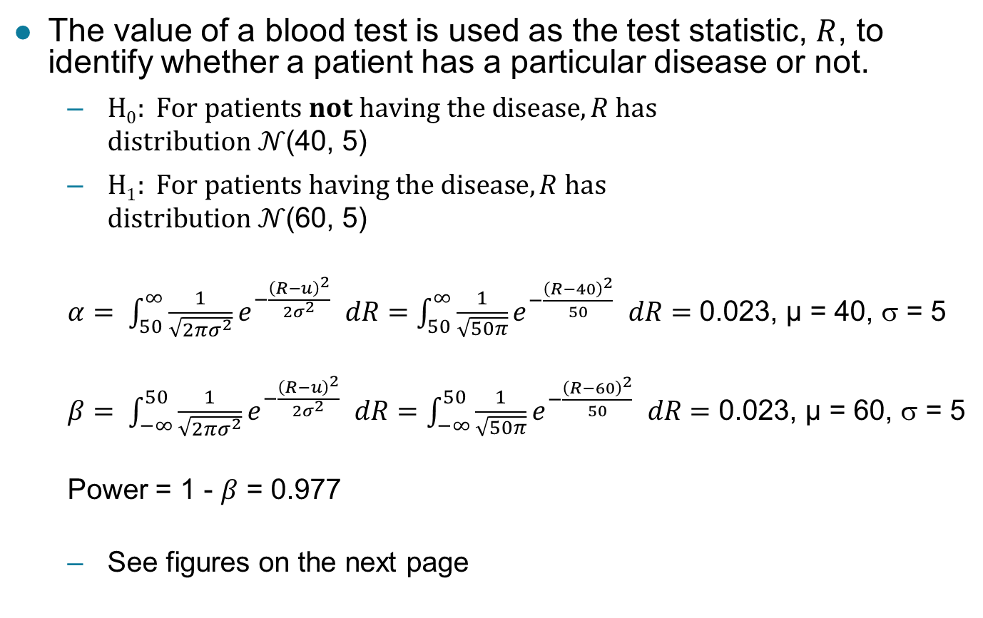
Example: Classifying Medical Results
The value of a blood test is used as the test statistic, $R$, to identify whether a patient has a particular disease or not.
$H0: For patients not having the disease,R has$ $distribution 𝒩$(40, 5)
$H1: For patients having the disease,R has$ $distribution 𝒩$(60, 5)
$α= \int_{50}^{∞}{\frac{1}{\sqrt{2πσ^{2}}}e^{−\frac{{\left(R−u\right)}^{2}}{2σ^{2}} }dR=}$ $\int_{50}^{∞}{\frac{1}{\sqrt{50π}}e^{−\frac{{\left(R−40\right)}^{2}}{50} }dR=}$ 0.023, µ = 40, σ = 5
$β= \int_{−∞}^{50}{\frac{1}{\sqrt{2πσ^{2}}}e^{−\frac{{\left(R−u\right)}^{2}}{2σ^{2}} }dR=}$ $\int_{−∞}^{50}{\frac{1}{\sqrt{50π}}e^{−\frac{{\left(R−60\right)}^{2}}{50} }dR=}$ 0.023, µ = 60, σ = 5
Power = 1 - $β$ = 0.977
See figures on the next page

Slide 22
$$α,β and Power for Medical Testing Example$$

Slide 23
Hypothesis Testing: Effect Size
Many times we can find a result that is statistically significant but not significant from a domain point of view
A drug that lowers blood pressure by one percent
Effect size measures the magnitude of the effect or characteristic being evaluated, and is often the magnitude of the test statistic.
Brings in domain considerations
The desired effect size impacts the choice of the critical region, and thus the significance level and power of the test

Slide 24
Effect Size: Example Problem
Consider several new treatments for a rare disease that have a particular probability of success. If we only have a sample size of 10 patients, what effect size will be needed to clearly distinguish a new treatment from the baseline which has is 60 % effective?
R/p(X=1) | 0.60 | 0.70 | 0.80 | 0.90
0 | 0.0001 | 0.0000 | 0.0000 | 0.0000
1 | 0.0016 | 0.0001 | 0.0000 | 0.0000
2 | 0.0106 | 0.0014 | 0.0001 | 0.0000
3 | 0.0425 | 0.0090 | 0.0008 | 0.0000
4 | 0.1115 | 0.0368 | 0.0055 | 0.0001
5 | 0.2007 | 0.1029 | 0.0264 | 0.0015
6 | 0.2508 | 0.2001 | 0.0881 | 0.0112
7 | 0.2150 | 0.2668 | 0.2013 | 0.0574
8 | 0.1209 | 0.2335 | 0.3020 | 0.1937
9 | 0.0403 | 0.1211 | 0.2684 | 0.3874
10 | 0.0060 | 0.0282 | 0.1074 | 0.3487

Slide 25
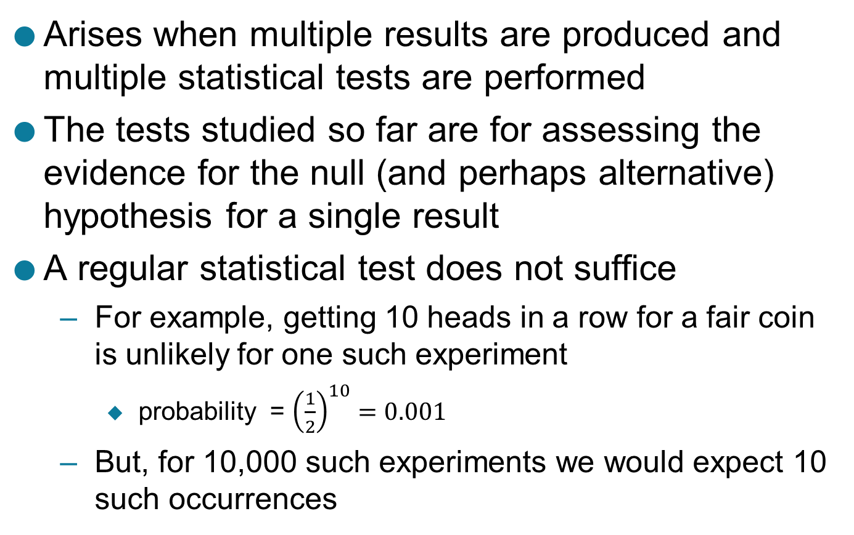
Multiple Hypothesis Testing
Arises when multiple results are produced and multiple statistical tests are performed
The tests studied so far are for assessing the evidence for the null (and perhaps alternative) hypothesis for a single result
A regular statistical test does not suffice
For example, getting 10 heads in a row for a fair coin is unlikely for one such experiment
probability = ${\left(\frac{1}{2}\right)}^{10}=0.001$
But, for 10,000 such experiments we would expect 10 such occurrences

Slide 26
Summarizing the Results of Multiple Tests
The following confusion table defines how results of multiple tests are summarized
We assume the results fall into two classes, + and –, which, follow the alternative and null hypotheses, respectively.
The focus is typically on the number of false positives (FP), i.e., the results that belong to the null distribution (– class) but are declared significant (+ class).

Slide 27
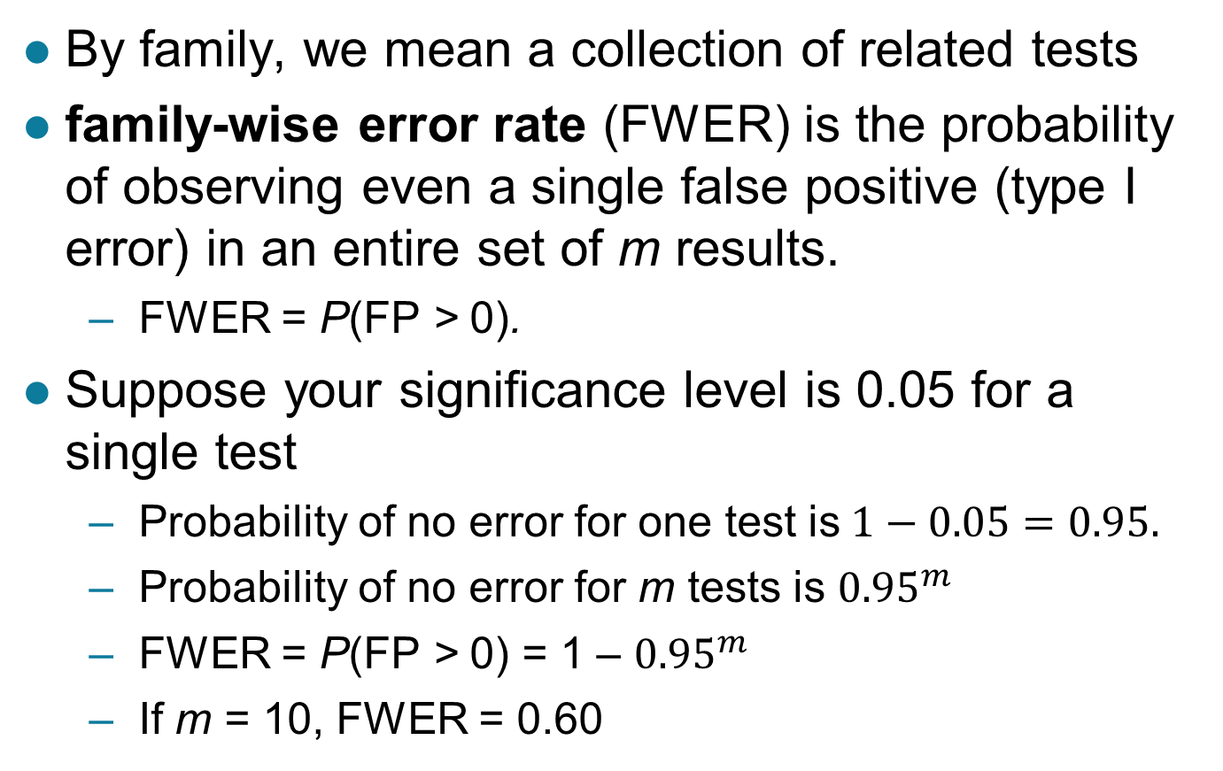
Family-wise Error Rate
By family, we mean a collection of related tests
family-wise error rate (FWER) is the probability of observing even a single false positive (type I error) in an entire set of m results.
FWER = P(FP > 0).
Suppose your significance level is 0.05 for a single test
Probability of no error for one test is$1−0.05=0.95.$
Probability of no error for m tests is ${0.95}^{m}$
FWER = P(FP > 0) = 1 – ${0.95}^{m}$
If m = 10, FWER = 0.60

Slide 28
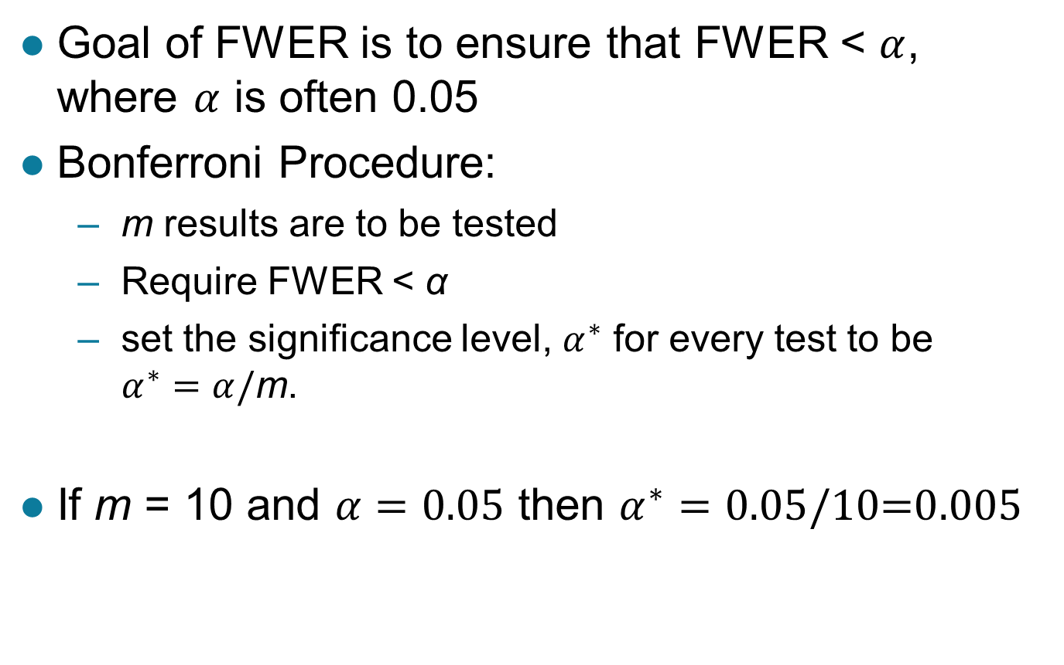
Bonferroni Procedure
Goal of FWER is to ensure that FWER < $α$, where $α$ is often 0.05
Bonferroni Procedure:
m results are to be tested
Require FWER < α
set the significance level, $α^{∗}$ for every test to be $α^{∗}=α/\text{m}$.
If m = 10 and $α=0.05$ then $α^{∗}=0.05/\text{10=0.005}$

Slide 29
Example: Bonferroni versus Naïve approach
Naïve approach is to evaluate statistical significance for each result without adjusting the significance level.
The family wise error rate (FWER) curves for the naïve approach and the Bonferroni procedure as a function of the number of results, m. $α=0.05.$

Slide 30
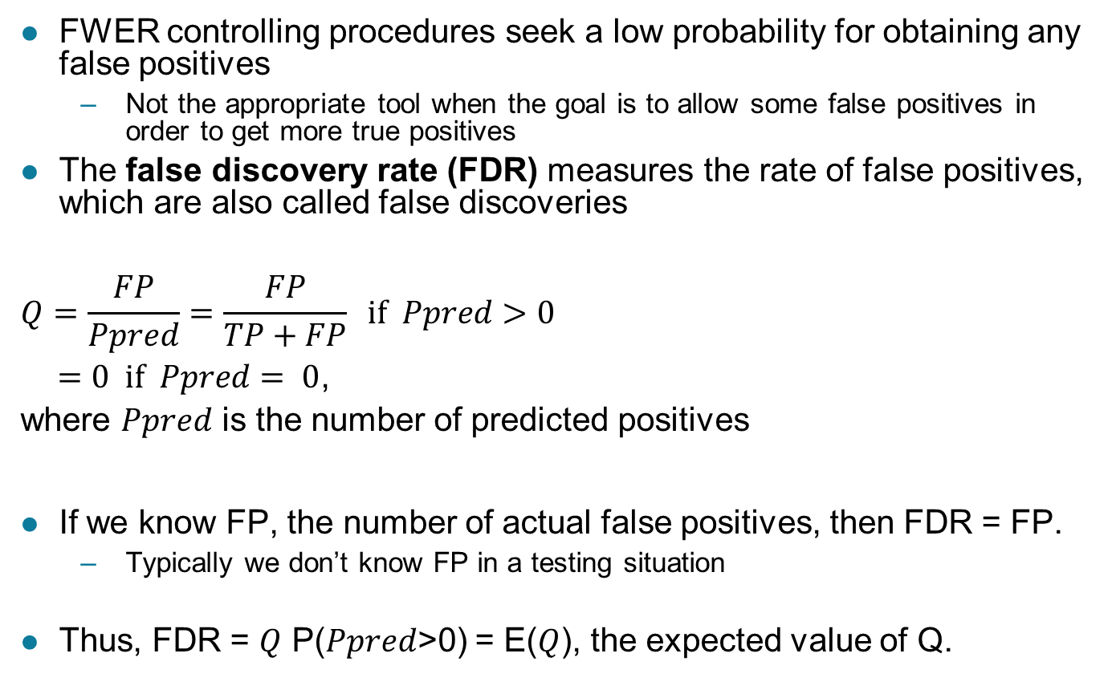
False Discovery Rate
FWER controlling procedures seek a low probability for obtaining any false positives
Not the appropriate tool when the goal is to allow some false positives in order to get more true positives
The false discovery rate (FDR) measures the rate of false positives, which are also called false discoveries
$$Q=\frac{FP}{Ppred}=\frac{FP}{TP+FP} if Ppred>0$$
$=0 if Ppred= 0$,
where $Ppred$ is the number of predicted positives
If we know FP, the number of actual false positives, then FDR = FP.
Typically we don’t know FP in a testing situation
Thus, FDR = $Q$ P($Ppred$>0) = E($Q$), the expected value of Q.

Slide 31

Benjamini-Hochberg Procedure
An algorithm to control the false discovery rate (FDR)
This procedure first orders the p-values from smallest to largest
Then it uses a separate significance level for each test
$α_{i}=i × \frac{α}{i}$

Slide 32
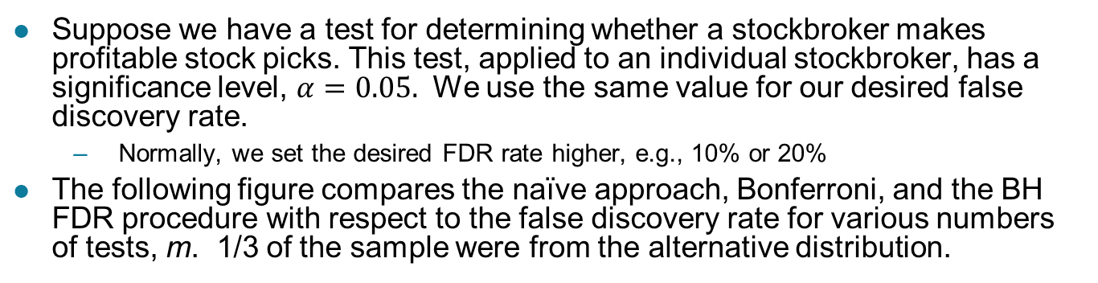
FDR Example: Picking a stockbroker
Suppose we have a test for determining whether a stockbroker makes profitable stock picks. This test, applied to an individual stockbroker, has a significance level, $α=0.05.$ We use the same value for our desired false discovery rate.
Normally, we set the desired FDR rate higher, e.g., 10% or 20%
The following figure compares the naïve approach, Bonferroni, and the BH FDR procedure with respect to the false discovery rate for various numbers of tests, m. 1/3 of the sample were from the alternative distribution.

Slide 33
FDR Example: Picking a stockbroker …
The following figure compares the naïve approach, Bonferroni, and the BH FDR procedure with respect to the power for various numbers of tests, m. 1/3 of the sample were from the alternative distribution.

Slide 34
Comparison of FWER and FDR
FWER is appropriate when it is important to avoid any error.
But an FWER procedure such as Bonferroni makes many Type II errors and thus, has poor power.
An FWER approach has very a very false discovery rate
FDR is appropriate when it is important to identity positive results, i.e., those belonging to the alternative distribution.
By construction, the false discovery rate is good for an FDR procedure such as the BH approach
An FDR approach also has good power

