Slide 1
Writing Advanced Scripts

Slide 2
Objectives
After completing this appendix, you should be able to:
  Describe the type of problems that are solved by using SQL to generate SQL
  Create a basic SQL script
  Capture the output in a file
  Dump the contents of a table to a file
  Generate a dynamic predicate
Notes:
In this appendix, you learn how to write a SQL script to generate a SQL script.
Oracle Database 12c: SQL Workshop II G - <number>

Slide 3

Using SQL to Generate SQL
  SQL can be used to generate scripts in SQL.
  The data dictionary is:
    A collection of tables and views that contain database information
    Created and maintained by the Oracle server
SQL
Data dictionary
SQL script
Notes:
SQL can be a powerful tool to generate other SQL statements. In most cases, this involves writing a script file. You can use SQL from SQL to:
Avoid repetitive coding
Access information from the data dictionary
Drop or re-create database objects
Generate dynamic predicates that contain run-time parameters
The examples used in this appendix involve selecting information from the data dictionary. The data dictionary is a collection of tables and views that contain information about the database. This collection is created and maintained by the Oracle server. All data dictionary tables are owned by the SYS user. Information stored in the data dictionary includes names of Oracle server users, privileges granted to users, database object names, table constraints, and audit information. There are four categories of data dictionary views. Each category has a distinct prefix that reflects its intended use.
Oracle Database 12c: SQL Workshop II G - <number>

Slide 4
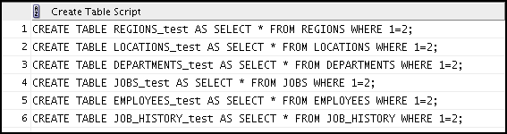
Creating a Basic Script
SELECT 'CREATE TABLE ' || table_name ||
'_test ' || 'AS SELECT * FROM '
|| table_name ||' WHERE 1=2;'
AS "Create Table Script"
FROM user_tables;
Notes:
The example in the slide produces a report with CREATE TABLE statements from every table you own. Each CREATE TABLE statement produced in the report includes the syntax to create a table using the table name with a suffix of _test and having only the structure of the corresponding existing table. The old table name is obtained from the TABLE_NAME column of the data dictionary view USER_TABLES.
The next step is to enhance the report to automate the process.
Note: You can query the data dictionary tables to view various database objects that you own. The data dictionary views frequently used include:
USER_TABLES: Displays description of the user’s own tables
USER_OBJECTS: Displays all the objects owned by the user
USER_TAB_PRIVS_MADE: Displays all grants on objects owned by the user
USER_COL_PRIVS_MADE: Displays all grants on columns of objects owned by the user
Oracle Database 12c: SQL Workshop II G - <number>

Slide 5
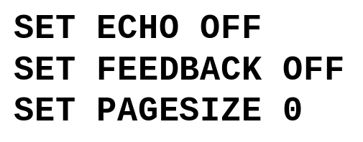
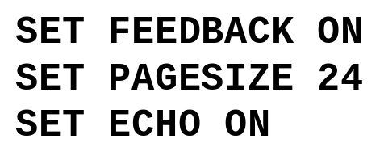
Controlling the Environment
Set system variables to appropriate values.
SQL statement
Set system variables back to the default value.
Notes:
To execute the SQL statements that are generated, you must capture them in a file that can then be run. You must also plan to clean up the output that is generated and make sure that you suppress elements such as headings, feedback messages, top titles, and so on. In SQL Developer, you can save these statements to a script. To save the contents of the Enter SQL Statement box, click the Save icon or select Save from the File menu. Alternatively, you can right-click in the Enter SQL Statement box and select the Save File option from the drop-down menu.
Note: Some of the SQL*Plus statements are not supported by SQL Worksheet. For the complete list of SQL*Plus statements that are supported, and not supported by SQL Worksheet, refer to the topic titled SQL*Plus Statements Supported and Not Supported in SQL Worksheet in the SQL Developer online Help.
Oracle Database 12c: SQL Workshop II G - <number>

Slide 6
The Complete Picture
SET ECHO OFF
SET FEEDBACK OFF
SET PAGESIZE 0
SELECT 'DROP TABLE ' || object_name || ';'
FROM user_objects
WHERE object_type = 'TABLE'
/
SET FEEDBACK ON
SET PAGESIZE 24
SET ECHO ON
Notes:
The output of the command in the slide is saved into a file called dropem.sql in SQL Developer. To save the output into a file in SQL Developer, you use the Save File option under the Script Output pane. The dropem.sql file contains the following data. This file can now be started from SQL Developer by locating the script file, loading it, and executing it.
Oracle Database 12c: SQL Workshop II G - <number>

Slide 7
Dumping the Contents of a Table to a File
SET HEADING OFF ECHO OFF FEEDBACK OFF
SET PAGESIZE 0
SELECT
'INSERT INTO departments_test VALUES
(' || department_id || ', ''' || department_name ||
''', ''' || location_id || ''');'
AS "Insert Statements Script"
FROM departments
/
SET PAGESIZE 24
SET HEADING ON ECHO ON FEEDBACK ON
Notes:
Sometimes, it is useful to have the values for the rows of a table in a text file in the format of an INSERT INTO VALUES statement. This script can be run to populate the table in case the table has been dropped accidentally.
The example in the slide produces INSERT statements for the DEPARTMENTS_TEST table, captured in the data.sql file using the Save File option in SQL Developer.
The contents of the data.sql script file are as follows:
INSERT INTO departments_test VALUES
(10, 'Administration', 1700);
INSERT INTO departments_test VALUES
(20, 'Marketing', 1800);
INSERT INTO departments_test VALUES
(50, 'Shipping', 1500);
INSERT INTO departments_test VALUES
(60, 'IT', 1400);
...
Oracle Database 12c: SQL Workshop II G - <number>

Slide 8
Dumping the Contents of a Table to a File
Source | Result
'''X''' '''' ''''||department_name||'''' ''', ''' ''');' | 'X' ' 'Administration' ',' ');
Notes:
You may have noticed the large number of single quotation marks in the previous slide. A set of four single quotation marks produces one single quotation mark in the final statement. Also remember that character and date values must be enclosed within quotation marks.
Within a string, to display one quotation mark, you need to prefix it with another single quotation mark. For example, in the fifth example in the slide, the surrounding quotation marks are for the entire string. The second quotation mark acts as a prefix to display the third quotation mark. Thus, the result is a single quotation mark followed by the parenthesis, followed by the semicolon.
Oracle Database 12c: SQL Workshop II G - <number>

Slide 9
Generating a Dynamic Predicate
COLUMN my_col NEW_VALUE dyn_where_clause
SELECT DECODE('&&deptno', null,
DECODE ('&&hiredate', null, ' ',
'WHERE hire_date=TO_DATE('''||'&&hiredate'',''DD-MON-YYYY'')'),
DECODE ('&&hiredate', null,
'WHERE department_id = ' || '&&deptno',
'WHERE department_id = ' || '&&deptno' ||
' AND hire_date = TO_DATE('''||'&&hiredate'',''DD-MON-YYYY'')'))
AS my_col FROM dual;
SELECT last_name FROM employees &dyn_where_clause;
Notes:
The example in the slide generates a SELECT statement that retrieves data of all employees in a department who were hired on a specific day. The script generates the WHERE clause dynamically.
Note: After the user variable is in place, you must use the UNDEFINE command to delete it.
The first SELECT statement prompts you to enter the department number. If you do not enter any department number, the department number is treated as null by the DECODE function, and the user is then prompted for the hire date. If you do not enter any hire date, the hire date is treated as null by the DECODE function and the dynamic WHERE clause that is generated is also a null, which causes the second SELECT statement to retrieve all the rows from the EMPLOYEES table.
Note: The NEW_V[ALUE] variable specifies a variable to hold a column value. You can reference the variable in TTITLE commands. Use NEW_VALUE to display column values or the date in the top title. You must include the column in a BREAK command with the SKIP PAGE action. The variable name cannot contain a pound sign (#). NEW_VALUE is useful for master/detail reports in which there is a new master record for each page.
Oracle Database 12c: SQL Workshop II G - <number>

Slide 10
Notes:
Note: Here, the hire date must be entered in the DD-MON-YYYY format.
The SELECT statement in the slide can be interpreted as follows:
IF (<<deptno>> is not entered) THEN
IF (<<hiredate>> is not entered) THEN
return empty string
ELSE
return the string ‘WHERE hire_date = TO_DATE('<<hiredate>>', 'DD-MON-YYYY')’
ELSE
IF (<<hiredate>> is not entered) THEN
return the string ‘WHERE department_id = <<deptno>> entered'
ELSE
return the string ‘WHERE department_id = <<deptno>> entered
AND hire_date = TO_DATE(' <<hiredate>>', 'DD-MON-YYYY')’
END IF
The returned string becomes the value of the DYN_WHERE_CLAUSE variable, which will be used in the second SELECT statement.
Note: Use SQL*Plus for these examples.
When the first example in the slide is executed, the user is prompted for the values for DEPTNO and HIREDATE:
Enter the values of DEPTNO and HIREDATE: 10 and 17-SEP-2007
The following value for MY_COL is generated:
When the second example in the slide is executed, the following output is generated
Oracle Database 12c: SQL Workshop II G - <number>

Slide 11
Summary
In this appendix, you should have learned how to:
  Create a basic SQL script
  Capture the output in a file
  Dump the contents of a table to a file
  Generate a dynamic predicate
Notes:
SQL can be used to generate SQL scripts. These scripts can be used to avoid repetitive coding, drop or re-create objects, get help from the data dictionary, and generate dynamic predicates that contain run-time parameters.
Oracle Database 12c: SQL Workshop II G - <number>

