Slide 1
Introduction

Slide 2
Lesson Objectives
After completing this lesson, you should be able to do the following:
  Define the goals of the course
  List the features of Oracle Database 12c
  Describe the salient features of Oracle Cloud
  Discuss the theoretical and physical aspects of a relational database
  Describe Oracle server’s implementation of RDBMS and object relational database management system (ORDBMS)
  Identify the development environments that can be used for this course
  Describe the database and schema used in this course
Notes:
In this lesson, you gain an understanding of the relational database management system (RDBMS) and the object relational database management system (ORDBMS). You are also introduced to Oracle SQL Developer and SQL*Plus as development environments used for executing SQL statements, and for formatting and reporting purposes.
Oracle Database 12c: SQL Workshop I 1 - <number>

Slide 3
Lesson Agenda
  Course objectives, agenda, and appendixes used in the course
  Overview of Oracle Database 12c and related products
  Overview of relational database management concepts and terminologies
  Introduction to SQL and its development environments
  The Human Resource(HR) Schema and the tables used in the Course
  Oracle database 12c SQL Documentation and Additional Resources
Notes:
Oracle Database 12c: SQL Workshop I 1 - <number>

Slide 4
Course Objectives
After completing this course, you should be able to:
  Identify the major components of Oracle Database
  Retrieve row and column data from tables with the SELECT statement
  Create reports of sorted and restricted data
  Employ SQL functions to generate and retrieve customized data
  Run complex queries to retrieve data from multiple tables
  Run data manipulation language (DML) statements to update data in Oracle Database
  Run data definition language (DDL) statements to create and manage schema objects
Notes:
This course offers you an introduction to the Oracle Database technology. In this class, you learn the basic concepts of relational databases and the powerful SQL programming language. This course provides the essential SQL skills that enable you to write queries against single and multiple tables, manipulate data in tables, create database objects, and query metadata.
Oracle Database 12c: SQL Workshop I 1 - <number>

Slide 5
Course Agenda
  Day 1:
    Introduction
    Retrieving Data Using the SQL SELECT Statement
    Restricting and Sorting Data
    Using Single-Row Functions to Customize Output
  Day 2:
    Using Conversion Functions and Conditional Expressions
    Reporting Aggregated Data Using the Group Functions
    Displaying Data from Multiple Tables Using Joins
    Using Subqueries to Solve Queries
Notes:
Oracle Database 12c: SQL Workshop I 1 - <number>

Slide 6
Course Agenda
  Day 3:
    Using the Set Operators
    Managing Tables Using DML Statements
    Introduction to Data Definition Language
Notes:
Oracle Database 12c: SQL Workshop I 1 - <number>

Slide 7
Appendices and Practices Used in the Course
  Appendix A: Table Descriptions
  Appendix B: Using SQL Developer
  Appendix C: Using SQL*Plus
  Appendix D: Commonly Used SQL Commands
  Activity Guide
    Practices and Solutions
    Additional Practices and Solutions
Notes:
Oracle Database 12c: SQL Workshop I 1 - <number>

Slide 8
Lesson Agenda
  Course objectives, agenda, and appendixes used in the course
  Overview of Oracle Database 12c and related products
  Overview of relational database management concepts and terminologies
  Introduction to SQL and its development environments
  The Human Resource(HR) Schema and the tables used in this course
  Oracle database 12c SQL Documentation and Additional Resources
Notes:
Oracle Database 12c: SQL Workshop I 1 - <number>

Slide 9

Oracle Database 12c: Focus Areas
Infrastructure
Grids
Information
Management
Application
Development
Oracle Cloud
Notes:
Oracle Database 12c offers extensive features across the following focus areas:
Infrastructure Grids: The Infrastructure Grid technology of Oracle enables pooling of low-cost servers and storage to form systems that deliver the highest quality of service in terms of manageability, high availability, and performance. Oracle Database 12c consolidates and extends the benefits of grid computing. Apart from taking full advantage of grid computing, Oracle Database 11g has unique change assurance features to manage changes in a controlled and cost effective manner.
Information Management: Oracle Database 12c extends the existing information management capabilities in content management, information integration, and information life-cycle management areas. Oracle provides content management of advanced data types such as Extensible Markup Language (XML), text, spatial, multimedia, medical imaging, and semantic technologies.
Application Development: Oracle Database 12c has capabilities to use and manage all the major application development environments such as PL/SQL, Java/JDBC, .NET and Windows, PHP, SQL Developer, and Application Express.
Oracle Cloud: The Oracle Cloud is an enterprise cloud for business. It provides an integrated collection of application and platform cloud services that are based upon best in class products and open Java and SQL standards.
Oracle Database 12c: SQL Workshop I 1 - <number>

Slide 10

Oracle Database 12c
Manageability
High availability
Performance
Security
Information integration
Notes:
Organizations need to support multiple terabytes of information for users who demand fast and secure access to business applications round the clock. The database systems must be reliable and must be able to recover quickly in the event of any kind of failure. Oracle Database 12c is designed along the following feature areas to help organizations manage infrastructure grids easily and deliver high-quality service:
Manageability: By using some of the change assurance, management automation, and fault diagnostics features, the database administrators (DBAs) can increase their productivity, reduce costs, minimize errors, and maximize quality of service. Some of the useful features that promote better management are Database Replay facility, the SQL Performance Analyzer, and the Automatic SQL Tuning facility. Real-Time Database Operations Monitoring.
Enterprise Manager Database Express 12c is a web-based tool for managing Oracle databases. Enterprise Manager Database Express greatly simplifies database performance diagnostics by consolidating the relevant database performance screens into a consolidated view called Database Performance Hub. DBAs get a single, consolidated view of the current real-time and historical view of the database performance across multiple dimensions such as database load, monitored SQL and PL/SQL, and Active Session History (ASH) in a single page for the selected time period.
Oracle Database 12c: SQL Workshop I 1 - <number>

Slide 11
Oracle Database 12c
Manageability
High availability
Performance
Security
Information integration
Notes:
High availability: By using the high availability features, you can reduce the risk of down time and data loss. These features improve online operations and enable faster database upgrades.
Performance: By using capabilities such as SecureFiles, compression for online transaction processing (OLTP), Real Application Clusters (RAC) optimizations, Result Caches, and so on, you can greatly improve the performance of your database. Oracle Database 12c enables organizations to manage large, scalable, transactional, and data warehousing systems that deliver fast data access using low-cost modular storage.
Security: Oracle Database 12c helps organizations protect their information with unique secure configurations, data encryption and masking, and sophisticated auditing capabilities. It delivers a secure and scalable platform for reliable and fast access to all types of information by using the industry-standard interfaces.
Information integration: Oracle Database 12c has many features to better integrate data throughout the enterprise. It also supports advanced information life-cycle management capabilities. This helps you manage the changing data in your database.
Oracle Database 12c: SQL Workshop I 1 - <number>

Slide 12
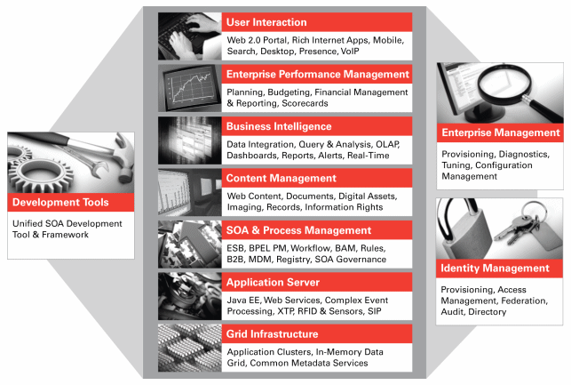
Oracle Fusion Middleware
Portfolio of leading, standards-based, and customer-proven software products that spans a range of tools and services from Java EE and developer tools, through integration services, business intelligence, collaboration, and content management
Notes:
Oracle Fusion Middleware is a comprehensive and well-integrated family of products that offers complete support for development, deployment, and management of Service-Oriented Architecture (SOA). SOA facilitates the development of modular business services that can be easily integrated and reused, thereby reducing development and maintenance costs, and providing higher quality of services. Oracle Fusion Middleware’s pluggable architecture enables you to leverage your investments in any existing application, system, or technology. Its unbreakable core technology minimizes the disruption caused by planned or unplanned outages.
Some of the products from the Oracle Fusion Middleware family include:
Application Server: Java EE, Web Services
SOA and Process Management: BPEL Process Manager, SOA Governance
Development Tools: Oracle Application Development Framework, JDeveloper, SOA Suite
Business Intelligence: Oracle Business Activity Monitoring, Oracle Data Integrator
Enterprise Management: Enterprise Manager
Identity Management: Oracle Identity Management
Content Management: Oracle Content Database Suite
User Interaction: Portal, Rich Internet Apps
Oracle Database 12c: SQL Workshop I 1 - <number>

Slide 13
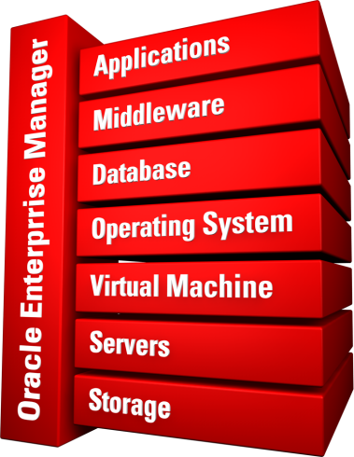
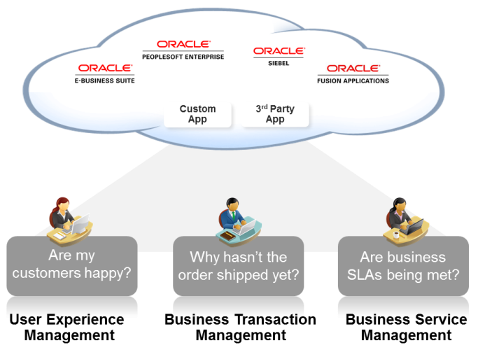


Oracle Enterprise Manager Cloud Control
  Create and manage a complete set of cloud services.
  Manage all phases of cloud life cycle.
  Manage the entire cloud stack
  Monitor the health of all components
  Identify, understand, and resolve business problems
Complete life cycle
Complete stack
Complete integration
Self-Service IT I Simple and Automated I Business-Driven
Notes:
Enterprise Manager Cloud Control is a management tool that provides monitoring and management capabilities for Oracle and non-Oracle components. It is a complete, integrated, and business-driven cloud management solution in a single product, which is referred to as “Total Cloud Control.”
Using Enterprise Manager Cloud Control, you can:
Create and manage a complete set of cloud services, including: Infrastructure-as-a-service, Database-as-a-service, Platform-as-a-service, and others
Manage all phases of cloud life cycle
Manage the entire cloud stack: from application to disk, including engineered systems (Exa series) and with integrated support capabilities
Monitor the health of all components, the hosts that they run on, and the key business processes that they support
Identify, understand, and resolve business problems through the unified and correlated management of User Experience, Business Transactions, and Business Services across all your packaged and custom applications
Oracle Database 12c: SQL Workshop I 1 - <number>

Slide 14
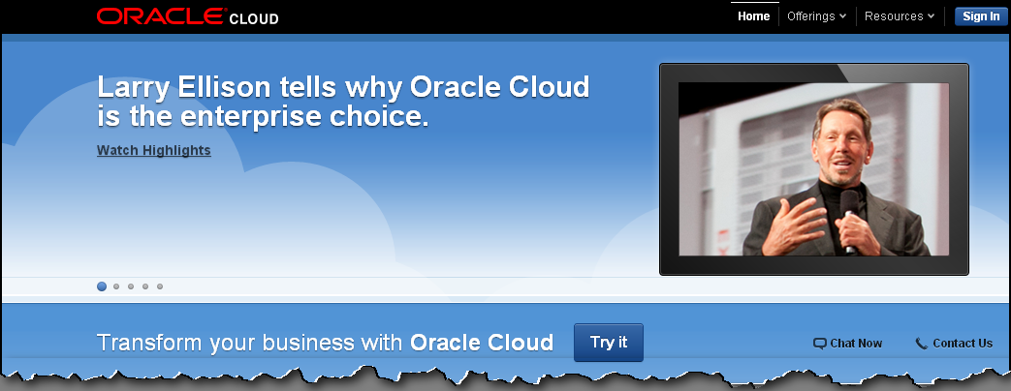
Oracle Cloud
The Oracle Cloud is an enterprise cloud for business. It consists of many different services which share some common characteristics:
  On-demand self-service
  Resource pooling
  Rapid elasticity
  Measured service
  Broad network access
www.cloud.oracle.com
Notes:
The Oracle Cloud is an enterprise cloud for business. It provides an integrated collection of application and platform cloud services that are based upon best-in-class products and open Java and SQL standards. The top two benefits of cloud computing are speed and cost.
As a result, the applications and databases deployed in the Oracle Cloud are portable and you can be easily moved them to or from a private cloud or on-premise environment.
All Cloud Services can be provisioned through a self-service interface. Users can get their Cloud Services delivered on an integrated development and deployment platform with tools to rapidly extend and create new services.
Oracle Cloud services are built on Oracle Exalogic Elastic Cloud and Oracle Exadata Database Machine, together offering a platform that delivers extreme performance, redundancy, and scalability.
Here are five essential characteristics of Oracle Cloud services:
On-demand self-service: Provisioning, monitoring, and management control
Resource pooling: Implies sharing and a level of abstraction between consumers and services
Rapid elasticity: Ability to quickly scale up or down as needed
Measured service: Metering utilization for either internal chargeback (private cloud) or external billing (public cloud)
Broad network access: Access through a browser on any networked device
Oracle Database 12c: SQL Workshop I 1 - <number>

Slide 15
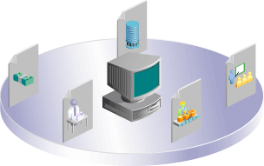
Oracle Cloud Services
Oracle Cloud provides three types of services:
  Software as a Service (SaaS)
  Platform as a Service (PaaS)
  Infrastructure as a Service (IaaS)
Notes:
(SaaS) generally refers to applications that are delivered to end users over the Internet. Oracle CRM On Demand is an example of a SaaS offering that provides both multitenant as well as single-tenant options, depending on the customer’s preferences.
(PaaS) generally refers to an application development and deployment platform delivered as a service to developers, enabling them to quickly build and deploy a SaaS application to end users. The platform typically includes databases, middleware, and development tools, all delivered as a service via the Internet
(IaaS) refers to computing hardware (servers, storage, and network) delivered as a service. This service typically includes the associated software as well as operating systems, virtualization, clustering, and so on. Examples of IaaS in the public cloud include Amazon’s Elastic Compute Cloud (EC2) and Simple Storage Service (S3).
The database cloud is built within an enterprise’s private cloud environment, as a PaaS model. The database cloud provides on-demand access to database services in a self-service, elastically scalable, and metered manner. The database cloud offers compelling advantages in cost, quality of service, and agility. You can deploy a database within a virtual machine in a laaS platform.
You can rapidly deploy Database clouds on Oracle Exadata which is a preintegrated and optimized hardware platform that supports both OLTP and DW workloads.
Oracle Database 12c: SQL Workshop I 1 - <number>

Slide 16





Cloud Deployment Models
Community cloud
Cloud Deployment Models
Public
cloud
Private cloud
Private cloud
Hybrid cloud
Hybrid cloud
Notes:
Private cloud: A single organization uses a private cloud, which it typically controls, manages, and hosts in private data centers. However, the organization can also outsource hosting and operation to a third-party service provider. Amazon’s Virtual Private Cloud is an example of a private cloud in an external provider setting
Public cloud: Multiple organizations(tenants) uses private cloud on a shared basis; hosted and managed by a third-party service provider. Example: Amazon Elastic Compute Cloud (EC2), IBM's Blue Cloud, Sun Cloud, Google AppEngine, etc.
Community cloud: A group of related organizations, who want to make use of a common cloud computing environment uses the community cloud. It is managed by the participating organizations or by a third-party managed service provider. It is hosted internally or externally. Example: A community might consist of the different branches of the military, all the universities in a given region, or all the suppliers to a large manufacturer.
Hybrid cloud: A single organization that wants to adopt both private and public clouds for a single application uses the hybrid cloud. A third model, the hybrid cloud, is maintained by both internal and external providers For example, an organization might use a public cloud service, such as Amazon Simple Storage Service (Amazon S3) for archived data but continue to maintain in-house(private cloud) storage for operational customer data.
Oracle Database 12c: SQL Workshop I 1 - <number>

Slide 17
Lesson Agenda
  Course objectives, agenda, and appendixes used in the course
  Overview of Oracle Database 12c and related products
  Overview of relational database management concepts and terminologies
  Introduction to SQL and its development environments
  The Human Resource(HR) Schema and the tables used in this course
  Oracle database 12c SQL Documentation and Additional Resources
Notes:
Oracle Database 12c: SQL Workshop I 1 - <number>

Slide 18
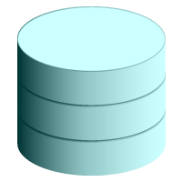

Relational and Object Relational
Database Management Systems
  Relational model and object relational model
  User-defined data types and objects
  Fully compatible with relational database
  Supports multimedia and large objects
  High-quality database server features
Notes:
The Oracle server supports both the relational and the object relational database models.
The Oracle server extends the data-modeling capabilities to support an object relational database model that provides object-oriented programming, complex data types, complex business objects, and full compatibility with the relational world.
It includes several features for improved performance and functionality of the OLTP applications, such as better sharing of run-time data structures, larger buffer caches, and deferrable constraints. Data warehouse applications benefit from enhancements such as parallel execution of insert, update, and delete operations; partitioning; and parallel-aware query optimization. The Oracle model supports client/server and Web-based applications that are distributed and multitiered.
For more information about the relational and object relational model, refer to Oracle Database Concepts for 10g or 11g database.
Oracle Database 12c: SQL Workshop I 1 - <number>

Slide 19
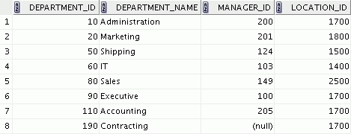
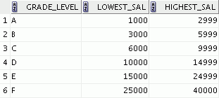



Data Storage on Different Media
Electronic spreadsheet
Filing cabinet
Database
Notes:
Every organization has some information needs. A library keeps a list of members, books, due dates, and fines. A company needs to save information about its employees, departments, and salaries. These pieces of information are called data.
Organizations can store data in various media and in different formats, such as a hard copy document in a filing cabinet, or data stored in electronic spreadsheets, or in databases.
A database is an organized collection of information.
To manage databases, you need a database management system (DBMS). A DBMS is a program that stores, retrieves, and modifies data in databases on request. There are four main types of databases: hierarchical, network, relational, and (most recently) object relational.
Oracle Database 12c: SQL Workshop I 1 - <number>

Slide 20
Relational Database Concept
  Dr. E. F. Codd proposed the relational model for database systems in 1970.
  It is the basis for the relational database management system (RDBMS).
  The relational model consists of the following:
    Collection of objects or relations
    Set of operators to act on the relations
    Data integrity for accuracy and consistency
Notes:
The principles of the relational model were first outlined by Dr. E. F. Codd in a June 1970 paper titled A Relational Model of Data for Large Shared Data Banks. In this paper, Dr. Codd proposed the relational model for database systems.
The common models used at that time were hierarchical and network, or even simple flat-file data structures. Relational database management systems (RDBMS) soon became very popular, especially for their ease of use and flexibility in structure. In addition, a number of innovative vendors, such as Oracle, supplemented the RDBMS with a suite of powerful, application development and user-interface products, thereby providing a total solution.
Components of the Relational Model
Collections of objects or relations that store the data
A set of operators that can act on the relations to produce other relations
Data integrity for accuracy and consistency
For more information, refer to An Introduction to Database Systems, Eighth Edition (Addison-Wesley: 2004), written by Chris Date.
Oracle Database 12c: SQL Workshop I 1 - <number>

Slide 21


Definition of a Relational Database
A relational database is a collection of relations or
two-dimensional tables controlled by the Oracle server.
Oracle
server
Table name: EMPLOYEES
Table name: DEPARTMENTS
…
…
Notes:
A relational database uses relations or two-dimensional tables to store information.
For example, you might want to store information about all the employees in your company. In a relational database, you create several tables to store different pieces of information about your employees, such as an employee table, a department table, and a salary table.
Oracle Database 12c: SQL Workshop I 1 - <number>

Slide 22


Data Models
Model of
system
in client’s
mind
Entity model of
client’s model
Table model
of entity model
Oracle
server
Tables on disk
Notes:
Models are the cornerstone of design. Engineers build a model of a car to work out any details before putting it into production. In the same manner, system designers develop models to explore ideas and improve the understanding of database design.
Purpose of Models
Models help to communicate the concepts that are in people’s minds. They can be used to do the following:
Communicate
Categorize
Describe
Specify
Investigate
Evolve
Analyze
Imitate
The objective is to produce a model that fits a multitude of these uses, can be understood by an end user, and contains sufficient detail for a developer to build a database system.
Oracle Database 12c: SQL Workshop I 1 - <number>

Slide 23
Entity Relationship Model
  Create an entity relationship diagram from business specifications or narratives:
  Scenario:
    “. . . Assign one or more employees to a
    department . . .”
    “. . . Some departments do not yet have assigned employees
    . . .”
EMPLOYEE
#* number
* name
o job title
DEPARTMENT
#* number
* name
o location
assigned to
composed of
Notes:
In an effective system, data is divided into discrete categories or entities. An entity relationship (ER) model is an illustration of the various entities in a business and the relationships among them. An ER model is derived from business specifications or narratives and built during the analysis phase of the system development life cycle. ER models separate the information required by a business from the activities performed within the business. Although businesses can change their activities, the type of information tends to remain constant. Therefore, the data structures also tend to be constant.
Oracle Database 12c: SQL Workshop I 1 - <number>

Slide 24
Notes:
Benefits of ER Modeling
Documents information for the organization in a clear, precise format
Provides a clear picture of the scope of the information requirement
Provides an easily understood pictorial map for database design
Offers an effective framework for integrating multiple applications
Key Components
Entity: An aspect of significance about which information must be known. Examples are departments, employees, and orders.
Attribute: Something that describes or qualifies an entity. For example, for the employee entity, the attributes would be the employee number, name, job title, hire date, department number, and so on. Each of the attributes is either required or optional. This state is called optionality.
Relationship: A named association between entities showing optionality and degree. Examples are employees and departments, and orders and items.
Oracle Database 12c: SQL Workshop I 1 - <number>

Slide 25
Entity Relationship Modeling Conventions
Entity:
  Singular, unique name
  Uppercase
  Soft box
  Synonym in parentheses
Attribute:
  Singular name
  Lowercase
  Mandatory marked with “*”
  Optional marked with “o”
EMPLOYEE
#* number
* name
o job title
DEPARTMENT
#* number
* name
o location
assigned to
composed of
Unique Identifier (UID)
Primary marked with “#”
Secondary marked with “(#)”
Notes:
Entities
To represent an entity in a model, use the following conventions:
Singular, unique entity name
Entity name in uppercase
Soft box
Optional synonym names in uppercase within parentheses: ( )
Attributes
To represent an attribute in a model, use the following conventions:
Singular name in lowercase
Asterisk (*) tag for mandatory attributes (that is, values that must be known)
Letter “o” tag for optional attributes (that is, values that may be known)
Oracle Database 12c: SQL Workshop I 1 - <number>

Slide 26
Notes:
Relationships
Each direction of the relationship contains:
A label: For example, taught by or assigned to
An optionality: Either must be or maybe
A degree: Either one and only one or one or more
Note: The term cardinality is a synonym for the term degree.
Each source entity {may be | must be} in relation {one and only one | one or more} with the destination entity.
Note: The convention is to read clockwise.
Unique Identifiers
A unique identifier (UID) is any combination of attributes or relationships, or both, that serves to distinguish occurrences of an entity. Each entity occurrence must be uniquely identifiable.
Tag each attribute that is part of the UID with a hash sign “#”.
Tag secondary UIDs with a hash sign in parentheses (#).
Oracle Database 12c: SQL Workshop I 1 - <number>

Slide 27
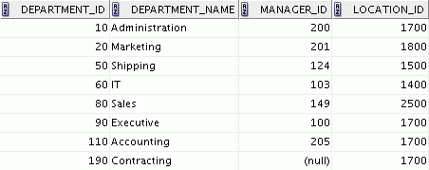
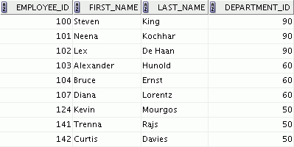
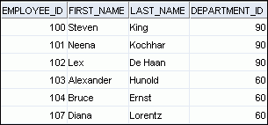
Relating Multiple Tables
  Each row of data in a table can be uniquely identified by a primary key.
  You can logically relate data from multiple tables using foreign keys.
Table name: DEPARTMENTS
Table name: EMPLOYEES
…
Primary key
Primary key
Foreign key
Notes:
Each table contains data that describes exactly one entity. For example, the EMPLOYEES table contains information about employees. Categories of data are listed across the top of each table, and individual cases are listed below. By using a table format, you can readily visualize, understand, and use information.
Because data about different entities is stored in different tables, you may need to combine two or more tables to answer a particular question. For example, you may want to know the location of the department where an employee works. In this scenario, you need information from the EMPLOYEES table (which contains data about employees) and the DEPARTMENTS table (which contains information about departments). With an RDBMS, you can relate the data in one table to the data in another by using the foreign keys. A foreign key is a column (or a set of columns) that refers to a primary key in the same table or another table.
You can use the ability to relate data in one table to data in another to organize information in separate, manageable units. Employee data can be kept logically distinct from the department data by storing it in a separate table.
Oracle Database 12c: SQL Workshop I 1 - <number>

Slide 28
Notes:
Guidelines for Primary Keys and Foreign Keys
You cannot use duplicate values in a primary key.
Primary keys generally cannot be changed.
Foreign keys are based on data values and are purely logical (not physical) pointers.
A foreign key value must match an existing primary key value or unique key value; otherwise, it must be null.
A foreign key must reference either a primary key or a unique key column.
Oracle Database 12c: SQL Workshop I 1 - <number>

Slide 29
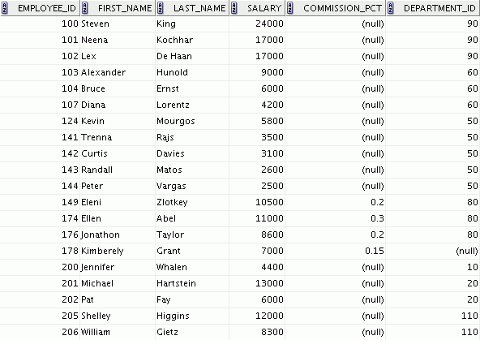
Relational Database Terminology
3
2
4
5
6
1
Notes:
A relational database can contain one or many tables. A table is the basic storage structure of an RDBMS. A table holds all the data necessary about something in the real world, such as employees, invoices, or customers.
The slide shows the contents of the EMPLOYEES table or relation. The numbers indicate the following:
1. A single row (or tuple) representing all the data required for a particular employee. Each row in a table should be identified by a primary key, which permits no duplicate rows. The order of rows is insignificant; specify the row order when the data is retrieved.
2. A column or attribute containing the employee number. The employee number identifies a unique employee in the EMPLOYEES table. In this example, the employee number column is designated as the primary key. A primary key must contain a value and the value must be unique.
3. A column that is not a key value. A column represents one kind of data in a table; in this example, the data is the salaries of all the employees. Column order is insignificant when storing data; specify the column order when the data is retrieved.
Oracle Database 12c: SQL Workshop I 1 - <number>

Slide 30
Notes:
4. A column containing the department number, which is also a foreign key. A foreign key is a column that defines how tables relate to each other. A foreign key refers to a primary key or a unique key in the same table or in another table. In the example, DEPARTMENT_ID uniquely identifies a department in the DEPARTMENTS table.
5. A field can be found at the intersection of a row and a column. There can be only one value in it.
6. A field may have no value in it. This is called a null value. In the EMPLOYEES table, only those employees who have the role of sales representative have a value in the COMMISSION_PCT (commission) field.
Oracle Database 12c: SQL Workshop I 1 - <number>

Slide 31
Lesson Agenda
  Course objectives, agenda, and appendixes used in the course
  Overview of Oracle Database 12c and related products
  Overview of relational database management concepts and terminologies
  Introduction to SQL and its development environments
  The Human Resource(HR) Schema and the tables used in this course
  Oracle database 12c SQL Documentation and Additional Resources
Notes:
Oracle Database 12c: SQL Workshop I 1 - <number>

Slide 32
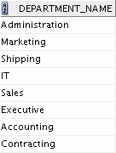
Using SQL to Query Your Database
Structured query language (SQL) is:
  The ANSI standard language for operating relational databases
  Efficient, easy to learn, and use
  Functionally complete (With SQL, you can define, retrieve, and manipulate data in the tables.)
SELECT department_name
FROM departments;
Oracle
server
Notes:
In a relational database, you do not specify the access route to the tables, and you do not need to know how the data is arranged physically.
To access the database, you execute a structured query language (SQL) statement, which is the American National Standards Institute (ANSI) standard language for operating relational databases. SQL is also compliant to ISO Standard (SQL 1999).
SQL is a set of statements with which all programs and users access data in an Oracle Database. Application programs and Oracle tools often allow users access to the database without using SQL directly, but these applications, in turn, must use SQL when executing the user’s request.
SQL provides statements for a variety of tasks, including:
Querying data
Inserting, updating, and deleting rows in a table
Creating, replacing, altering, and dropping objects
Controlling access to the database and its objects
Guaranteeing database consistency and integrity
SQL unifies all of the preceding tasks in one consistent language and enables you to work with data at a logical level.
Oracle Database 12c: SQL Workshop I 1 - <number>

Slide 33
SQL Statements Used in the Course
SELECT
INSERT
UPDATE
DELETE
MERGE
CREATE
ALTER
DROP
RENAME
TRUNCATE
COMMENT
GRANT
REVOKE
COMMIT
ROLLBACK
SAVEPOINT
Data manipulation language (DML)
Data definition language (DDL)
Data control language (DCL)
Transaction control
Notes:
SQL Statements
SQL statements supported by Oracle comply with industry standards. Oracle Corporation ensures future compliance with evolving standards by actively involving key personnel in SQL standards committees. The industry-accepted committees are ANSI and International Standards Organization (ISO). Both ANSI and ISO have accepted SQL as the standard language for relational databases.
Oracle Database 12c: SQL Workshop I 1 - <number>

Slide 34
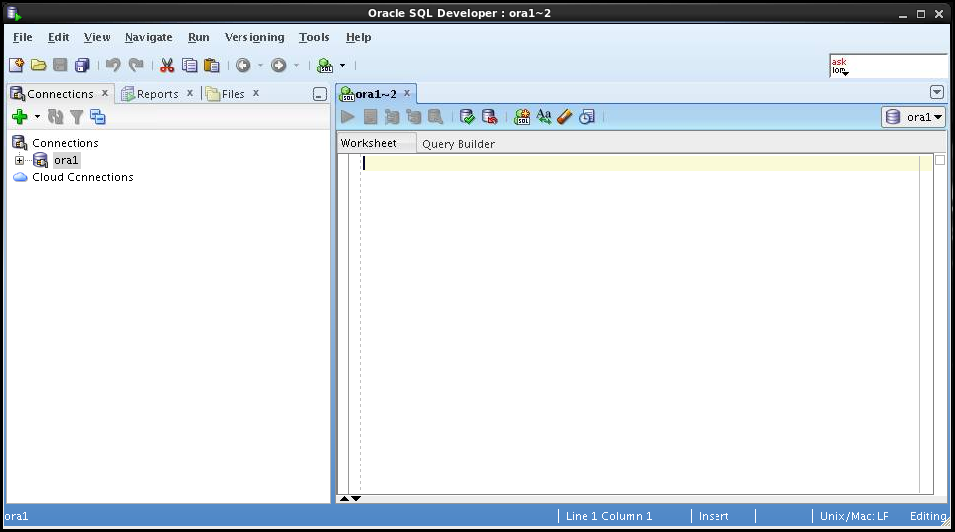
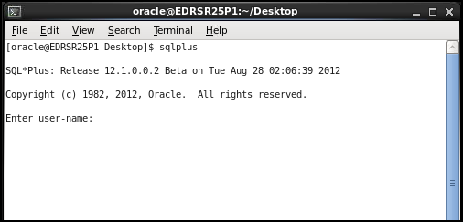
Development Environments for SQL
There are two development environments for this course:
  The primary tool is Oracle SQL Developer.
  SQL*Plus command-line interface can also be used.
SQL Developer
SQL*Plus
Notes:
SQL Developer
This course is developed using Oracle SQL Developer as the tool for running the SQL statements discussed in the examples in the lessons and the practices. SQL Developer is the default tool for this class.
SQL*Plus
The SQL*Plus environment can also be used to run all SQL commands covered in this course.
Note
See Appendix B for information about using SQL Developer, including simple instructions on installation process.
See Appendix C for information about using SQL*Plus.
Oracle Database 12c: SQL Workshop I 1 - <number>

Slide 35
Lesson Agenda
  Course objectives, agenda, and appendixes used in the course
  Overview of Oracle Database 12c and related products
  Overview of relational database management concepts and terminologies
  Introduction to SQL and its development environments
  The Human Resource(HR) Schema and the tables used in this course
  Oracle database 12c SQL Documentation and Additional Resources
Notes:
Oracle Database 12c: SQL Workshop I 1 - <number>

Slide 36
Human Resources (HR) Schema
DEPARTMENTS
department_id
department name
manager_id
location_id
LOCATIONS
location_id
street address
postal code
city
state province
Country id
JOB_HISTORY
employee_id
start_date
end_date
job_id
department_id
EMPLOYEES
employee_id
first_name
last_name
email
phone_number
hire_date
job_id
salary
commission_pct
manager_id
department_id
COUNTRIES
country_id
country_name
region_id
JOBS
job_id
job_title
min_salary
max_salary
REGIONS
region_id
region_name
Notes:
Human Resources (HR)Schema Description
The Human Resources (HR) schema is a part of the Oracle Sample Schemas that can be installed in an Oracle Database. The practice sessions in this course use data from the HR schema.
Table Descriptions
REGIONS contains rows that represent a region such as America, Asia, and so on.
COUNTRIES contains rows for countries, each of which is associated with a region.
LOCATIONS contains the specific address of a specific office, warehouse, or production site of a company in a particular country.
DEPARTMENTS shows details about the departments in which the employees work. Each department may have a relationship representing the department manager in the EMPLOYEES table.
EMPLOYEES contains details about each employee working for a department. Some employees may not be assigned to any department.
JOBS contains the job types that can be held by each employee.
JOB_HISTORY contains the job history of the employees. If an employee changes departments within a job or changes jobs within a department, a new row is inserted into this table with the earlier job information of the employee.
Oracle Database 12c: SQL Workshop I 1 - <number>

Slide 37
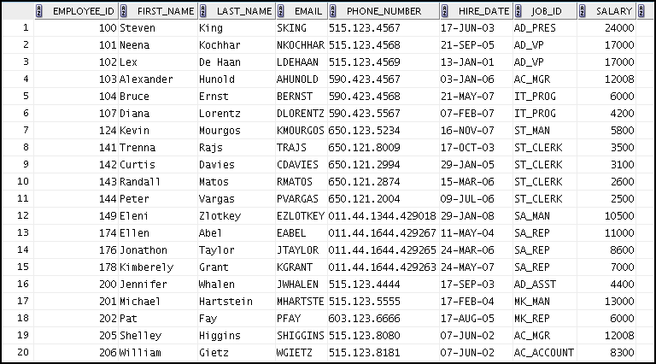
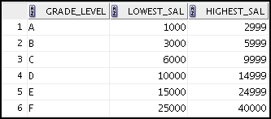
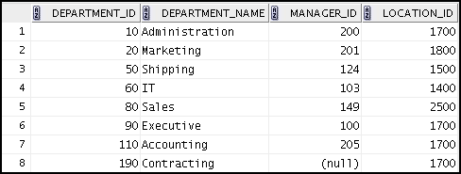
Tables Used in the Course
EMPLOYEES
DEPARTMENTS
JOB_GRADES
Notes:
The following main tables are used in this course:
EMPLOYEES table: Gives details of all the employees
DEPARTMENTS table: Gives details of all the departments
JOB_GRADES table: Gives details of salaries for various grades
Apart from these tables, you will also use the other tables listed in the previous slide such as the LOCATIONS and the JOB_HISTORY table.
Note: The structure and data for all the tables are provided in Appendix A.
Oracle Database 12c: SQL Workshop I 1 - <number>

Slide 38
Lesson Agenda
  Course objectives, agenda, and appendixes used in the course
  Overview of Oracle Database 12c and related products
  Overview of relational database management concepts and terminologies
  Introduction to SQL and its development environments
  The Human Resource(HR) Schema and the tables used in this course
  Oracle database 12c SQL Documentation and Additional Resources
Notes:
Oracle Database 12c: SQL Workshop I 1 - <number>

Slide 39
Oracle Database Documentation
  Oracle Database New Features Guide
  Oracle Database Reference
  Oracle Database SQL Language Reference
  Oracle Database Concepts
  Oracle Database SQL Developer User's Guide
Notes:
Navigate to http://www.oracle.com/pls/db102/homepage to access the Oracle Database 10g documentation library.
Navigate to http://www.oracle.com/pls/db112/homepage to access the Oracle Database 11g documentation library.
Oracle Database 12c: SQL Workshop I 1 - <number>

Slide 40
Additional Resources
For additional information about Oracle Database 12c, refer to the following:
  Oracle Database 12c: New Features eStudies
  Oracle Learning Library:
    http://www.oracle.com/goto/oll
  Oracle Cloud :
    www.cloud.oracle.com
Notes:
Oracle Database 12c: SQL Workshop I 1 - <number>

Slide 41
Summary
In this lesson, you should have learned that:
  Oracle Database 12c extends:
    The benefits of infrastructure grids
    The existing information management capabilities
    The capabilities to use the major application development environments such as PL/SQL, Oracle Java/JDBC, .NET, XML, and so on
    Oracle Cloud
  The database is based on ORDBMS
  Relational databases are composed of relations, managed by relational operations, and governed by data integrity constraints
  With the Oracle server, you can store and manage information by using SQL
Notes:
Relational database management systems are composed of objects or relations. They are managed by operations and governed by data integrity constraints.
Oracle Corporation produces products and services to meet your RDBMS needs. The main products are the following:
Oracle Database with which you store and manage information by using SQL
Oracle Fusion Middleware with which you develop, deploy, and manage modular business services that can be integrated and reused
Oracle Enterprise Manager Grid Control, which you use to manage and automate administrative tasks across sets of systems in a grid environment
SQL
The Oracle server supports ANSI-standard SQL and contains extensions. SQL is the language that is used to communicate with the server to access, manipulate, and control data.
Oracle Database 12c: SQL Workshop I 1 - <number>

Slide 42
Practice 1: Overview
This practice covers the following topics:
  Starting Oracle SQL Developer
  Creating a new database connection
  Browsing the HR tables
Notes:
In this practice, you perform the following:
Start Oracle SQL Developer and create a new connection to the ora1 account.
Use Oracle SQL Developer to examine data objects in the ora1 account. The ora1 account contains the HR schema tables.
Note the following location for the lab files:
/home/oracle/labs/sql1/labs
If you are asked to save any lab files, save them in this location.
In any practice, there may be exercises that are prefaced with the phrases “If you have time” or “If you want an extra challenge.” Work on these exercises only if you have completed all other exercises within the allocated time and would like a further challenge to your skills.
Perform the practices slowly and precisely. You can experiment with saving and running command files. If you have any questions at any time, ask your instructor.
Note: All written practices use Oracle SQL Developer as the development environment. Although it is recommended that you use Oracle SQL Developer, you can also use SQL*Plus that is available in this course.
Oracle Database 12c: SQL Workshop I 1 - <number>

