Slide 1
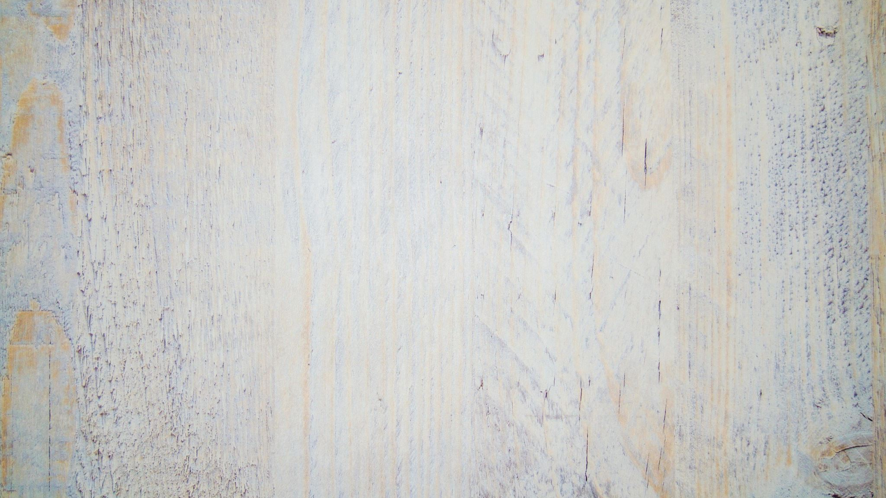
DSC 530 10.4 Assignment: Term Project – Predicting Diabetes
Hanh Tran
Due Date: 8/8/2020
Summer 2020

Slide 2
Statistical Question/Hypothesis
What variables are more correlated with having diabetes?/ What Factors are statistically significant to the outcome of being diabetic?
Hypothesis: There is an effect of the predictor variable on the outcome variable, diabetes
Null Hypothesis: The variable Glucose and BMI does not predict a diabetes outcome.
Based on this assumption, compute the probability of the apparent effect. P-Value. Since the P-value is low for Glucose, the null hypothesis is unlikely to be true.

Slide 3
Variables
The datasets consists of several medical predictor variables and one target variable:
Pregnancies: Number of times pregnant
Glucose: Plasma glucose concentration over 2 hours in an oral glucose tolerance test
BMI: Body mass index (weight in kg/(height in m)2)
DiabetesPedigreeFunction: Diabetes pedigree function (a function which scores likelihood of diabetes
based on family history)
Age: Age (years)
Outcome: Class variable (0 if non-diabetic, 1 if diabetic)

Slide 4
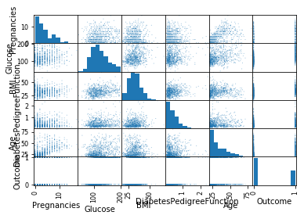
Histogram of Variables

Slide 5
Descriptive Characteristics about Variables
Pregnancies | Glucose | BMI | DiabetesPedigreeFunction | Age | Outcome
count | 752.000000 | 752.000000 | 752.000000 | 752.000000 | 752.000000 | 752.000000
mean | 3.851064 | 121.941489 | 32.454654 | 0.473051 | 33.312500 | 0.351064
std | 3.375189 | 30.601198 | 6.928926 | 0.330108 | 11.709395 | 0.477621
min | 0.000000 | 44.000000 | 18.200000 | 0.078000 | 21.000000 | 0.000000
25% | 1.000000 | 99.750000 | 27.500000 | 0.244000 | 24.000000 | 0.000000
50% | 3.000000 | 117.000000 | 32.300000 | 0.377000 | 29.000000 | 0.000000
75% | 6.000000 | 141.000000 | 36.600000 | 0.627500 | 41.000000 | 1.000000
max | 17.000000 | 199.000000 | 67.100000 | 2.420000 | 81.000000 | 1.000000

Slide 6
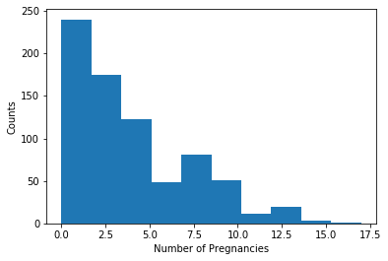
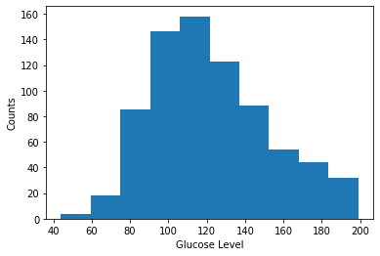
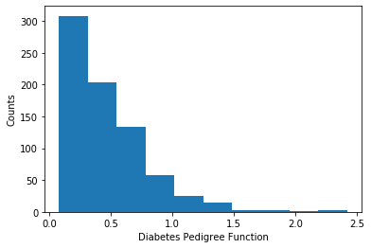
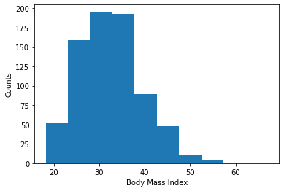
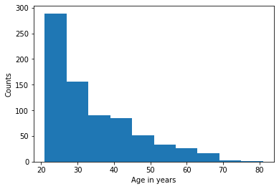
Descriptive Characteristics about Variables part 2
Pregnancies distribution is skewed to the right, with a right tail
Glucose is slightly skewed/somewhat normal
BMI is skewed
Diabetes Pedigree Function is skewed to the right with a right tail
Age is understandably skewed to the right as this sample is taken from women 21 and over

Slide 7
Outliers
Using the Z-score index to detect outliers.
calculating the Z-score to re-scale and center the data (mean of 0 and standard deviation of 1) and look for the instances which are too far from zero. These data points that are way too far from zero are treated as the outliers. In most common cases the threshold of 3 .
However, Keeping the outliers. Even though 17 pregnancies seems a lot, someone just may have that many pregnancies. Also keeping the other outliers as those are possible values in this analysis.
Rejection Pregnancies 4
Glucose 0
BMI 4
DiabetesPedigreeFunction 10
Age 4
Outcome 0
dtype: int64 points
z-score of 3 corresponds to prob of 0.27%

Slide 8
Descriptive Characteristics about Variables Part 3
diabetic outcome tend to be older, have more pregnancies, have a higher glucose, BMI and Diabetes history in family
Pregnancies | Glucose | BMI | DiabetesPedigreeFunction | Age
Outcome
0 | 3.321721 | 110.825820 | 30.876434 | 0.429848 | 31.309426
1 | 4.829545 | 142.488636 | 35.371970 | 0.552909 | 37.015152

Slide 9
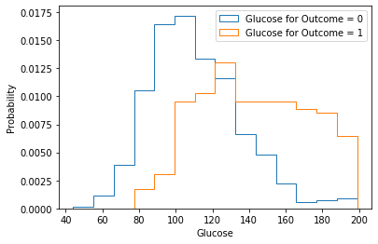
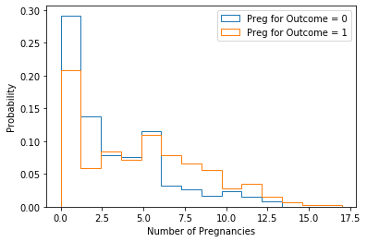
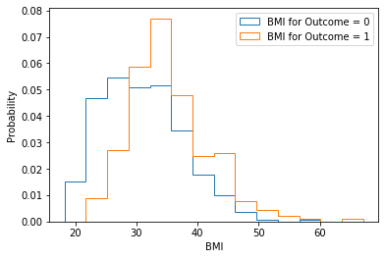
Probability Mass Function for Discrete Outcomes 0,1
comparing two scenarios in data using a PMF (One variable in each graph but two scenarios – orange step line=diabetic, blue step line= non-diabetic:
diabetic group probability tend to have higher glucose than non-diabetic.
diabetic group probability tend to have higher BMI than non-diabetic.

Slide 10
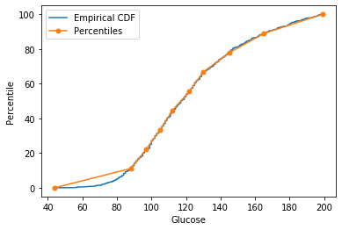
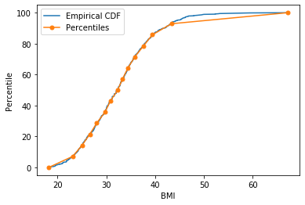
CDF
Below the 10th percentile there is a discrepancy between the data and the model: there are more low glucose levels than we would expect in a normal distribution. Since We are specifically interested in high glucose levels as a factor in a diabetic diagnosis. We can see from the glucose histogram that the distribution is approximately normal.
above the 85th percentile there is a discrepancy between the data and the model.

Slide 11
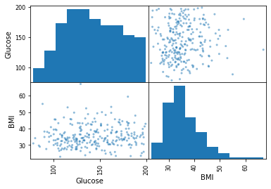
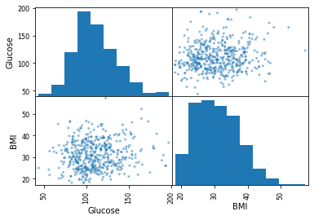
Plot analytical distribution of variables. The highest correlated variables to outcome Glucose and BMI distributions are approximately Gaussians or normal so we can apply model

Slide 12
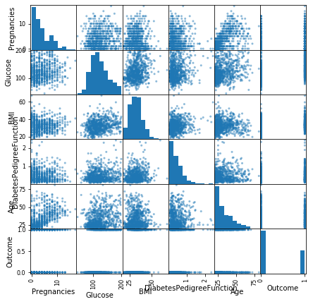
Scatterplot comparing Variables
There are no multicollinearity between explanatory variables

Slide 13
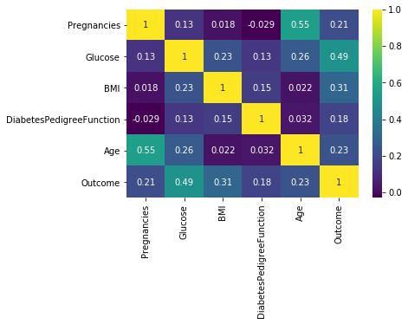
Correlation Analysis between variables
The correlation matrix shows that Glucose, and BMI have the strongest correlation to Outcome variable
Pregnancies | Glucose | BMI | DiabetesPedigreeFunction | Age | Outcome
Pregnancies | 1.000000 | 0.125717 | 0.018352 | -0.029159 | 0.545238 | 0.213371
Glucose | 0.125717 | 1.000000 | 0.232771 | 0.133945 | 0.261490 | 0.494190
BMI | 0.018352 | 0.232771 | 1.000000 | 0.153683 | 0.022144 | 0.309884
DiabetesPedigreeFunction | -0.029159 | 0.133945 | 0.153683 | 1.000000 | 0.031674 | 0.178052
Age | 0.545238 | 0.261490 | 0.022144 | 0.031674 | 1.000000 | 0.232734
Outcome | 0.213371 | 0.494190 | 0.309884 | 0.178052 | 0.232734 | 1.000000

Slide 14
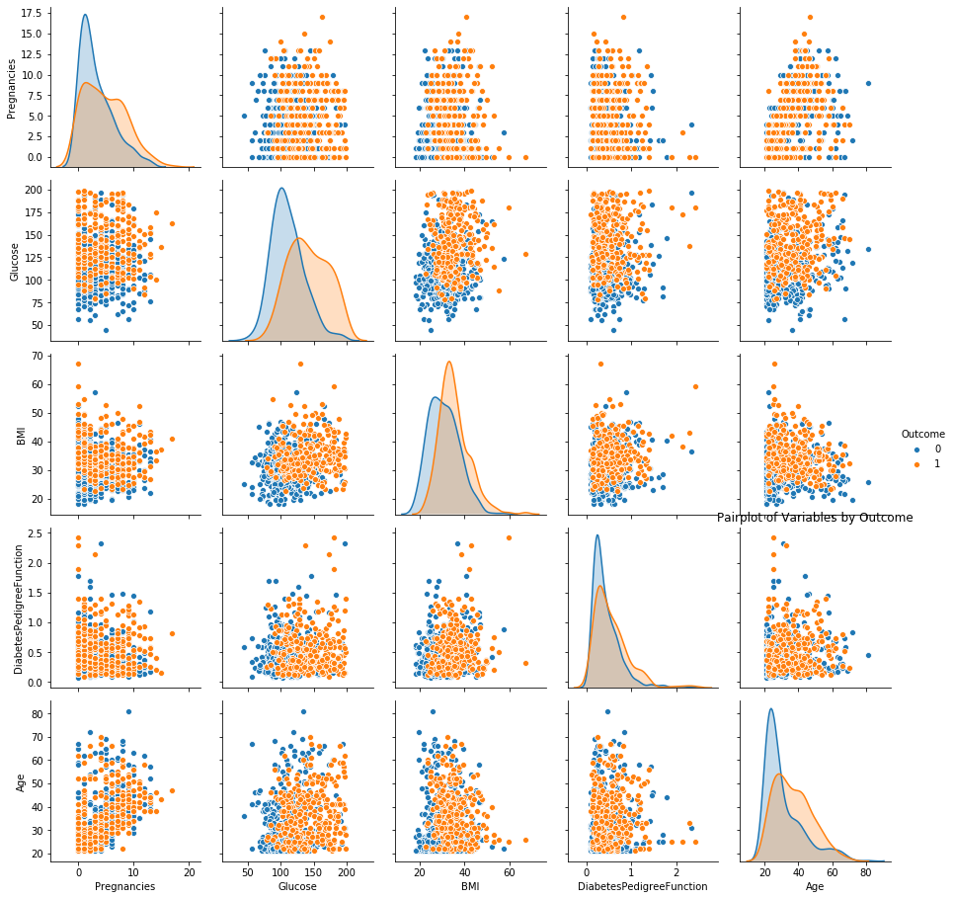
Non-Linear Relationships
There are no non-linear relationships

Slide 15
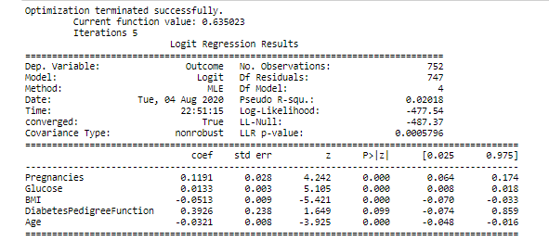
Hypothesis Testing
at p-value<0.05, the variable influences the outcome. By chance, it is unlikely that someone with a high glucose would not have diabetes. So glucose as a variable is statistically significant.
We can reject the Null Hypothesis and say that glucose level has a high chance of predicting an outcome of diabetes

Slide 16
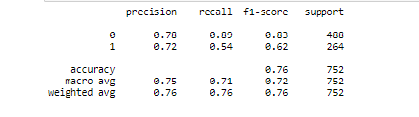
Logistic Regression Analysis
Running a regression analysis on explanatory variables:
Model is about 76% accurate at predicting diabetes based on the variables Glucose and BMI.

