Slide 1
Predictive Modeling in Employee Attrition
MSA 8010 : Data Programming for Analytics

Slide 2








Team Introduction
Pouya Khazaeli Pour
Hiba Ahsan
Mourya Bekkanur Dinesh
Tran Le
Sumanth Pulagante

Slide 3
Problem Motivation
High employee attrition disrupts operations and increases recruitment and training costs.
Traditional HR approaches identify turnover risk too late for effective intervention.

Slide 4
Introduction & Analytical Approach
Why It Matters for the Organization?
Workforce stability is essential for productivity and service quality.
Early identification of at-risk employees enables targeted, proactive retention efforts.
Predictive modeling supports data-driven workforce planning.
Objective: Enhance the employee attrition prediction model to achieve higher recall, stability, and business-ready interpretability for HR decision-making.
Analytical focus: Move beyond baseline predictions to a technical model that HR can trust, understand, and act upon with confidence.

Slide 5
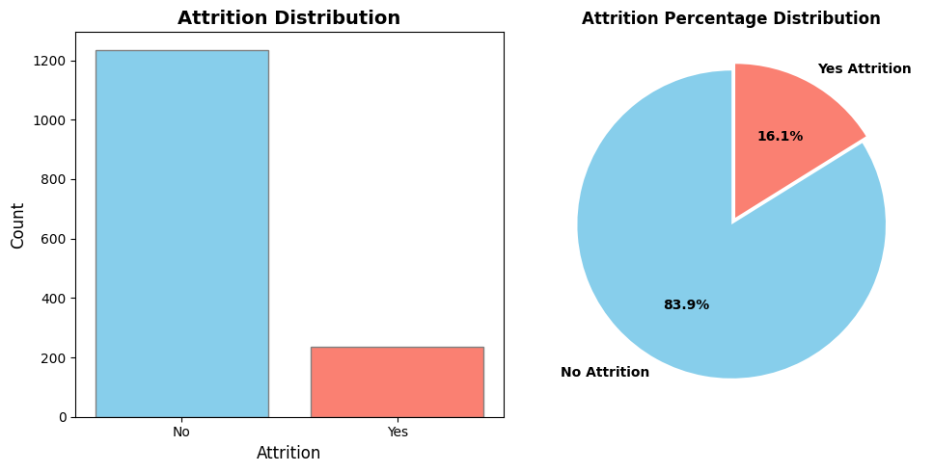
Datasets, Descriptive Statistics
Dataset: IBM HR Employee Attrition dataset comprising 1,470 employees with 28 descriptive features and a binary target variable (Attrition: Yes/No).
Key statistics:
Age range: 18–60 years (mean: 36.9)
Attrition rate: 16.1% (237 departures vs. 1,233 retained) - significant class imbalance
Employees exist average: age 33.6, tenure 5.1 years, monthly income $3,202
Employees continue average: age 37.6, tenure 7.4 years, monthly income $5,204

Slide 6
DATA
PRE- PROCESSING
&
EDA

Slide 7
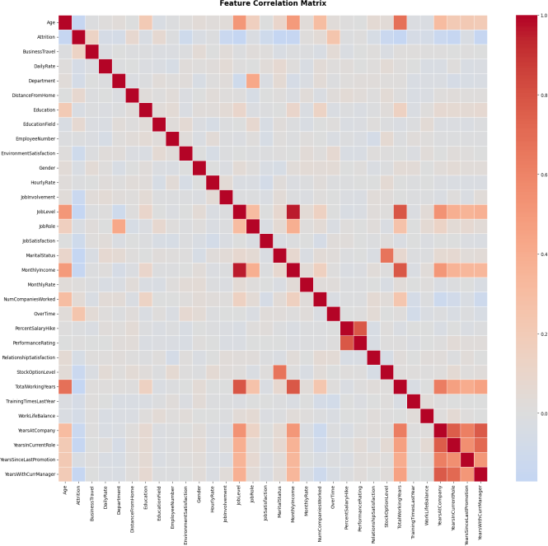
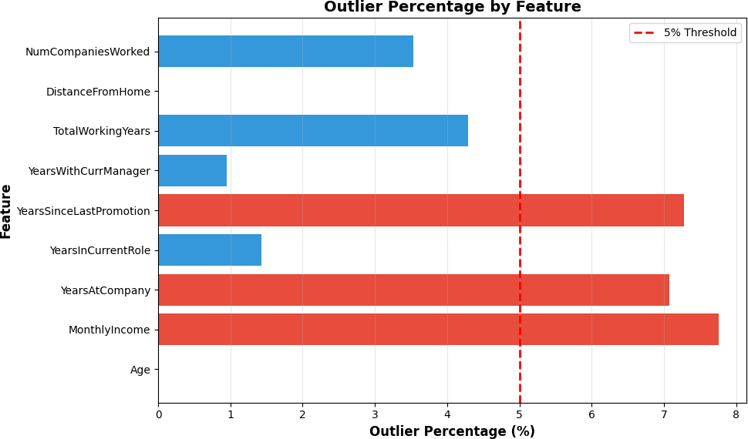
Data Pre-processing & Exploratory Data Analysis
Data Quality Checks: data shape, columns name, missing values.
Feature Encoding:
  Gender, Attrition, OverTime → binary encoding.
  Department, Business Travel, Job Role, Education Field, Marital Status → ordinal encoding.
Train–Test Split : 80% – 20% using stratified sampling
to preserve the Attrition distribution.
Feature Scaling: StandardScaler
Addressing Class Imbalance : Used class_weight = 'balanced' and later SMOTE for balanced resampling during model improvement.
Correlation Analysis
Outlier Detection

Slide 8
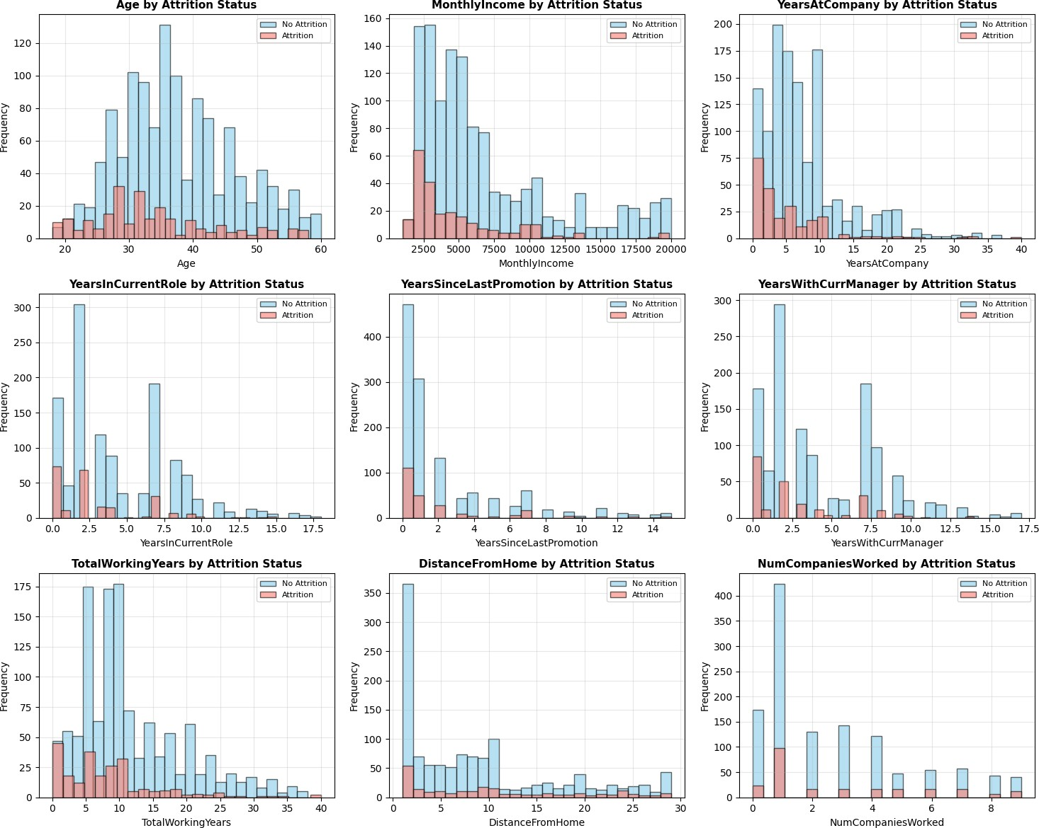
Data Pre-processing & Exploratory Data Analysis

Slide 9
MACHINE LEARNING MODELS
& EVALUATION

Slide 10
Machine Learning Models
MODELS EVALUATED
Logistic regression
Decision Tree
Random Forrest
SVM
XGBoost
SELECTION CRITERIA
RECALL is Primary Metric
FN cost $50-$150K each (missed departures)
Business impact prioritized over pure accuracy

Slide 11
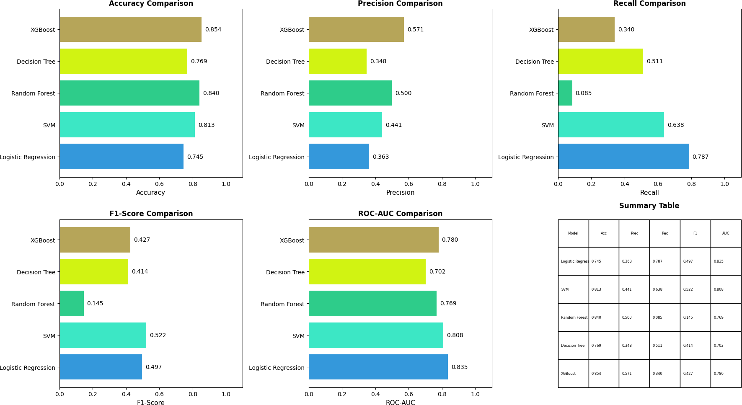
Machine Learning Models Comparison

Slide 12
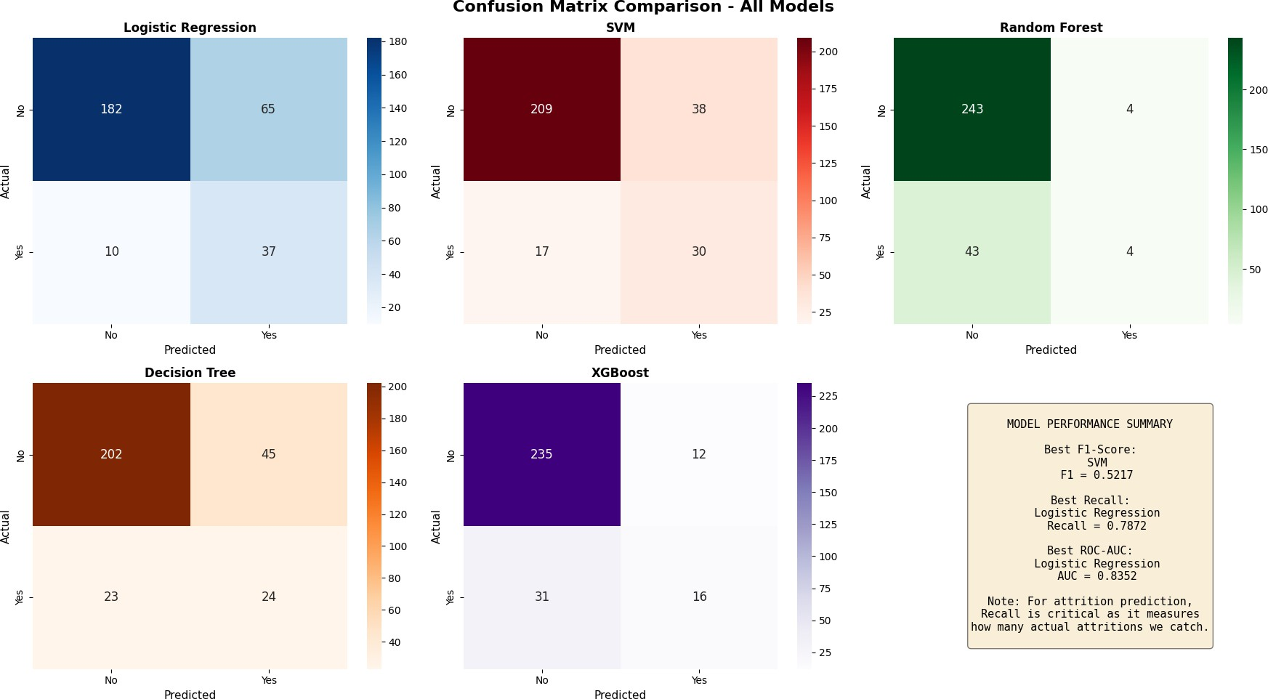
Machine Learning Models Comparison

Slide 13
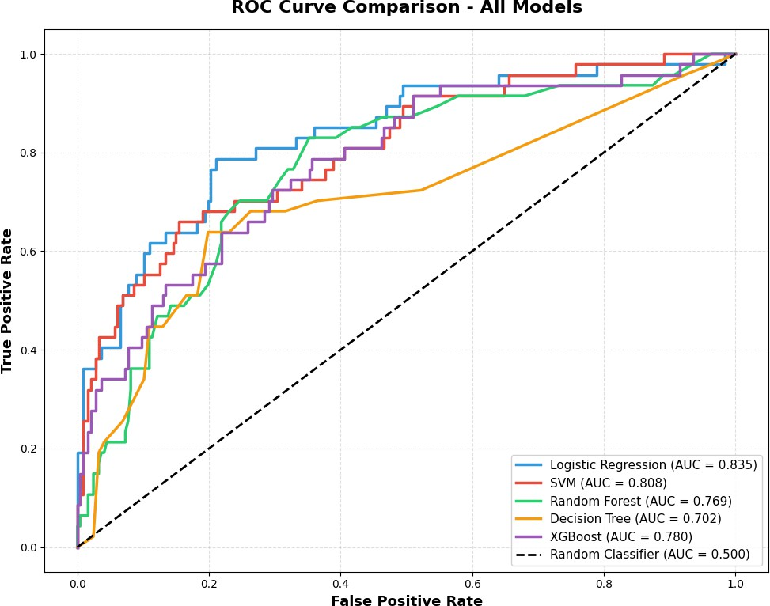
Machine Learning Models Comparison

Slide 14
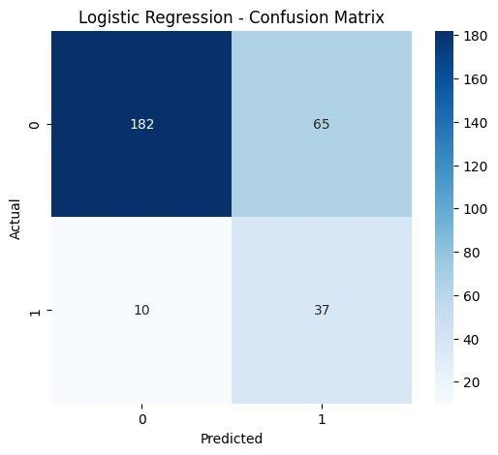
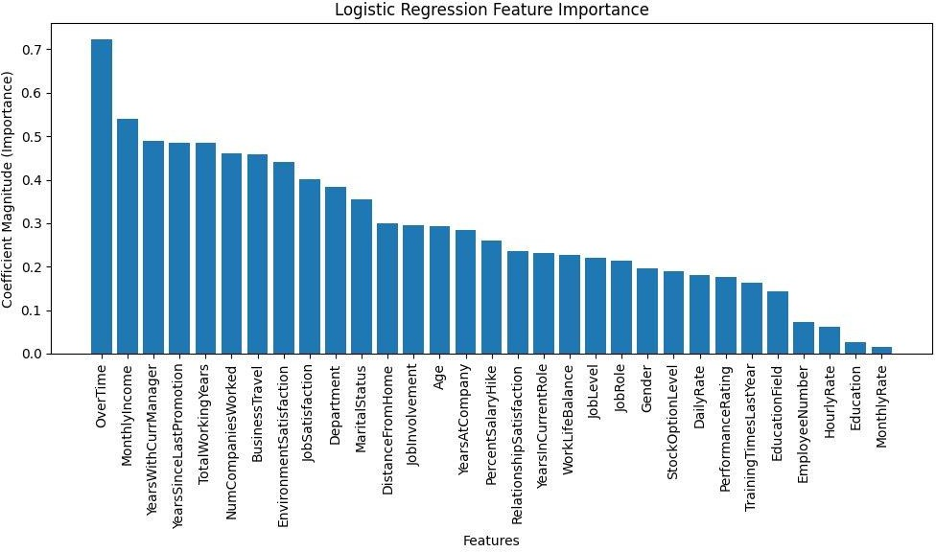
Why Logistic Regression WINS
Catches 37 of 47 departing employees (correctly identifies departures)
ROC-AUC Superior: Best discrimination between attrition and retention across all thresholds.
Interpretability: Feature coefficients show exactly which factors raise attrition risk

Slide 15
MODEL PERFORMANCE IMPROVEMENTS

Slide 16
Modeling Strategy & Experiments
Baseline: Class-weighted Logistic Regression with standardized features, stratified split,achieving 78.7% recall on attrition cases.
Hyperparameter tuning: GridSearchCV/RandomizedSearchCV optimizing
regularization(C), penalty type (L1/L2), solver, and class weights across stratified K-fold
cross-validation.
SMOTE + Hyperparameter tuning : Using SMOTE to address imbalance and hyperparameter tuning

Slide 17
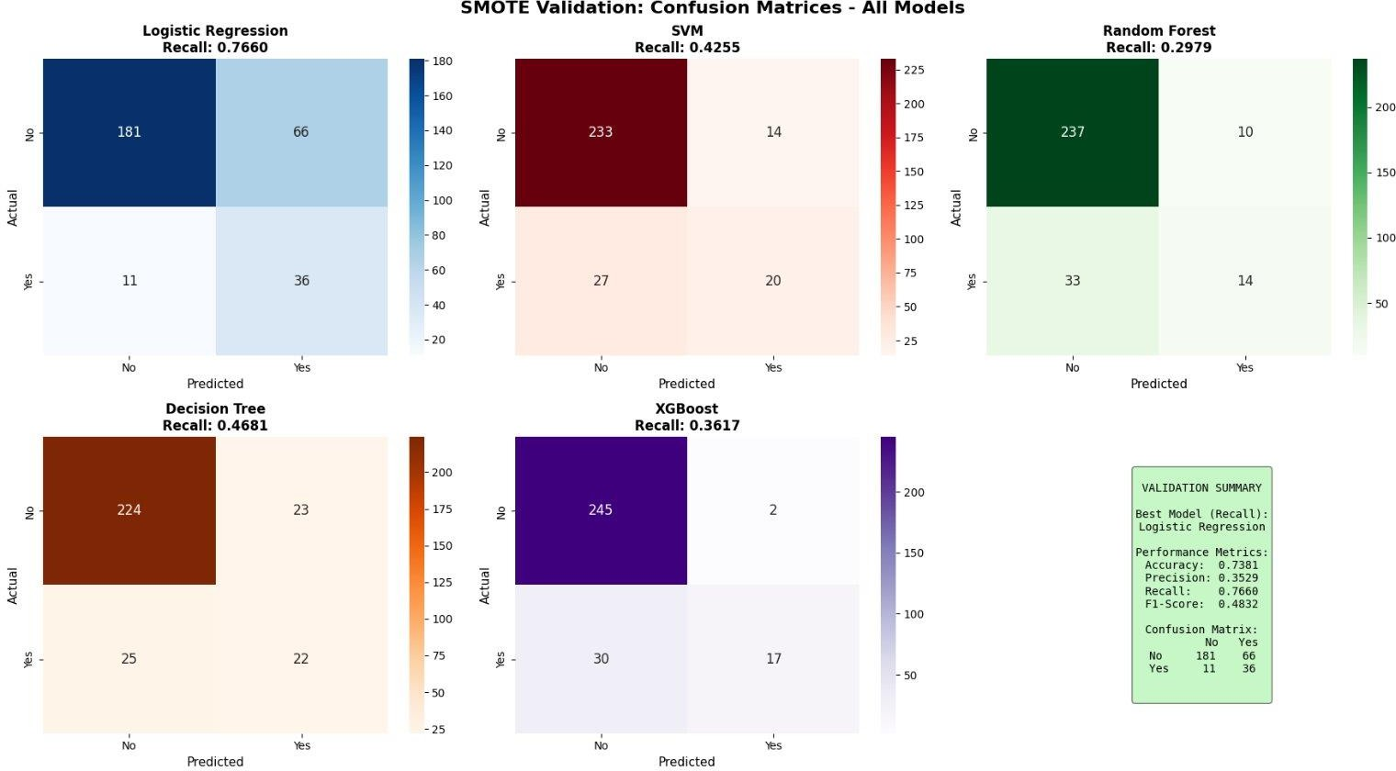
Evaluation Analysis
Tested 5 ML models with SMOTE to validate Logistic Regression as the best choice

Slide 18
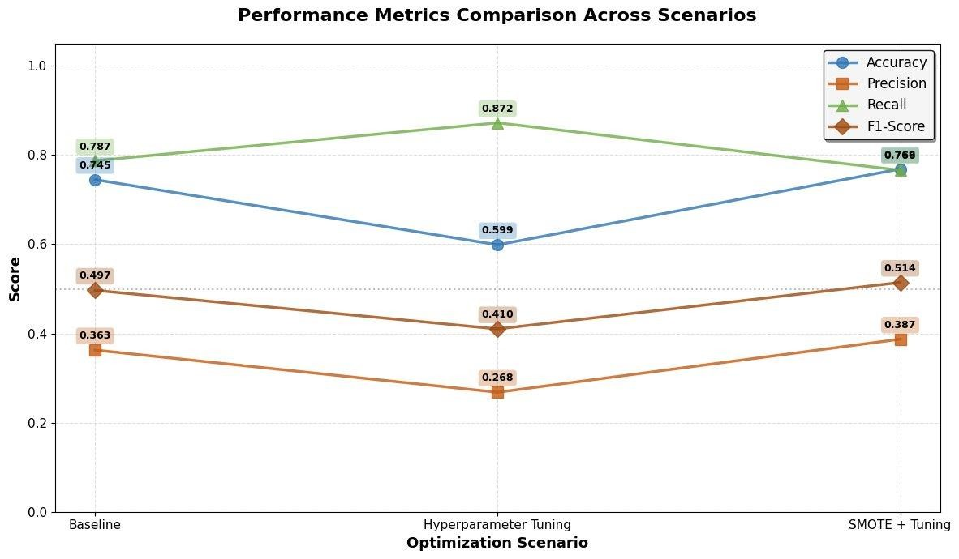
Performance Metrics comparison

Slide 19
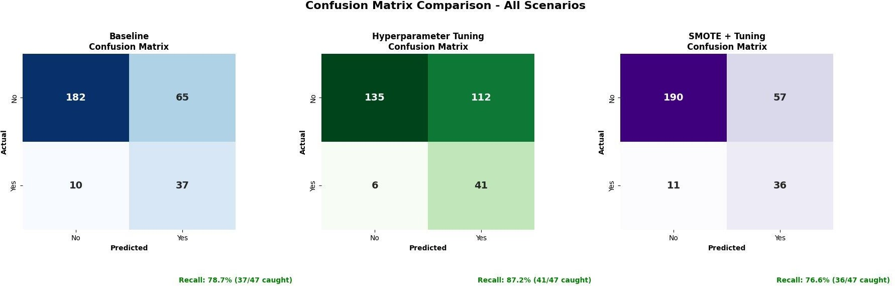
Confusion Matrix Comparison

Slide 20





Key Findings
& Business Impact

Slide 21
Key Findings and Business Impact
Key Findings
Clear risk factors identified: Overtime, low income, lack of promotions, heavy travel, and manager relationship length.
Prioritized retention focus.
Consistent, reliable performance: The
model outperforms all other tested models in recall, ROC-AUC, and interpretability.
Business Impact
Shift from Reactive to Proactive HR
Significant Cost Savings Potential
Greater stability
Higher productivity
Smarter HR decisions
Enhanced employee retention:

Slide 22
Recommendation & Conclusion
Deploy the attrition prediction model within HR systems to identify at-risk employees early and enable
proactive retention efforts.
Address key risk factors by reducing overtime workload, improving promotion pathways, and adjusting
compensation for vulnerable groups.
Strengthen manager–employee relationships through leadership training and consistent check-ins, as this is one of the strongest predictors of retention.
Model provides early prediction into workforce risks, improving HR decision-making.
Strengthens workforce stability, reducing operational disruptions and lowering turnover-related costs.

Slide 23

Questions!

