Slide 1
Introducing the Extracted Features Dataset
DH 2016 Workshop

Slide 2
EF DATASET
A DATASET OF PAGE-LEVEL EXTRACTED FEATURES FOR VOLUMES IN THE HATHITRUST DIGITAL LIBRARY

Slide 3
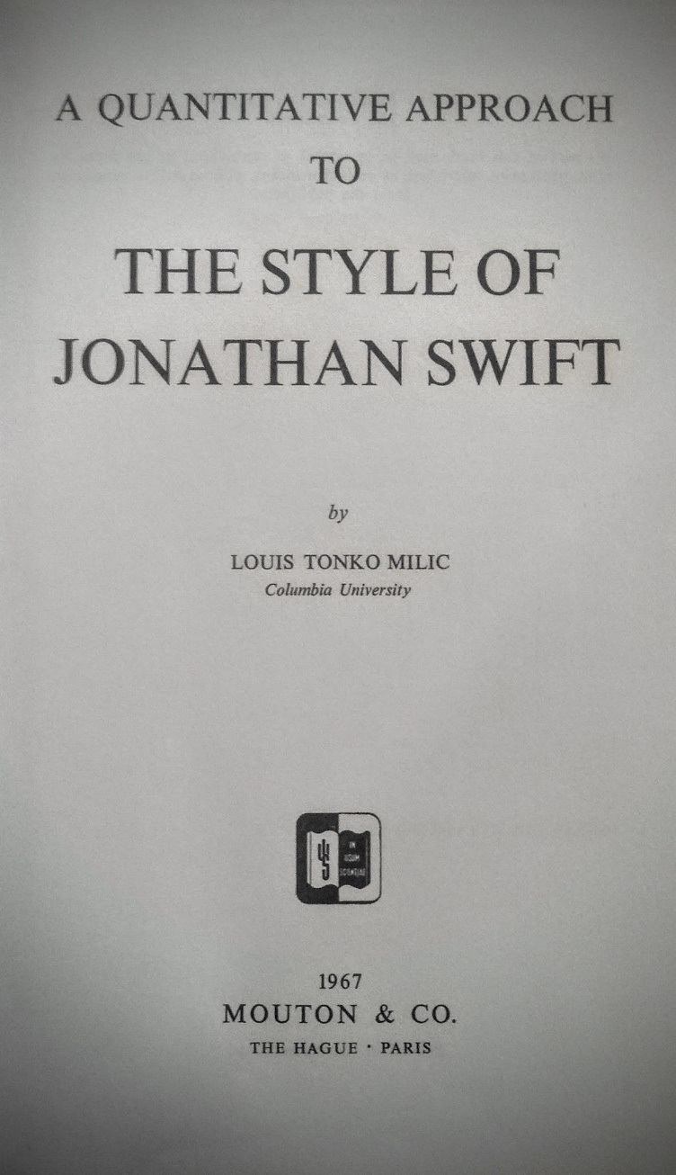

Slide 4
LARGER CORPORA ALLOW FOR DIFFERENT KINDS OF INSIGHTS.
HISTORIC
CULTURAL
LINGUISTIC

Slide 5
INTELLECTUAL PROPERTY LAWS ARE AN IMPEDIMENT TO SCHOLARLY WORK AT LARGE-SCALES
IT CAN BE ARGUED THAT DEEP READING DOES NOT ‘CONSUME’ A WORK, BUT IT IS DIFFICULT TO GUARANTEE THIS WHEN DISTRIBUTING TEXTS

Slide 6
THE EXTRACTED FEATURES DATASET IS ONE APPROACH FOR ‘NON-CONSUMPTIVE’ BUT MALLEABLE REPRESENTATIONS OF WORKS FOR RESEARCH

Slide 7
FEATURES ARE A TRANSLATION OF TEXT FROM LANGUAGE THAT HUMANS UNDERSTAND TO LANGUAGE THAT MACHINES UNDERSTAND.
RAW TEXT
▼
TRANSLATION INTO FEATURES (YOU ARE HERE)
▼
ALGORITHMIC USE

Slide 8
HARD TO MAKE ONE SIZE FIT ALL
EXTRACTED FEATURES DATASET ASSISTS IN
MORE OBSCURE QUESTIONS
FUNCTIONALITY NOT IN HTRC
SENSITIVITY TO WHAT IS HAPPENING TO DATA

Slide 9
DATA
https://sharc.hathitrust.org/features
1825 MILLION PAGES, IN 4.8 MILLION VOLUMES
CURRENTLY RESTRICTED TO PUBLIC DOMAIN SCANNED WORKS

Slide 10
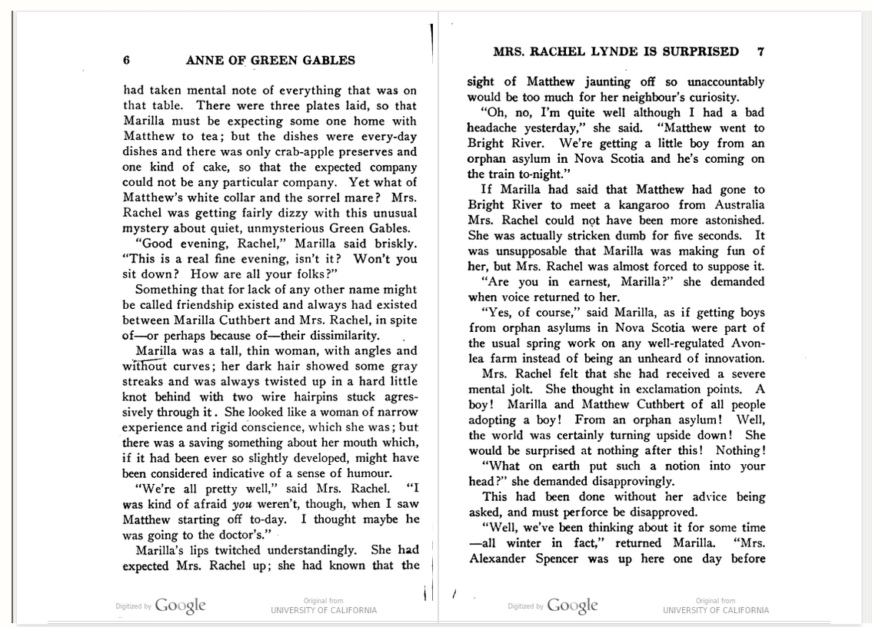
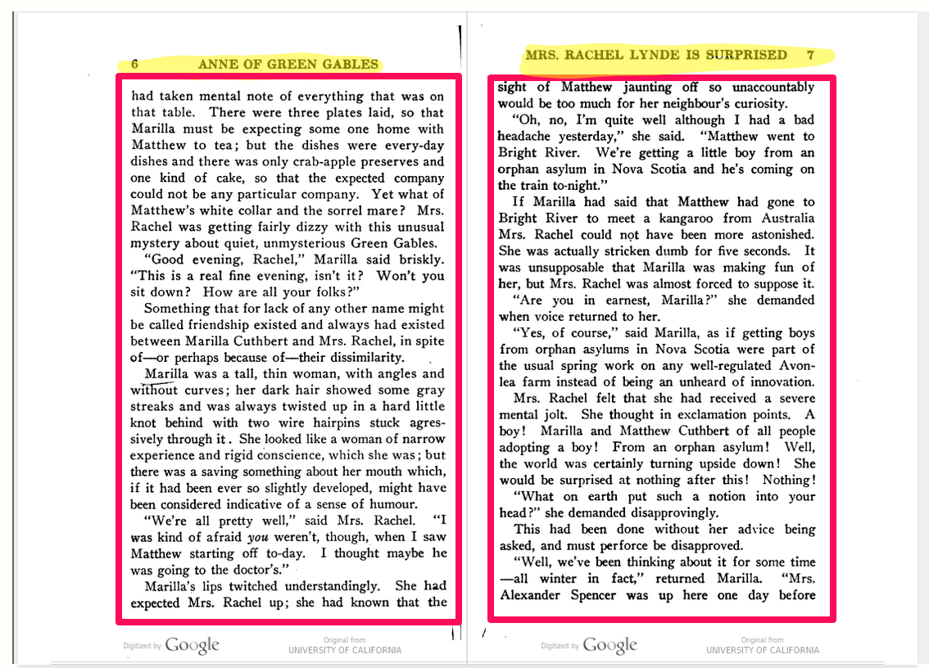

Slide 11
PER SECTION OF EACH PAGE (HEADER/FOOTER/BODY)
TOKEN COUNT, LINE COUNT, EMPTY LINE COUNT, SENTENCE COUNT
COUNTS OF CHARACTERS OCCURRING AT THE BEGINNINGS OF LINES, END OF LINES
POS-TAGGED TOKEN FREQUENCIES (CASE-SENSITIVE)
E.G. “ROSE” (VERB), “ROSE” (NOUN), AND “ROSE” ARE COUNTED SEPARATELY

Slide 12
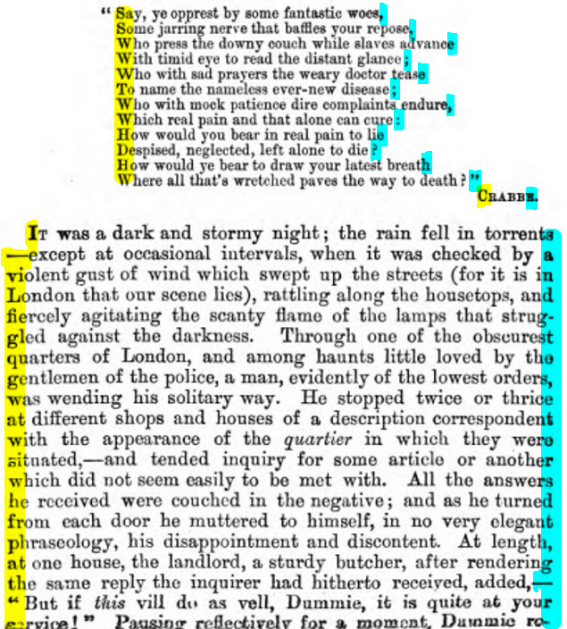

Slide 13
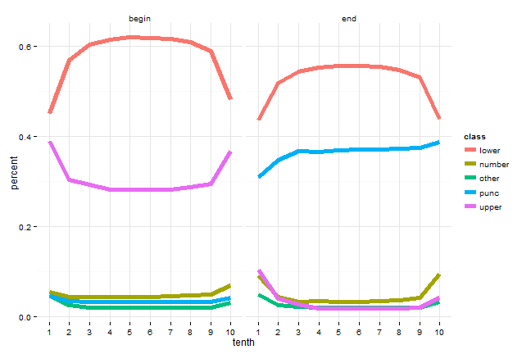

Slide 14
POSSIBILITIES
COMPARE TERM COUNTS, WORD CLOUDS
WITHIN-BOOK COMPARISON OF THEMES
CLASSIFICATION AGAINST METADATA (E.G. BUILD A GENRE DETECTOR!)
IDENTIFY PART OF BOOK (VIA CHARACTER INFORMATION)
IDENTIFY CHAPTER HEADINGS, FRONTISPIECES (VIA LINE COUNT INFORMATION)
TOPIC MODELING

Slide 15
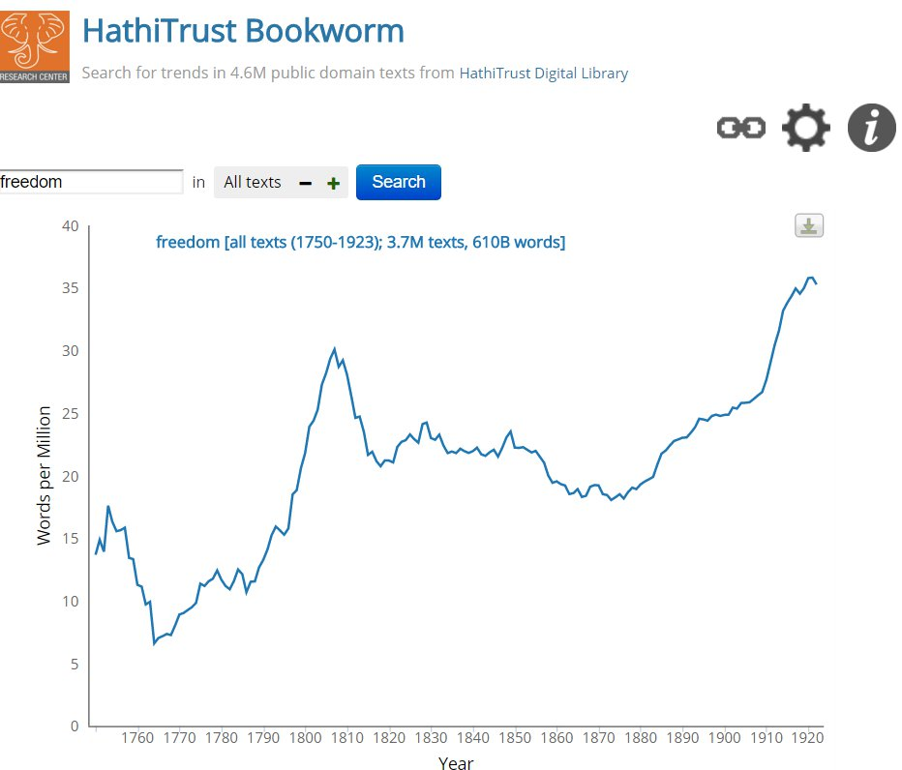
http://bookworm.htrc.illinois.edu

Slide 16
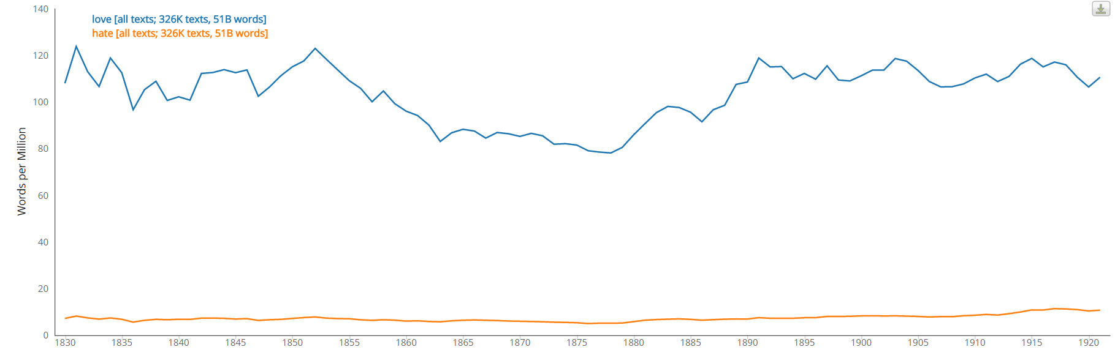
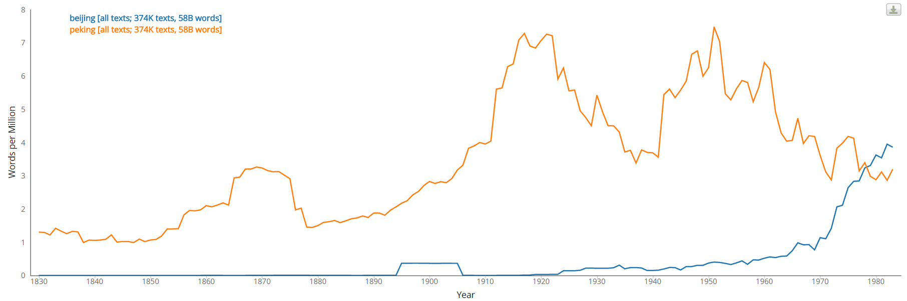
Notes:
Most basically, Bookworm functions like the Google N-Gram viewer.

Slide 17
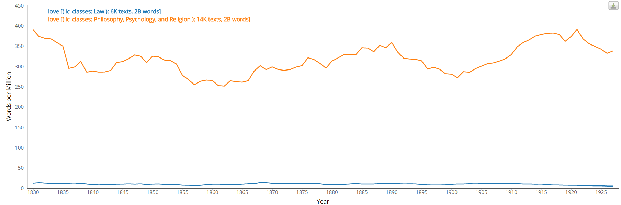
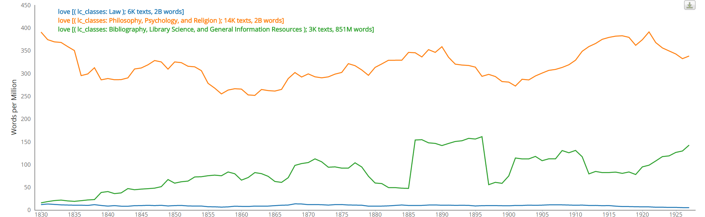
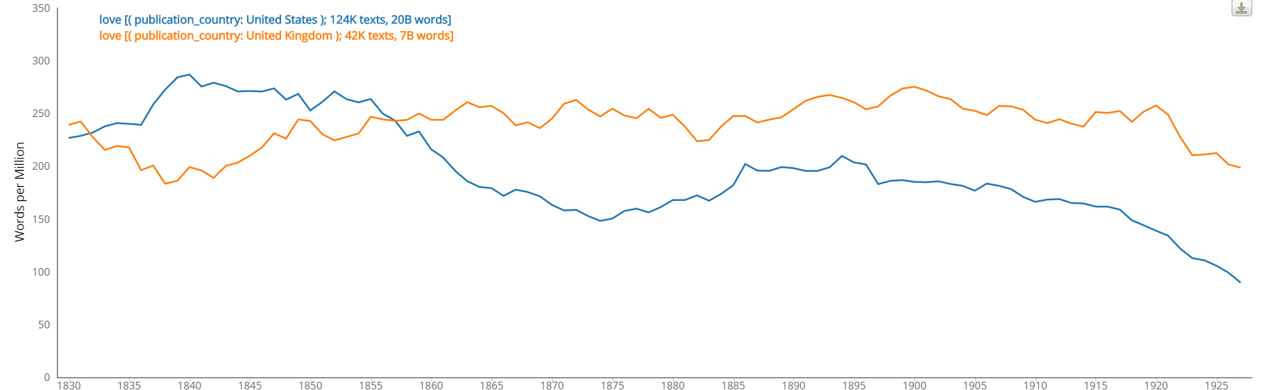
Notes:
Advanced use:
Facets
lc classes, genres, subclasses, gender, publication country

Slide 18
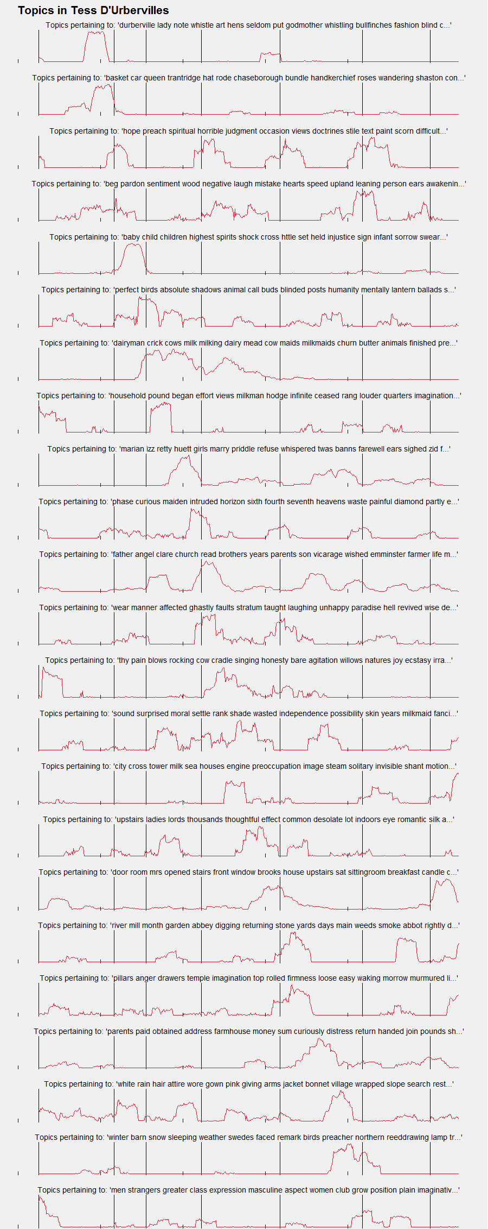

Slide 19
