Slide 1


Slide 2

DCMB BioComputing BootCamp Day 3, Lecture 2: R Control Structures and Functions
Armand Bankhead
bankhead@umich.edu
8/23/2017
Slides Partially Sourced from Barry Grant and Hui Jiang

Slide 3
Overview
Working Directory
Reading and Writing Data in R
Factors
Using Indexes
Merging Data Frames
Functions
Program Control Structures

Slide 4
The R Working Directory
Do it Yourself!
R executes commands from a ‘working directory’
scripts, input files, output files
absolute and relative directories may be specified
Use getwd() to display current working directory
> getwd()
[1] “C:/Users/bankhead/Documents”
Use setwd() to change your working directory
> setwd(“../Desktop/armandsFolder”)
Use dir() to list files and folders in your working directory
Exercise: Create a directory using the
mkdir command and navigate to that directory

Slide 5
Writing Data To Text Files
Do it Yourself!
First lets create something to write as a text file
> m4 = matrix(1:300,nrow=100,ncol=3)
> colnames(m4) = c(‘A’,’B’,C’)
> m4 = data.frame(m4,D = c(rep(‘X’,50),rep(‘Y’,50)))
Use write.table() to write data to a file
Many arguments! Use ?write.table to find out more
> write.table(m4, ‘myData.txt’, quote=F, row.names=F,sep=“\t”)
> dir()
[1] “myData.txt”

Slide 6
Reading Data From Text Files
Do it Yourself!
Use read.delim() to read data from a file
> m5 = read.delim(‘myData.txt’)
> dim(m5)
> head(m5)
By default the first row is read in as column names
Our data appears to be read in correctly but R has converted our text data into something called a factor
> m5$D

Slide 7
Data Structures: Factors
Do it Yourself!
Factors are used to break complex data up into discrete categories
This comes in handy when we need to group samples for statistical analysis (e.g. fitting linear models)
Adding new values can generate an errors!
By default R will convert non-numeric data into factors
Use options(stringsAsFactors=FALSE) to over ride!
> options(stringsAsFactors = FALSE)
> m5 = read.delim(‘myData.txt’)
> m5$D
Notes:
Fat

Slide 8
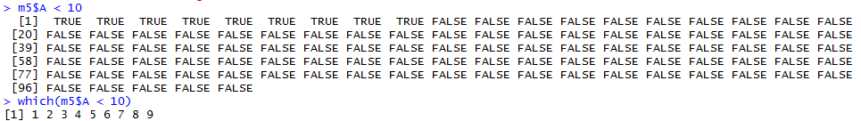
Using Indexes
Indexing is a powerful tool for filtering large data frames or matrices
There are two central ways to index:
Logical vectors:
> m5$A < 10
[1] TRUE TRUE TRUE ….
Integer vectors:
> which(m5$A < 10)
[1] 1 2 3 4 5 6 7 8 9

Slide 9
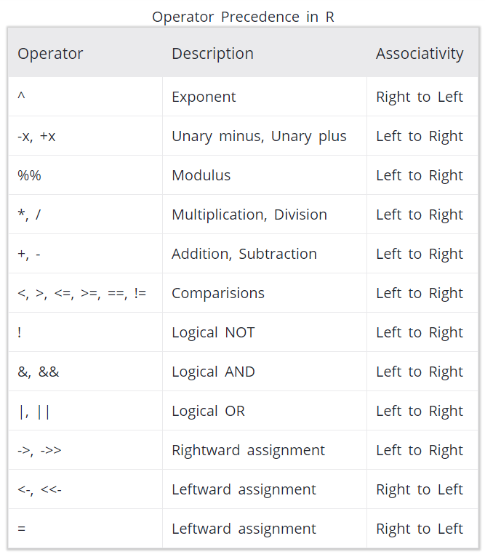
Using Indexes
We can combine multiple conditions use the &, |, and parens
> m5$A < 10 & M5$B > 205
> m5$A < 10 & M5$B > 205 | M5$D == ‘Y’
> m5$A < 10 | m5$D == ‘Y’ & m5$A < 55
Be aware of operator precedence
Use the sum command to count how many positive values survive
Indexes can be used to index vectors, matrices, or data frames
> idx = m5$A < 10 & m5$B > 205
> subMatrix = m5[idx,]
https://www.programiz.com/r-programming/precedence-associativity

Slide 10
Merging Data Frames
Do it Yourself!
Use merge() to join together data from two different matrices or data frames
Important: both matrices must contain unique row identifiers to join on!
> df1 = data.frame(gene = c(‘AKT1’,’ERBB2’,’EGFR’), log2rpkm = c(5,.5,10))
> df2 = data.frame(gene = c(‘AKT1’,ERBB2’,’EGFR’), entrez = c(207,2064,1956))
> combined = merge(df1,df2,by=‘gene’)
Exercise: What happens if gene is not unique?
Add a duplicate gene name and find out.

Slide 11
Functions
Functions allow us to break our R scripts up into modular pieces
Modular program design has already been discussed in unix (day1) and python (day2)
Benefits to our code include:
Program design
Readability
Re-use
Trouble-shooting
Functions are specified using the ‘function’ key word
myFunction = function(arg1,arg2,…) {
statements
}
When multiple arguments are specified R will match first by name, prefix matching arguments, then by position

Slide 12
Functions
Do it Yourself!
> sq1 = function(x) return(x * x)
> sq1 = function(x) x * x
> randomValues = rnorm(1000)
> randomValuesSquared = sq1(randomValues)
> myAnalysis = function() {
vector1 = randomValues
vector2 = randomValuesSquared
result = cor(vector1,vector2)
}
Exercise: Create an R script contains the myAnalysis function
What correlation value is generated?

Slide 13
Program Control Structures
R programs need not be completely sequential
Besides functions, program flow may be modified using control structures
apply
if/else/else if
for
while
Other important R commands that can alter program flow:
break – exit loop
next – skip to the next iteration

Slide 14
Program Control Structures: apply
Do it Yourself!
Use the apply function to iterate through a data.frame, matrix, or arrays
Use lapply() to iterate through lists or vectors
apply function takes at least 3 values
data frame/matrix
1 or 2 indicating rows or columns respectively
function to ‘apply’ to each value (standard or custom)
> m4 = matrix(1:300,nrow=100,ncol=3)
> rowMeans = apply(m4,1,mean)
> columnMeans = apply(m4,2,mean)
Exercise: Run the code above.
What data structures are rowMeans and columnMeans?
Are rows are average larger or columns?

Slide 15
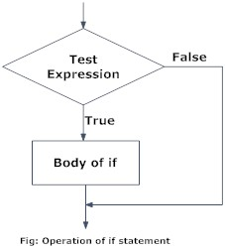
Program Control Structures: if/else/else if
‘if’ statements allow us to condition our program flow
basic syntax:
if(condition) {
statement1
}
else if(condition){
statement2
}
else {
statement3
}
conditions must be TRUE or FALSE
statements are a series of R commands
https://www.programiz.com/r-programming/if-else-statement

Slide 16
Program Control Structures: if/else/else if
Example if statement
m5 = read.delim(‘myData.txt’)
if(ncol(m5) == 4 && is.factor(m5$D)) {
print(‘factors!’)
}
else {
print(‘no factors!’)
}
Multiple conditions can be combined using:
II OR
&& AND
! NOT
() parens
https://www.programiz.com/r-programming/if-else-statement

Slide 17
Program Control Structures: for
‘for’ loops allow us to iterate our code
Basic syntax:
for(counter in vector) {
statements
}
vectors can represent a list of numbers (e.g. 1:10) or arbitrary data types (e.g. c(‘mon’,’tues’,’wed’,…))

Slide 18
Program Control Structures: for
Example #1:
for(i in 1:5) {
print(i:5)
}
Example #2:
m5 = read.delim(‘myData.txt’)
for(column in 1:ncol(m5)) {
print(mean(m5[,column]))
}
‘break’ can be used to exit loop structure
We could have used apply!

Slide 19
Program Control Structures: while
while() loops allow iteration until a condition is met
Basic syntax:
while(condition) {
statements
}
To exit the loop structure
‘break’ can be used to exit loop structure
set condition to be false

Slide 20
Exercise (if time)
Do it Yourself!
The unique() function can be used to get the unique values in a vector
The CO2 data set contains 84 measurements from an experiment comparing the C02 uptake of Echinochloa crus-galli sourced from Quebec and Mississippi. Plants were measured chilled and nonchilled.
Using the CO2 data set determine if the average expression of chilled plants from Quebec is higher than plants from Mississippi.
Notes:
CO2 dataset = relationship between plant CO2 uptake and impact of cold. Plants sourced from Mississippi and Quebec. Grass species Echinochloa crus-galli.

Slide 21
Closing Remarks/Advice
Comment your code
Short programs are better
Plan!
Be prepared to iterate

Slide 22
References
Gentleman, Robert. R Programming for Bioinformatics. CRC Press, 2009.
Some Examples Sourced from Barry Grant and Hui Jiang

