Slide 1
JUnit Basics
Recitation 1
February 5th, 2021
Professor Xu

Slide 2
What Is JUnit?
Junit is an open-source framework used to create and run automated tests.
Junit is widely used by all types of developers to test their code
Junit is a part of the XUnit testing frameworks

Slide 3
Why Use JUnit?
Simple to use
Provides versatility in how you can test your code
Can be run on command line
Runs on most common IDE’s
IntelliJ (I’ll be using this one for demonstration)
NetBeans
Eclipse
Etc.

Slide 4
Goals For This Recitation
Set up environment for running and testing
Learn how to write Junit tests
Learn to run JUnit tests

Slide 5
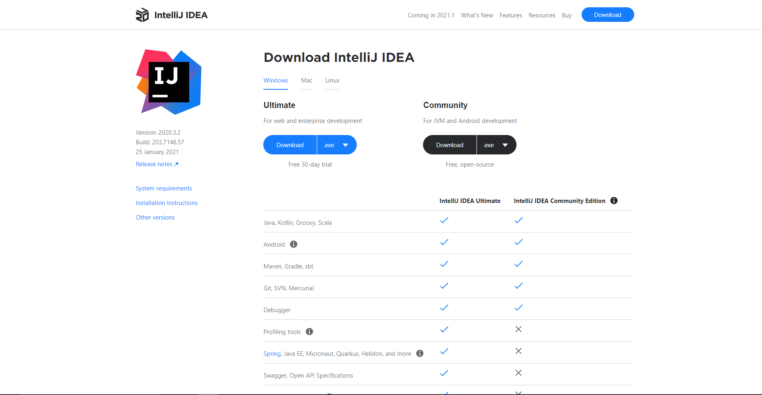
Step 1: Download IntelliJ
Download the latest version of IntelliJ
https://www.jetbrains.com/idea/download/#section=windows
The page should look like this

Slide 6
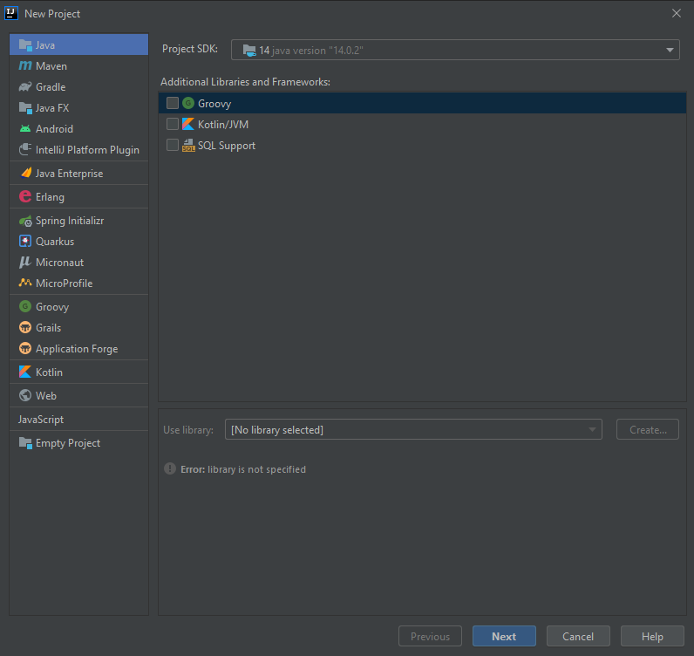
Step 2: New Project
Start a new java project
Hit next
Check the box
Name the project
Leave base package blank (or don’t, its up to you)
Click finish

Slide 7
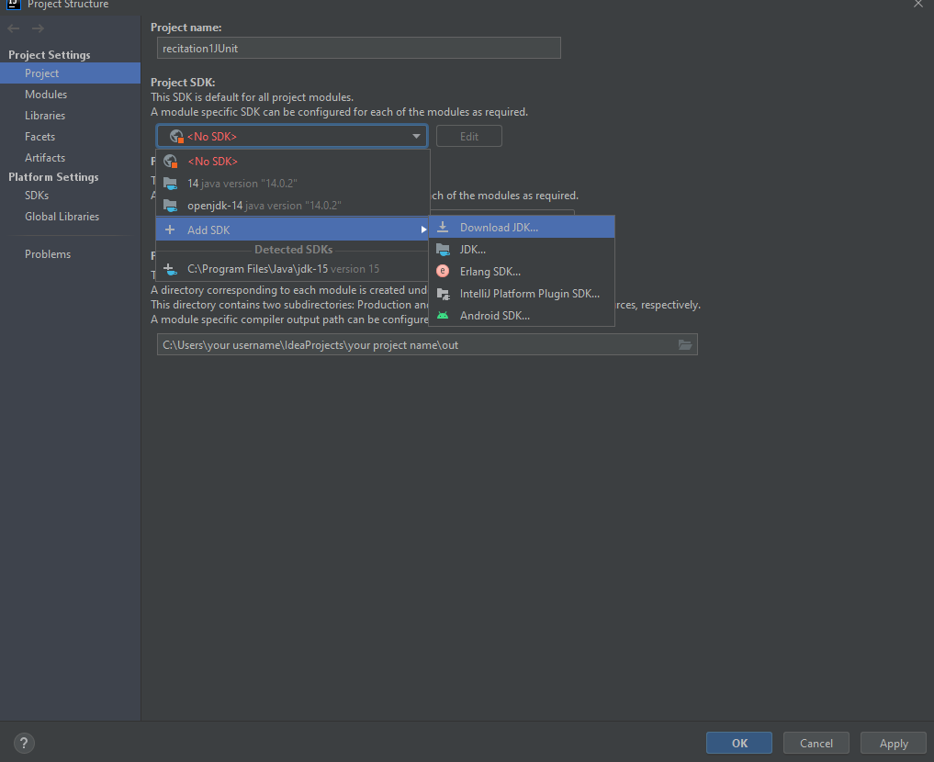
Step 3: Add SDK
After creating new project press file then press project structure
Go to project SDK -> add SDK -> Download SDK and get the most recent one
Now we should be good for writing and testing
For Mac you have to download the SDK manually
https://www.oracle.com/java/technologies/javase-jdk15-downloads.html (latest one)

Slide 8
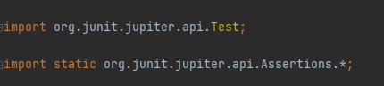
Import Statements
When making the test files yourself it is important to include the following import statements to gain access to JUnit api’s

Slide 9
Assertions
Assertions are api’s that come from Junit to assert whether a desired answer is what the program produced
These are the most common way for testing, and they will most likely be all you need to test your assignments for this class.
Use them to test all kinds of inputs

Slide 10
Assertions: Equals
assertEquals(<desired answer>, <function call>);
Used to assert that the function call from your code is equal to the value you desire
Example:
Say we have a method, numberOne(), that returns the integer one
And another method, numberTwo(), that returns the integer two
assertEquals(1, numberOne()); -> this test case would pass
assertEquals(1, numberTwo()); -> this test case would not pass

Slide 11
Assertions: True
assertTrue(<function call>);
Used to assert that the function call from your code is equal to the Boolean true
Example:
Say we have a method, isTrue(), that returns the Boolean true
And another method, isFalse(), that returns the Boolean false;
assertTrue(isTrue()); -> this test case would pass
assertTrue(isFalse()); -> this test case would not pass

Slide 12
Assertions: False
assertFalse(<function call>);
Used to assert that the function call from your code is equal to the Boolean false
Example:
Say we have a method, isTrue(), that returns the Boolean true
And another method, isFalse(), that returns the Boolean false;
assertFalse(isTrue()); -> this test case would not pass
assertFalse(isFalse()); -> this test case would pass

Slide 13
Example
Say we have a car class in a Car.java file that looks like so:
public class Car{
int year;
public Car(int year){ this.year = year;
}
public int getYear(){
return this.year;
}
}
We would like to test the getYear() function. Which assert should we use?

Slide 14
Example
This would be out CarTest file to test our code
import org.junit.jupiter.api.Test;
import static org.junit.jupiter.api.Assertions.*;
class CarTest{
//create a new instance of your class
Car toyota = new Car(2006);
//must put @Test before your test function
@Test
void getYear() {
assertEquals(“2006”, Toyota.getYear());
}
}
This test case should pass

Slide 15
Creating Tests
In IntelliJ the test class should be made in a separate directory
To make one. Right click on the out folder go to new-> directory and I recommend you call it “test”.
After the file is created go to file -> project structure -> modules
From here click on your new test folder and mark it as a green tests folder and click ok
Press on the name of the function you would like to make a test for and press the Alt+Enter (control+return on mac) keys at the same time

Slide 16
Creating Tests
This will open up a pop up. Press on create test (test… on mac).
Another pop up will show up. Select your testing library as Junit5
It’ll say “JUnit5 is not found in module” click on fix and select use JUnit5 from IntelliJ IDEA distribution and click okay
Select the functions that you would like to test and IntelliJ will auto generate the code to initialize the test functions

Slide 17
Running Tests
For IntelliJ on the top toolbar of the window select run->run-><your test file class name> This will build the project and run the tests. Press on the build tab at the bottom of the window too see the process

Slide 18
Practice
Make a Teacher class that has 3 data fields, a string called name, a Boolean called tenure and a String department
make a constructor that requires no parameters and set these fields to: name: ”John” , tenure: true, department: “Math”
Make getter methods for these fields
Write test cases for each getter method

