Slide 1

ST. VINCENT PALLOTTI COLLEGE OF ENGINEERING AND TECHNOLOGY
DEPARTMENT OF INFORMATION TECHNOLOGY
Academic Year 2026–27
Introductory Seminar on
YouTube Social Media Engagement
Analytics Dashboard
Project Member
Project Focus
Amrit Kaur Gahir
Public YouTube data collection, analytics, and Power BI reporting
B.E. Information Technology, Semester VI
18-10-2026
1
Notes:
Project presentation for the YouTube Social Media Engagement Analytics Dashboard. Project member: Amrit Kaur Gahir.

Slide 2
Table of Content
•
Introduction and problem definition
•
Technical literature survey
•
Existing and proposed system
•
System architecture
•
Project flow
•
Implementation and analytics
•
Dashboard output
•
Hardware and software requirements
•
References
18-10-2026
2

Slide 3
1. Problem Definition
Scattered public metrics
Manual tracking
01
Video metadata and public counts need to be collected from separate API resources.
02
Repeatedly checking many videos makes comparisons slow and inconsistent.
No observation history
Missing statistics
03
A single export cannot show how a video’s public counts changed over time.
04
Likes or comments may be unavailable and must not be mistaken for zero.
Power BI key errors
Need for a repeatable flow
05
Snapshot tables repeat video IDs, so they cannot be used as unique lookup tables.
06
Collection, validation, storage, analytics, and exports need one documented workflow.
18-10-2026
3

Slide 4
2. Technical Literature Survey
Source / technology | Focus | Project implication
YouTube Data API v3 | Channel uploads and video resources | Use uploads playlist pagination and batch video-detail requests.
FastAPI | HTTP APIs and OpenAPI documentation | Expose versioned routes with interactive Swagger UI and ReDoc.
Pydantic | Typed data models and validation | Reject malformed handles and out-of-range collection limits.
Power BI modeling | Dimensions, facts, and relationships | Use Videos as the unique lookup table and snapshots as fact tables.
Design takeaway: validate API inputs, preserve snapshot grain, and keep the Power BI relationship keys unique.
18-10-2026
4
Notes:
Sources: YouTube Data API playlistItems.list reference, FastAPI documentation, Pydantic model documentation, and Microsoft Power BI star schema guidance.
https://developers.google.com/youtube/v3/docs/playlistItems/list
https://fastapi.tiangolo.com/features/
https://docs.pydantic.dev/latest/concepts/models/
https://learn.microsoft.com/power-bi/guidance/star-schema

Slide 5
3. Existing Systems vs. Proposed System
Parameter | Existing approach | Proposed project system
Data collection | Manual browsing or separate scripts | YouTube Data API v3 with pagination and batching
Validation | Ad hoc checks | Pydantic request constraints and normalized records
Historical tracking | One-time values or overwritten files | Timestamped metric snapshots in SQLite
Missing statistics | Often treated as blank or zero | Unavailable public counts remain null
Analytics | Manual spreadsheet calculations | Python services calculate rankings and rates
Power BI model | Duplicate IDs can be assigned as keys | Unique video dimension relates to snapshot facts
Data handoff | Manual copying | CSV exports generated from stored records
18-10-2026
5

Slide 6
4. Proposed System Architecture
MrBeast
public channel
YouTube
Data API v3
Python
services
SQLite
Database
CSV
datasets
Power BI
Dashboard
Channel handle and
public statistics
Uploads pagination
and video details
Validate, normalize
and calculate metrics
Videos and dated
metric snapshots
Stored records
prepared for reporting
KPIs, trends, rankings
and comparisons
Analytics are calculated from stored observations. Growth needs at least two collection times for the same video.
Scope: public metadata and statistics from the Data API. Private YouTube Studio measures such as watch time and impressions are outside this project.
18-10-2026
6
Notes:
The architecture is based on the project design and actual implementation. Public YouTube API data flows through validation and collection services into SQLite. Analytics and CSV exports feed Power BI.
https://developers.google.com/youtube/v3/docs/playlistItems/list
Project architecture: docs/architecture.md

Slide 7
5. Project Flow
1. Request
2. Validate
3. Collect
4. Normalize
5. Persist
6. Analyze
Choose channel handle
and video limit
Check request fields
and API credentials
Resolve channel and
read uploads pages
Parse metadata and
nullable statistics
Upsert video and
append a snapshot
Calculate metrics and
export CSV datasets
Power BI consumes exports from the stored database
Repeated video IDs belong in observation tables; the Videos table provides the unique key.
18-10-2026
7
Notes:
Collection requests are validated, the uploads playlist is paginated, video details are requested in batches, records are normalized, and each run creates timestamped metric observations.
Project source: app/services/collection_service.py and app/services/export_service.py

Slide 8
6. System Implementation and Analytics
Engagement rate calculation
Implemented API functions
if views and views > 0 and likes is not None
and comments is not None:
rate = 100 * (likes + comments) / views
else:
rate = None
•
Health, channel, and paginated video access
•
Collection with YouTube API error handling
•
Overview, top videos, publishing patterns, and growth
Missing counts remain unknown. The service excludes them from calculations that require those values.
•
CSV export for videos, snapshots, engagement, and channel summary
•
Swagger UI, ReDoc, and OpenAPI schema
18-10-2026
8
Notes:
The collection request schema constrains channel handles and video limits. Analytics only calculates engagement when views, likes, and comments are available.
Project source: app/schemas/video.py, app/services/analytics_service.py, app/services/collection_service.py

Slide 9
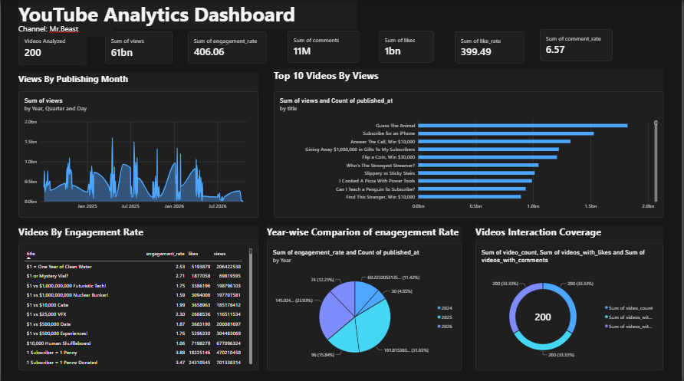
7. Dashboard Output
Dashboard views
•
Channel and engagement KPI cards
•
Views by publication month
•
Top 10 videos by views
•
Engagement rate table
•
Year comparison and interaction coverage
Screenshot values are the supplied dashboard view.
18-10-2026
9
Notes:
The dashboard image is the screenshot supplied for this project. Displayed metrics and charts are reproduced as a reference view; refreshed values depend on the current stored data and Power BI model.
Power BI model guidance: https://learn.microsoft.com/power-bi/guidance/star-schema

Slide 10
8. Hardware and Software Requirements
Hardware Requirement
Software Requirement
•
Windows or Linux computer
•
Python 3 and FastAPI
•
Intel i5 or equivalent processor
•
Pydantic and SQLAlchemy
•
8 GB RAM recommended
•
SQLite database
•
10 GB available storage
•
YouTube Data API v3 client
•
Internet connection for live API calls
•
Pandas for data processing
•
GPU not required for this workflow
•
Power BI Desktop and VS Code
18-10-2026
10

Slide 11
9. References
[1] Google Developers
YouTube Data API v3, playlistItems.list
developers.google.com/youtube/v3/docs/playlistItems/list
[2] FastAPI
Features and interactive API documentation
fastapi.tiangolo.com/features/
[3] Pydantic
Models and data validation
docs.pydantic.dev/latest/concepts/models/
[4] SQLAlchemy
SQLite dialect documentation
docs.sqlalchemy.org/en/20/dialects/sqlite.html
[5] Microsoft Learn
Understand star schema in Power BI
learn.microsoft.com/power-bi/guidance/star-schema
18-10-2026
11
Notes:
References were accessed for the system design and API implementation.
YouTube Data API v3, playlistItems.list: https://developers.google.com/youtube/v3/docs/playlistItems/list
FastAPI features and OpenAPI: https://fastapi.tiangolo.com/features/
Pydantic models: https://docs.pydantic.dev/latest/concepts/models/
SQLAlchemy SQLite dialect: https://docs.sqlalchemy.org/en/20/dialects/sqlite.html
Power BI star schema: https://learn.microsoft.com/power-bi/guidance/star-schema

Slide 12
THANK YOU
Questions
18-10-2026
12
Notes:
Thank the audience and invite questions.

