Slide 1

AI-Powered Energy Poverty
Detection & Policy Advisor
A GenAI system that predicts which California cities are at HIGH risk of energy poverty, explains why using SHAP explainability, and recommends real assistance programs — grounded in actual policy documents via RAG.
GEN AI
Grid
Watch
XGBoost · SHAP
RAG · FAISS
LLM Chain-of-Thought
By Jay A Panchal
Predicting Risk · Explaining Why · Recommending Action

Slide 2
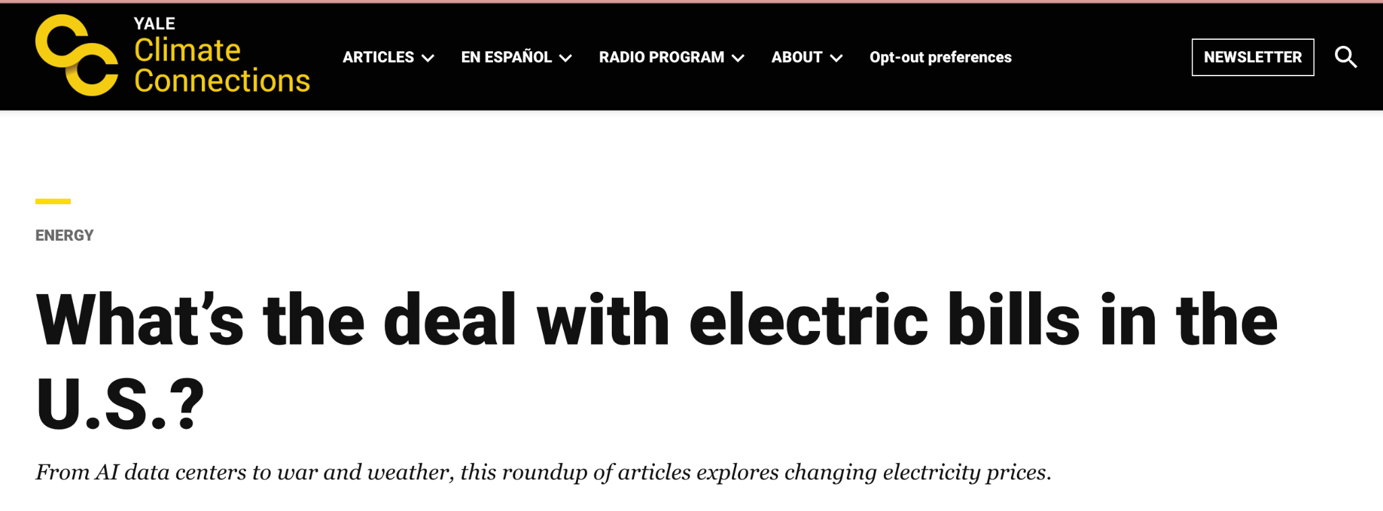
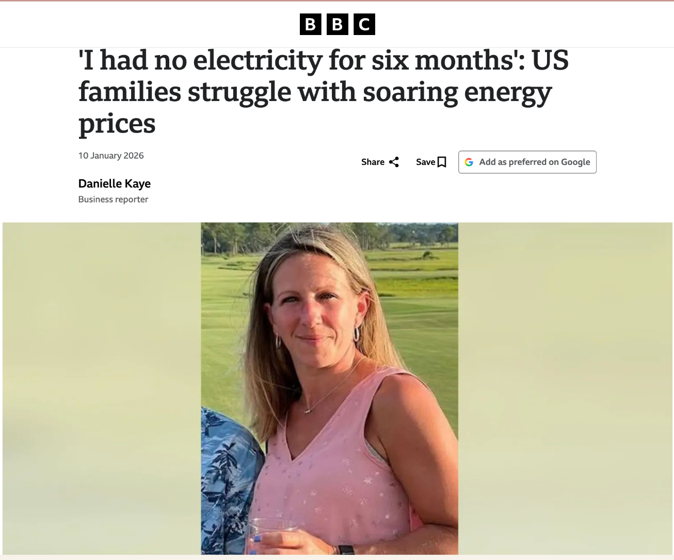

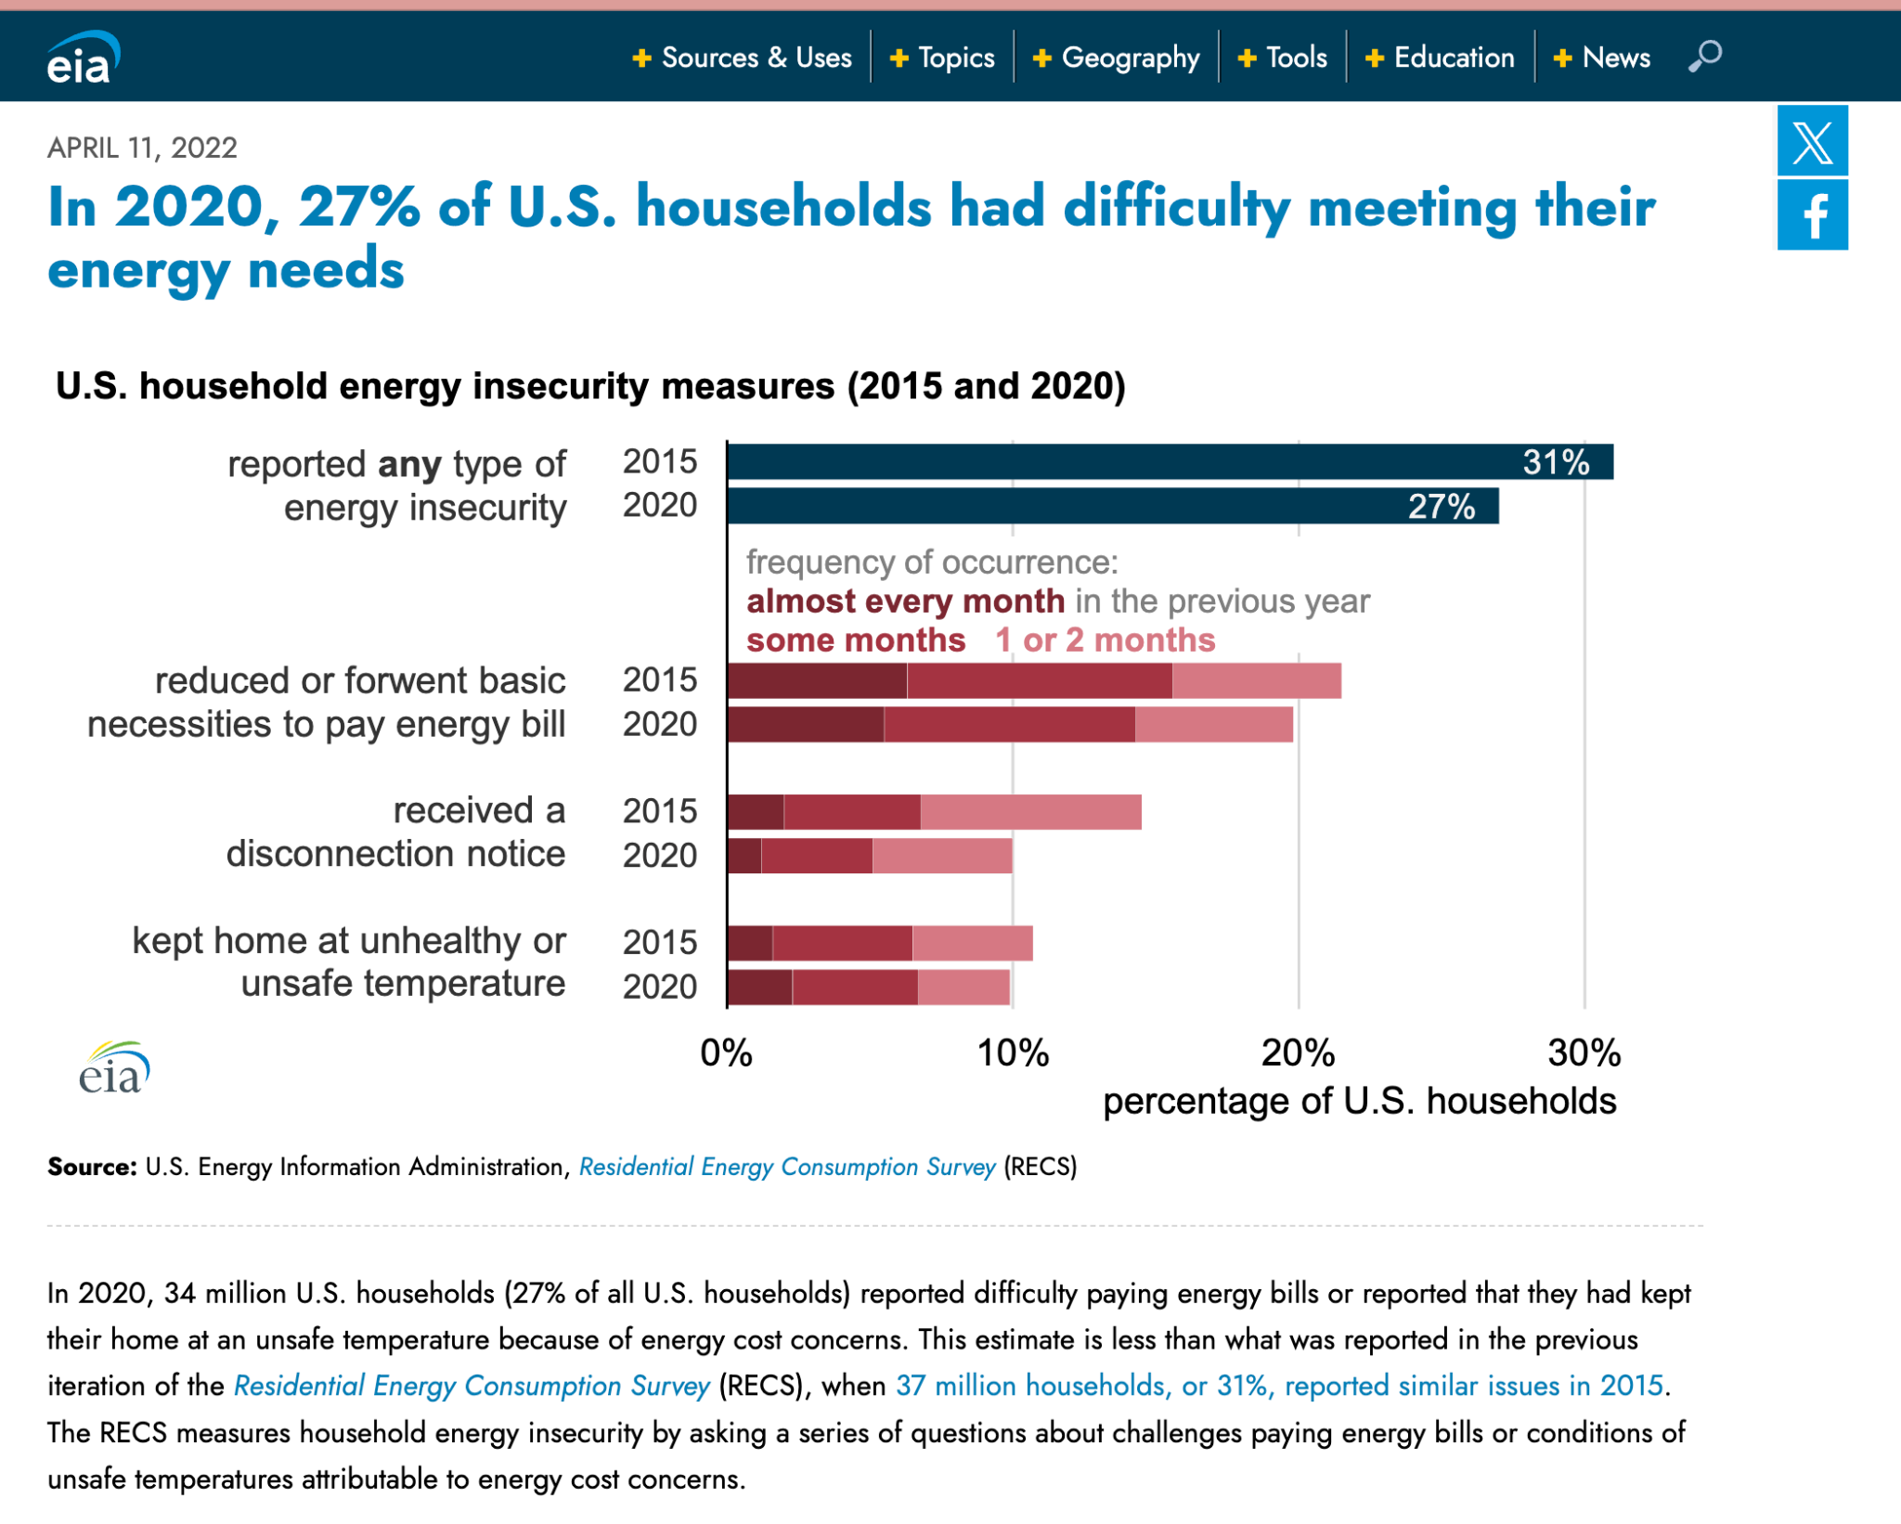
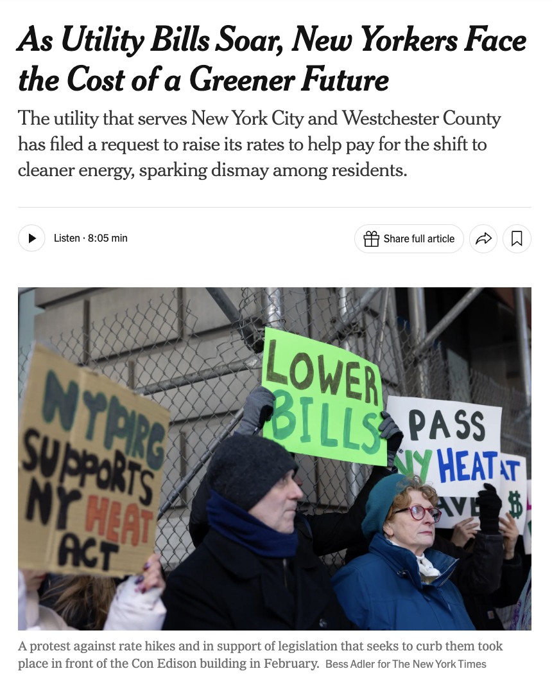
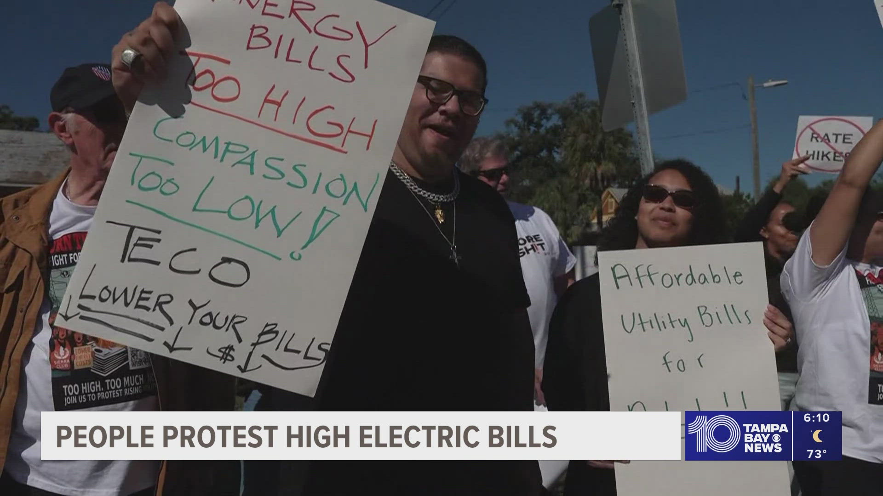

Slide 3




THE PROBLEM
Energy Poverty Is a Hidden Crisis Hiding in Plain Sight
30M+
8–10%
3×
$9.4B
US Households
Income Spent
Energy Burden
Annual Gap
struggle to pay energy bills each year
on energy by low-income families vs 3% for wealthier households
heavier for low-income vs high-income families — a systemic gap
in federal assistance vs actual household energy need in the US
Despite the data, there is NO unified, city-level tool that tells policymakers: who is at risk, why, and what to do about it.

Slide 4
THE SOLUTION
GridWatch in Theory — How It Works
GridWatch is a 3-layer AI pipeline: a machine learning model predicts risk, a SHAP layer explains it, and a RAG-powered LLM translates it into actionable policy recommendations for any California city.
01
02
03
DETECT RISK
EXPLAIN WHY
RECOMMEND ACTION
Who is at risk?
Why are they at risk?
What should be done?
Input: income, energy costs, temperature forecasts, energy burden %
SHAP (SHapley Additive exPlanations) runs on every prediction
4 policy documents loaded: LIHEAP, CARE/FERA, ESA, WAP
XGBoost ML model trained on historical California city data
Breaks the black box: shows each feature's exact contribution
RAG retrieves relevant policy chunks using semantic search
Output: HIGH / LOW risk classification with probability score
Visual bar chart: income contributes 0.30, temp 0.19, etc.
LLM reasons step-by-step using retrieved context only
Covers all major California cities updated with real data
Makes the AI defensible and auditable for policymakers
Outputs city-specific program matches with eligibility info

Slide 5




GEN AI STACK
Models & Technology Used
ML PREDICTION
EXPLAINABILITY
XGBoost
SHAP
Risk Classification
SHapley Additive exPlanations
Trained on California city-level data to classify HIGH / LOW energy poverty risk. Produces interpretable probability scores.
Opens the black box — breaks down each prediction into per-feature contribution values so every result is transparent and defensible.
RETRIEVAL
GENERATION
RAG Pipeline
Claude / GPT
Sentence-Transformers + FAISS
Chain-of-Thought Reasoning
Embeds policy documents (LIHEAP, CARE/FERA, ESA, WAP) into a vector index. Retrieves top-k relevant chunks before generating answers.
LLM reasons step-by-step using retrieved policy chunks — not general knowledge. Shows its logic and cites sources in every response.

Slide 6
DATA SOURCES
What GridWatch Is Built On
📊 FEATURE DATASETS (ML Model Inputs)
📄 POLICY DOCUMENTS (RAG Knowledge Base)
US Census Bureau (ACS)
LIHEAP Program Guidelines
Feature: Median Household Income
Federal low-income heating & cooling assistance
Primary risk driver — drives SHAP score highest
Income thresholds, benefit amounts, eligibility rules
EIA — Energy Info. Administration
CARE / FERA Program
Feature: Avg. Residential Energy Costs
California utility discount programs
Monthly $/kWh by California utility zone
20-30% bill discount, income eligibility by household size
NOAA / Open-Meteo API
ESA Program Rules
Feature: Min / Max Temperature Forecasts
Energy Savings Assistance (PG&E / SCE / SDG&E)
Seasonal demand spikes — heating & cooling load
Free weatherization, appliance replacement for low-income
ACEEE / DOE Reports
WAP — Weatherization Assist.
Feature: Energy Burden Percentage
DOE weatherization for low-income homes
% of income spent on energy bills historically
Insulation, HVAC upgrades, avg $7,000/home investment

Slide 7
THE PROCESS
From Raw Data to Final Product — The Full Pipeline
1
Data Collection
2
Data Processing
3
Model Training
Pull Census income data via API
→
Merge all sources by city
→
Train XGBoost on labeled data
Fetch EIA energy prices
Handle missing values
Cross-validate (k-fold)
Query NOAA temp forecasts
Normalize features (0-1)
Tune hyperparameters
Scrape ACEEE burden rates
Label: HIGH/LOW from burden %
Evaluate: accuracy, F1 score
4
RAG Pipeline
5
LLM Integration
6
Streamlit App
Load 4 PDF policy docs
→
Build chain-of-thought prompt
→
City dropdown → risk prediction
Chunk into ~500-word segments
Connect retriever to LLM
SHAP bar chart displayed
Embed with Sentence-Transformers
Add city risk context to prompt
Policy Q&A chat interface
Index with FAISS vector store
Enable multi-turn chat memory
Research dashboard + eval

Slide 8
SYSTEM ARCHITECTURE
How All Layers Connect Together
USER INPUT
City selection from dropdown
↓
ML LAYER
XGBoost → risk score + SHAP explanation
DATA FLOW →
RESPONSE ←
↓
RAG LAYER
Query → Sentence-Transformers → FAISS → top-k chunks
↓
GENERATION LAYER
LLM receives city context + policy chunks → answer
↓
UI LAYER
Streamlit: risk flag, SHAP chart, chat, eval dashboard

Slide 9

LIVE DEMO

