Slide 1
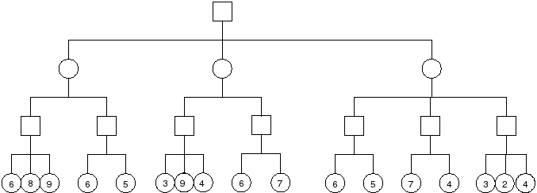
HW3.1 In this game tree the value of the static evaluator function is shown for the leaves. Squares are maximizing nodes and circles minimizing nodes. Use the minimax algorithm to compute a value for each non-leaf node and write it in the node. Indicate which move the maximizing player should make with a *.

Slide 2
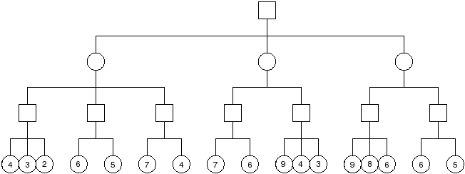
HW3.2 The value of the static evaluator function is shown for the leaves. Squares are maximizing nodes and circles minimizing. Simulate the alpha-beta algorithm on this tree, crossing out nodes that are pruned. For each non-leaf node that is not pruned, show the exact value (e.g., =3) or the last constraint (e.g., <= 2, >=8) that the alpha-beta algorithm determines. Indicate which move the maximizing player should make with a *.

