Slide 1
ICTAK
ALUMNI JOB PORTAL

Slide 2
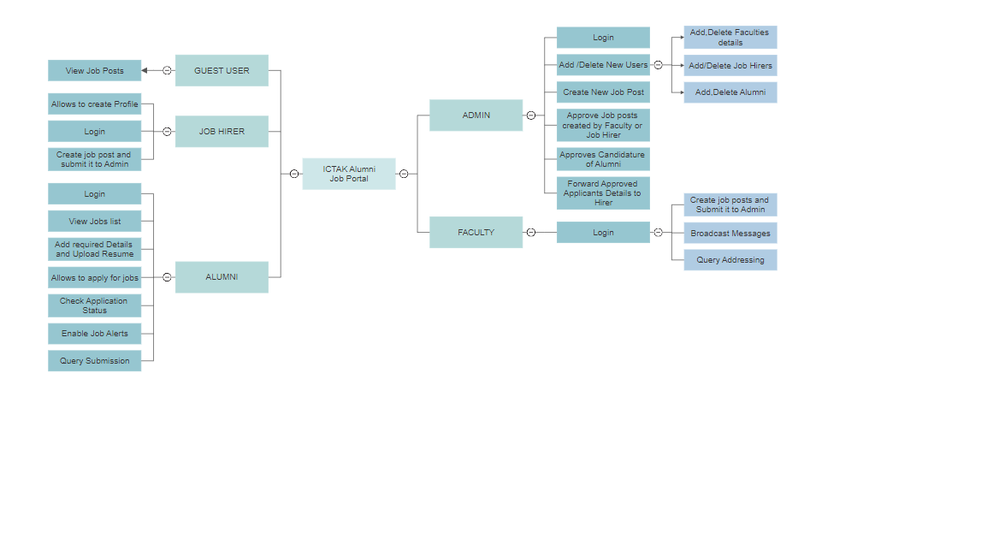

Slide 3
