Slide 1


Python ! Python ! Python !
Nima uchun PYTHON ?
Neurons, URINOV AZIZBEK, KII co. 01.04.2023

Slide 2
Darsdan maqsad :
‘ IT ‘ : Talab, Taklif va O’rganish
Dasturlash Tillari (PYTHON) o’zi nima ?
Nima uchun ‘ PYTHON ’ ni o’rganish kerak ?
NEURONS ‘ PYTHON ’ darslik rejasi
Qo’shimcha topshiriq !!!
Neurons, URINOV AZIZBEK, KII co. 01.04.2023

Slide 3
‘ IT ’ : Talab, Taklif va O’rganish
Talab :
Ingliz tili (Elementary darajada)
Matematika boshlang’ich darajada
Xohish yuqori darajada (yuqori darajada)
Taklif :
Doimiy ravishda darslarni ketma ketlik bilan kuzatib borish
Yaxshi bilim va daromad
O’rganish :
Qo’shimcha mashg’ulotlarni bajarish va doimiy shug’ullanish
Neurons, URINOV AZIZBEK, KII co. 01.04.2023

Slide 4
‘ IT ’ : Talab, Taklif va O’rganish
60 dan ortiq IT ish turlari
Computer systems manager
Network architect
Systems analyst
IT coordinator
Network administrator
Network engineer
Service desk analyst
System administrator (also known as sysadmin)
Wireless network engineer
Database administrator
Database analyst
Data quality manager
….
Link orqalik yanada batafsil o’qib chiqing
https://www.aha.io/roadmapping/guide/information-technology/it-job-titles
Neurons, URINOV AZIZBEK, KII co. 01.04.2023

Slide 5
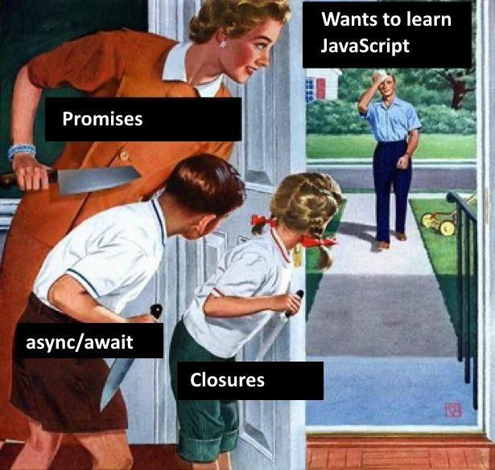
‘ IT ’ : Talab, Taklif va O’rganish
Software Developer
Bu siz (2023)
IT ni o’rganaman
AI (Sun’iy Intellekt)
Software Developer
Data Analytics
https://www.linkedin.com/pulse/hottest-job-trends-watch-2023-comprehensive-guide-getworknow/
Neurons, URINOV AZIZBEK, KII co. 01.04.2023

Slide 6
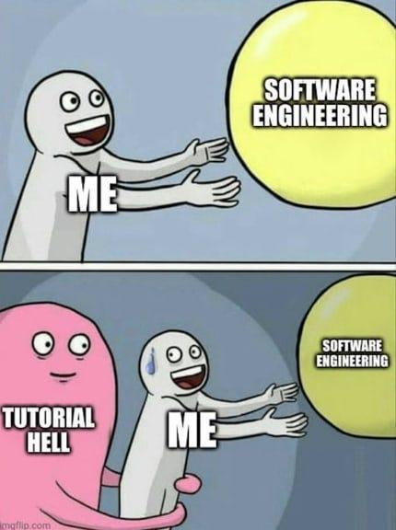
‘ IT ’ : Talab, Taklif va O’rganish
Software Developer
IT va PUL
Muamo : O’zi dasturlash tili nima? Va nima uchun IT ni tog’ri dasturlash tilini tanlash orqalik boshlash kerak?
MEN
IT va PUL
Dasturlash Tillari
MEN
MEN
Neurons, URINOV AZIZBEK, KII co. 01.04.2023

Slide 7
2. Dasturlash tillari (Python) o’zi nima?
Software Developer
Dasturlash Tili (Programming Language)
Computer Vision
Machine Learning
Deep Learning
Neural Networks
Natural Language Processing(NLP)
2023 yil eng ko’p ishlatilgan 3 IT yo’nalishlari
AI (Sun’iy Idrok)
Web apps
Backend Services
Mobile Apps
Desktop Apps
…
Dasturlash Tillari
IT
Software Developer
Data Analytics
Data Mining
Data Modeling
Data Visualization
Statistics
…
Neurons, URINOV AZIZBEK, KII co. 01.04.2023

Slide 8
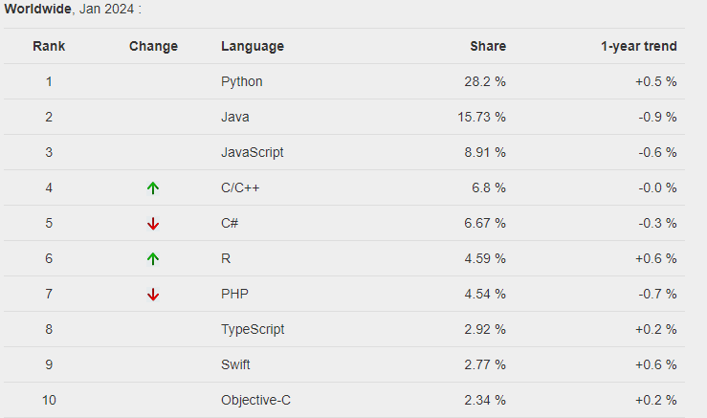
3. Nima uchun ‘ PYTHON ’ ni o’rganish kerak ?
Software Developer
PYPL PopularitY of Programming Language (Dasturlash tillarining mashxurligi)
Ko’proq statistikani ko’rish
https://pypl.github.io/PYPL.html
Neurons, URINOV AZIZBEK, KII co. 01.04.2023

Slide 9
3. Nima uchun ‘ PYTHON ’ ni o’rganish kerak ?
Software Developer
PYTHON nima sababdan bunchalik eng ko'p IT dasturchilari foydalanadigan Dasturlash tili hisoblanadi?
Quyidagi link ni bosing va o’qib chiqing :
TOP10 Sabablar : https://www.simplilearn.com/tutorials/python-tutorial/why-learn-python
Link ni bosing va PYTHON nima sababdan mashxur dasturlash tili ekanligini o’qib chiqing. Link orqalik o’tilgan site ingliz tilida. Iltimos ‘Google Extensions dan Google Translate ni tortib oling va saytni o’zbek tiliga tarjima qilib o’qing.’
Neurons, URINOV AZIZBEK, KII co. 01.04.2023

Slide 10
4. NEURONS ‘ PYTHON ’ darslik rejasi ?
Software Developer
5
Object-Oriented Programming (OOP)
Python Mashqlar va kodlash
- File ni yozish, o’qish va o’zgartirish
- Qo’shimcha preyekt va mashqlar
4
3
Funksiyalar va Modullar
2
Data Strukturalari
List, Dictionary, Tuples va Set lar
Python Asoslari
- Variables, data turlari, operatorlar
- Kontrol Strukturalar : if, else va loop lar
1
Neurons, URINOV AZIZBEK, KII co. 01.04.2023

Slide 11
5. Qo’shimcha topshiriq !!!
Software Developer
Quyidagi link dagi site ni O’zbek tiliga o’giring (yoki English) va Python o’zi nima degan savolga yanada yaxshiroq javob olib chiqing. LINK : https://www.w3schools.com/python/python_intro.asp
Quyidagi link dagi site ni O’zbek tiliga o’giring (yoki English) va Python o’zi nima uchun kerak va mashxur degan savolga yanada yaxshiroq javob oling. LINK : https://www.simplilearn.com/tutorials/python-tutorial/why-learn-python
Quyidagi link orqalik ‘Google Translate’ extension ni Chrome ga o’rnating va saytlarni turli xil tillarga o’girishni test qilib ko’ring (Agarda Ingliz tilini bilsangz har bir saytni bemalol ishlatishingiz mumkin). LINK : https://chromewebstore.google.com/detail/google-translate/aapbdbdomjkkjkaonfhkkikfgjllcleb
ILTIMOS VIDEO VA DARSLIKLARNI TARTIB BILAN KO’RING !!!
Neurons, URINOV AZIZBEK, KII co. 01.04.2023

Slide 12
NEURONS
Raxmat
Software Developer
YouTube : www.youtube.com/@NEURONS-UZ
Website : https://zero-suger.github.io/Neurons/
GitHub Link : https://github.com/orgs/https-github-com-zero-suger/repositories
Telegram : https://t.me/NEURONS199816
Gmail : uacoding01@gmail.com
ESLATMA : HAR BIR INSON BU SLIDE DAN FOYDALANISH HUQUQIGA EGA. LEKIN ILTIMOS QUYIDAGI 2 NARSANI O’CHIRMANG
Neurons, URINOV AZIZBEK, KII co. 01.04.2023

