Slide 1

‘ Python ’ ni O’rnatish
Neurons, URINOV AZIZBEK, KII co. 15.01.2024

Slide 2
Takrorlash
IT va uning boshqa yo’nalishlari
Birinchi muamo ‘Dasturlash tillari’
Nima uchun Python ?
Biz qanday o’rganamiz?
Qo’shimcha topshiriq
Neurons, URINOV AZIZBEK, KII co. 15.01.2024

Slide 3
Bugungi maqsad
OS (Operating Systems) nima ?
Python qanday o’rnatiladi (WINDOWS)?
O’rnatilgan ‘Python’ ni qanday test qilib koramz ?
Qo’shimcha topshiriq?
Neurons, URINOV AZIZBEK, KII co. 15.01.2024

Slide 4
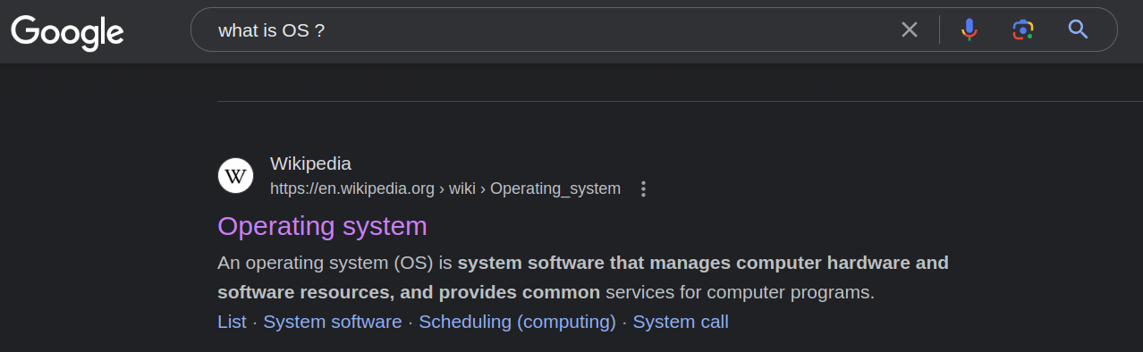
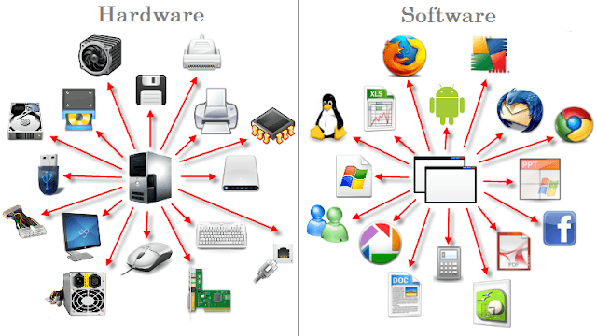
OS (Operating Systems) nima ?
Neurons, URINOV AZIZBEK, KII co. 15.01.2024

Slide 5
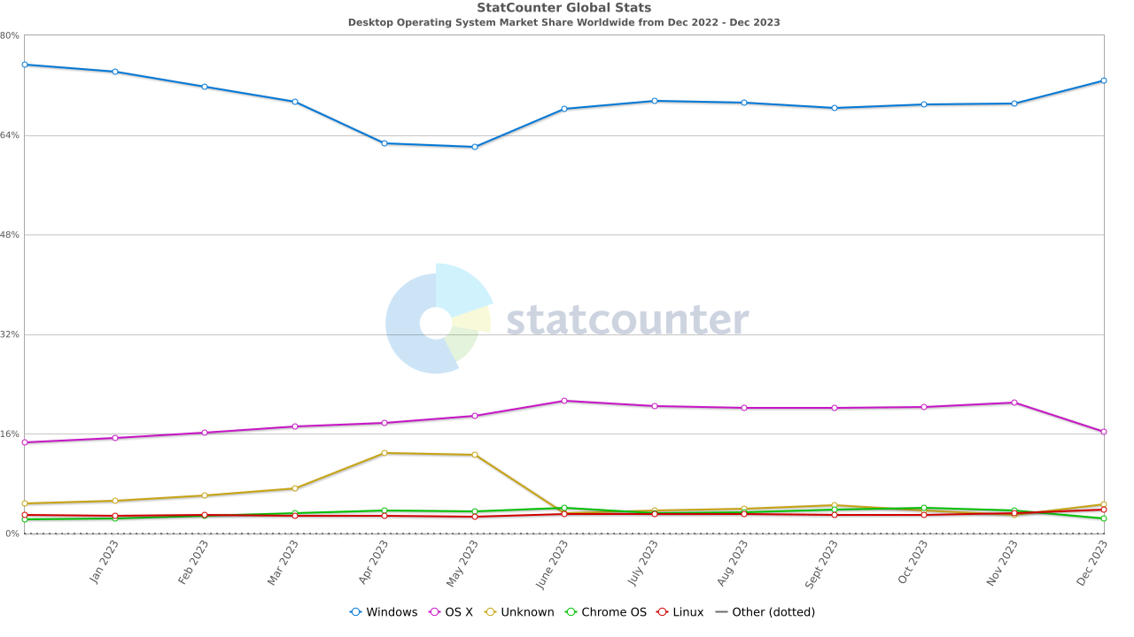
OS (Operating Systems) nima ?
Muamo : Biz qaysi OS dan foydalanishimiz kerak?
Yechim : ‘Hozircha’ WINDOWS Sabablar : 1. Mashxurligi va muamoga nisbatan oson yechim
2. Darslarda maqsadni umumlashtirish va extmoliy muamolarni oldini olish
3. Juda ham ko’plab tekin funksiyalar
4. Va boshqalar …
https://gs.statcounter.com/os-market-share/desktop/worldwide
Neurons, URINOV AZIZBEK, KII co. 15.01.2024

Slide 6
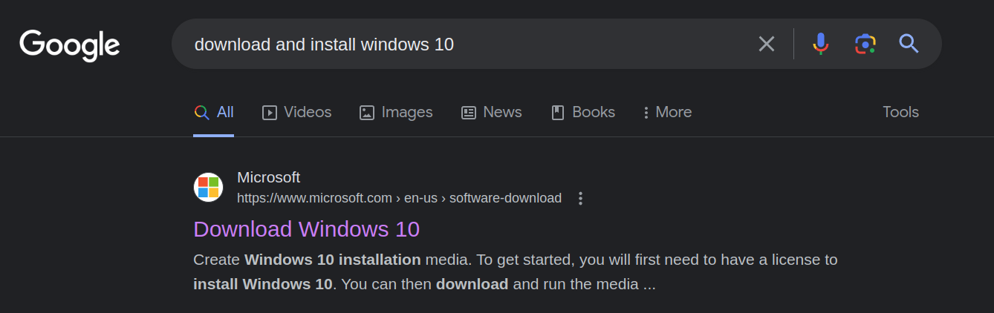
OS (Operating Systems) nima ?
Windows qanday o’rnatiladi (masalan WINDOWS 10)?
Eslatma : Iltimos doimo qonuniy va pullik WINDOWS ni o’rnating? Bu bn umringizni va asabingizni tejab qolasz
Neurons, URINOV AZIZBEK, KII co. 15.01.2024

Slide 7
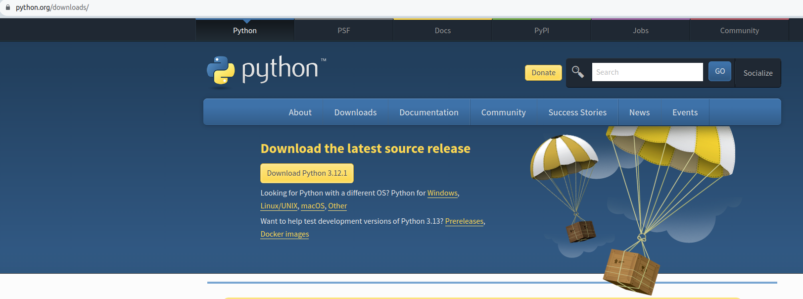
Python qanday o’rnatiladi (WINDOWS?)
Python veb sahifasiga boramiz : https://www.python.org/downloads/
1
2
Neurons, URINOV AZIZBEK, KII co. 15.01.2024

Slide 8
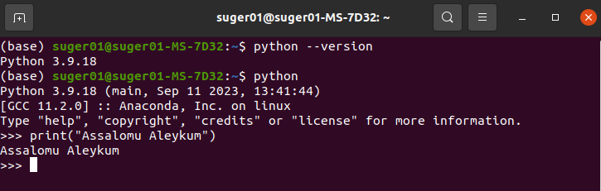
O’rnatilgan ‘Python’ ni qanday test qilib koramz ?
Python versiyasini tekshirish
Powershell ni iching va
2. Python ga kirish
3. Python da birinchi kod ni yozish
Neurons, URINOV AZIZBEK, KII co. 15.01.2024

Slide 9
Qo’shimcha topshiriq !!!
OS (Operating Systems) haqida GOOGLE da ko’proq malumot izlang va o’rganib chiqing
Windows (7 ~) o’rnating (Agar sizda oldindan mavjud bolsa unda OKEY)
PYTHON ni darsda o’rgatilgandek o’rnating va test qiling
ILTIMOS VIDEO VA DARSLIKLARNI TARTIB BILAN KO’RING !!!
Neurons, URINOV AZIZBEK, KII co. 01.04.2023

Slide 10
NEURONS
Raxmat
Software Developer
YouTube : www.youtube.com/@NEURONS-UZ
Website : https://zero-suger.github.io/Neurons/
GitHub Link : https://github.com/orgs/https-github-com-zero-suger/repositories
Telegram : https://t.me/NEURONS199816
Gmail : uacoding01@gmail.com
ESLATMA : HAR BIR INSON BU SLIDE DAN FOYDALANISH HUQUQIGA EGA. LEKIN ILTIMOS QUYIDAGI 2 NARSANI O’CHIRMANG
Neurons, URINOV AZIZBEK, KII co. 01.04.2023

