Slide 1
Agentic AI — Building Autonomous Intelligent Systems
Seyhan Yildiz
Role: Senior Data Scientist / Gen AI Engineer

Slide 2
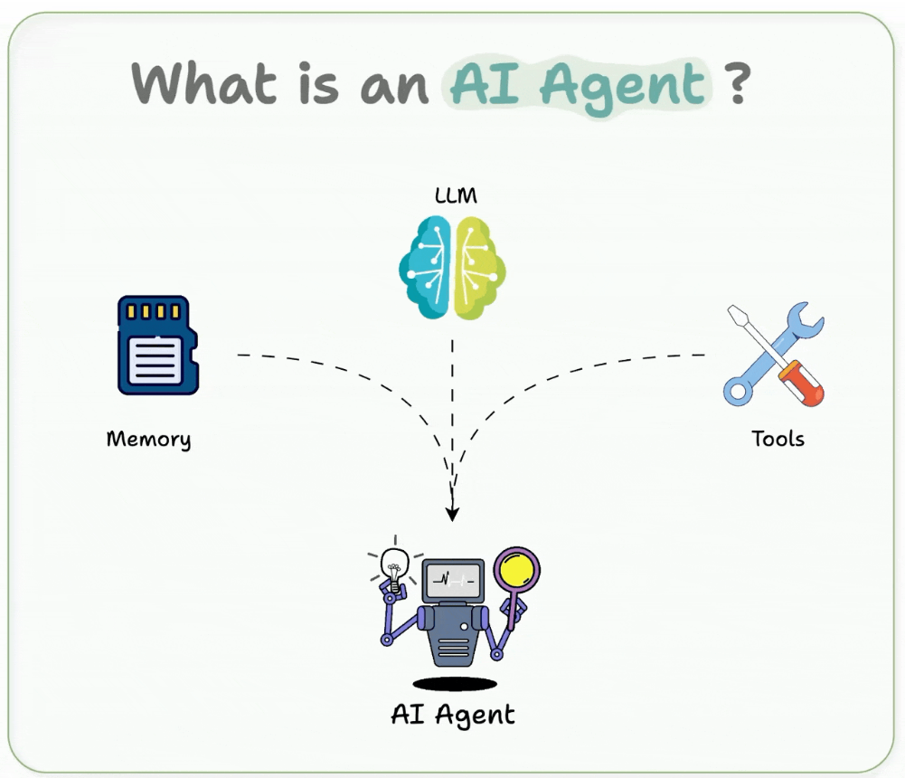
AI Agent

Slide 3
What is Agentic AI?
Agentic AI refers to LLM-powered systems that can reason, plan, and act to achieve specific goals.
Moves beyond static prompts(in LLM) — adds autonomy, memory, and decision loops.
Inspired by multi-agent collaboration and human-like workflows.
Used in automation, customer service, policy support, and compliance.
This shift is like moving from chatbots to digital workers.
Agentic systems don’t just respond — they think and act with intent.

Slide 4
What is Agentic AI?
How it differs from traditional LLM applications: reasoning, goal-directed behaviour, environment awareness, memory.
Maturity of orchestration frameworks (LangGraph, CrewAI, AutoGen, PydanticAI).

Slide 5
Why It Matters
Reduces manual intervention in AI-driven workflows.
Increases scalability for data-driven decision-making.
Enables integration with external tools and APIs.
Drives productivity in government, banking, and health sectors.

Slide 6
Core Architecture of Agentic AI
Components of an agentic system:
Perception: input understanding (text, code, multimodal data).
Reasoning & Planning: decision-making loop.
Action: executing on tasks or APIs.
Memory: storing context for long-term awareness.
These four layers form the intelligence loop — allowing the agent to act, learn, and adapt.
Agent interaction models: single agent vs multi-agent vs hierarchical.

Slide 7
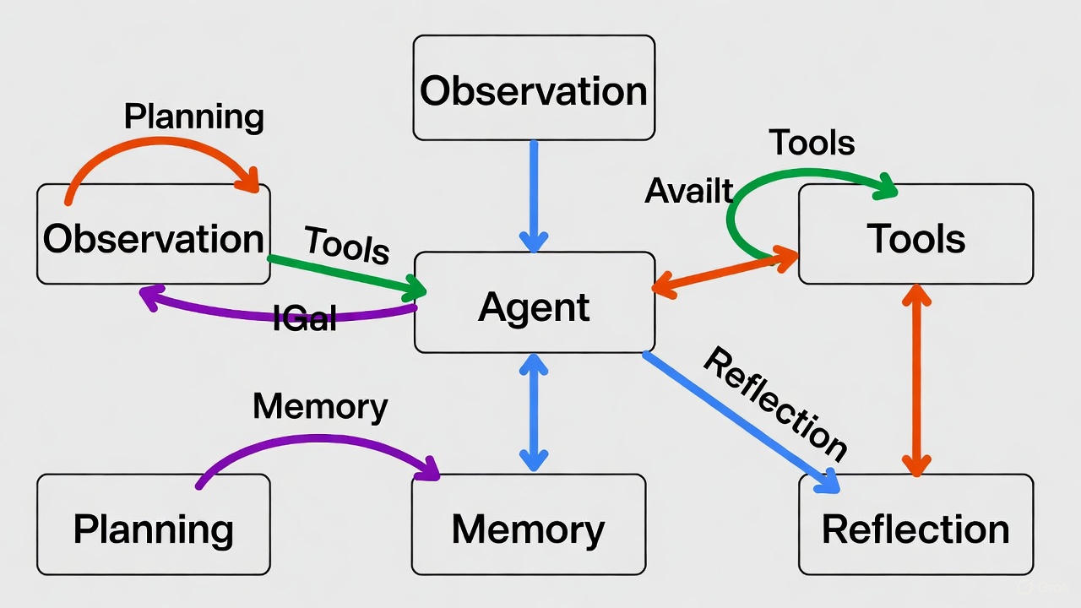
A High-Level Agentic AI Architecture

Slide 8
Explanation of the Diagram
Agent (center): The brain — usually a large language model (LLM) that does the reasoning.
Observation (top-left): Everything the agent sees — user messages, tool results, sensor data, etc.
Tools (top-right): External functions the agent can call (search, code execution, calculators, APIs, etc.).
Planning (bottom-left): The agent creates or updates plans (to-do lists, step-by-step strategies).
Memory (bottom-center): Stores past experiences. Split into:
Short-term memory (current conversation/context window)
Long-term memory (vector database or summaries of older stuff)
Reflection (bottom-right): The agent looks back at what it did, critiques mistakes, and improves future behavior.

Slide 9
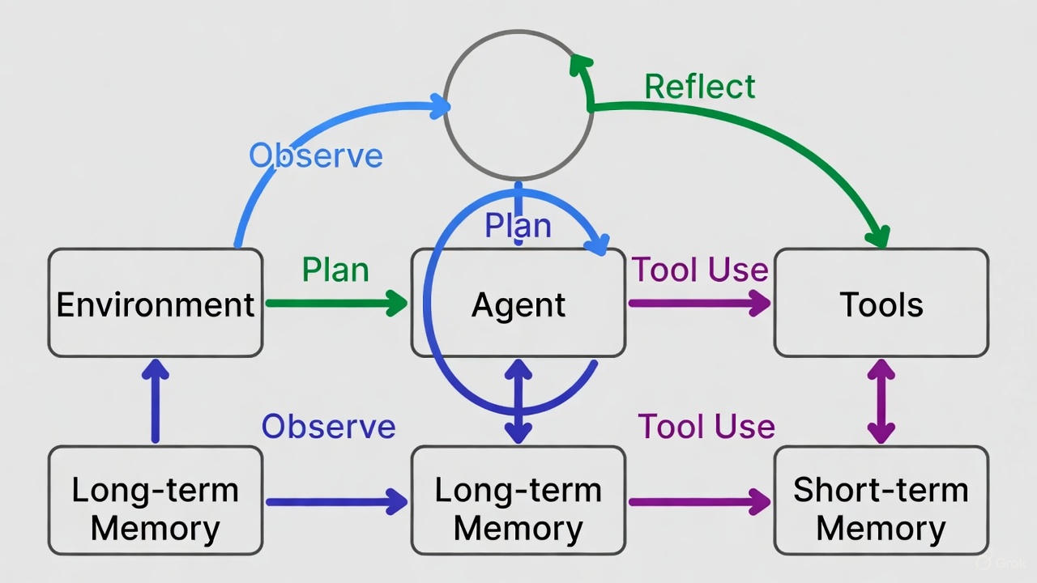
Classic ReAct + Memory + Reflection Loop

Slide 10
Explanation of the Diagram
This is the most popular mental model in 2024–2025 agent systems (OpenAI o1, DeepSeek R1, many open-source agents).
It shows the four-phase reasoning cycle that repeats until the task is done:
Observe (blue arrows)
  Agent receives new information from the Environment or Tools and from its own Memory.
Plan (green arrows)
  Agent decides what to do next: break the goal into steps, choose a tool, or give a final answer.
Tool Use / Act (purple arrows)
  Agent calls external tools (web search, code interpreter, etc.) or outputs text.
Reflect (big green loop at the top)
  Agent reviews what just happened, critiques its own actions or plans, and updates memory or the plan.
Memory layers:
  Long-term Memory → feeds into the agent at the start of each cycle.
  Short-term Memory → accumulates everything that happened in the current episode (grows until context limit, then gets summarized).
  Both memories are updated continuously.
This loop (Observe → Plan → Act/Tool Use → Reflect) is exactly how state-of-the-art reasoning agents like o1-preview, Claude 3.5 with tools, Grok with tools, and most open-source agent frameworks work under the hood.

Slide 11
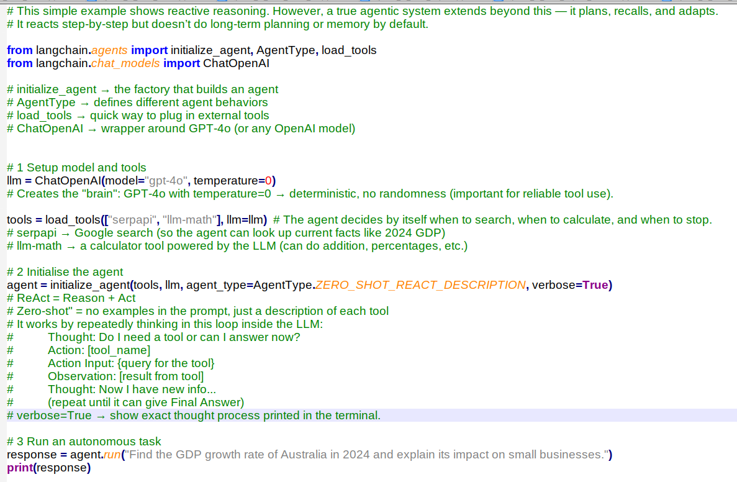
Minimal Working Agent

Slide 12
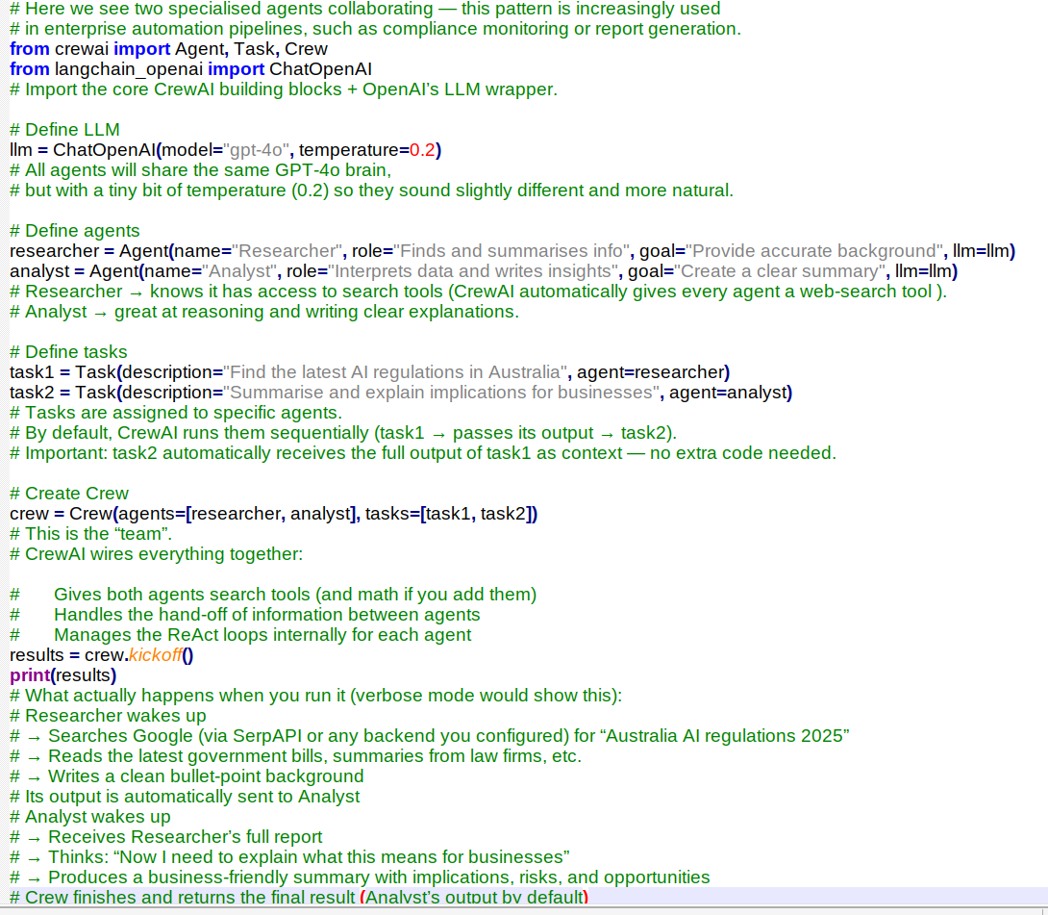
Multi-Agent Collaboration (CrewAI or LangGraph)

Slide 13
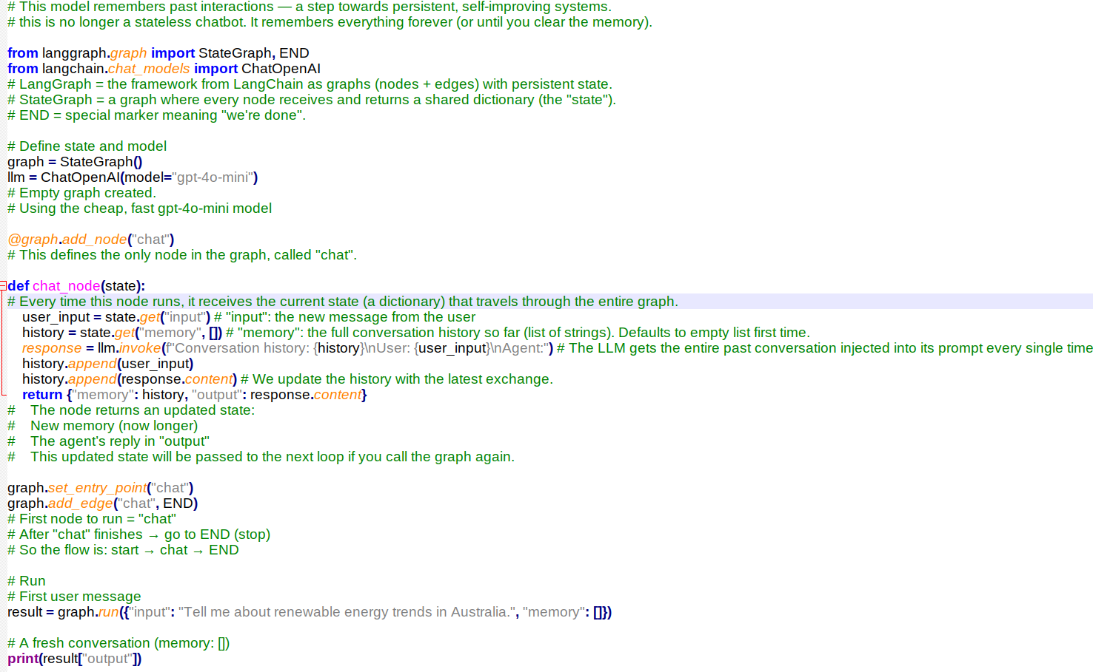
Adding Memory and State

Slide 14
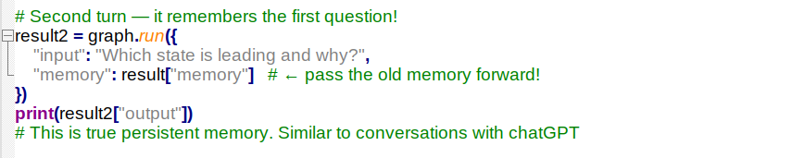
Adding Memory and State

Slide 15
Future of Agentic AI
Multi-modal perception (text + image + structured data)
    Agents no longer live in a text-only bubble.
    They natively see screenshots, PDFs, charts, live camera feeds, Excel files, videos, etc.
Decentralised agent networks
    Instead of one giant AI in the cloud, thousands or millions of small specialised agents run on laptop, phone, smart glasses, car, robot, etc.,
    And talk to each other peer-to-peer.
Integration with local RAG, APIs, and private datasets
    Agent’s “brain” is no longer just the LLM. Also long-term memory files, Notion, corporate knowledge base, GitHub repos, CRM, etc.
Continuous learning via feedback loops
  Agents get better every time they are used — automatically and safely.

