Slide 1
Writing News for Social Media
Howard Mosely Jr.
JRN301:Newsgathering and reporting
Professor Cunningham
07/05/2023

Slide 2
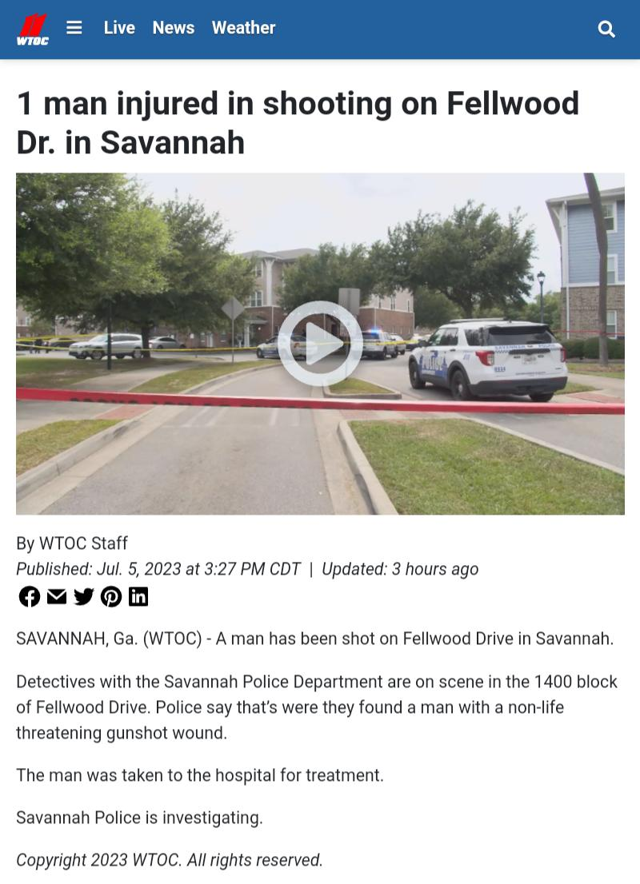
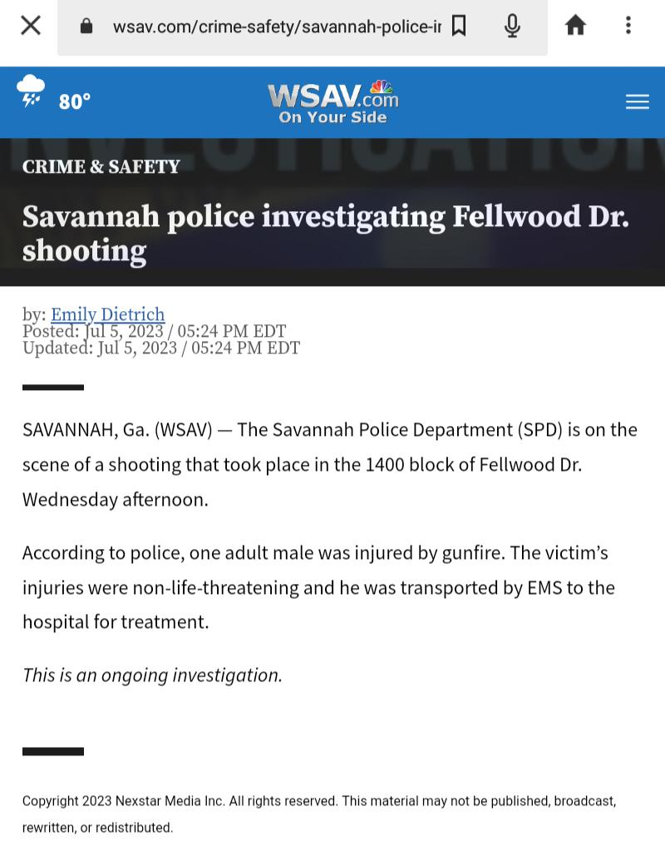
Writing News for Social Media
These two related stories are from different outlets but are reporting the same events. The first article announced at 3:27 PM, July 5, 2023 that the Savannah Police was on scene of a shooting. The article informed the audience of where the shooting occurred. Finally, the article made note of a male victim being hospitalized due to the shooting.
It is obvious that the story is an ongoing investigation because it is plainly stated at the end of the second article. This article written by Emily Dietrich of WSAV.com reports much of the same information as the previous article and announce the investigation. This article written at 5:24 PM updated the status of the shooting victim injuries; adding that they are non-life threatening.

Slide 3


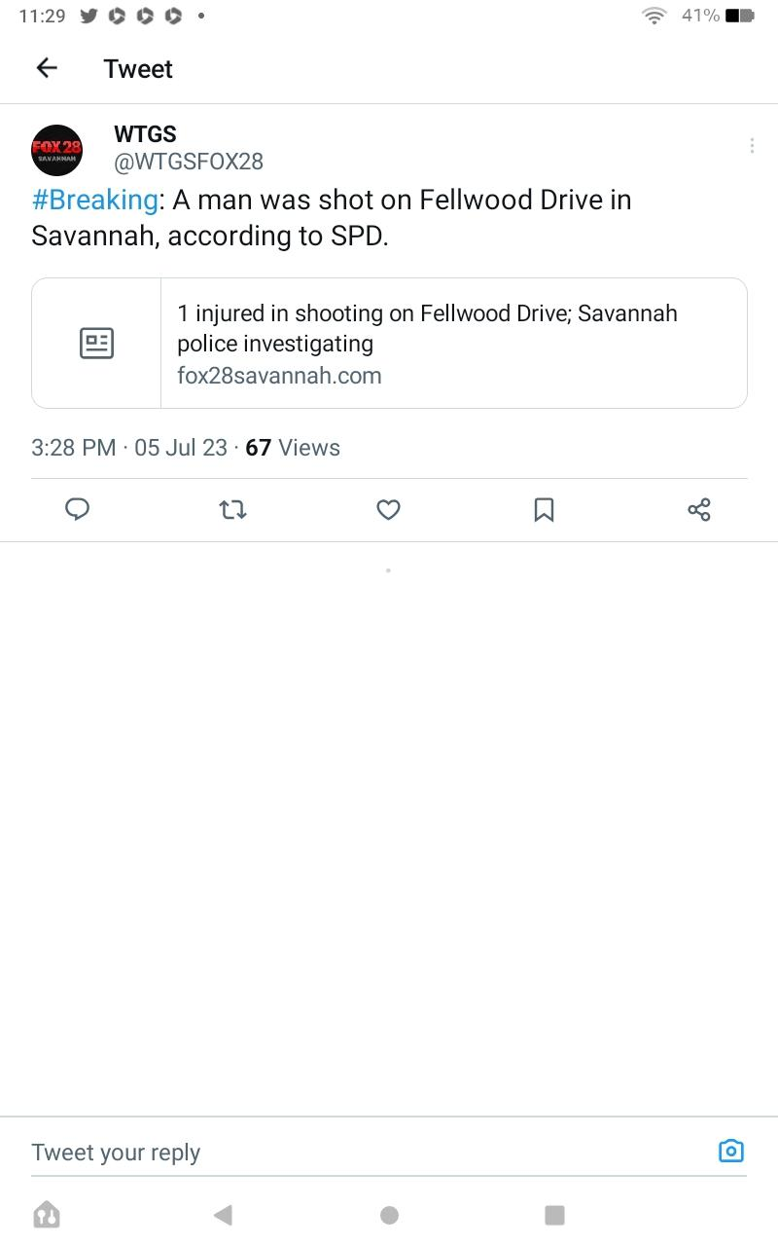
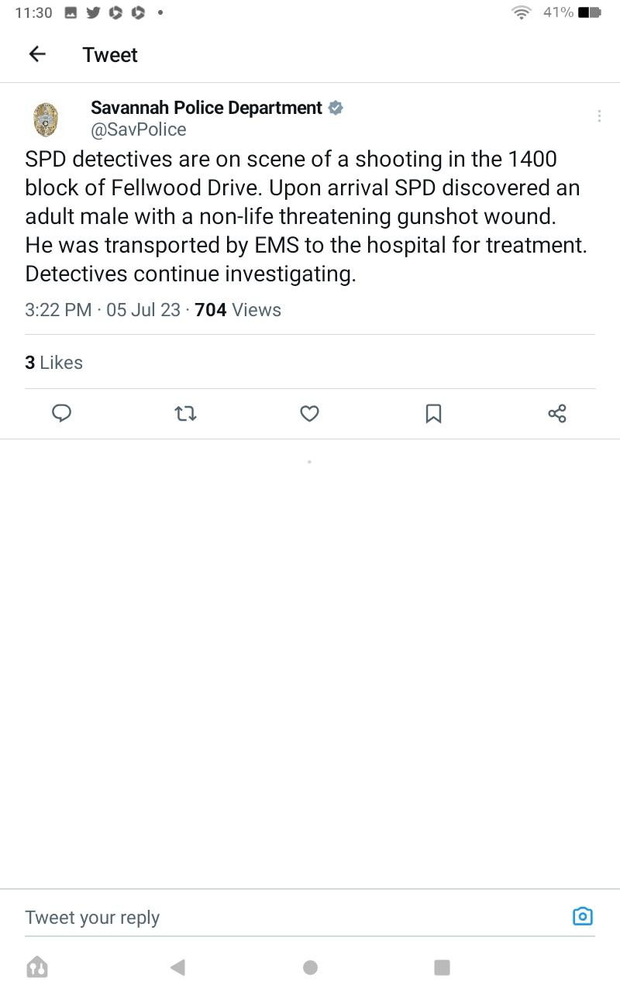
AU CHAMPION
AU CHAMPION
The Official Twitter Feed of the AU Champion for JRN 301
Online, Anywhere
TWEETS FOLLOWING FOLLOWERS FAVORITES LISTS
14K 25k 65k 732 57
AU CHAMPION @AUCHAMP June 5, 2023 3:30 PM
Breaking News from Savannah, Georgia; Savannah Police Department are investigating a shooting of a man on Fellwood Drive.
AU CHAMPION @AUCHAMP June 5, 2023 3:25PM
Shooting on the 1400 block
Fellwood Drive; investigation underway.
Media outlets such as this one gathered the information offered by the police department and introduced the story as “breaking news” through their outlets.
Coverage of the story from a reliable tweet. EMS and Police Departments are vital sources will covering developing stories.

