Slide 1
COOP-II | Evaluation-II
Project Presentation of CO-OP Project at Industry (Module-2) (22CS421)
On
Comparative Analysis of Resource Utilization
Docker Containers vs Virtual Machines
Under Web Application Workloads
Arham Jain
2210991337
Ansh Mittal
2210991297
Anuj Kumar
2210991316
Dept. of Computer Science & Engineering (CUIET) • Chitkara University, Punjab
Supervised By: Dr. Anshu Singla (anshu.singla@chitkara.edu.in)
Department of Computer Science and Engineering,
Chitkara University, Punjab
COOP-II Evaluation-II • 2026
1

Slide 2
Agenda
01
Introduction
Why this comparison matters
02
Architecture
How Docker & VMs work
03
Methodology
Our test setup & approach
04
CPU & Memory
Resource efficiency results
05
Disk, Network & Startup
I/O & speed results
06
Security
Isolation trade-offs
07
Conclusion
Key findings & recommendations
2

Slide 3
Introduction — Why Does This Matter?
The Problem
Key Numbers at a Glance
• Cloud apps need elastic, efficient & secure infrastructure
• Two dominant choices for deploying web apps:
→ Hardware VMs (2+ decades of cloud backbone)
→ Docker Containers (#1 platform as of 2024)
• Both have trade-offs — which is better for web workloads?
• Prior research used synthetic benchmarks, not realistic HTTP traffic
123×
40%
Faster startup (Docker vs VM)
Less memory used by Docker
23%
74%
Our Research Goal
Higher network throughput
More app instances per server
• Systematic comparison under realistic web workloads
• 5 resource dimensions: CPU, Memory, Disk, Network, Startup
• Actionable guidance for DevOps & cloud architects
3

Slide 4
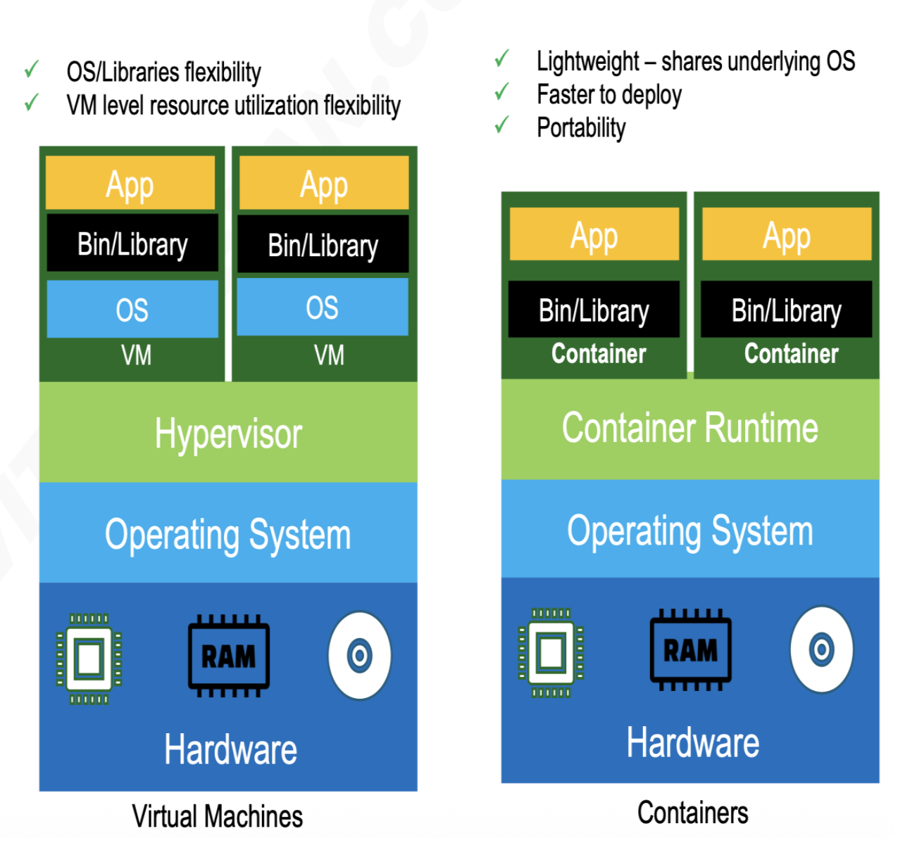
Architecture Overview — VM vs Container
Virtual Machines
• Full Guest OS per VM
• Hypervisor translates hardware
• Strong hardware-enforced isolation
• Fixed OS overhead: 256 MB – 1 GB
• OS/Libraries flexibility
Docker Containers
• Shares host OS kernel
• namespaces + cgroups isolation
• No guest OS — lightweight
• Millisecond startup, portable
• Faster to deploy
4

Slide 5
Key Architectural Differences (Table I)
Property | Docker Container | Virtual Machine
Isolation Layer | OS (kernel namespaces) | Hardware (hypervisor)
Guest OS | Not required | Required (256 MB – 1 GB)
Startup Time | ~300 ms | ~38 seconds
Memory Overhead | Low (app only) | High (OS + app)
Filesystem | Layered OverlayFS | Block device image
Kernel | Shared with host | Dedicated guest kernel
Portability | Image-level | Snapshot-level
Security | Moderate | Strong
5

Slide 6
Experimental Methodology
Test Hardware
Software Stack
Test Protocol
• Intel Core i9-12900K (16C/24T)
• 64 GB DDR5 RAM @ 4800 MT/s
• 2 TB Samsung 980 Pro NVMe
• 10 Gbps Intel X550 NIC
• Ubuntu 22.04 LTS (kernel 5.15)
• KVM/QEMU 7.0 + Docker Engine 24
• VM: 4 vCPU, 8 GB RAM, 40 GB disk
• Container: --cpus=4 --memory=8g
• App: Node.js 18 + Express 4.18
• Load Gen: Apache JMeter 5.6
• 60 s warmup + 300 s measure
• Concurrency: 50 / 200 / 500 users
• 5 runs averaged per config
• Startup: 30 trials each
Two Workload Types Tested
Static (I/O-bound)
Serve 50 KB JSON payload — simulates a REST API response
Dynamic (CPU-bound)
Fibonacci(n=35) per request — simulates compute-intensive processing
6

Slide 7
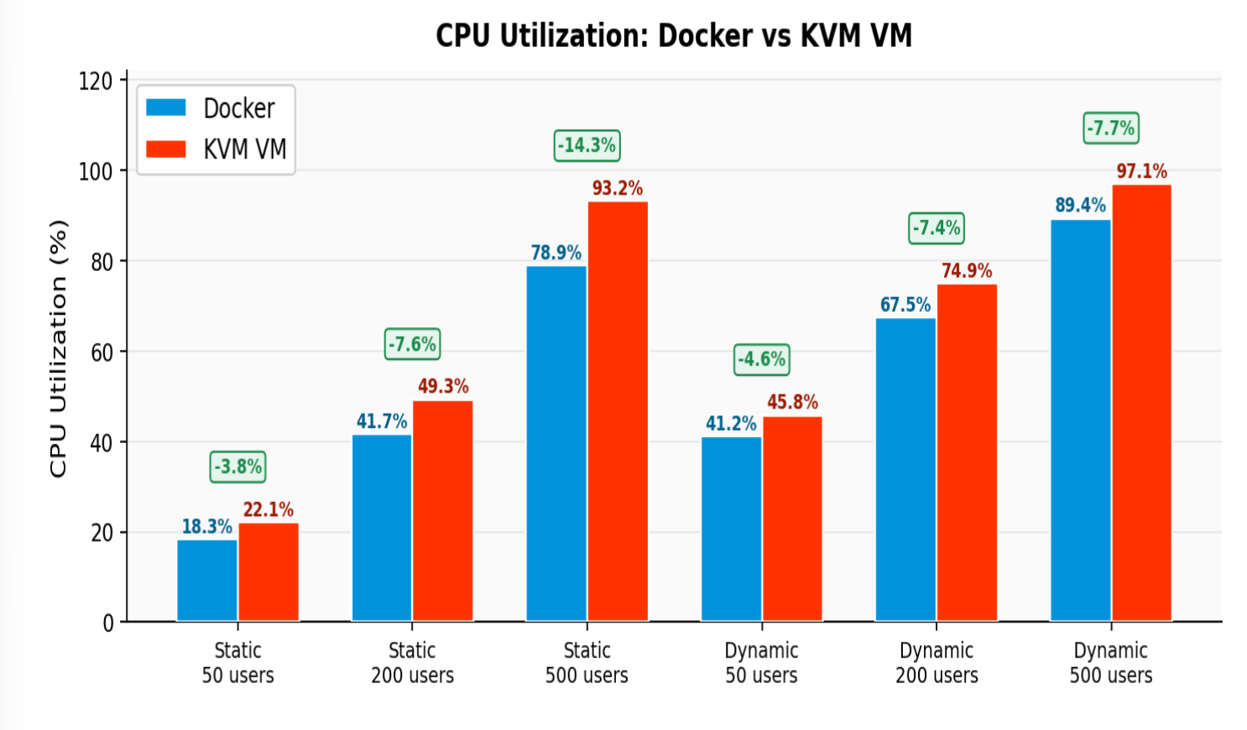
Results: CPU Utilization
What the numbers mean
• Docker: 8–17% less CPU across all tests
• VM hit 93.2% at 500u static — nearly saturated
• Docker stayed at 78.9% — still had headroom
• VM reached saturation 18% earlier
• Root cause: virtio NIC emulation cycles in VM
• Docker uses host network stack directly
Key Insight: Less CPU overhead = more capacity for your actual application
7

Slide 8
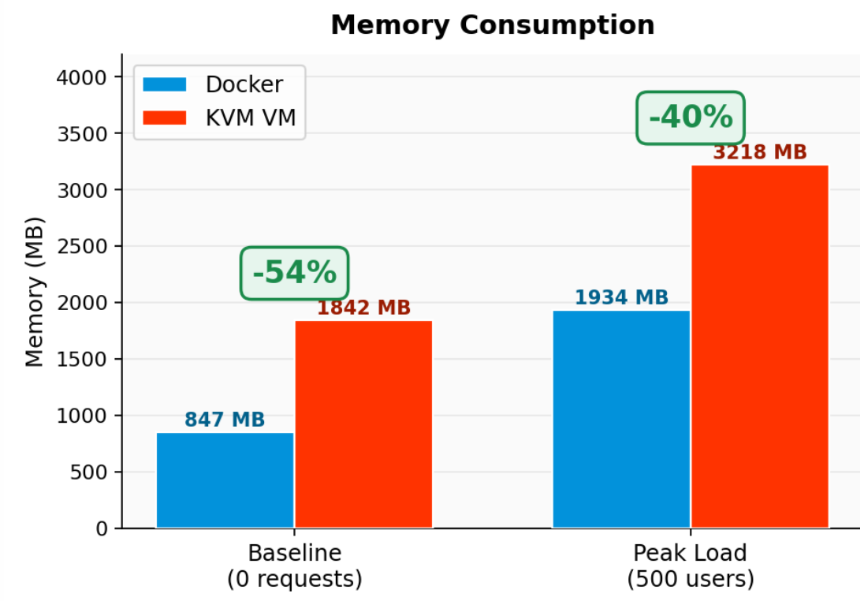
Results: Memory Consumption
Memory Consumption
Server Instance Density on 64 GB RAM Host
Docker Containers 33 instances / 64 GB host
Virtual Machines 19 instances / 64 GB host
D
D
D
D
D
D
VM
VM
VM
VM
D
D
D
D
D
D
VM
VM
VM
VM
D
D
D
D
D
D
VM
VM
VM
VM
D
D
D
D
D
D
VM
VM
VM
VM
D
D
D
D
D
D
VM
VM
VM
D
D
D
+74% more density with Docker
Why this matters in production
Key numbers: Docker baseline 847 MB vs VM 1842 MB (−54%); peak 1934 MB vs VM 3218 MB (−40%). On 64 GB RAM: 33 Docker containers vs 19 VMs → 74% more density → direct cost savings.
8

Slide 9
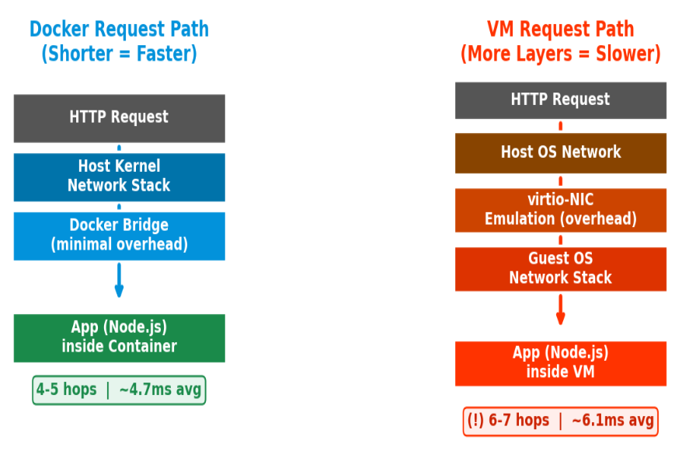
Results: Disk I/O & Why Docker Is Faster
Why Docker Has Lower Latency: Request Path Comparison
Disk I/O Performance at 200 Concurrent Users
IOPS (Ops/sec) higher is better
I/O Latency (ms) lower is better
Disk I/O Key Numbers (200 concurrent users)
• Read IOPS: Docker 4,820 vs VM 3,940 → +22.3% | Read Latency: 0.21 ms vs 0.34 ms → 38.2% faster
• Write IOPS: Docker 2,150 vs VM 1,780 → +20.8% | Write Latency: 0.38 ms vs 0.51 ms → 25.5% faster
• Root cause: VM uses virtio-blk emulation layer; Docker reads directly from host NVMe
9

Slide 10
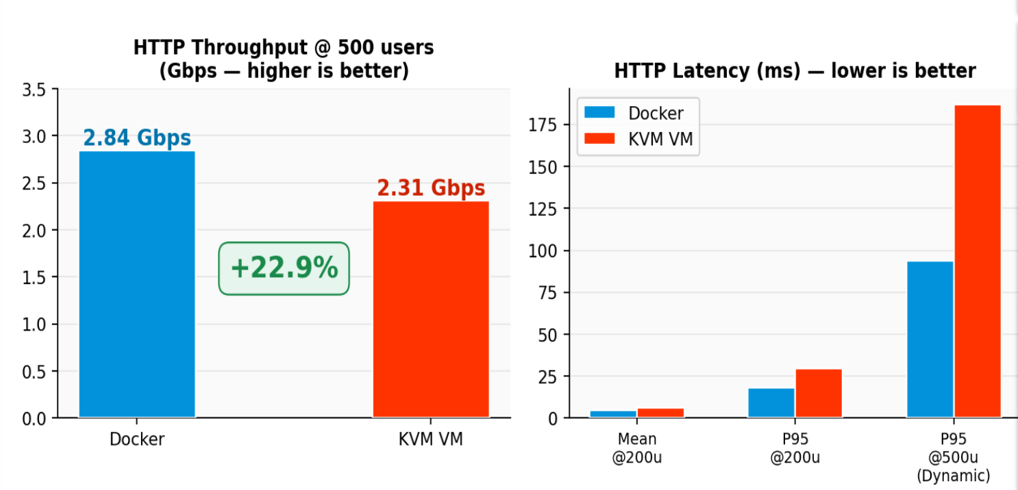
Results: Network Throughput & Latency
Network Performance Comparison
Latency Numbers (Table IV)
Metric | Docker | VM
Throughput @500u | 2.84 Gbps | 2.31 Gbps
Mean Lat @200u | 4.7 ms | 6.1 ms
P95 Lat @200u | 18.3 ms | 29.7 ms
P95 Lat @500u dyn | 94 ms | 187 ms
⚠ P95 latency at 500 users dynamic: VM = 187 ms vs Docker = 94 ms (VM is 99% worse for tail latency — directly affects user experience)
10

Slide 11
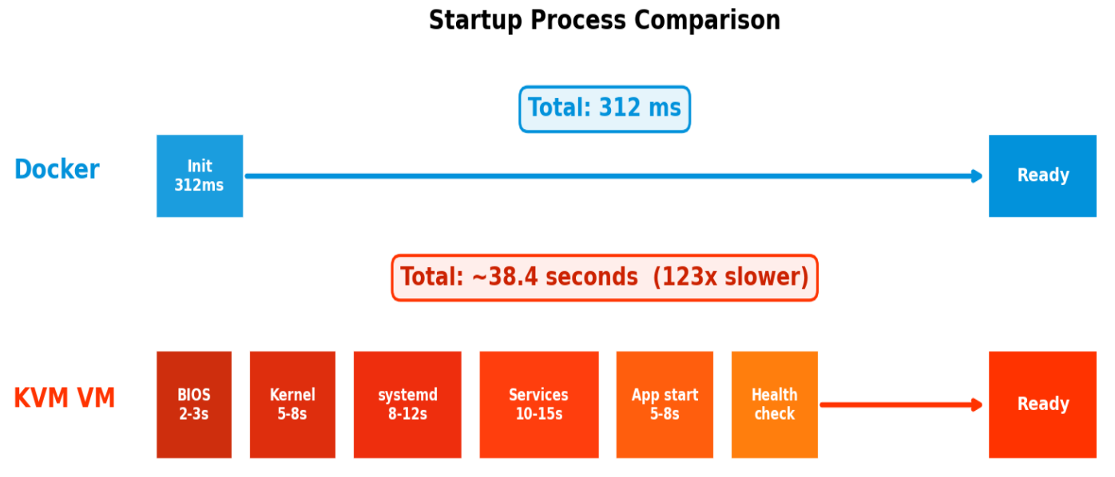
Results: Startup Time — 123× Faster
Table V (30 trials each)
 | Docker | KVM VM
Mean | 312 ms | 38.4 s
Median | 298 ms | 36.9 s
Min | 241 ms | 29.1 s
Max | 489 ms | 52.7 s
Std Dev | 47 ms | 5.8 s
Real-world impact: Scale out 10 new instances during a traffic spike
Docker: ready in ~4 ms
KVM VM: ready in ~60 secs
11

Slide 12
Security Considerations
Isolation Model Comparison
Virtual Machine Security
Docker Container Security
Application Layer
Container A
Container B
VM Security (Strong)
VS
• Hardware-enforced boundary (Intel VT-x/AMD-V)
• Guest kernel breach ≠ host breach
• Foundation of AWS/Azure/GCP multi-tenancy
Guest OS (separate kernel)
Docker Engine + cgroups/namespaces
Hypervisor (HW Virtualization)
Shared Host OS Kernel ⚠ (risk point)
Host OS
Host OS
Container Security (Moderate)
Physical Hardware
Physical Hardware
• Shared host kernel — single point of risk
• CVE-2019-5736: runc escape
• Harden with: non-root, seccomp, AppArmor (+0.8% CPU)
[ Hardware Isolation Boundary ]
Sandboxed Runtimes: Best of Both Worlds
• gVisor: user-space kernel intercepts syscalls — near-container speed, VM-level isolation
• Kata Containers: microVM per container — only 5–15% overhead vs Docker (vs 15–23% for full KVM)
12

Slide 13
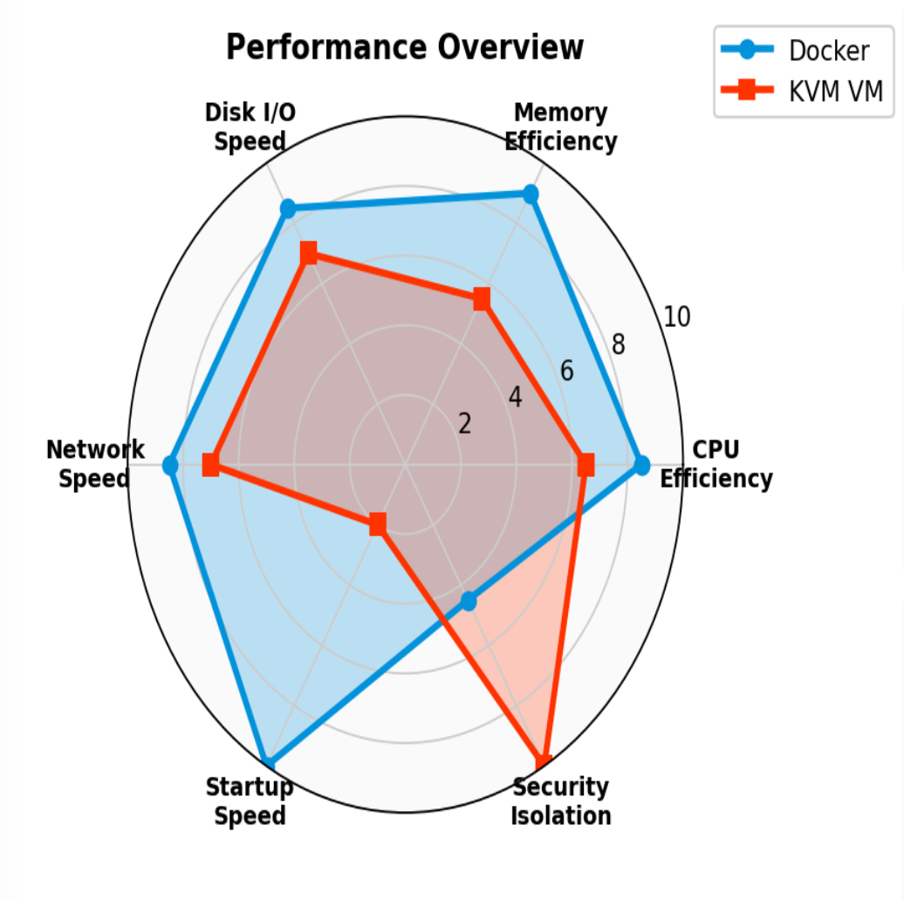
Discussion & Practical Recommendations
Use Docker When ✓
• Latency-sensitive microservices & REST APIs
• Fast scaling & high instance density needed
• CI/CD pipelines, Kubernetes deployments
• Stateless web workloads
Use VMs When ✓
• Multi-tenant cloud with untrusting users
• Regulated environments: PCI-DSS, HIPAA
• Need custom kernel or full OS isolation
• Maximum security is non-negotiable
Hybrid Architecture (Production Best Practice)
• Kubernetes nodes run as VMs on cloud
• Docker containers run inside each VM
• VM isolation at node + container density within
• Used by Google GKE, AWS EKS, Azure AKS
13

Slide 14
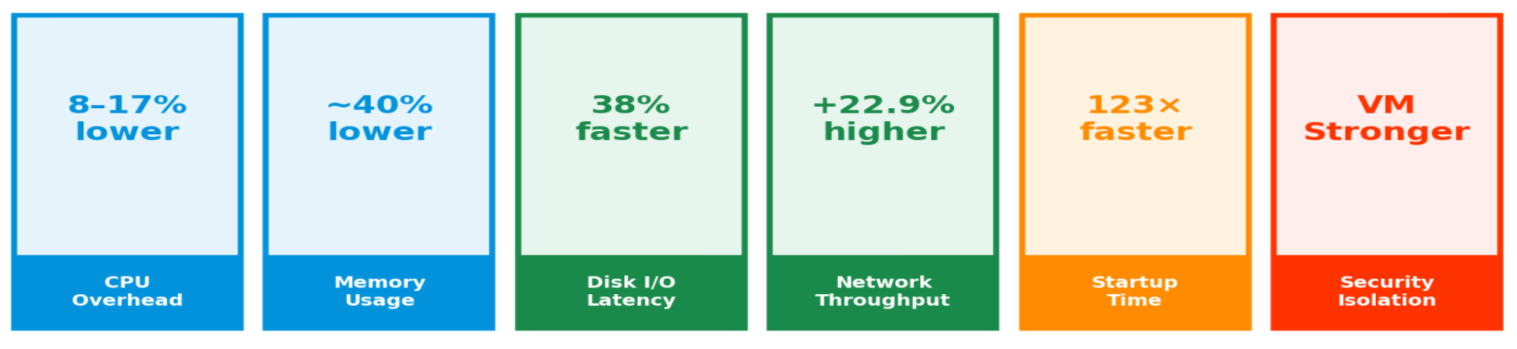
Conclusion
Docker outperforms KVM VMs across 5 of 6 dimensions
Startup Time
Summary
• Docker containers consistently outperform KVM VMs across CPU, Memory, Disk I/O, Network, and Startup Time
• VMs retain a meaningful advantage in workload isolation — hardware-enforced security at silicon level
• For most production web deployments: Hybrid VM+Container architecture captures both benefits
• Emerging runtimes (Kata Containers, gVisor) are closing the performance–isolation gap
Future Work
Serverless platforms (AWS Fargate, Cloud Run) • Kubernetes + Istio overhead • Firecracker microVMs • Security hardening cost at scale • ARM64 vs x86_64
14

Slide 15
References
[1] Docker, Inc., "Docker Hub: Container Image Repository," 2023.
[2] G.J. Popek & R.P. Goldberg, "Formal requirements for virtualizable third generation architectures," CACM, 1974.
[3] D. Merkel, "Docker: Lightweight Linux containers for consistent development & deployment," Linux Journal, 2014.
[4] W. Felter et al., "An updated performance comparison of VMs and Linux containers," IEEE ISPASS, 2015.
[5] R. Morabito et al., "Hypervisors vs. lightweight virtualization: A performance comparison," IEEE IC2E, 2015.
[6] M.G. Xavier et al., "Performance evaluation of container-based virtualization for HPC," IEEE PDP, 2013.
[7] S. Soltesz et al., "Container-based OS virtualization: A scalable alternative to hypervisors," ACM EuroSys, 2007.
[8] C. Pahl & B. Lee, "Containers and clusters for edge cloud architectures," FiCloud, 2015.
[9] D. Bernstein, "Containers and cloud: From LXC to Docker to Kubernetes," IEEE Cloud Computing, 2014.
[10] M.-T. Chung et al., "Using Docker in high performance computing applications," IEEE ICCE, 2016.
[11] C.C. Spoiala et al., "Performance comparison of a WebRTC server on Docker vs VM," IEEE SACI, 2016.
[12] J.E. Smith & R. Nair, "The architecture of virtual machines," IEEE Computer, 2005.
[13] Q. Zhang et al., "A comparative study of containers and VMs in big data environments," IEEE CLOUD, 2018.
15

Slide 16
Thank You
Questions & Discussion
Research Summary
Title: Comparative Analysis of Resource Utilization — Docker vs Virtual Machines
Method: Node.js/Express + Apache JMeter | Dedicated i9-12900K physical testbed
Result: Docker outperforms KVM VMs across all 5 resource dimensions measured
Arham Jain • Ansh Mittal • Anuj Kumar
Dept. of CSE (CUIET), Chitkara University, Punjab | COOP-II Evaluation-II | 2026
16

