Slide 1
Common SENSES
Understanding your neighborhood, together.
Blue Hill Avenue · Boston, MA
commonsensesproject.org

Slide 2


This is about YOUR neighbourhood.
01
We know this community faces real challenges from heat, air quality, to noise.
This project exists to put that information in YOUR hands.
The data is yours
Everything the sensors collect is free, public, and available to anyone. No passwords, no barriers.
No surveillance, ever
These sensors only measure the environment. No cameras, no tracking people, no personal information collected.
It's community-led
Community members like you helped decide where sensors go, based on what you experience every day.
commonsensesproject.org

Slide 3
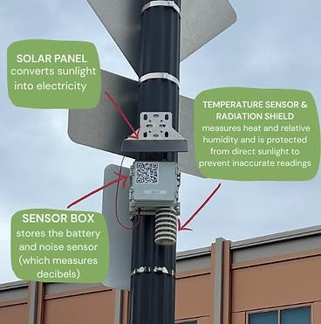
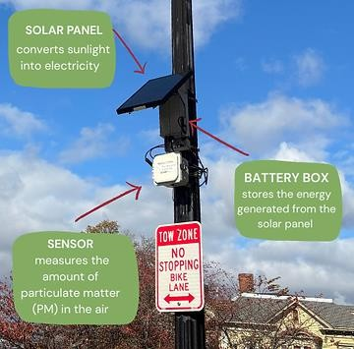
What are the sensors?
02
Small devices installed around the neighbourhood that measure what's happening in the air around you, 24 hours a day.
75
Sensors Total
Readings update live
Placed collaboratively with the community
Free to view at any time
commonsensesproject.org

Slide 4

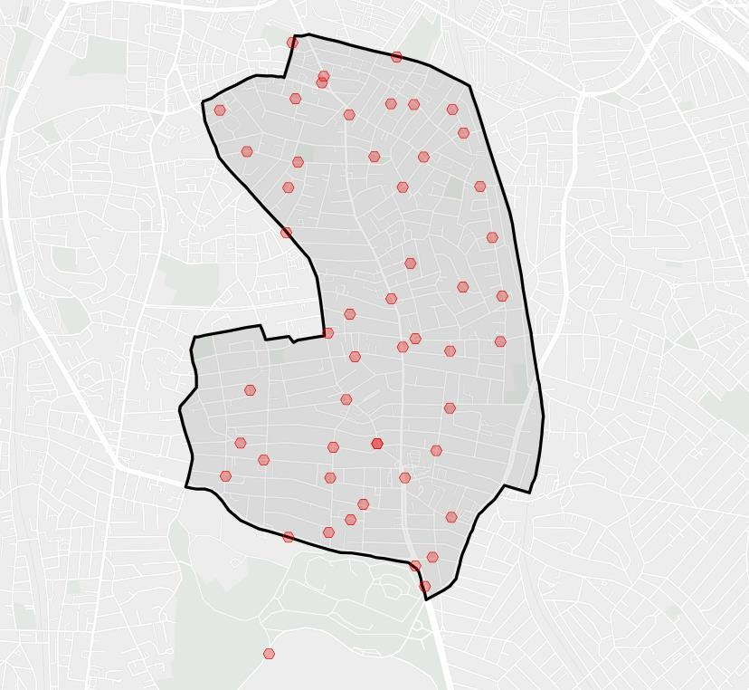
What are the sensors?
02
Small devices installed around the neighbourhood that measure what's happening in the air around you, 24 hours a day.
51
Heat & Noise Sensors
How hot it feels outside
How loud it is on your street
Humidity in the air
commonsensesproject.org

Slide 5
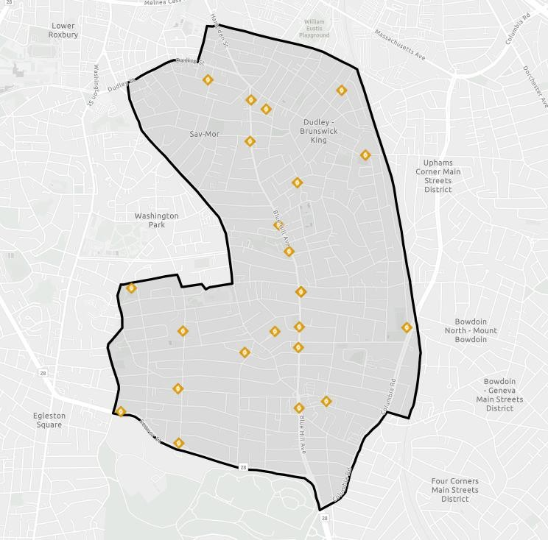
What are the sensors?
02
Small devices installed around the neighbourhood that measure what's happening in the air around you, 24 hours a day.
24
Air Quality Sensors
Tiny particles you breathe in
Exhaust and smoke in the air
Temperature and humidity
commonsensesproject.org

Slide 6
Air quality: what the colors mean
04
The air quality sensors measure tiny particles in the air. The color shows how safe the air is to breathe right now.
EPA Guidelines for PM exposure over 24 hours
Feels fine outside. No special air concerns today.
Good
Moderate
Mostly fine. People with asthma or breathing issues should take it easy.
Unhealthy for Some
Elderly, kids, and those with asthma should limit time outside today.
Unhealthy
Everyone should reduce time spent outdoors. Keep windows closed.
Very Unhealthy
Stay inside if you can. Avoid going outside, especially kids and elders.
Hazardous
commonsensesproject.org

Slide 7
Heat: what the colors mean
05
Heat sensors measure how hot it actually feels on your body, not just the air temperature. On humid days it can feel much hotter than the thermometer reads.
US National Weather Service Heat Index Classification
Feels fine outside. No special heat concern today
No Heat Classification
Feels like Below 80°F
Caution
Feels like 80 to 90°F
Fatigue is possible with long outdoor activity. Drink water and take breaks.
Heat cramps or exhaustion are possible. Limit outdoor time.
Extreme Caution
Feels like 91 to 103°F
Danger
Feels like 103 to 124°F
Heat exhaustion is likely. Heatstroke is possible. Stay inside if you can.
Extreme Danger
Feels like Above 125°F
Heatstroke is very likely. This is a medical emergency level. Stay indoors.
commonsensesproject.org

Slide 8



Noise: what the numbers mean
06
Noise sensors measure sound in decibels (dB). Boston has rules about how loud it can be, and these sensors help hold that line.
City of Boston noise ordinance
11 PM to 7 AM
OK 0 to 50 dB Too Loud above 50 dB
That's quieter than a normal conversation. Nighttime quiet matters for sleep and health.
Any time of day
OK 0 to 70 dB Too Loud 70+ dB
70 dB is about as loud as a vacuum cleaner. Above that is against Boston city rules.
For reference: how loud is that?
30 dB
Whisper
50 dB
Quiet conversation
70 dB
Vacuum cleaner
85 dB
Lawn mower
100 dB
Jackhammer or subway
commonsensesproject.org

Slide 9








Sensors on your map
07
Every sensor has a dot on the map. Click or tap it to see exactly what it's reading right now.
Coolest Path
Find your street
Search your address and see what's happening on your block right now.
Blue Hill Ave
Zones change color
When air quality or heat shifts, the color of your zone updates right away.
Tap any sensor dot
See the temperature, noise level, and air quality for that exact spot.
commonsensesproject.org/live-sensor-data
commonsensesproject.org

Slide 10
Ideas we’re exploring
The slides up to here show what is already running. These next three are ideas we want your feedback on.
1
2
3
The Coolest Path
Get alerts
Your neighborhood, right now
Picks a walking route that keeps off the hottest, smokiest streets.
Sends a free warning before heat or air gets bad, so nobody has to keep checking.
One screen showing how the whole area is doing at this moment.
commonsensesproject.org

Slide 11

The Coolest Path
08
A smarter way to get around on hot or smoky days
Elders walking to appointments Kids walking to school
Anyone with asthma or breathing issues Pregnant neighbors
Anyone out on the hottest summer days
How it works
You put in where you want to go. The system looks at all the sensor data along possible routes and picks the path that is coolest and has the cleanest air.
Instead of just the fastest way, you get the safest way.
Who it helps most
commonsensesproject.org

Slide 12



Get alerts before it gets bad
09
Sign up for free alerts. We'll let you know so you don't have to check the map every day.
Bad air day coming
We'll let you know before air quality gets unhealthy so you can plan your day.
Air Quality Alert
PM2.5 is elevated near Dudley Square right now. Consider staying inside.
Extreme heat nearby
Get a heads-up when it's dangerously hot near your home or your child's school.
Heat Warning
It's 97°F near sensor 14 on Blue Hill Ave. Seek shade or AC.
Your zone changed color
If the color on your block changes, you'll hear about it right away.
Air is Better
Air quality on your block is now Good. Safe
to go outside.
All clear
Good news counts too. We'll tell you when it's a great day to be outside.
commonsensesproject.org

Slide 13
Your neighborhood, right now
One screen that answers the first thing people ask: is it okay to go outside right now?
What it is
HEAT & NOISE
Heat Caution, feels like 88°F
It reads the same sensors, but instead of a map full of dots it just says how your block is doing right now.
Good for a quick check before going out, or for anyone who would rather not read a map.
Noise OK, within limits
AIR QUALITY
Air quality Good
Updated 2 min ago, example data
commonsensesproject.org

