Slide 1
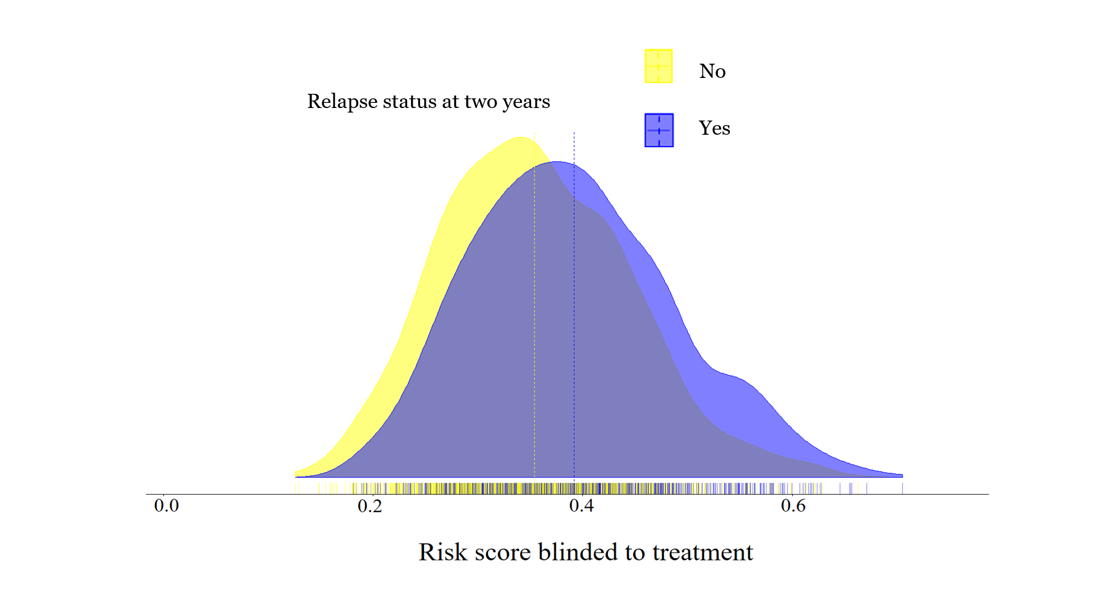
Figure 1 The distribution of predicted risk of any relapse within the next two years for individuals by relapse status in the RCTs dataset (Stage2). The dashed lines indicate the mean of predicted risk for individuals who did experience a relapse (purple) and for those who did not (yellow)

Slide 2
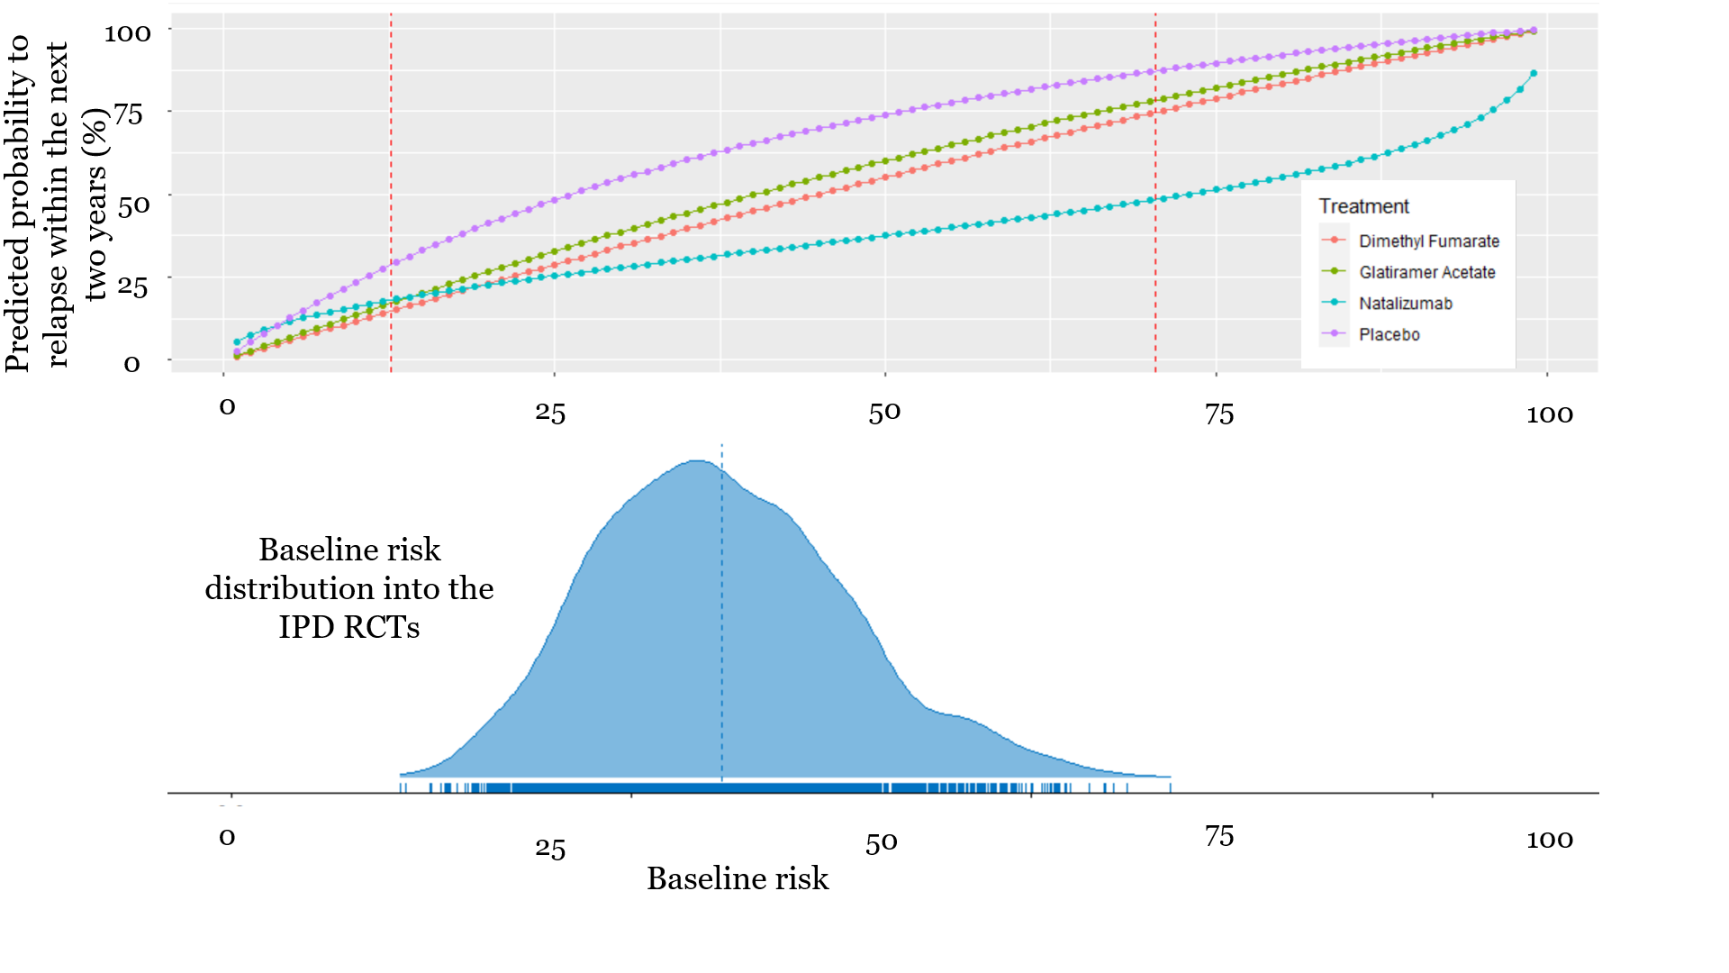
Figure 2 Predicted probability of any relapse within the next two years as a function of the baseline risk score (Stage 3). The x-axis shows the baseline risk score of relapsing within the next two years (after re-calibration, stage 2)and the y-axis shows the predicted probability to relapse within the next two years under each one of the available treatments. Between the two dashed vertical lines are the baseline risk values observed in our data. The distribution of the baseline risk into the IPD RCTs is also presented in the bottom of the graph.

