Slide 1
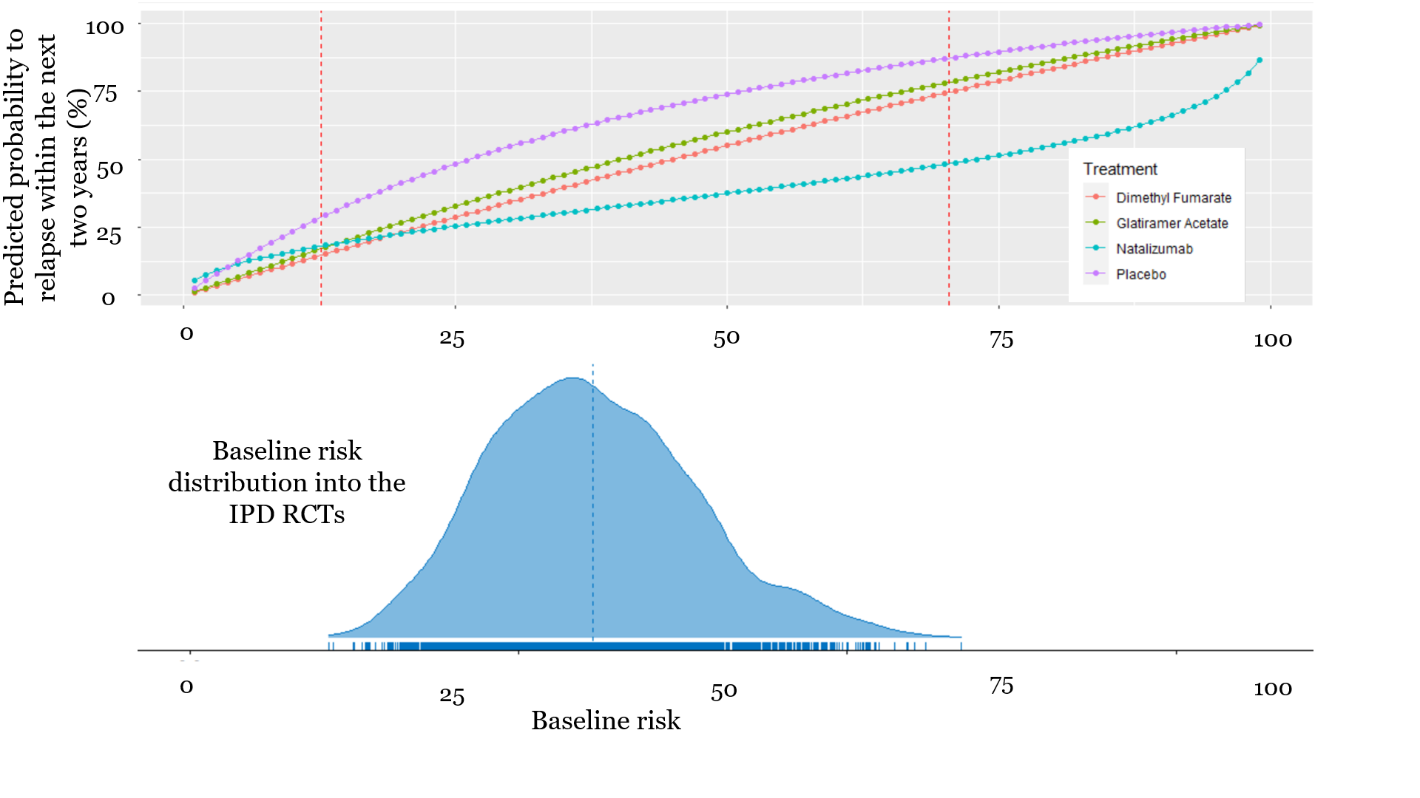
Figure 2 Predicted probability of any relapse within the next two years as a function of the baseline risk score (Stage 3). The x-axis shows the baseline risk score of relapsing within the next two years (after re-calibration, stage 2)and the y-axis shows the predicted probability to relapse within the next two years under each one of the available treatments. Between the two dashed vertical lines are the baseline risk values observed in our data. The distribution of the baseline risk into the IPD RCTs is also presented in the bottom of the graph.

