Slide 1
Houston Pollen Count in 2021
Cheng Cheng

Slide 2

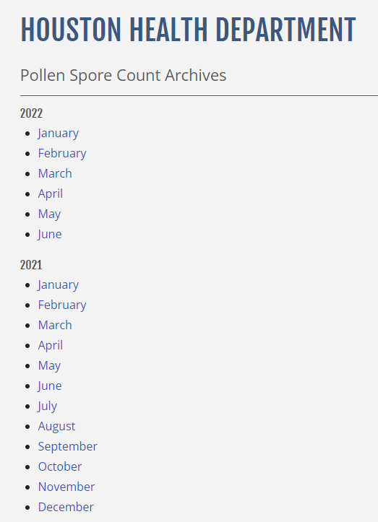
Background
A pollen count is the measurement of the number of grains of pollen in a cubic meter of air
High pollen counts can sometimes lead to increased rates of allergic reaction for those with allergic disorders
Houston Health Department laboratory measures air samples to provide a daily report and recorded message for the pollen count within the area
Pollen count in the daily report includes tree pollen, grass pollen, and weed pollen
Question: which month has high pollen count, and what contributes to the pollen count?
https://www.houstontx.gov/health/Pollen-Mold/pollen-archives.html

Slide 3
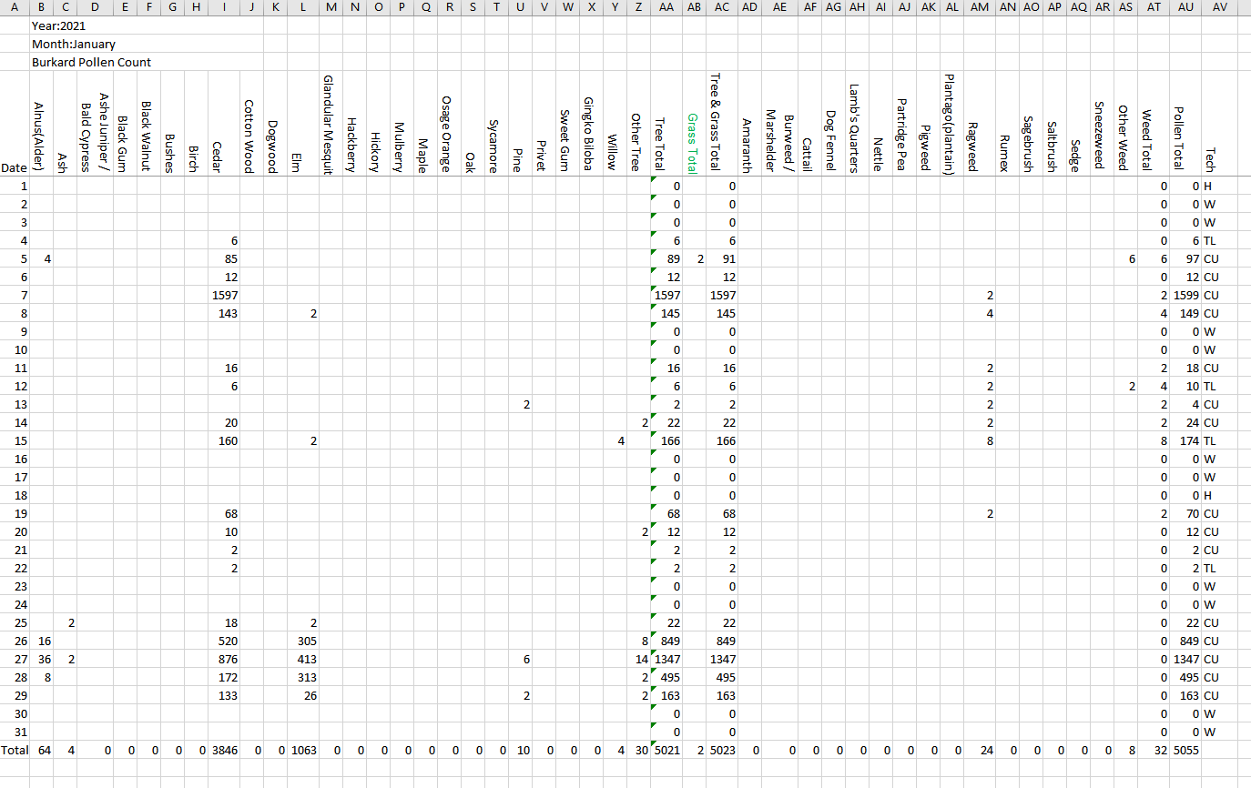
Data Acquisition & Processing
Example Spreadsheet
Download the 2021 daily pollen count data from Houston Health Department website
Spreadsheet data for each month
Examine the datasets to fix errors
Analyze and plot monthly pollen count data
Identify which contributes the most for the total pollen count

Slide 4
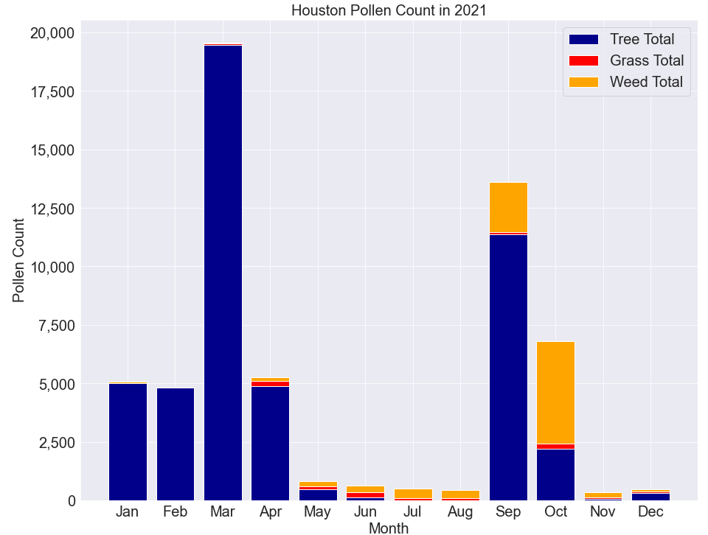
Pollen Count
March has the highest pollen count among all months, followed by September
January, February, April, and October also have higher pollen count
May, June, July, August, November, and December have lower pollen count

Slide 5
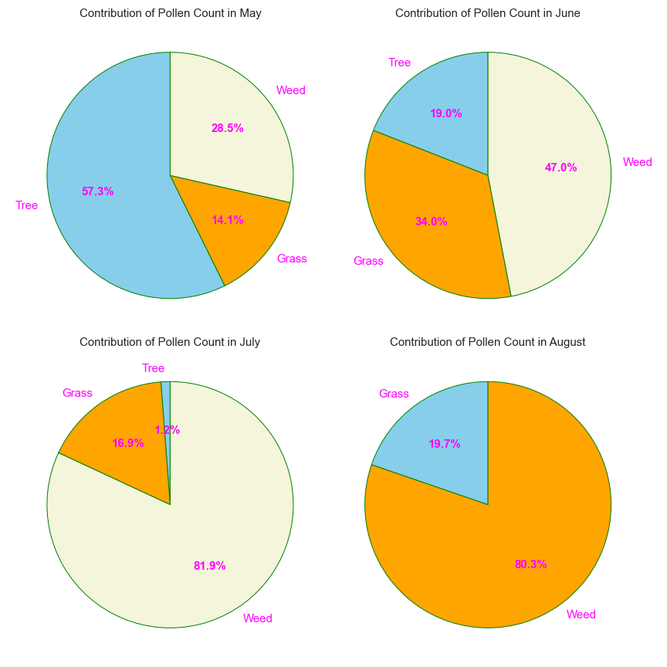
Contribution to Pollen Count
From January to May, tree pollen is the primary contributor to the total pollen count
From June to August, weed pollen is the primary contributor to the total pollen count, followed by grass pollen

Slide 6
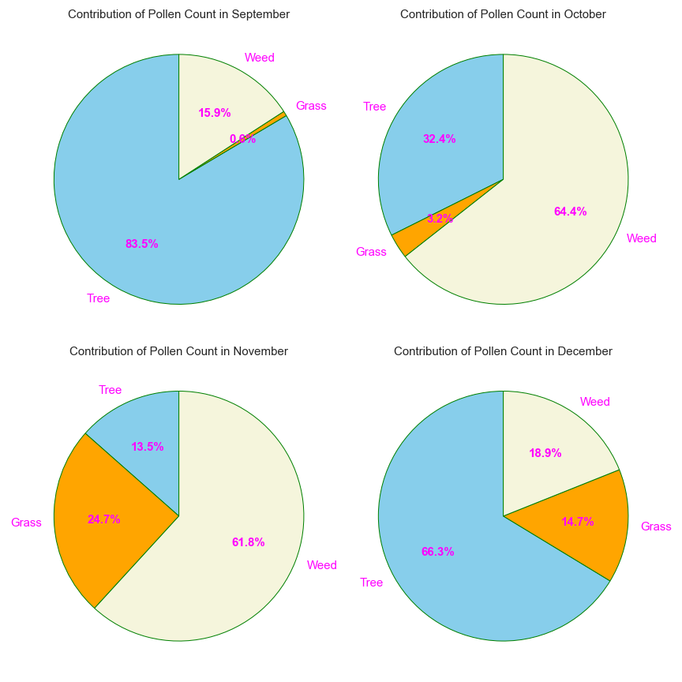
Contribution to Pollen Count
Tree pollen is the primary contributor to the total pollen count in September and December, followed by weed
Weed pollen is the primary contributor to the total pollen count in October and November

Slide 7
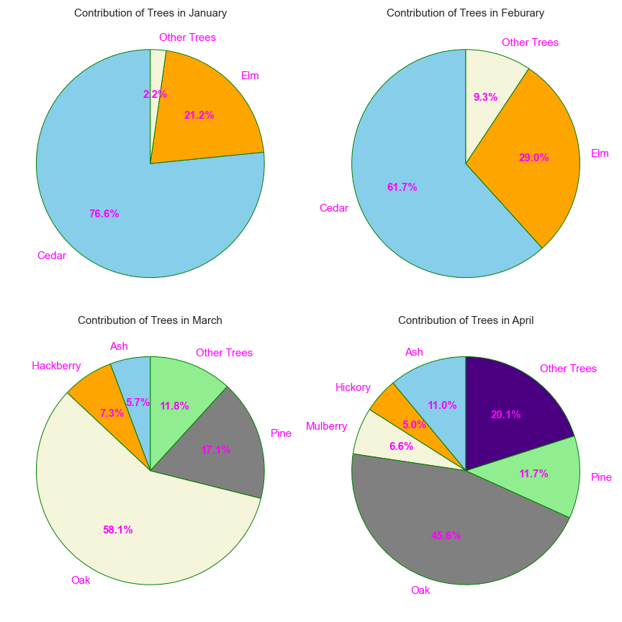
Contribution to Tree Pollen Count
Cedar and Elm are the primary contributors to the tree pollen count in January and February
Oak and pine are the primary contributors to the tree pollen count in March and April

Slide 8
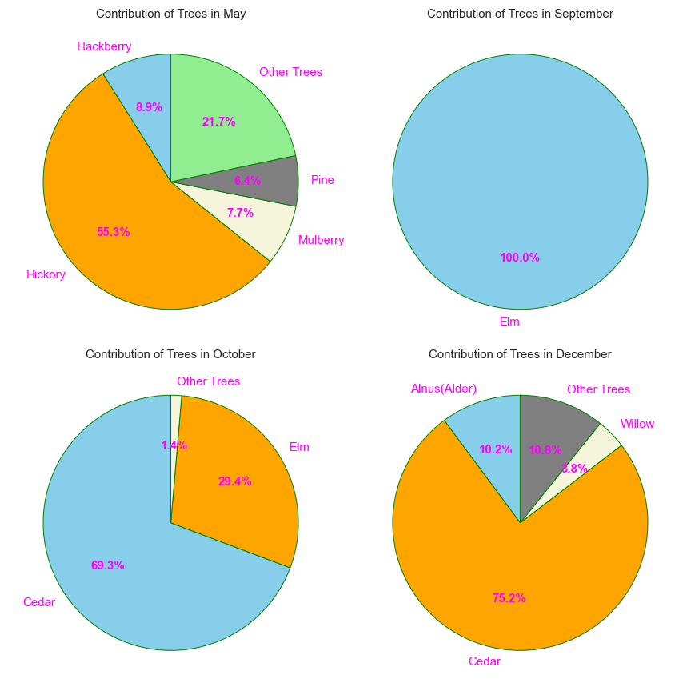
Contribution to Tree Pollen Count
Hickory is the primary contributor to the tree pollen count in May
Tree pollen is negligible in June, July, and November
Elm is the primary contributor to the tree pollen count in September
Cedar is the primary contributor to the tree pollen count in November and December

Slide 9
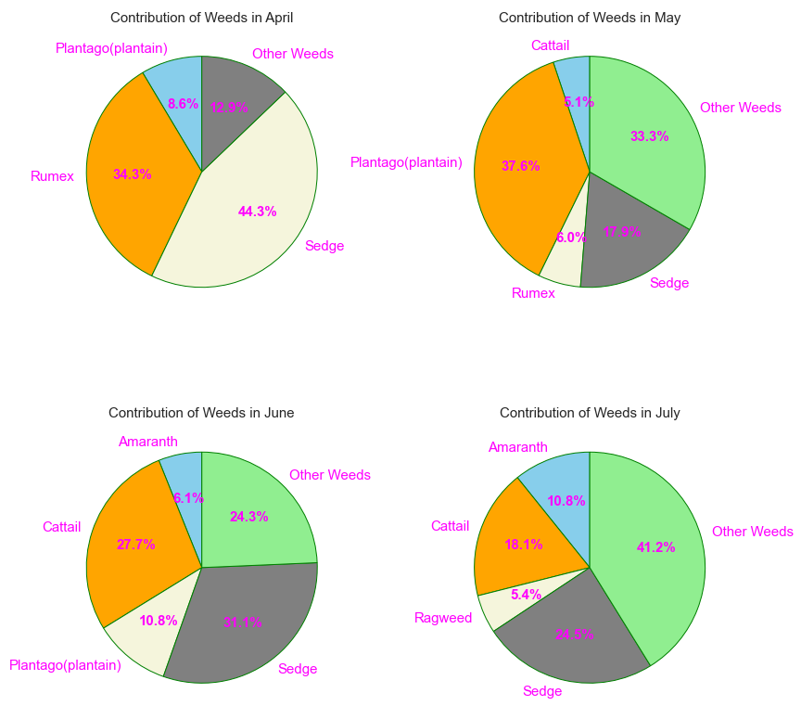
Contribution to Weed Pollen Count
Weed pollen is negligible in January, February, March, and December
Sedge and Rumex are the primary contributors to the weed pollen count in April
Sedge, Cattail, and Plantago are the primary contributors to the weed pollen count in May, June, and July

Slide 10
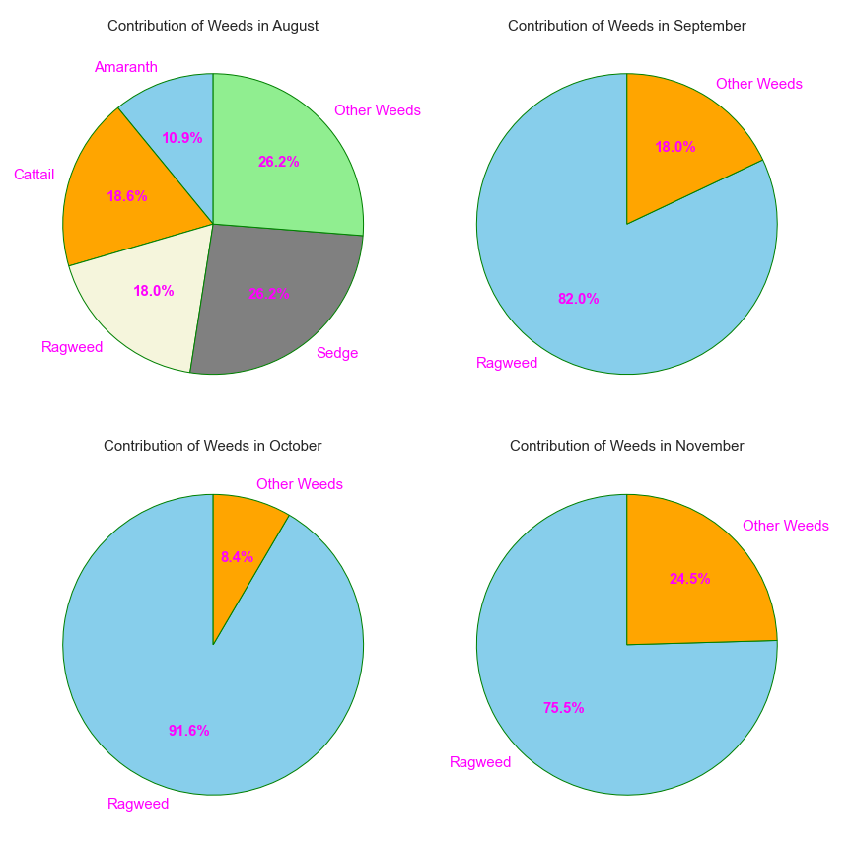
Contribution to Weed Pollen Count
Sedge, Cattail, and Plantago are the primary contributors to the weed pollen count in May, June, and July
Ragweed is the primary contributor to the weed pollen count in September, October, and November

Slide 11
Summary
Pollen count is higher in late winter, spring and fall and lower in summer
March and September have the highest pollen count
January, February, April, and October also have relatively higher pollen count
Tree pollen is the primary contributor to the total pollen count in late winter & spring, weed pollen is the primary contributor in summer & late fall, and grass pollen provides a small contribution in summer
Cedar and elm are the primary contributors to the tree pollen in fall & winter, while oak is the primary contributor to the tree pollen in spring
Ragweed is the primary contributor to the weed pollen count in fall, while Sedge, Cattail, and Plantago are the primary contributors to the weed pollen count in late spring & summer

