Slide 1
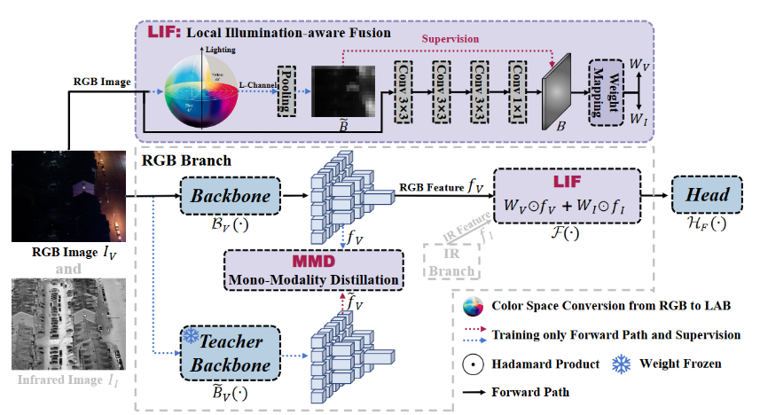
Rethinking Multi-Modal Object Detection from the Perspective of
Mono-Modality Feature Learning

Slide 2
# # HSV
img_v, _ = torch.max(RGB_img, dim=1, keepdim=True)
img_v = img_v.detach()
gt = self.pool_for_FIA(img_v)
# YCbCr
# r = RGB_img[:, 0, :, :]
# g = RGB_img[:, 1, :, :]
# b = RGB_img[:, 2, :, :]
# y = 0.299 * r + 0.587 * g + 0.114 * b
# gt = self.pool_for_FIA(y)
FIA_module = self.model.model[2]
weight = FIA_module(RGB_img)
illumination_loss = torch.abs(gt - weight).mean() # no_sup
illumination_loss *= 1.3 # weight
self.loss += illumination_loss
self.loss_items = torch.cat(
(
self.loss_items, illumination_loss.unsqueeze(0).detach()),
dim=0)
HSV
YCBCr
取最高值作为V值
相比于HSV，YUV基于人眼对颜色的感受加权了一下
没用LAB可能是因为计算复杂
提取的亮度值用作监督
加到总损失里面

Slide 3
# Parameters
nc: 80 # number of classes
scales: # model compound scaling constants, i.e. 'model=yolov8n.yaml' will call yolov8.yaml with scale 'n'
# [depth, width, max_channels]
n: [0.33, 0.25, 1024] # YOLOv8n summary: 225 layers, 3157200 parameters, 3157184 gradients, 8.9 GFLOPs
s: [0.33, 0.50, 1024] # YOLOv8s summary: 225 layers, 11166560 parameters, 11166544 gradients, 28.8 GFLOPs
m: [0.67, 0.75, 768] # YOLOv8m summary: 295 layers, 25902640 parameters, 25902624 gradients, 79.3 GFLOPs
l: [1.00, 1.00, 512] # YOLOv8l summary: 365 layers, 43691520 parameters, 43691504 gradients, 165.7 GFLOPs
x: [1.00, 1.25, 512] # YOLOv8x summary: 365 layers, 68229648 parameters, 68229632 gradients, 258.5 GFLOPs
# YOLOv8.0n backbone
backbone:
# [from, repeats, module, args]
- [-1, 1, Conv, [64, 3, 2]] # 0-P1/2
- [-1, 1, Conv, [128, 3, 2]] # 1-P2/4
- [-1, 3, C2f, [128, True]]
- [-1, 1, Conv, [256, 3, 2]] # 3-P3/8
- [-1, 6, C2f, [256, True]]
- [-1, 1, Conv, [512, 3, 2]] # 5-P4/16
- [-1, 6, C2f, [512, True]]
- [-1, 1, Conv, [1024, 3, 2]] # 7-P5/32
- [-1, 3, C2f, [1024, True]]
- [-1, 1, SPPF, [1024, 5]] # 9
# YOLOv8.0n head
head:
- [-1, 1, nn.Upsample, [None, 2, "nearest"]]
- [[-1, 6], 1, Concat, [1]] # cat backbone P4
- [-1, 3, C2f, [512]] # 12
- [-1, 1, nn.Upsample, [None, 2, "nearest"]]
- [[-1, 4], 1, Concat, [1]] # cat backbone P3
- [-1, 3, C2f, [256]] # 15 (P3/8-small)
- [-1, 1, Conv, [256, 3, 2]]
- [[-1, 12], 1, Concat, [1]] # cat head P4
- [-1, 3, C2f, [512]] # 18 (P4/16-medium)
- [-1, 1, Conv, [512, 3, 2]]
- [[-1, 9], 1, Concat, [1]] # cat head P5
- [-1, 3, C2f, [1024]] # 21 (P5/32-large)
- [[15, 18, 21], 1, Detect, [nc]] # Detect(P3, P4, P5)
堆叠块数量，通道数
层数索引
第n特征层/是原图m分之一

Slide 4
ch: 6
nc: 3 # FLIR
backbone:
- [ -1, 1, IN, [ ] ] # 0
- [ -1, 1, Multiin, [ 1 ] ] # 1
- [ -1, 1, LIF, [] ] # 2
- [ -3, 1, Multiin, [ 2 ] ] # 3
- [ -3, 1, Conv, [ 64, 3, 2 ] ] # 4-P1/2
- [ -2, 1, Conv, [ 64, 3, 2 ] ]
- [ -2, 1, Conv, [ 128, 3, 2 ] ] # 6-P2/4
- [ -2, 1, Conv, [ 128, 3, 2 ] ]
- [ -2, 3, C2f, [ 128, True ] ] # 8
- [ -2, 3, C2f, [ 128, True ] ]
- [ -2, 1, Conv, [ 256, 3, 2 ] ] # 10-P3/8
- [ -2, 1, Conv, [ 256, 3, 2 ] ]
- [ -2, 6, C2f, [ 256, True ] ] # 12
- [ -2, 6, C2f, [ 256, True ] ]
- [ [ -1, -2, 2 ], 1, LIFAdd, [ 3 ] ] # 14
- [ -3, 1, Conv, [ 512, 3, 2 ] ] # 15-P4/16
- [ -3, 1, Conv, [ 512, 3, 2 ] ]
- [ -2, 6, C2f, [ 512, True ] ] # 17
- [ -2, 6, C2f, [ 512, True ] ]
- [ [ -1, -2, 2 ], 1, LIFAdd, [ 4 ] ] # 19
- [ -3, 1, Conv, [ 1024, 3, 2 ] ] # 20-P5/32
- [ -3, 1, Conv, [ 1024, 3, 2 ] ]
- [ -2, 3, C2f, [ 1024, True ] ] # 22
- [ -2, 3, C2f, [ 1024, True ] ]
- [ [ -1, -2, 2 ], 1, LIFAdd, [ 5 ] ] # 24
- [ -1, 1, SPPF, [ 512, 5 ] ] # 25
MUL IN
MUL IN
MUL IN
RGB
RGB
IR
LIF
Conv
Conv
C2F
C2F
…
…
LIF ADD
Conv
Conv
C2F
C2F
…
…
LIF ADD
Conv
Conv
C2F
C2F
…
…
LIF ADD
SPPF

Slide 5
class IN(nn.Module):
def __init__(self):
super().__init__()
def forward(self, x):
return x
class Multiin(nn.Module): # stereo attention block
def __init__(self, out=1):
super().__init__()
self.out = out
def forward(self, x):
x1, x2 = x[:, :3, :, :], x[:, 3:, :, :]
if self.out == 1:
x = x1
else:
x = x2
return x

Slide 6
class LIF(nn.Module):
# forward返回一个80*80的权重图
def __init__(self):
super(LIF, self).__init__()
# 640*640 -> 80*80
self.conv1 = Conv(3, 32, k=3, p=1)
self.conv2 = Conv(32, 64, k=3, p=1)
self.conv3 = Conv(64, 64, k=3, p=1)
self.conv4 = Conv(64, 1, k=1, p=0)
self.relu = nn.ReLU()
self.pool = nn.AvgPool2d(kernel_size=2, stride=2)
def forward(self, x):
x = self.pool(self.conv1(x))
x = self.pool(self.conv2(x))
x = self.pool(self.conv3(x))
x = self.relu(self.conv4(x))
return x
class LIFAdd(nn.Module):
def __init__(self, layer):
super(LIFAdd, self).__init__()
self.layer = layer
self.pool_layer4 = nn.AvgPool2d(kernel_size=2, stride=2)
self.pool_layer5 = nn.AvgPool2d(kernel_size=4, stride=4)
self.beta = 0.4
def forward(self, x):
x_ir = x[0]
x_rgb = x[1]
weight = x[2]
step1 = (weight - 0.31) / 0.63
step2 = torch.clamp(step1, max=0.5)
weight = self.beta * step2 + 0.5
if self.layer == 3:
pass
elif self.layer == 4:
weight = self.pool_layer4(weight)
elif self.layer == 5:
weight = self.pool_layer5(weight)
# h, w = x_rgb.shape[2:]
# print(h, w)
weight_rgb = weight
weight_ir = 1 - weight
return weight_rgb * x_rgb + weight_ir * x_ir
这里其实是归一化
将数值压缩到0.3-0.7之间
这么做可能源于后面要说的一个问题

Slide 7
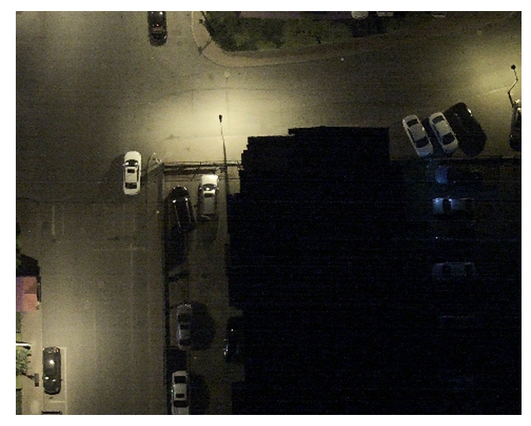
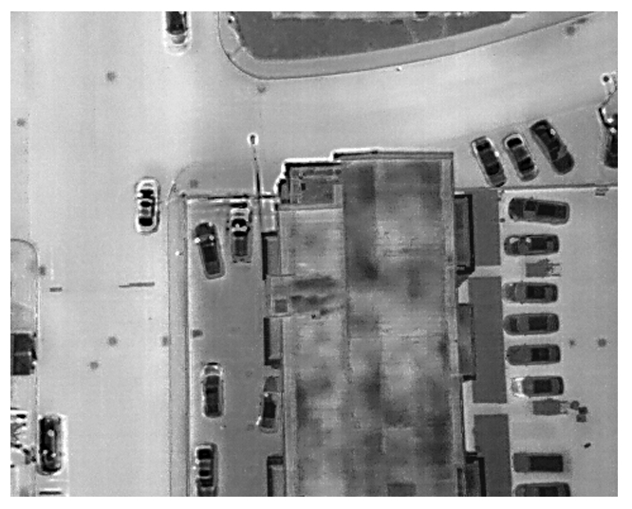
Drone Vehicle
names:
0: car
1: truck
2: feright_car
3: bus
4: van
<annotation>
<folder>5-11</folder>
<filename>DJI_0318</filename>
<path>E:\program\ProcessedData-20190617.part\5-11\DJI_0318.jpg</path>
<source>
<database>Unknown</database>
</source>
<size>
<width>840</width>
<height>712</height>
<depth>3</depth>
</size>
<segmented>0</segmented>
<object>
<name>car</name>
<pose>Unspecified</pose>
<truncated>0</truncated>
<difficult>0</difficult>
<polygon>
<x1>269</x1>
<y1>148</y1>
<x2>295</x2>
<y2>148</y2>
<x3>289</x3>
<y3>87</y3>
<x4>262</x4>
<y4>90</y4>
</polygon>
</object>
VOC格式
<object>
<name>car</name>
<pose>Unspecified</pose>
<truncated>0</truncated>
<difficult>0</difficult>
<polygon>
<x1>234</x1>
<y1>275</y1>
<x2>258</x2>
<y2>276</y2>
<x3>258</x3>
<y3>336</y3>
<x4>234</x4>
<y4>332</y4>
</polygon>
</object>

Slide 8
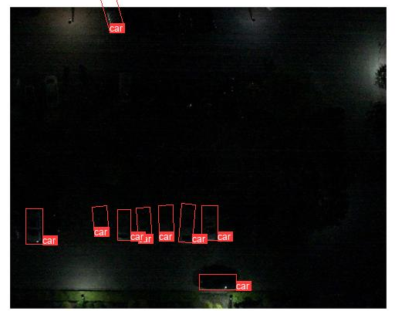
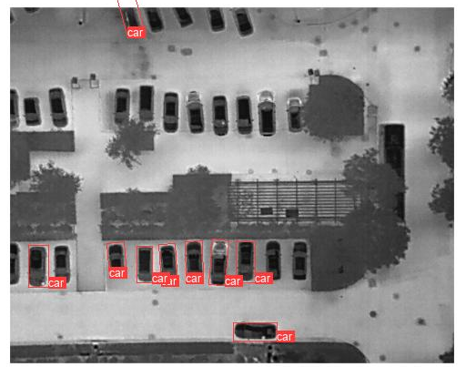
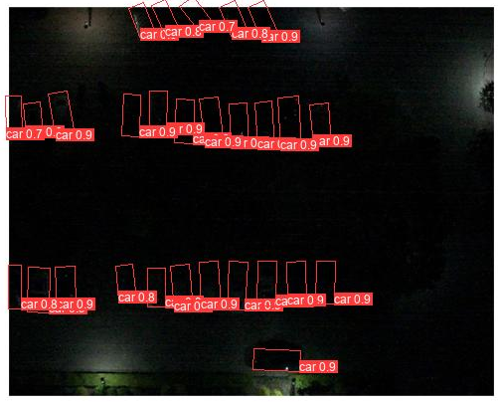
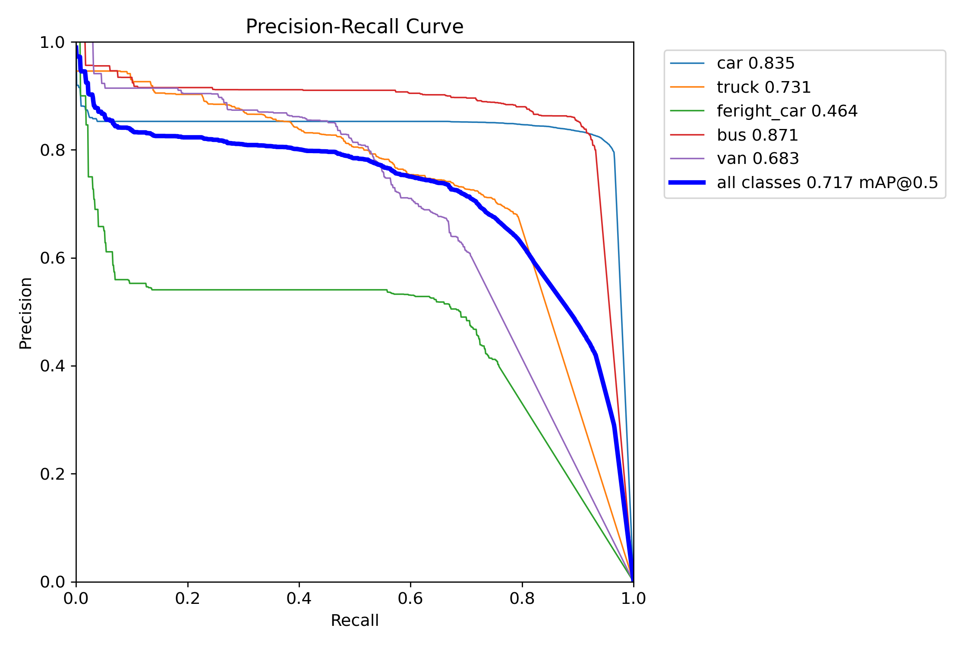
这是他的多模态模型
DroneVehicle
YOLOv8_LIF_obb summary (fused): 354 layers, 37070899 parameters, 0 gradients, 124.6 GFLOPs
val: Scanning D:\DeepLearning\Dataset\DroneVehicle_YOLO_OBB\labels\val... 954 images, 0 backgrounds, 0 corrupt: 100%|██████████| 954/954 [00:00<00:00, 1839.94it/s]
val: New cache created: D:\DeepLearning\Dataset\DroneVehicle_YOLO_OBB\labels\val.cache
Class Images Instances Box(P R mAP50 mAP50-95): 100%|██████████| 954/954 [00:18<00:00, 52.60it/s]
all 954 15387 0.828 0.81 0.833 0.631
car 954 13701 0.873 0.958 0.905 0.664
truck 954 688 0.865 0.741 0.833 0.612
bus 954 560 0.9 0.929 0.932 0.744
van 954 438 0.672 0.614 0.661 0.505
Speed: 0.3ms preprocess, 14.0ms inference, 0.0ms loss, 2.1ms postprocess per image
?

Slide 9
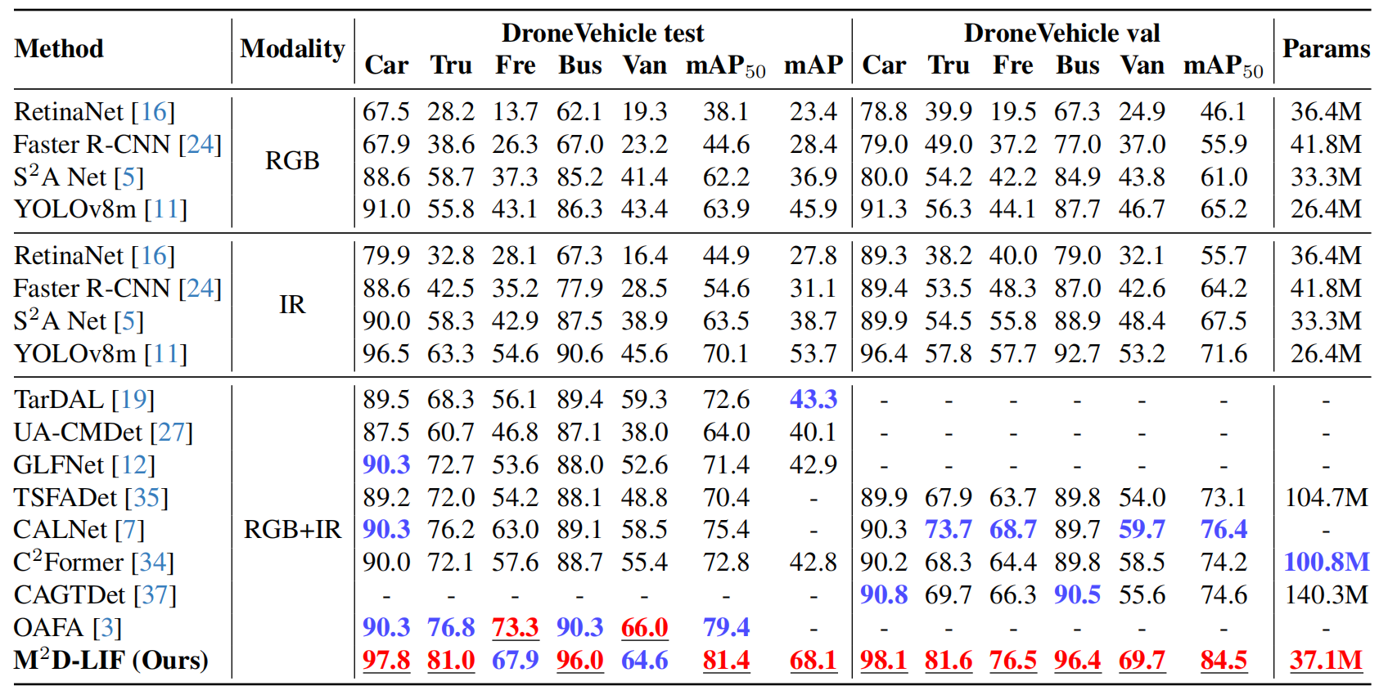
YOLOv8_LIF_obb summary (fused): 354 layers, 37070899 parameters, 0 gradients, 124.6 GFLOPs
val: Scanning D:\DeepLearning\Dataset\DroneVehicle_YOLO_OBB\labels\val... 954 images, 0 backgrounds, 0 corrupt: 100%|██████████| 954/954 [00:00<00:00, 1839.94it/s]
val: New cache created: D:\DeepLearning\Dataset\DroneVehicle_YOLO_OBB\labels\val.cache
Class Images Instances Box(P R mAP50 mAP50-95): 100%|██████████| 954/954 [00:18<00:00, 52.60it/s]
all 954 15387 0.828 0.81 0.833 0.631
car 954 13701 0.873 0.958 0.905 0.664
truck 954 688 0.865 0.741 0.833 0.612
bus 954 560 0.9 0.929 0.932 0.744
van 954 438 0.672 0.614 0.661 0.505
Speed: 0.3ms preprocess, 14.0ms inference, 0.0ms loss, 2.1ms postprocess per image

Slide 10
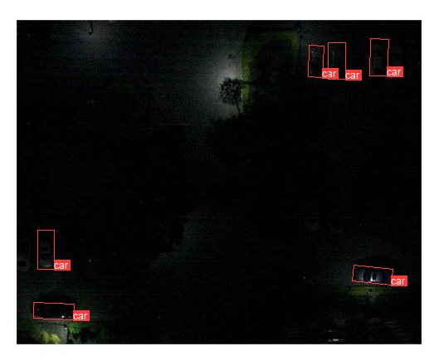
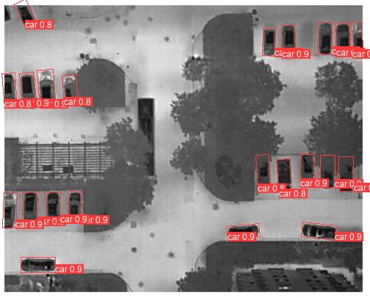
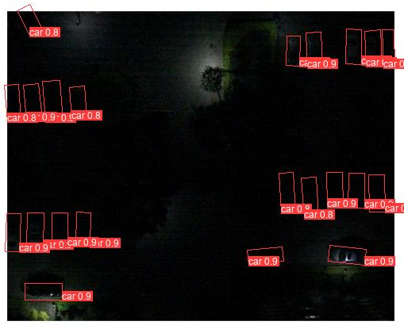
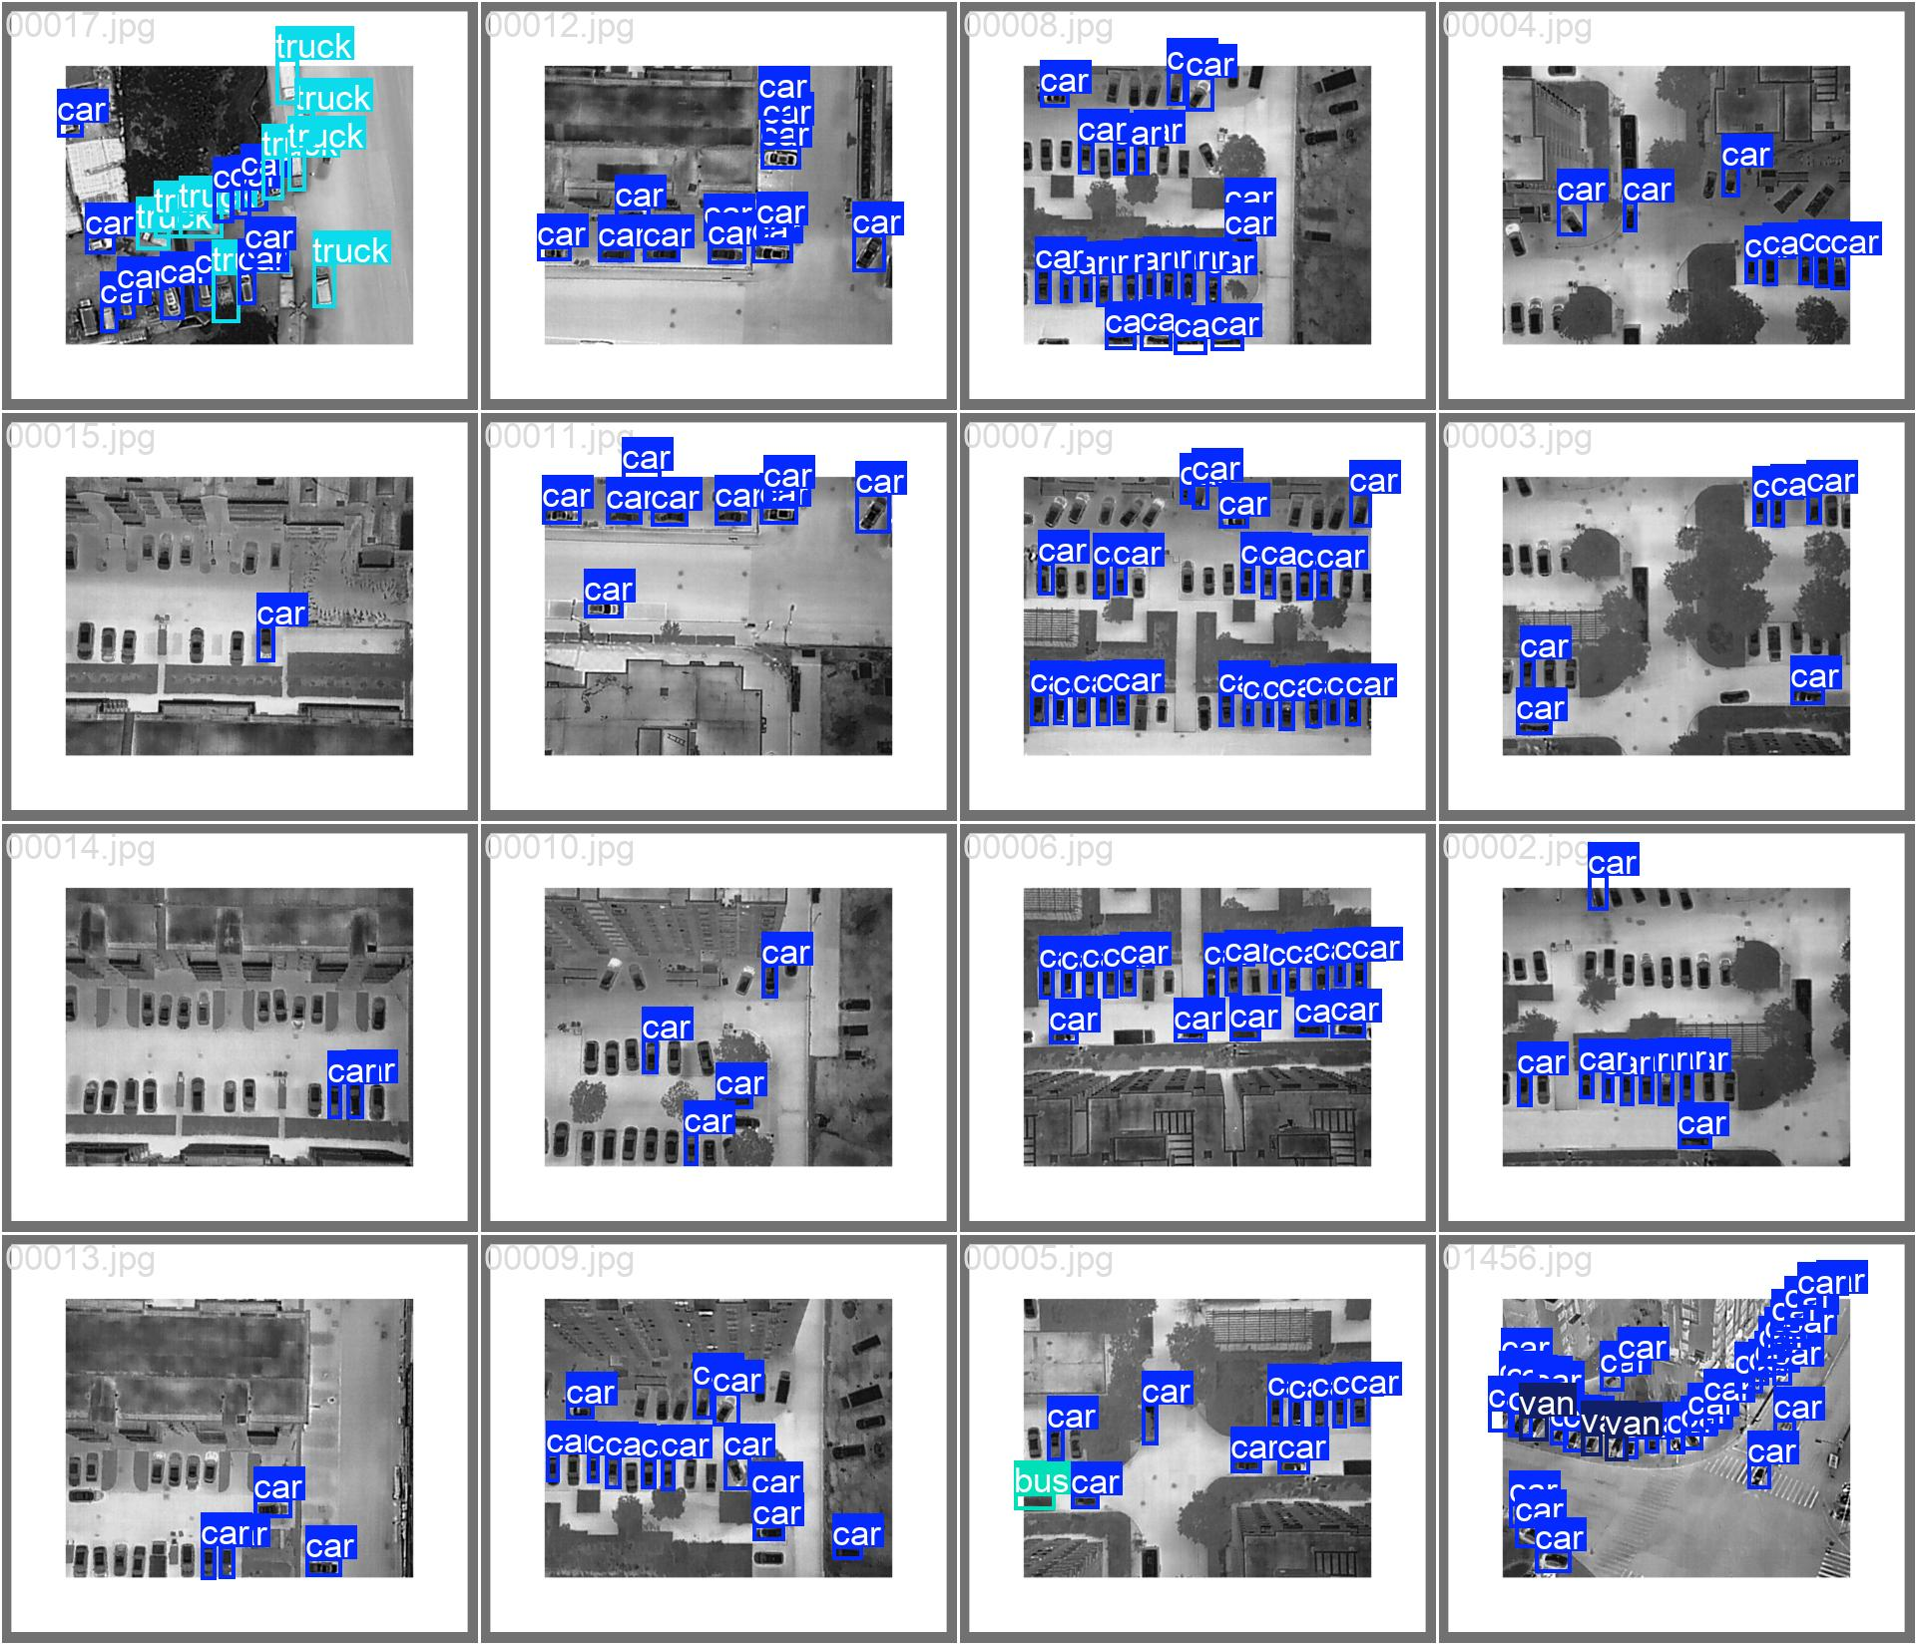
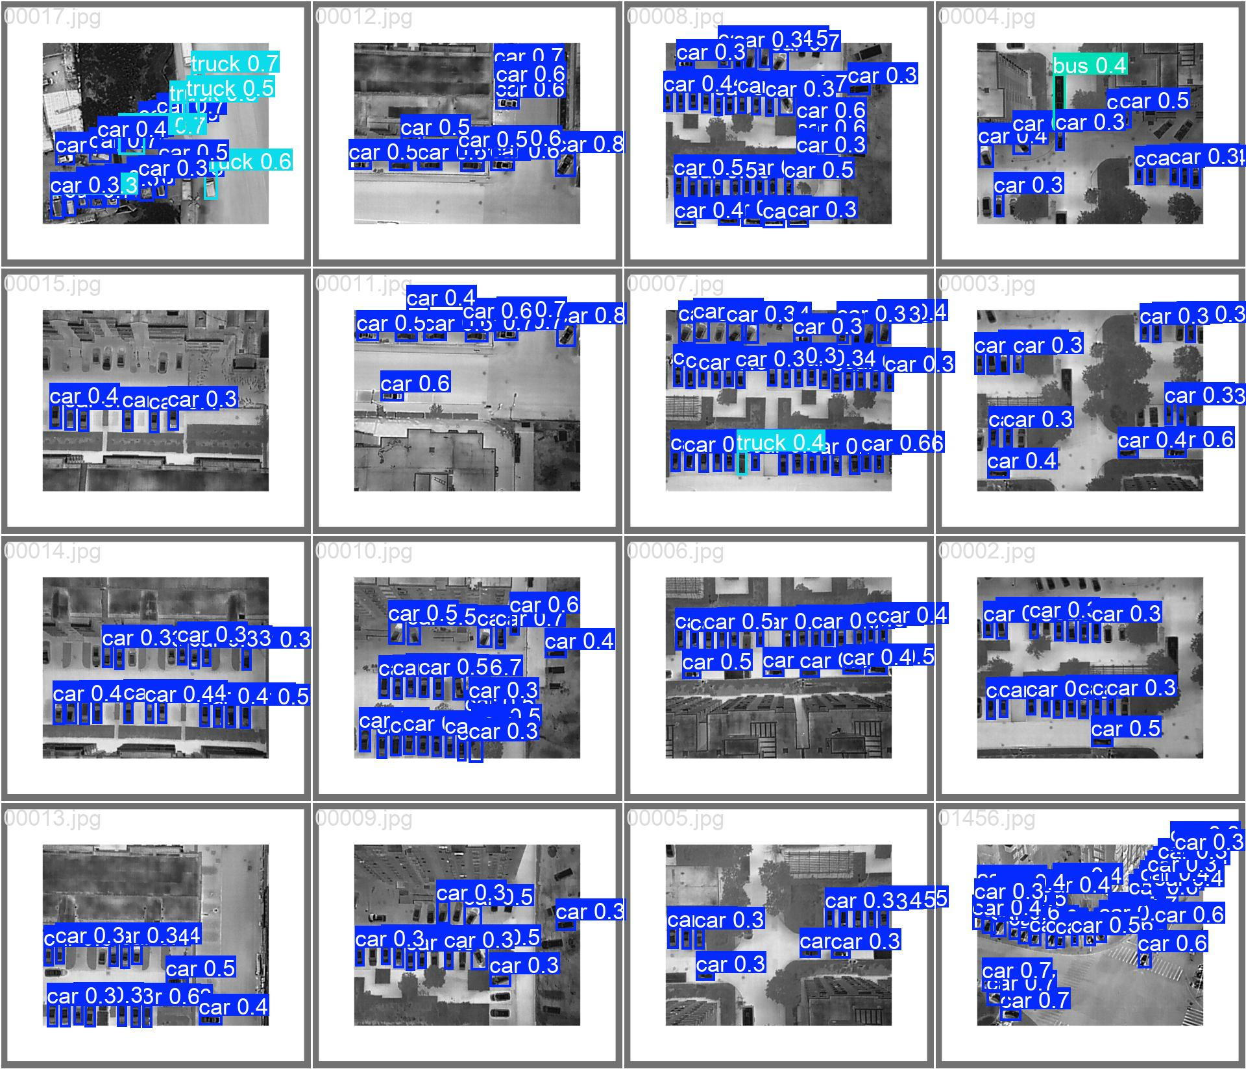
这是他的多模态模型
这是我的nano

Slide 11
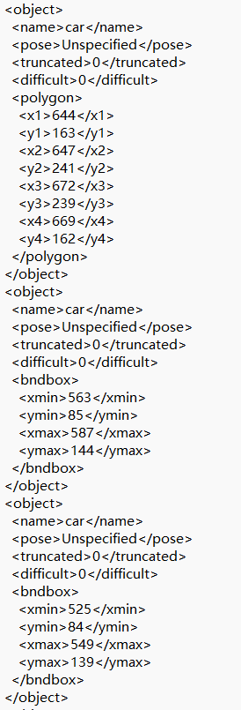
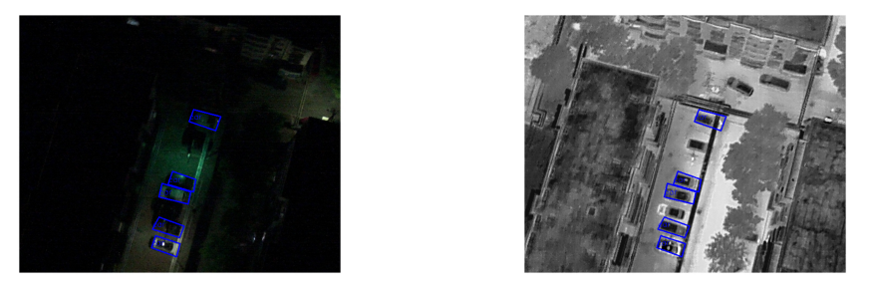
未知类别统计(Total: 6022)
- 'feright_car': 出现 6019 次
- 'feright': 出现 1 次
- '*': 出现 1 次
- 'truvk': 出现 1 次
Total Train Val
---------------------------------------------------------------
XML 文件数 19459 17990 1469
标注对象总数 309278 286815 22463
有效对象数 280645 259947 20698
缺失 Polygon 22611 21361 1250
未知类别 6022 5507 515
还存在标注缺失的情况

Slide 12
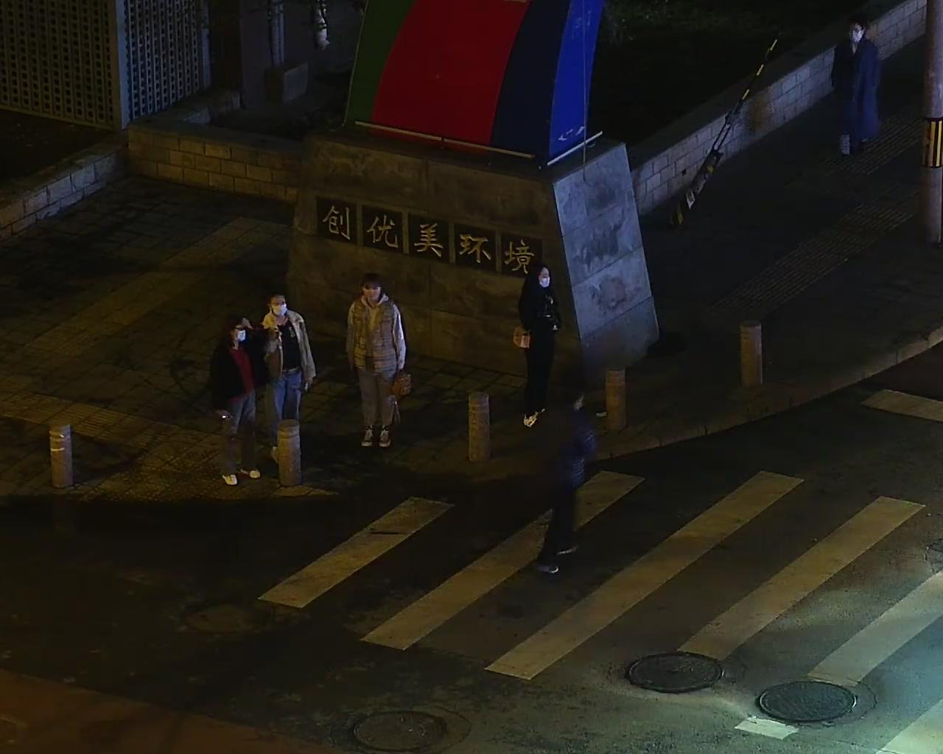
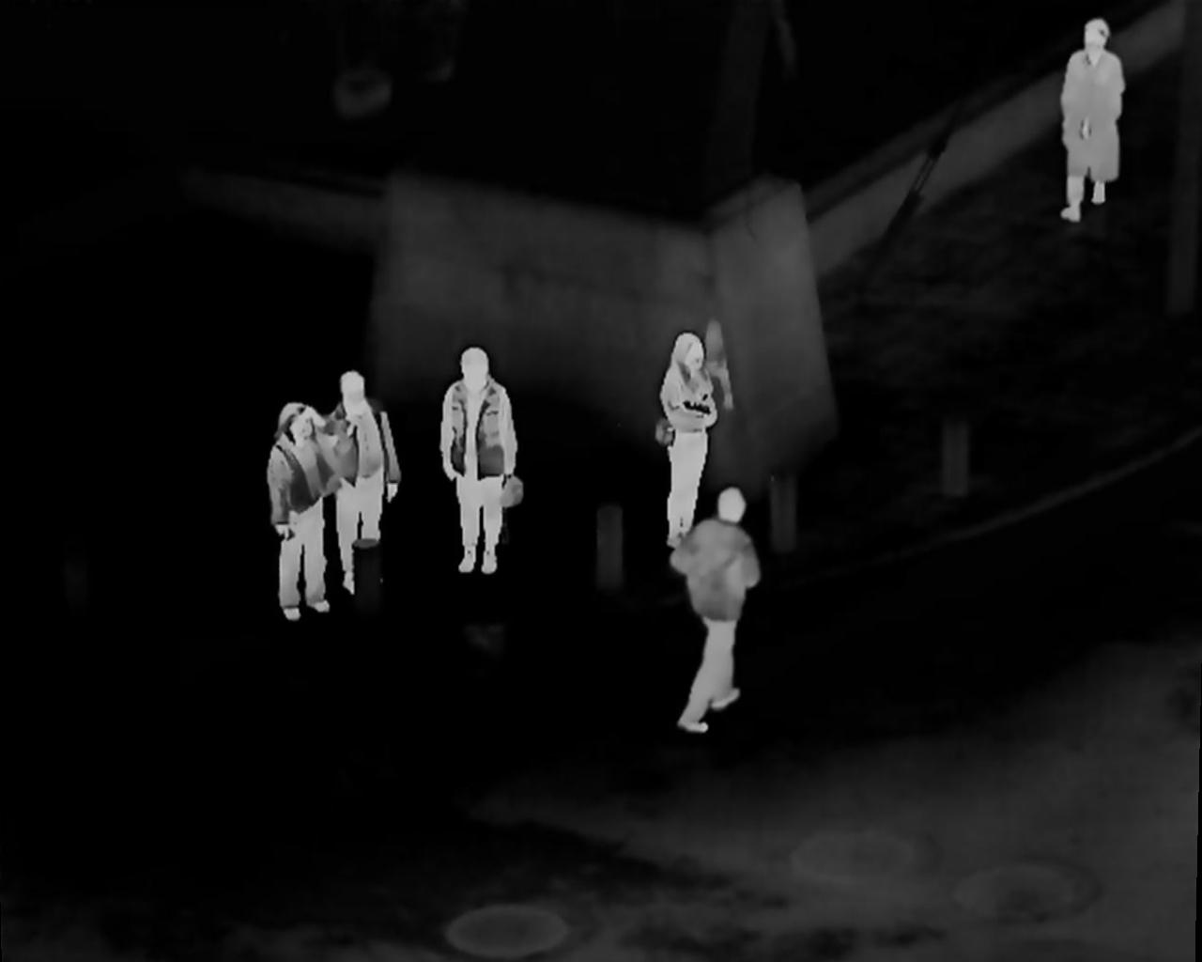
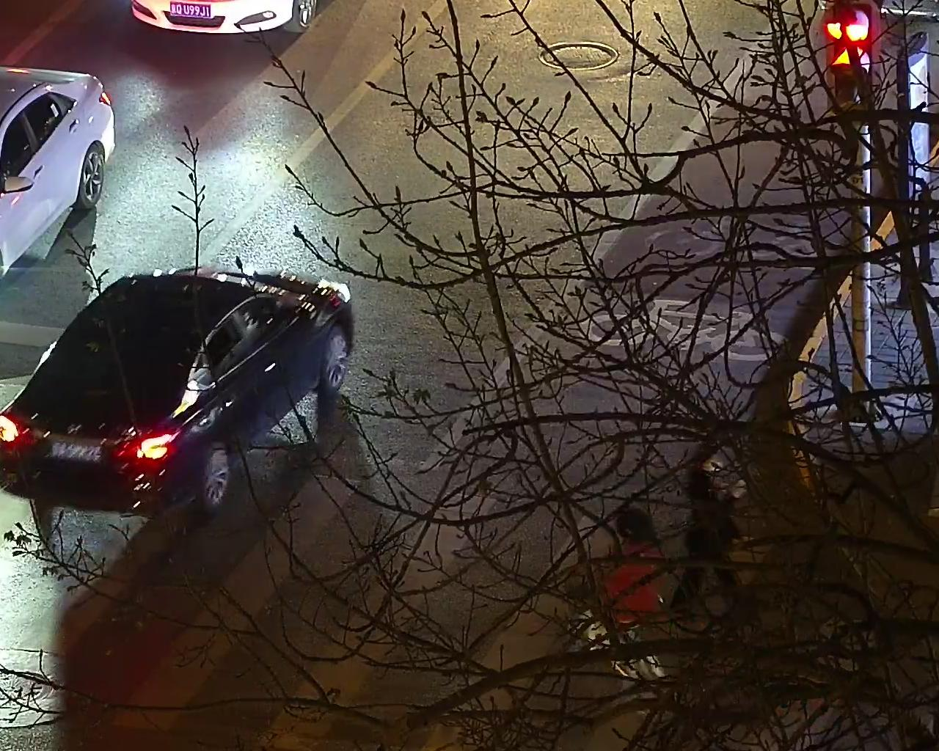
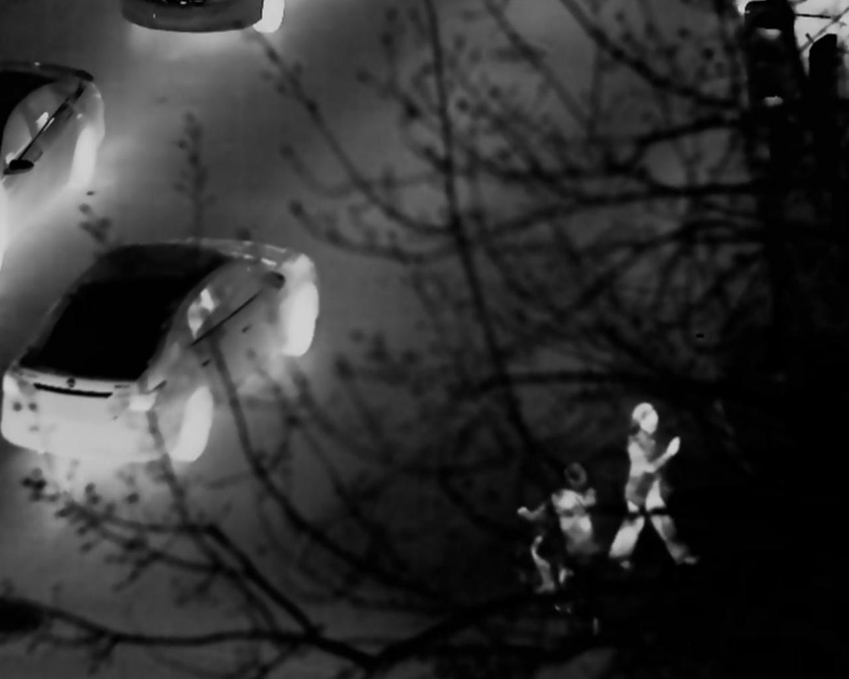
LLVIP
只有“人”一个类别

Slide 13
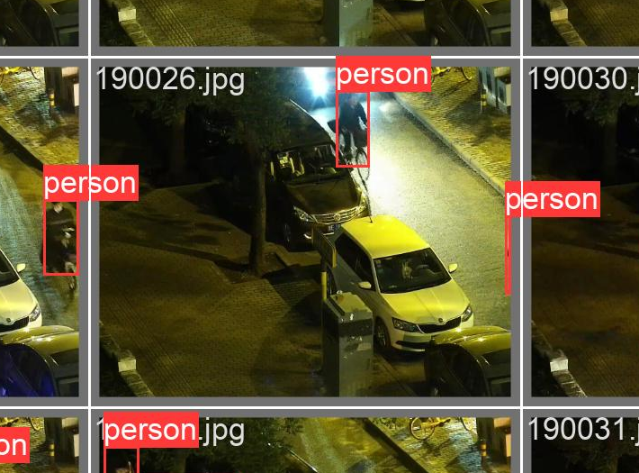
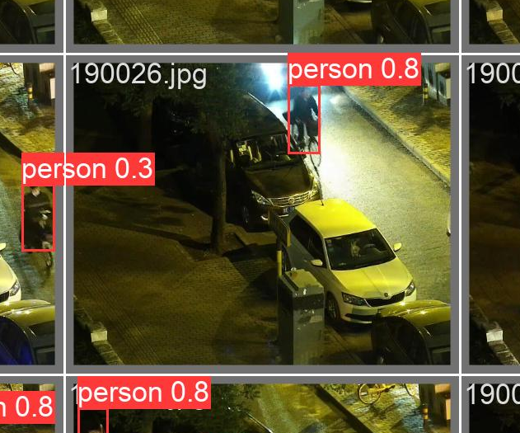
？

Slide 14
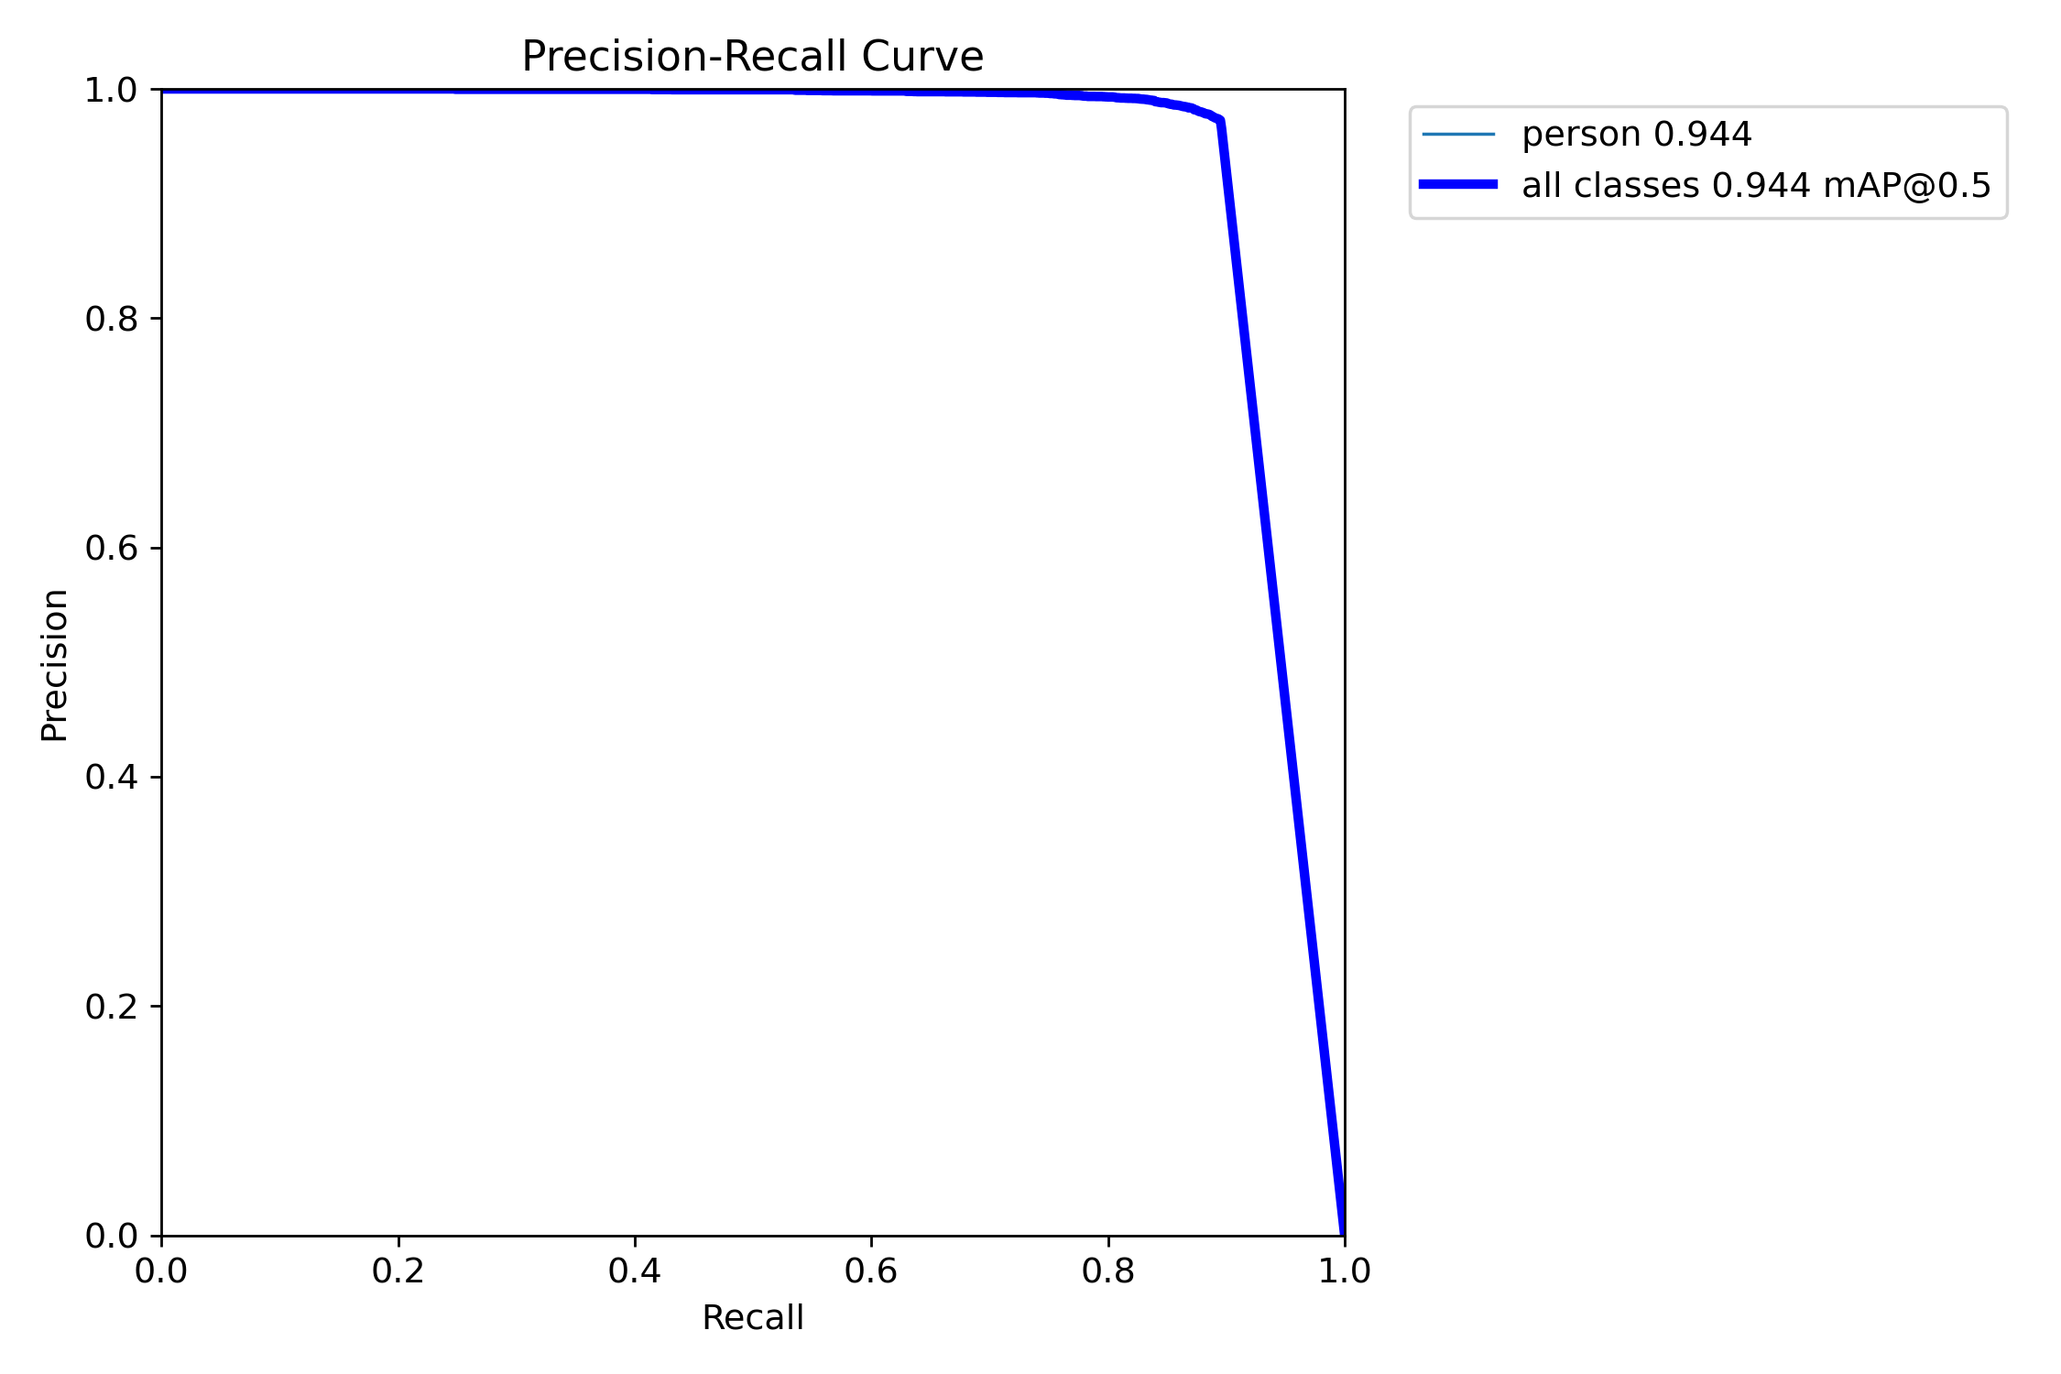
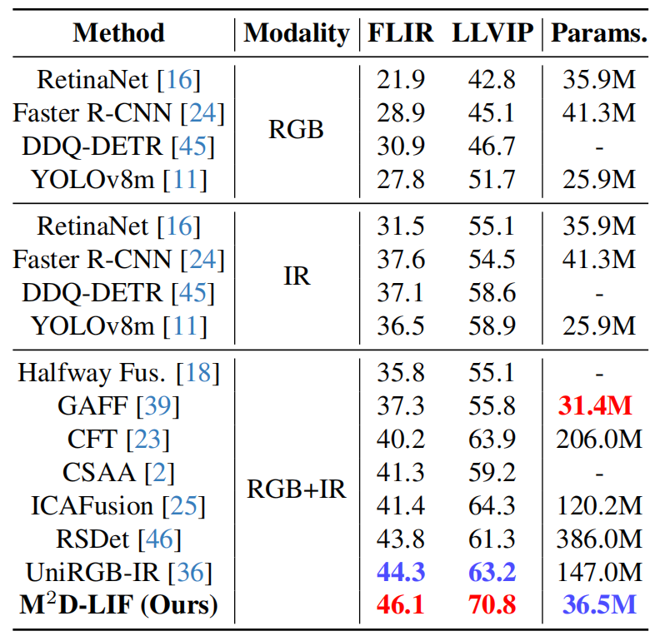
?
mAP@50-95在68.5
与论文的差别可能是我的数据集不怎么干净
YOLOv8-LIF summary (fused): 335 layers, 36508276 parameters, 0 gradients, 122.4 GFLOPs
val: Scanning D:\DeepLearning\Dataset\LLVIP_YOLO\labels\val... 3463 images, 0 backgrounds, 0 corrupt: 100%|██████████| 3463/3463 [00:01<00:00, 2770.41it/s]
val: New cache created: D:\DeepLearning\Dataset\LLVIP_YOLO\labels\val.cache
Class Images Instances Box(P R mAP50 mAP50-95): 100%|██████████| 3463/3463 [01:04<00:00, 53.49it/s]
all 3463 8302 0.972 0.895 0.944 0.685
Speed: 0.3ms preprocess, 12.5ms inference, 0.0ms loss, 0.9ms postprocess per image
用他的val代码，用它提供的模型

Slide 15
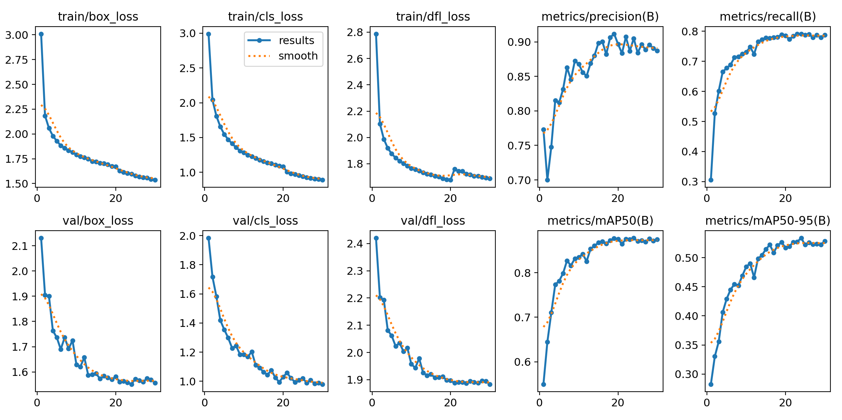
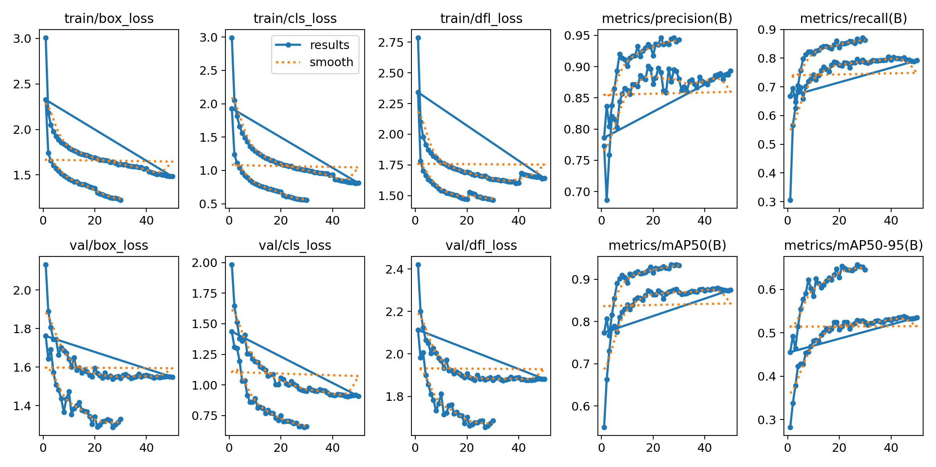
YOLOv8n RGB
mAP@50-95在52.8
YOLOv8n RGB
50epoch的那个
YOLOv8n IR
30epoch的那个
mAP@50-95在65.7
用他的val代码，用我的单模态n模型IR
YOLOv8n summary (fused): 168 layers, 3005843 parameters, 0 gradients, 8.1 GFLOPs
val: Scanning D:\DeepLearning\Dataset\LLVIP_YOLO\labels\val... 3463 images, 0 backgrounds, 0 corrupt: 100%|██████████| 3463/3463 [00:01<00:00, 2135.02it/s]
val: New cache created: D:\DeepLearning\Dataset\LLVIP_YOLO\labels\val.cache
Class Images Instances Box(P R mAP50 mAP50-95): 100%|██████████| 3463/3463 [00:31<00:00, 110.28it/s]
all 3463 8302 0.945 0.866 0.934 0.657
Speed: 0.2ms preprocess, 5.1ms inference, 0.0ms loss, 1.2ms postprocess per image

Slide 16
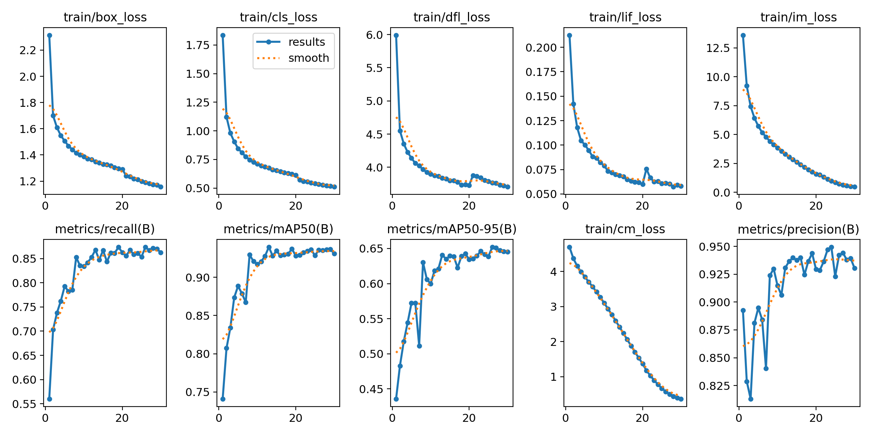
Epoch GPU_mem box_loss cls_loss dfl_loss lif_loss im_loss cm_loss Instances Size
1/1 16.6G 1.924 1.887 6.48 0.1261 7.274 4.303 7 1280: 100%|██████████| 6013/6013 [3:03:46<00:00, 1.83s/it]
Class Images Instances Box(P R mAP50 mAP50-95): 100%|██████████| 866/866 [04:38<00:00, 3.10it/s]
all 3463 8302 0.826 0.672 0.762 0.486
满血模型1 epoch
Epoch GPU_mem box_loss cls_loss dfl_loss lif_loss im_loss cm_loss Instances Size
1/1 4.72G 2.265 1.822 5.88 0.1833 12.24 4.587 10 640: 100%|██████████| 3007/3007 [07:59<00:00, 6.28it/s]
Class Images Instances Box(P R mAP50 mAP50-95): 100%|██████████| 433/433 [00:27<00:00, 16.01it/s]
all 3463 8302 0.842 0.669 0.788 0.451
n版1 epoch
YOLOv8n-LIF summary (fused): 255 layers, 4053332 parameters, 0 gradients, 17.4 GFLOPs
Class Images Instances Box(P R mAP50 mAP50-95): 100%|██████████| 217/217 [00:32<00:00, 6.58it/s]
all 3463 8302 0.936 0.867 0.941 0.657
Nnn多模态训练结果

Slide 17
YOLOv8n-LIF summary (fused): 255 layers, 4053332 parameters, 0 gradients, 17.4 GFLOPs
val: Scanning D:\DeepLearning\Dataset\LLVIP_YOLO\labels\val.cache... 3463 images, 0 backgrounds, 0 corrupt: 100%|██████████| 3463/3463 [00:00<?, ?it/s]
Class Images Instances Box(P R mAP50 mAP50-95): 100%|██████████| 3463/3463 [01:08<00:00, 50.45it/s]
all 3463 8302 0.942 0.874 0.936 0.652
Speed: 0.4ms preprocess, 8.6ms inference, 0.0ms loss, 1.0ms postprocess per image
用他的val代码，我的多模态nnn版
YOLOv8s summary (fused): 168 layers, 11125971 parameters, 0 gradients, 28.4 GFLOPs
val: Scanning D:\DeepLearning\Dataset\LLVIP_YOLO\labels\val.cache... 3463 images, 0 backgrounds, 0 corrupt: 100%|██████████| 3463/3463 [00:00<?, ?it/s]
Class Images Instances Box(P R mAP50 mAP50-95): 100%|██████████| 3463/3463 [00:29<00:00, 117.02it/s]
all 3463 8302 0.956 0.89 0.945 0.676
Speed: 0.2ms preprocess, 4.6ms inference, 0.0ms loss, 1.0ms postprocess per image
用他的val代码，yolo s ir
假设他的流程没问题（策略合理）
低光数据过多（上万张图片只有几张是白天）
场景中树过多
低光数据IR更加准确，模型更加倾向于相信IR
树过多导致RGB纹理信息噪声大
反而也能印证他的架构有自适应融合的能力（某种程度上也解答了“为什么不直接用L通道”的问题）
Echo归一化至0.3-0.7
我训练出来多模态效果差IR一些可能是因为epoch不够（曲线未完全收敛）
最小化无用模态影响
消除融合退化

Slide 18
backbone:
# [from, repeats, module, args]
- [ -1, 1, IN, [ ] ]
- [ -1, 1, Multiin, [ 1 ] ]
- [ 0, 1, Multiin, [ 2 ] ]
- [ 1, 1, LIF, [] ]
# Stream 1: RGB (from index 1)
- [ 1, 1, Conv, [ 64, 3, 2 ] ] # 4 P1
- [ -1, 1, Conv, [ 128, 3, 2 ] ] # 5 P2
- [ -1, 1, C2f, [ 128, True ] ] # 6
- [ -1, 1, Conv, [ 256, 3, 2 ] ] # 7 P3
- [ -1, 6, C2f, [ 256, True ] ] # 8
- [ -1, 1, Conv, [ 512, 3, 2 ] ] # 9 P4
- [ -1, 6, C2f, [ 512, True ] ] # 10
- [ -1, 1, Conv, [ 512, 3, 2 ] ] # 11 P5
- [ -1, 3, C2f, [ 512, True ] ] # 12
# Stream 2: IR (from index 2)
- [ 2, 1, Conv, [ 64, 3, 2 ] ] # 13 P1
- [ -1, 1, Conv, [ 128, 3, 2 ] ] # 14 P2
- [ -1, 1, C2f, [ 128, True ] ] # 15
- [ -1, 1, Conv, [ 256, 3, 2 ] ] # 16 P3
- [ -1, 6, C2f, [ 256, True ] ] # 17
- [ -1, 1, Conv, [ 512, 3, 2 ] ] # 18 P4
- [ -1, 6, C2f, [ 512, True ] ] # 19
- [ -1, 1, Conv, [ 512, 3, 2 ] ] # 20 P5
- [ -1, 3, C2f, [ 512, True ] ] # 21
# --- LIF Fusion Blocks ---
- [ [ 17, 8, 3 ], 1, LIFAdd, [ 3 ] ] # 22
- [ [ 19, 10, 3 ], 1, LIFAdd, [ 4 ] ] # 23
- [ [ 21, 12, 3 ], 1, LIFAdd, [ 5 ] ] # 24
- [ 24, 1, SPPF, [ 512, 5 ] ] # 25
基于跨模态知识蒸馏的无人机遥感实时目标检测
中间特征层蒸馏
backbone:
# [from, repeats, module, args]
- [ -1, 1, Conv, [ 64, 3, 2 ] ] # 0-P1/2
- [ -1, 1, Conv, [ 128, 3, 2 ] ] # 1-P2/4
- [ -1, 3, C2f, [ 128, True ] ]
- [ -1, 1, Conv, [ 256, 3, 2 ] ] # 3-P3/8
- [ -1, 6, C2f, [ 256, True ] ]
- [ -1, 1, Conv, [ 512, 3, 2 ] ] # 5-P4/16
- [ -1, 6, C2f, [ 512, True ] ]
- [ -1, 1, Conv, [ 1024, 3, 2 ] ] # 7-P5/32
- [ -1, 3, C2f, [ 1024, True ] ]
- [ -1, 1, SPPF, [ 1024, 5 ] ] # 9

Slide 19
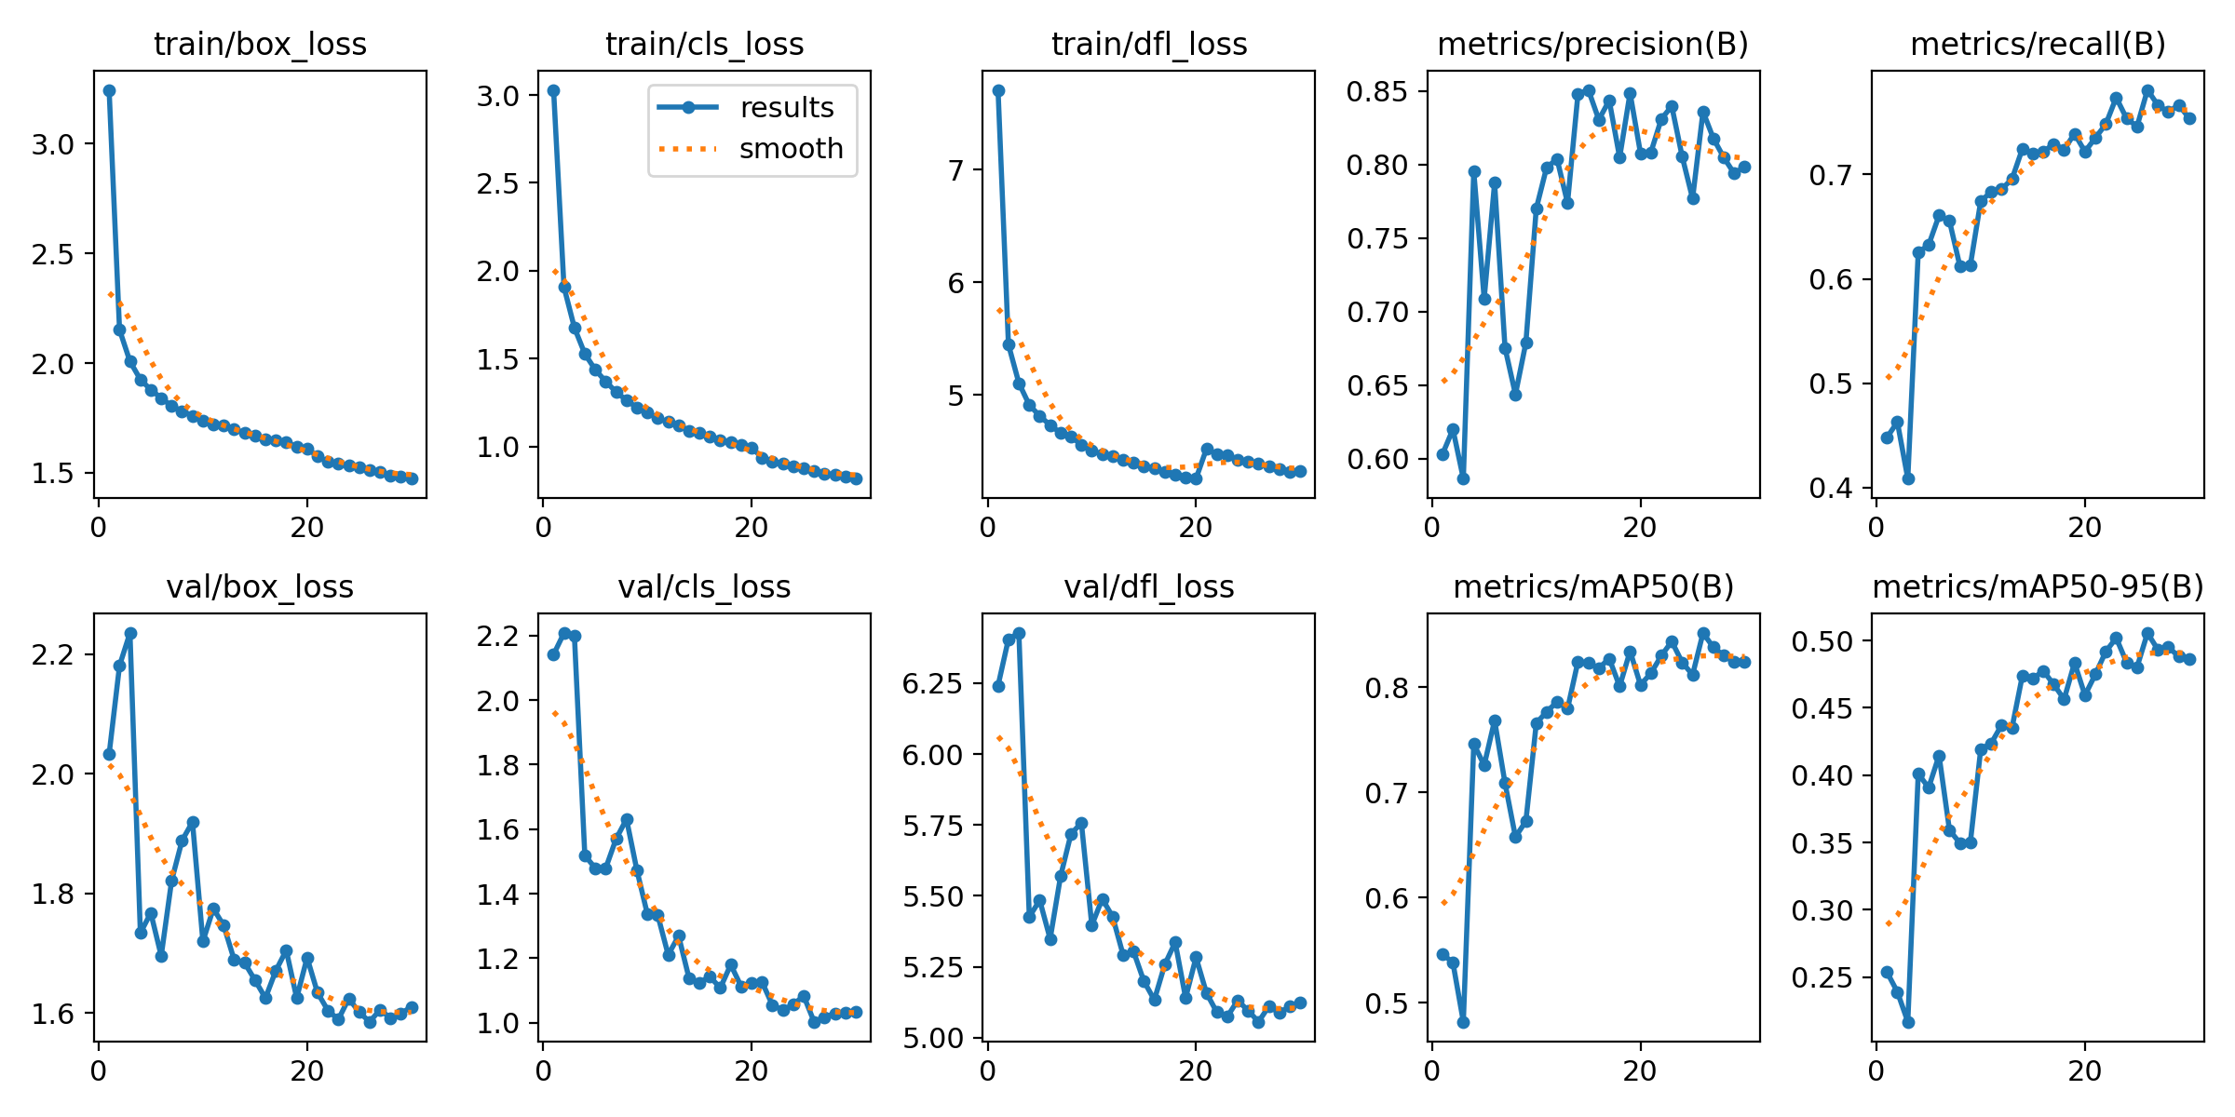
YOLOv8n summary (fused): 168 layers, 3005843 parameters, 0 gradients, 8.1 GFLOPs
Class Images Instances Box(P R mAP50 mAP50-95): 100%|██████████| 109/109 [00:19<00:00, 5.51it/s]
all 3463 8302 0.838 0.764 0.854 0.508
Speed: 0.2ms preprocess, 2.2ms inference, 0.0ms loss, 0.9ms postprocess per image
CWD蒸馏结果 30epoch
50 epoch 效果类似
YOLOv8n RGB
mAP@50-95在52.8
Nnn多模态
mAP@50-95在65.7
没有baseline效果好
Baseline作为教师的教师，模型不如教师是合理的
作为测试，训练策略不对，应该用s/m当老师测试这个想法
数据集对RGB不怎么友好
老师依赖IR较多，但单一RGB学生难以学习自己看不见的表征
可以训练MM2IR测试一下这个想法
LIF模块与YOLO标准特征层差距较大
蒸馏细节有误，梯度不稳定
没用PKD，只用了CWD，如果CWD糟糕，那么PKD只会更糟糕

