Slide 1
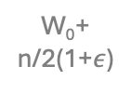






T₀
w₀
₁
_{k-}$ε$
₁
_{k-}$ε$
_{k-}$ε$
k
1+ $$ε$$
k
1+ $$ε$$
1+ $$ε$$
W₀+ n/2(1+$ε$)
w₀
T₁
T₂
T₃
T₄
T_{n}
P₁
T₀
T₂
T₄
T₆
T_{n}
P₂
c₀₁
T₁
P₃
c₀₃
T₃
For $k>εn/2$, the cost of the optimal solution is $k+n/2$
P₄
c₀₅
T₅
c_{0 n-1}
T_{n-1}

Slide 2
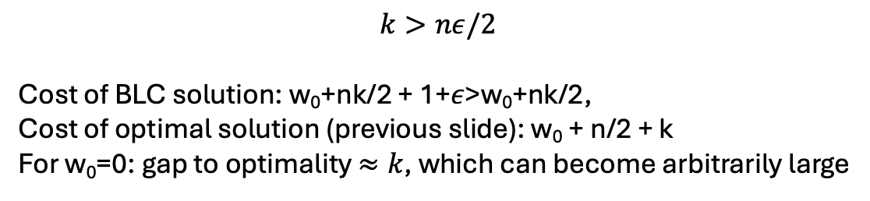
$$k>nε/2$$
Cost of BLC solution: w₀+nk/2 + 1+$ε$>w₀+nk/2,
Cost of optimal solution (previous slide): w₀ + n/2 + k
For w₀=0: gap to optimality $≈k$, which can become arbitrarily large
W₀+
k
W₀+
2k
W₀+
3k
W₀+ nk/2
w₀
P₁
T₀
T₁
T₃
T₅
T_{n-1}
P₂
c₀₂
T₂
P₃
c₀₄
T₄
P₄
c₀₆
T₆
c_{0n}
T_{n}

