Slide 1

Project Name: OcnoBrain AI
Team Name: Maryam Naeem
Group:Track1
Theme: good health and wellbeing.

Slide 2


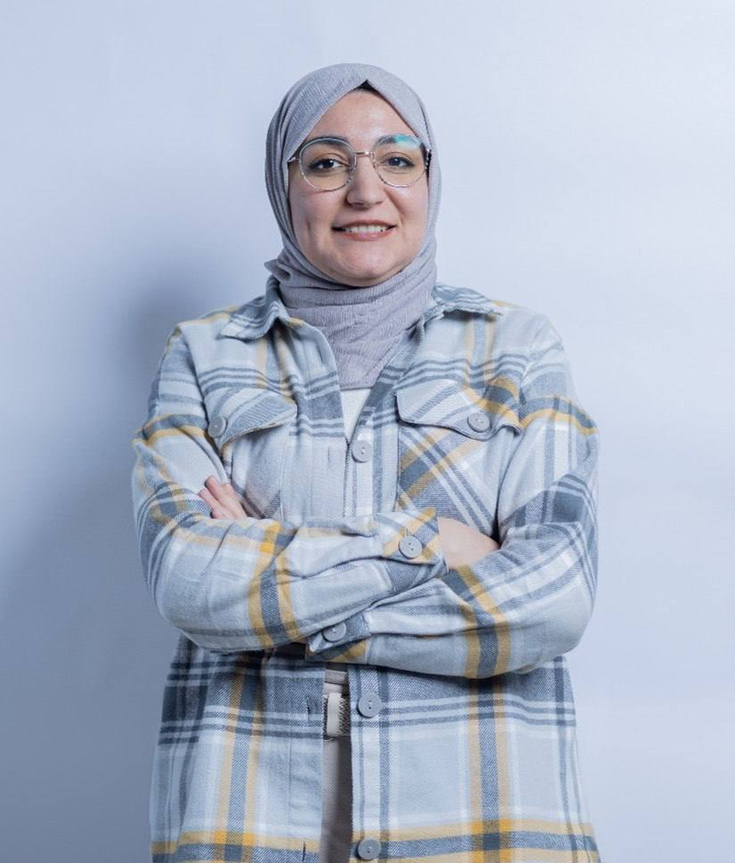
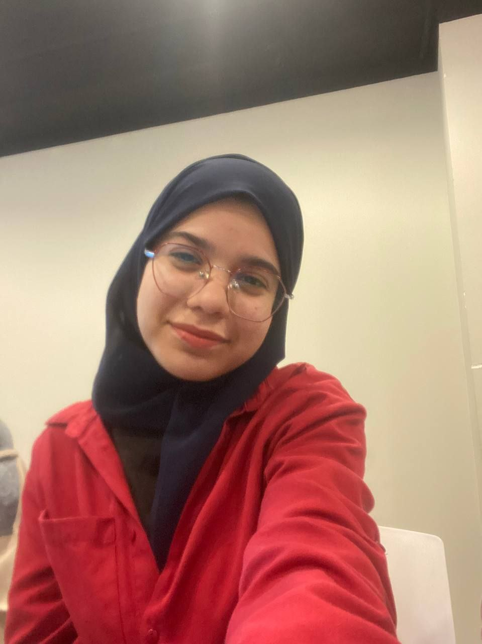
Codeavour 6.0 International
Team Member: Maryam Naeem
Mentors: Fatima Jassim,

Slide 3
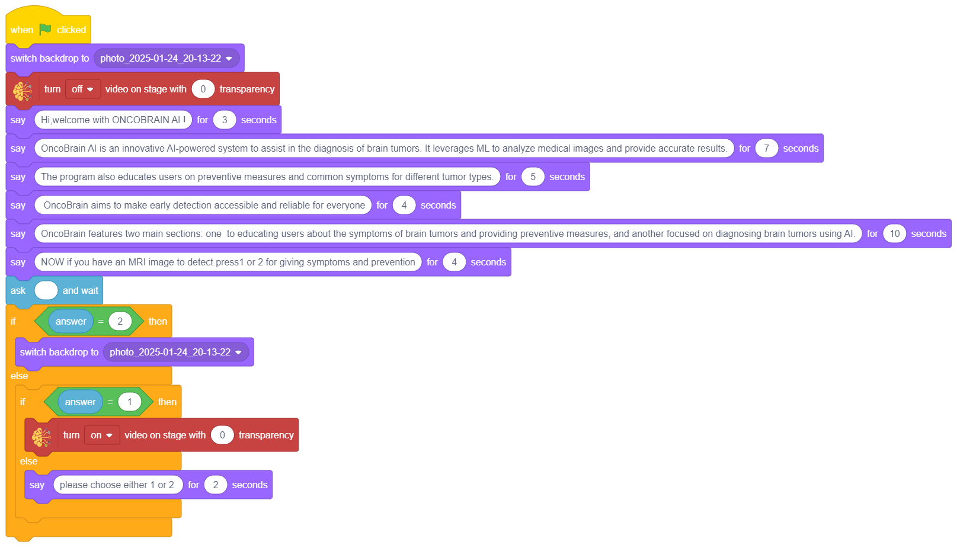
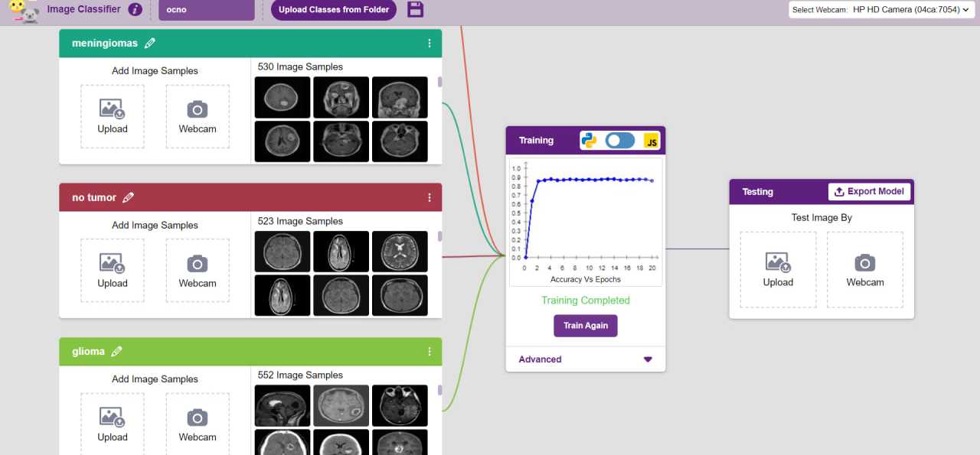
Add Image
Good health and wellbeing
OcnoBrain AI
This project uses artificial intelligence to diagnose brain tumors from MRI images, providing users with detailed information on symptoms, prevention,
and tumor types.
It aims to enhance early diagnosis, raise awareness, and improve healthcare accessibility, particularly in remote areas.
Add Image
Add Image

Slide 4

Problem
Hospitals often face overcrowding, leading to long waiting times for diagnostic results. This delay can be critical, as every minute counts in determining a patient's treatment and survival chances.
Medical students and radiology trainees need reliable tools to enhance their learning and improve accuracy in interpreting medical images.
Another major issue is the lack of awareness about preventive measures for brain tumors. Many cases could be avoided or detected earlier if people had better knowledge of risk factors and symptoms.

Slide 5

Solution
I found the solution by developing this project, which relies on artificial intelligence and machine learning to address all these issues in an efficient and practical way. I trained the model using 2073 of medical images, enabling it to analyze MRI scans quickly, reducing hospital waiting times and easing overcrowding.
This solution is not limited to doctors; it also simplifies diagnosis for the general public and supports medical students, radiology trainees, and physics students, helping them learn and improve their skills in interpreting medical images. Additionally, the system acts as a reliable assistant for doctors, minimizing diagnostic errors and providing fast, accurate support

Slide 6
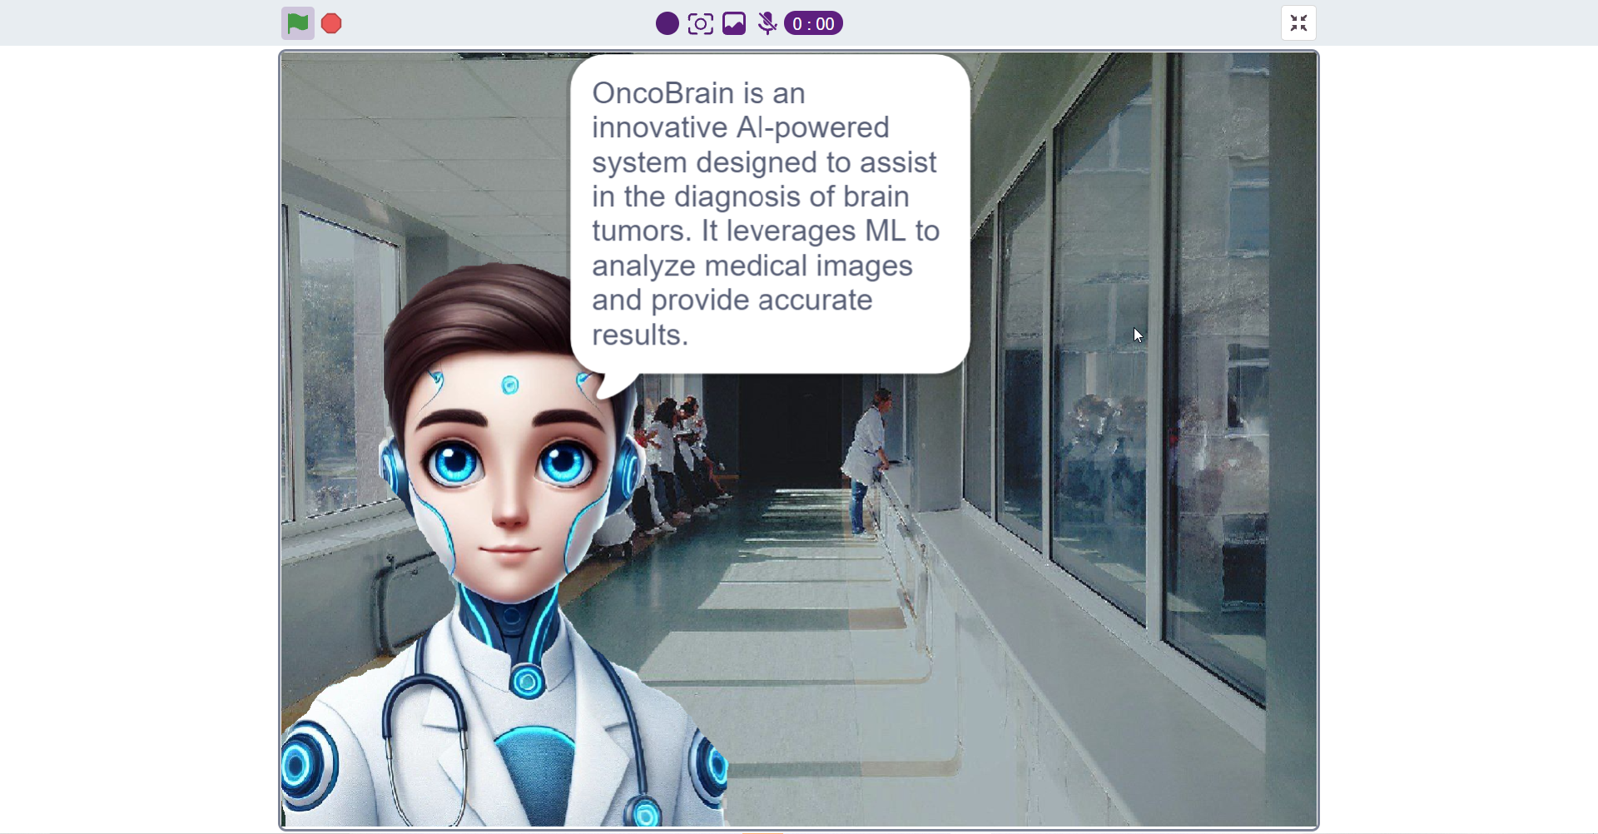
Solution
Currently this program can recognize 3 types of tumors:
Glioma
Meningioma
Pitutary tumor in addition to normal brain tumors
I tested the efficiency of this program with several different pictures and I found that its accuracy more than 85%
Moreover ,I added another section which dedicated to give definitions, symptoms, prevention ,and the shape or structure of each type of these tumors.

Slide 7
What sets this project apart from similar ones is its focus on integrating artificial intelligence for brain tumor diagnosis in a simple and user-friendly way, while also providing additional information such as symptoms, prevention methods, and the various forms of tumors. This combination of diagnosis and preventive advice makes the project comprehensive, assisting both medical students and the general public in better understanding the disease.
Furthermore, the project is scalable, allowing for the addition of other types of tumors, expanding its scope to eventually cover tumors across the entire body. Its ease of use also makes it accessible to people in remote areas, who may not have regular access to specialized doctors.
These factors make this project unique in improving healthcare and raising awareness, contributing to better quality of life for individuals globally.

Slide 8
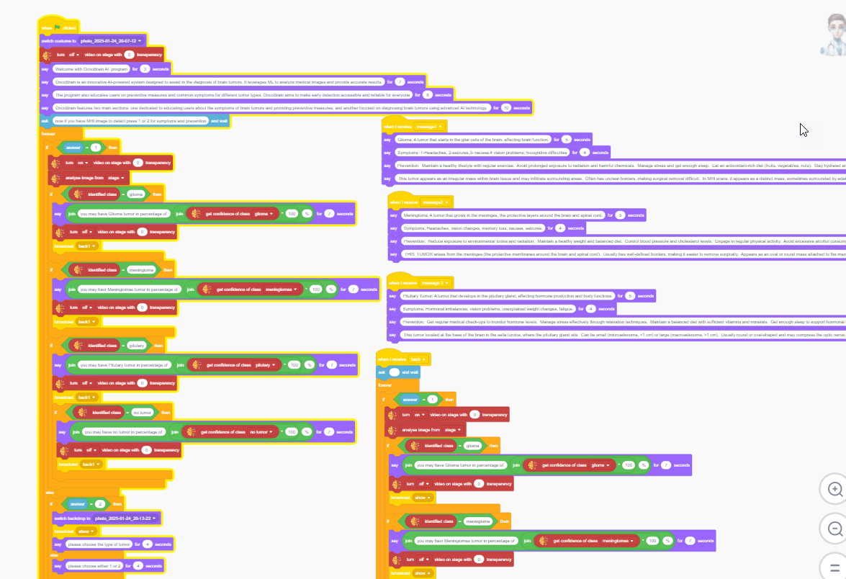

Insert Feature Image of Your Project
I AM A YOUNG INNOVATOR
THANK YOU!
www.codeavour.org

