Slide 1
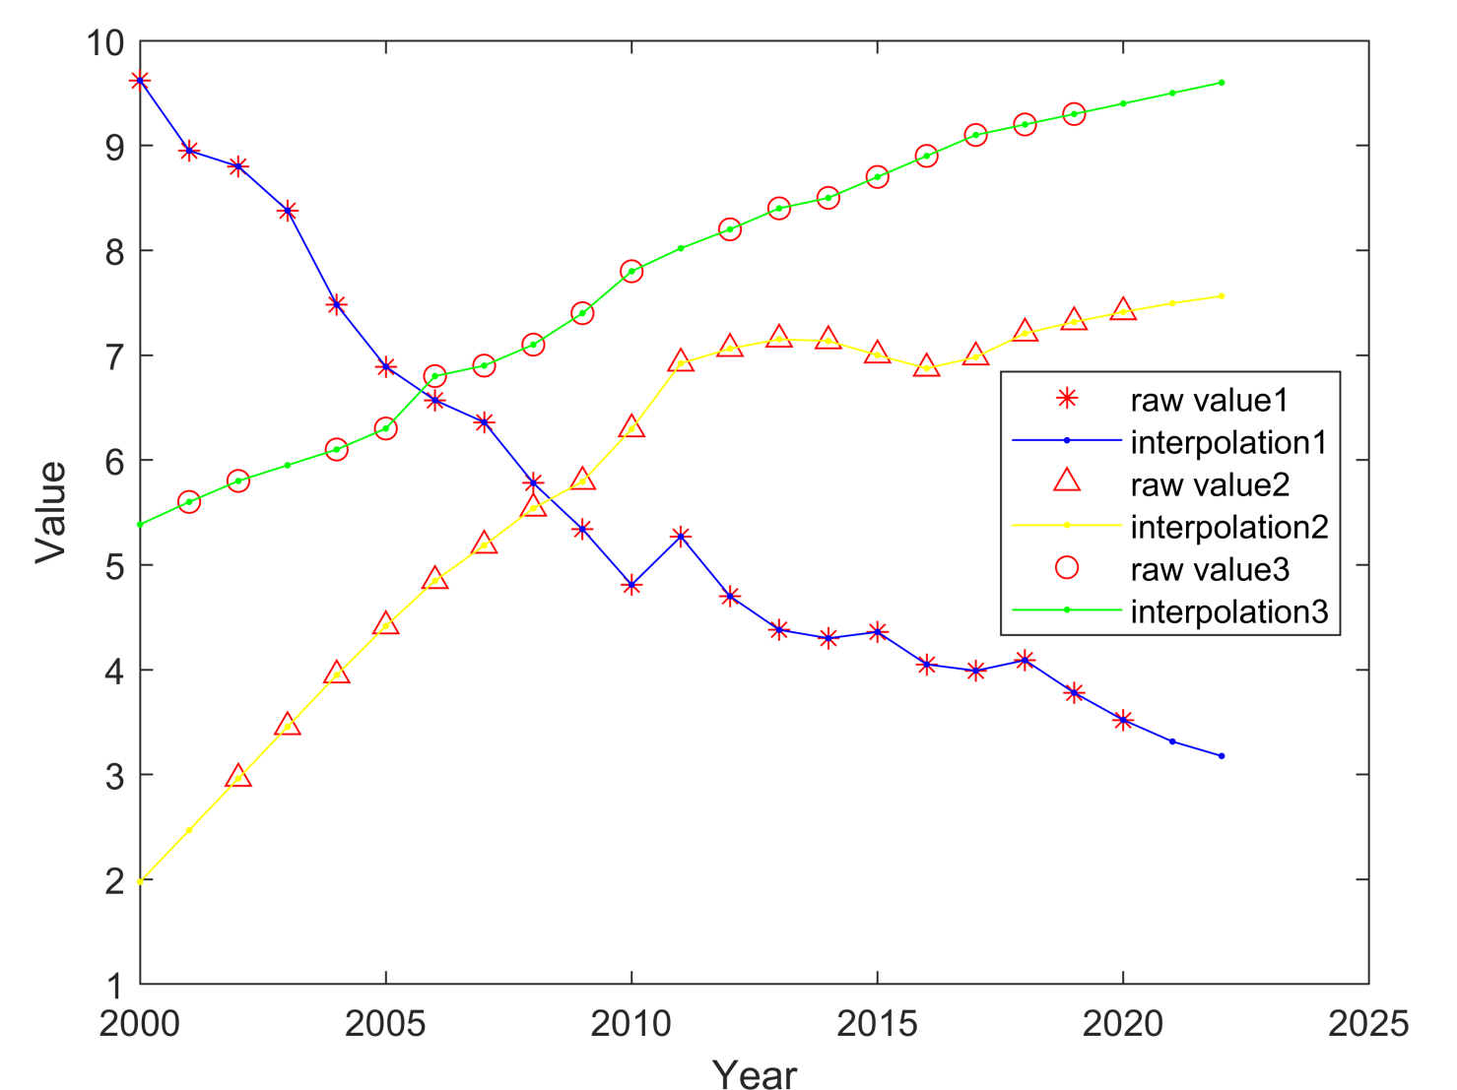
In the Middle
At the Head
At the End

