Slide 1
InsuranceMantra
Web Development Tools & Methods
-Jyoti sharma

Slide 2
Choice of Topic
Insurance is very much needed. But from a huge policy provider market which one to go for?
Multiple vendor at one place.
We can look for multiple policy plans from one place and request a quote for the same from the provider.

Slide 3
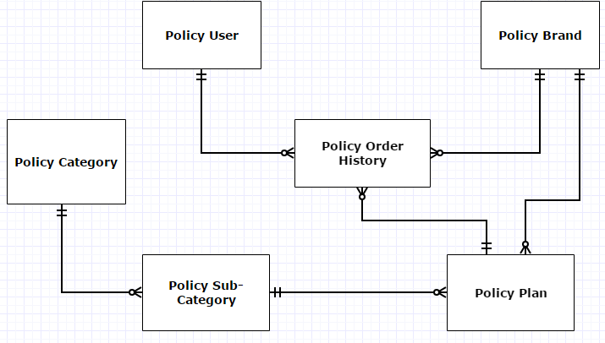
Database Design

Slide 4
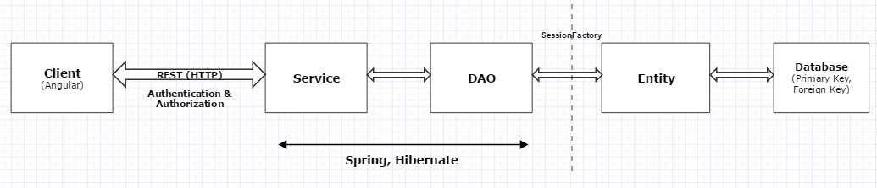
Application Architecture

Slide 5
Application Flow- roles and responsibilities
Roles:
Guest
No login required.
Can view all the Categories, Subcategories, Brand and respective Plans.
Registered Customer
Can view all the Categories, Subcategories, Brand and respective Plans.
Request a Quote for a particular policy.
View his profile and order history.
Edit his profile.

Slide 6
Application Flow- roles and responsibilities
Seller
View his profile
Edit his profile
Add a new Policy Plan
View existing Policy Plans
Edit the Policy Plan list
Admin
Login and look at his Dashboard which reports
Total Policies
Total Categories
Total Sub-categories
Total Sellers

Slide 7
Application Flow- roles and responsibilities
Total Customers
Policies created today
Orders closed today
Total Orders
Create Policy Category and edit the list
Create Policy Sub-category and edit the list
Add Policy Plan and edit the list
View Seller/Brand List
Activate/ Disable Seller/Brand

Slide 8
KPI(s)
Best Selling Brand
Top 3 Policies based on no. of order placed for the Plan Policies.
For Admin– Report on dashboard.
Total Policies
Total Categories
Total Sub-categories
Total Sellers
Total Customers
Policies created today
Orders closed today
Total Orders

