Slide 1
HCP model: Single-label to Multi-label
By Zhangliliang

Slide 2
Characteristics
No bbox groundtruth needed while training
HCP infrastructure is robust to noisy
No explicit hypothesis label (reason: use CNN)
Pre-train CNN from ImageNet
Outputs as multi-label predictions

Slide 3
Overview
The Model overview
Hypotheses Extraction
BING
Normalized Cut
Initialization of HCP(Hypotheses-CNN-Pooling)
Hypotheses-fine-tuning
Testing
Result

Slide 4
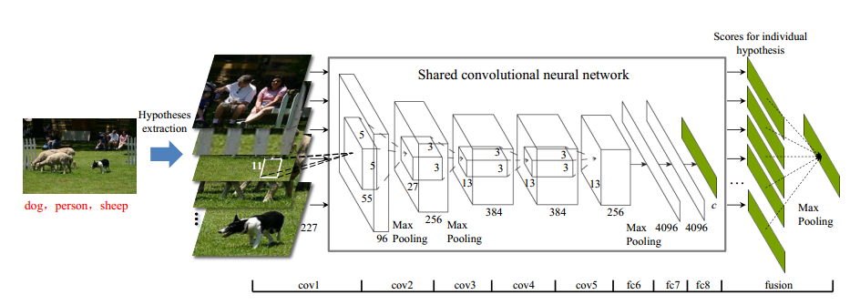
The Model of View

Slide 5
BING’s idea(1)
What is an object? What is objectness?
This work is motivated by the fact that objects are stand-alone things with well-defined closed boundaries and centers [3, 26, 32].
Objectness is usually represented as a value which reflects how likely an image window covers an object of any category
[3] B. Alexe, T. Deselaers, and V. Ferrari. Measuring the objectness of image windows. IEEE TPAMI, 34(11), 2012
[26] D. A. Forsyth, J. Malik, M. M. Fleck, H. Greenspan, T. Leung, S. Belongie, C. Carson, and C. Bregler. Finding pictures
of objects in large collections of images. Springer, 1996.
[32] G. Heitz and D. Koller. Learning spatial context: Using stuff to find things. In ECCV, pages 30–43. 2008.

Slide 6
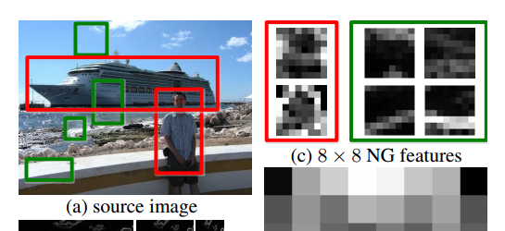
BING’s idea(2) 8*8 NG feature
NG for “Normed Gradient”:

Slide 7
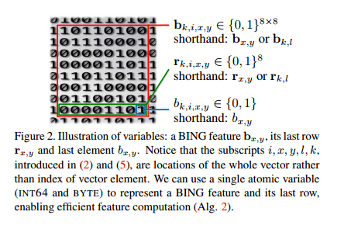
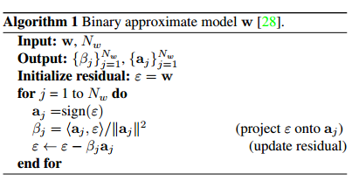
BING’s idea(3):From NG to BING
Purpose: speed up
Extremely fast: 3ms per image on i7 CPU
Idea: use binary to estimate the NG feature (i.e. BING=BInary+NG), then we can use bit operation by SSE2 instructions to boost the speed.

Slide 8
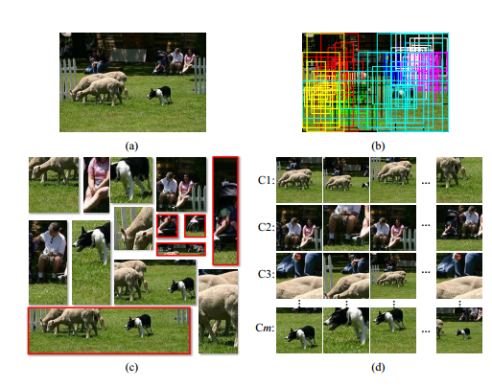

BING + Normalized Cut
(a) original image
(b) use Normalized Cut to cluster the-BING-generated-proposals.
Cluster matrix:
(c) filter out the small or high-ratio proposals.
(d) for each of the m clusters, pick up top k as the final proposals

Slide 9
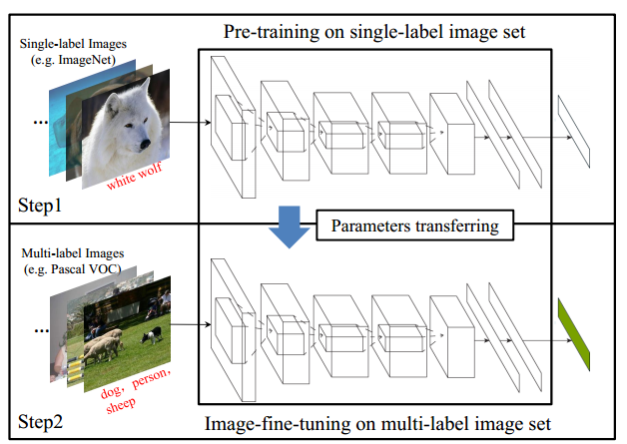
Initialization of HCP: overview
Step1: pre-training on single-label image set
Step2: Image-fine-turning on multi-label image set

Slide 10
Initialization of HCP: step1
Step1: pre-training on single-label image set
Model: AlexNet(5conv+3full+softmax)
Data: ImageNet(1000 class, 120w train samples)
Crop 227*227
Learning rate:0.01
90 epochs

Slide 11
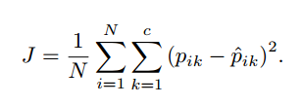


Initialization of HCP: step2
Step2: Image-fine-turning on multi-label image set
Loss function:
N: num of train samples
c: num of class (e.g. in VOC c=20)
Each train sample gt label as
Thus, p means the normed probalility:

Slide 12
Initialization of HCP: step2
More training detail
Copy parameter from pre-train model layers except the last full-conn layer
Learning rate differ:
lr@conv=0.001
lr@full1&full2=0.002
lr@full3=0.01

Slide 13
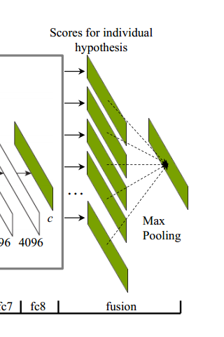

Hypotheses-fine-turning
Why can use no bbox gt?
Based Assumption:
each hypothesis contains at most one object
all the possible objects are covered by some subset of the extracted hypotheses.
Cross-hypotheses max-pooling:
Training as the I-FT

Slide 14
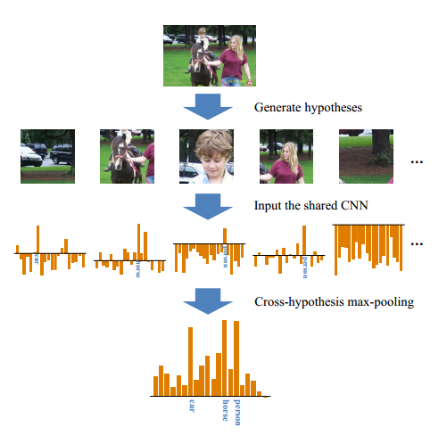
Review the model and Testing
An illustration of the proposed HCP for a VOC 2007 test image.
The second row indicates the generated hypotheses.
The third row indicate the predicted results for the input hypotheses.
The last row is predicted result for the test image after cross-hypothesis max-pooling operation.

Slide 15
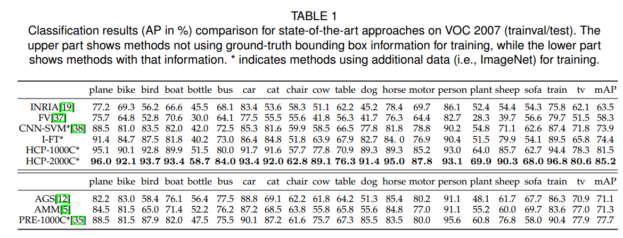
Result on VOC2007

Slide 16
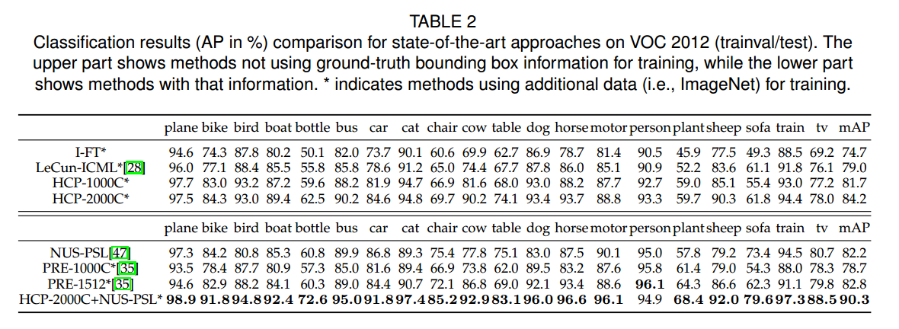
Results on VOC2012

Slide 17
Thanks

