Slide 1
R-CNN
By Zhang Liliang

Slide 2
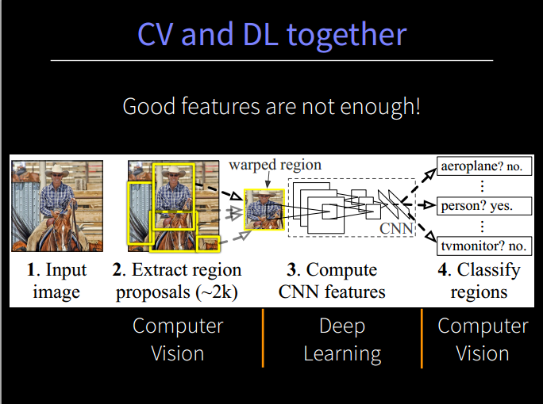
Main idea: good features are no enough
VOC07: mAP:35.1% -> 58.5%

Slide 3
Overview
(1) the model of R-CNN
(2) the result of R-CNN
(3) some discussions
Visualizing learned feature in CNN
Ablation Studies
Object proposal transformations
Bounding-box regression
Positive vs. Negative examples and softmax

Slide 4
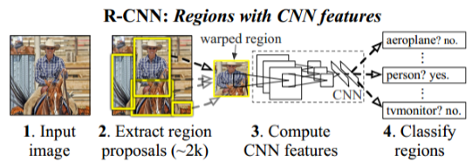
Model OverView
(1) Use Selective Search(IJCV13) to get the region proposals
(2) for each proposal, use CNN to get the Features(from the fc7 of AlexNet)
(3) input the feature to all of the cls-specified SVM to predict scores
(4) Rank the scores to get the final solution
(5) post-processing: class-specific regression on detection results

Slide 5
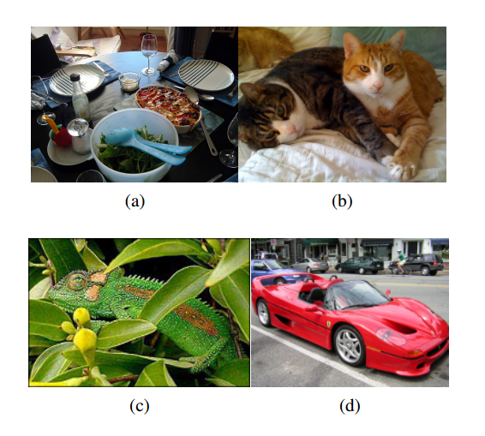
Why using segmentation and multi-strategy grouping can find Objs?
(a) an image is intrinsically hierarchical
(b) color helps to distinguish the objs
(c) texture helps to distinguish the objs
(d) “enclosed relation” helps to distinguish the objs

Slide 6
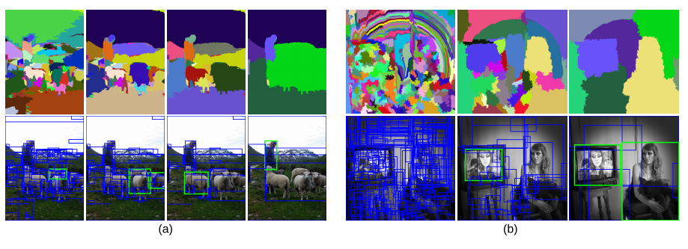
Selective Search
Selective Search
(1) Use [13] to get the smallest segment
(2) Use multi-strategy grouping to merge the two segments with the max similarity to form a big segment
(3) on and on until all segments merge to the whole image.
(4) rank all the segments and generate the bboxes
[13] P. F. Felzenszwalb and D. P. Huttenlocher. Efficient GraphBased Image Segmentation. IJCV, 59:167–181, 2004. 1, 3,
4, 5, 7

Slide 7
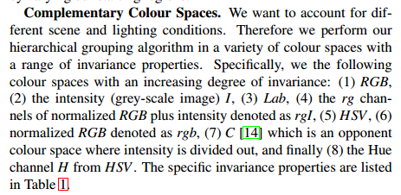
multi-strategy grouping
(1)multiply color space
(2) multiply measurements of distances between two segments: color, texture, enclose relation….

Slide 8
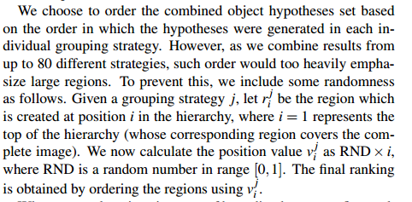
How to get a score to rank the segments?
Randomness on hierarchy:

Slide 9
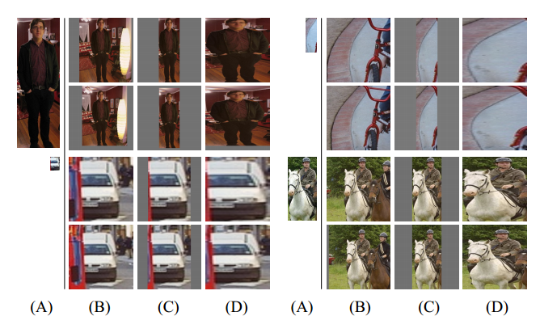
Feature Extraction: fc7 at AlexNet
warp the region proposal to 227*227( add 16 pixels border as context padding)

Slide 10
Feature Extraction: fc7 at AlexNet
use ImageNet classification dataset(120w) to pre-train a model, with 1000 way softmax outputs.
Use the pretrain model to fine-tuning a domain-specific CNN, with (N+1) way softmax outputs.(“1” for the background)
IoU > 0.5 as positive samples, otherwise as negative samples
Learn rate set as 0.001(1/10 of in initial pre-training rate)
Batch=128, 32 positive samples and 96 negative samples

Slide 11
Cls-specific L-SVM
For each class, train a Linear-SVM to distinguish it from the background.
IoU>0.5 as the positive samples
IoU<0.3 as the negative samples(why not 0.5? For mAP fell down by 5%)

Slide 12
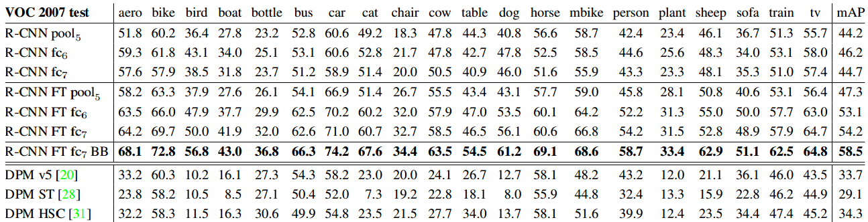
Results on PASCAL
35.1% -> 58.5%

Slide 13
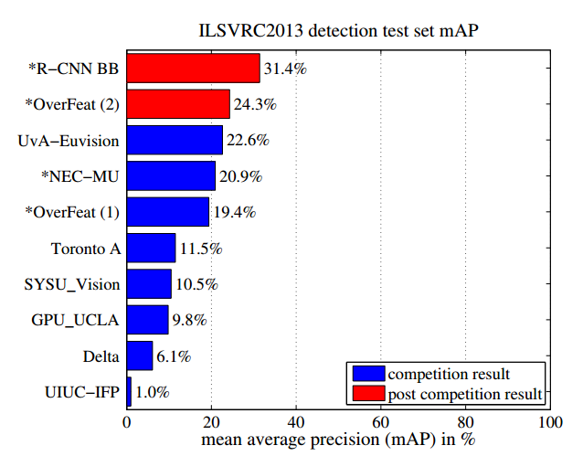
Result on ImageNet
24.3% -> 31.4%

Slide 14
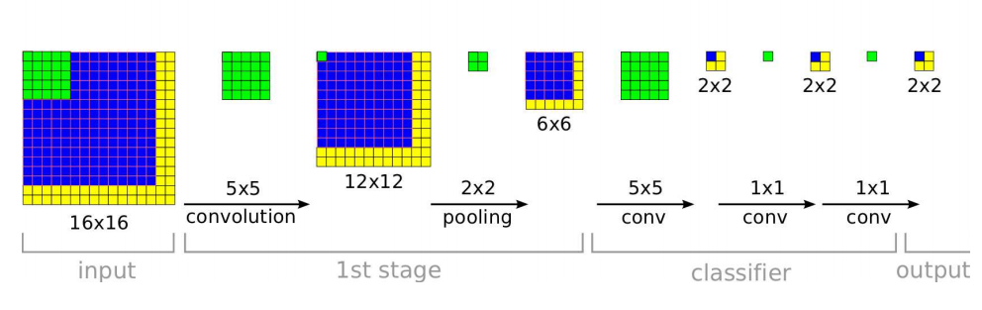
Discuss1:Visualizing learned feature in CNN
1 neturon at pool5 “see” 195*195 pixel in the image of 227*227

Slide 15
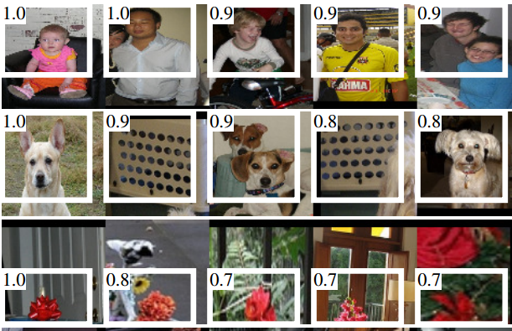
Discuss1:Visualizing learned feature in CNN
Select a spesical neutron at pool5
Compute the activations of 10M proposals
Rank and select the highest ones of NMS

Slide 16
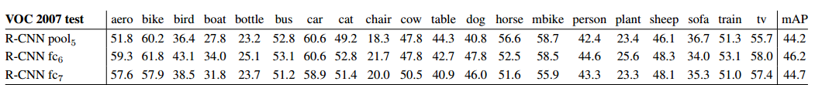
Discuss2: Ablation studies
Without fine-tuning:
“Much of the CNN representational power comes from its conv layers”
With fine-tuning
“most of the improvement is gained from learning domain-specific non-linear classifiers on top of them”

Slide 17
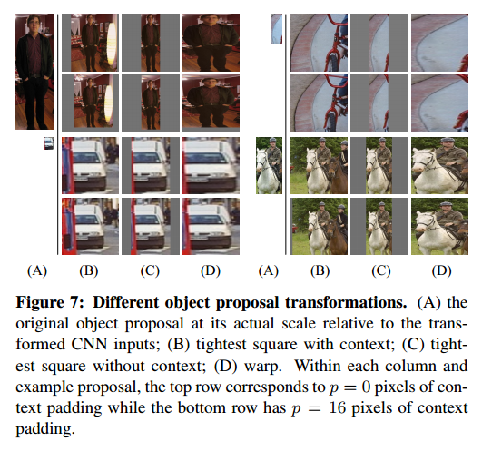
Discuss3:Object proposal transformations
Add some context can helps classification(3~5% mAP)

Slide 18
Discuss4: Bounding-box regression
After getting the detection bbox, process a regression to local the obj more precisely. (3~4% mAP)
It make sense for the 16-pixel context padding in the bbox.

Slide 19
Discuss 5:Positive vs. Negative examples and softmax
To train CNN, IoU<0.5 as negative samples, while to train SVM, IoU<0.3 as negative samples. (5% mAP)
Softmax vs SVM, 50.9% vs 54.2%, for SVM can use hard negative samples specific for each class.

Slide 20
Thanks

