Slide 1

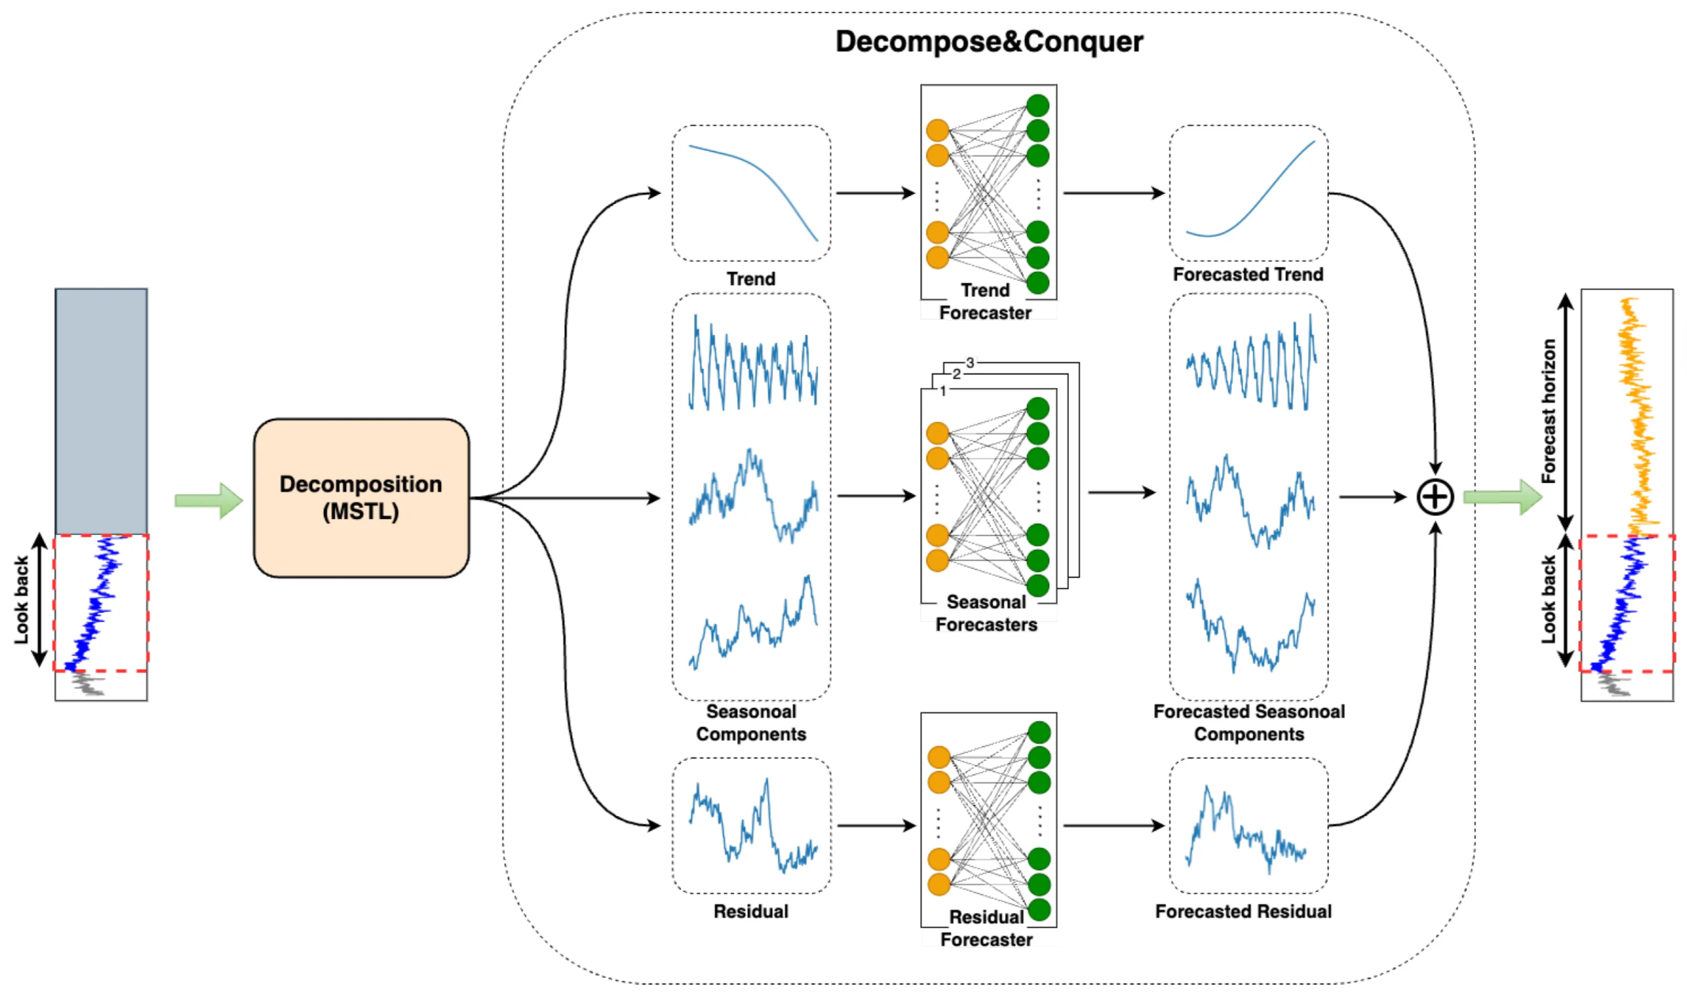
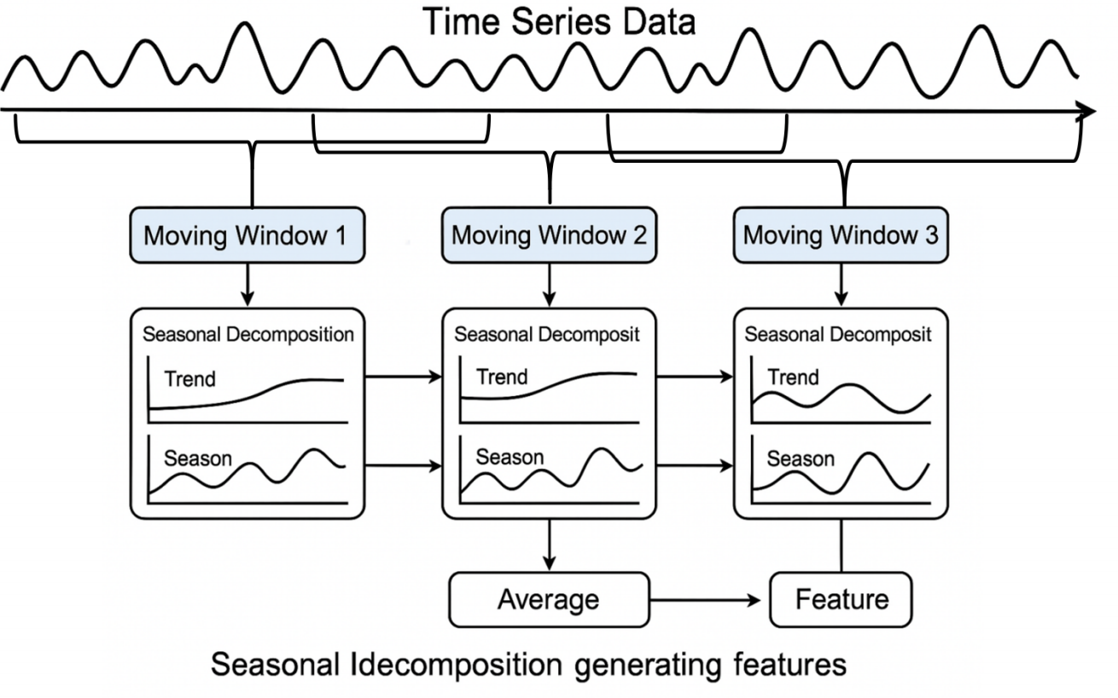
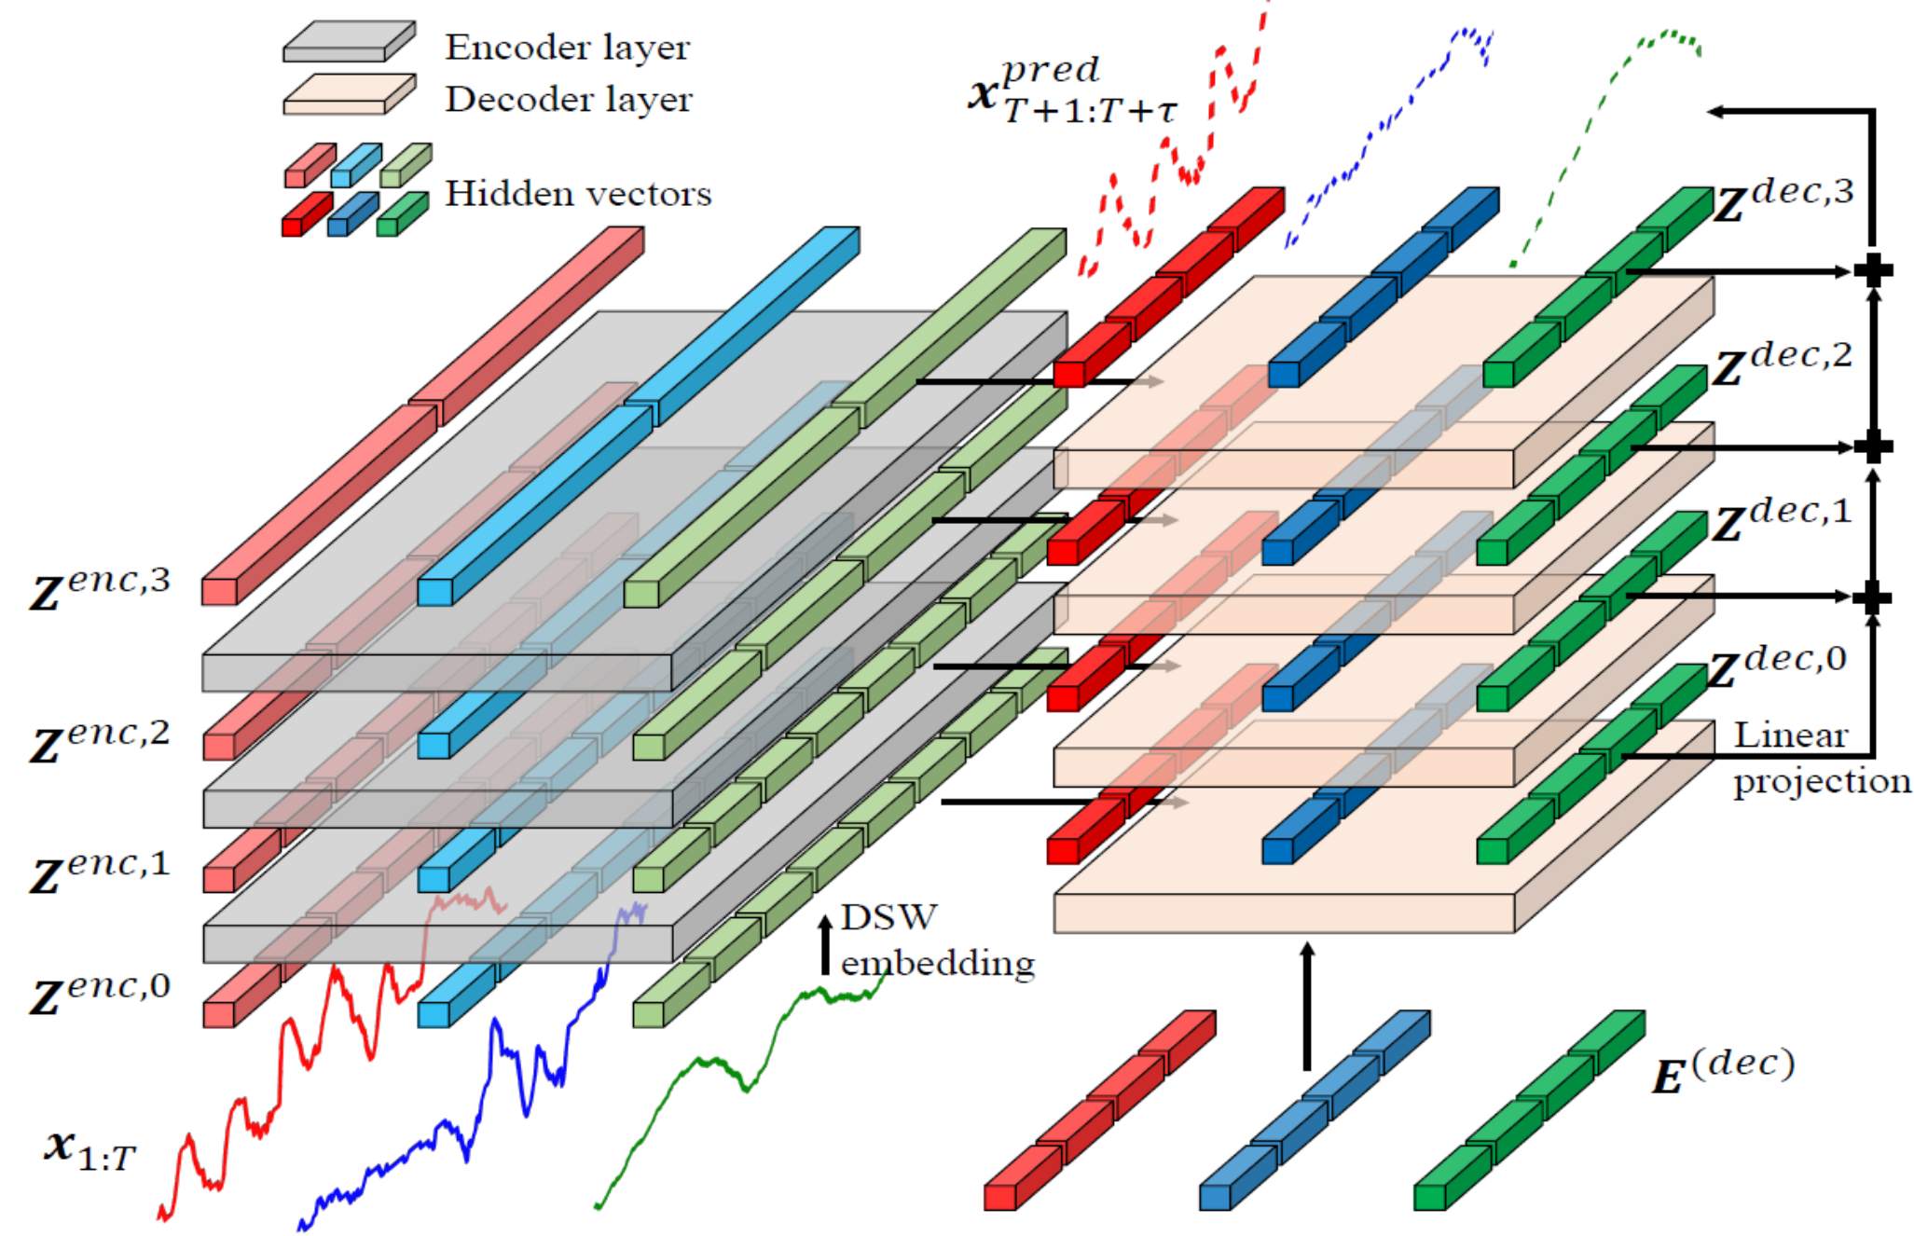
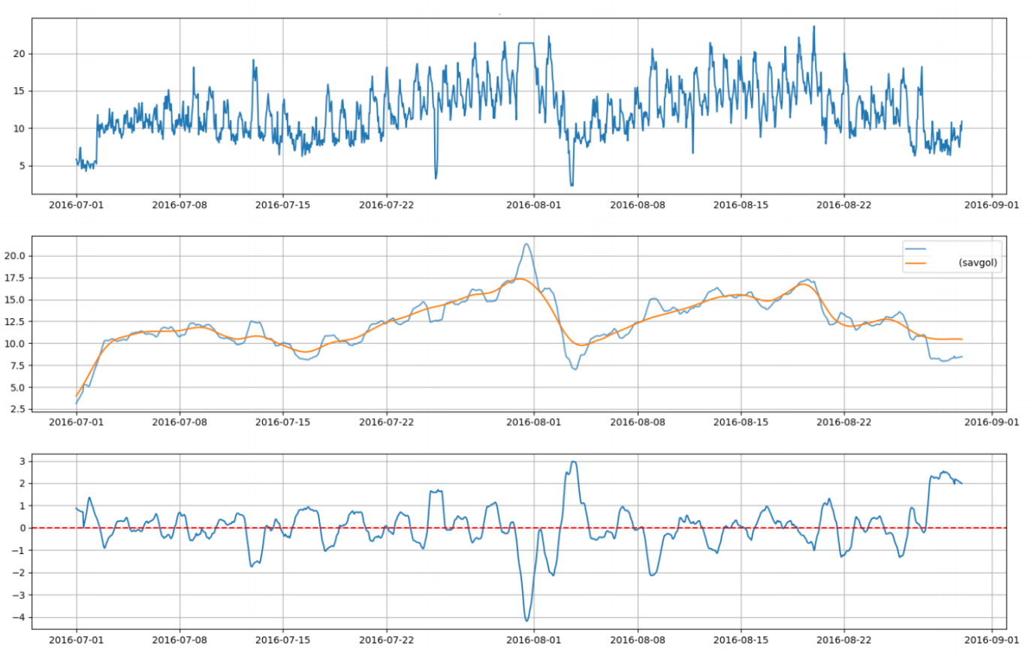
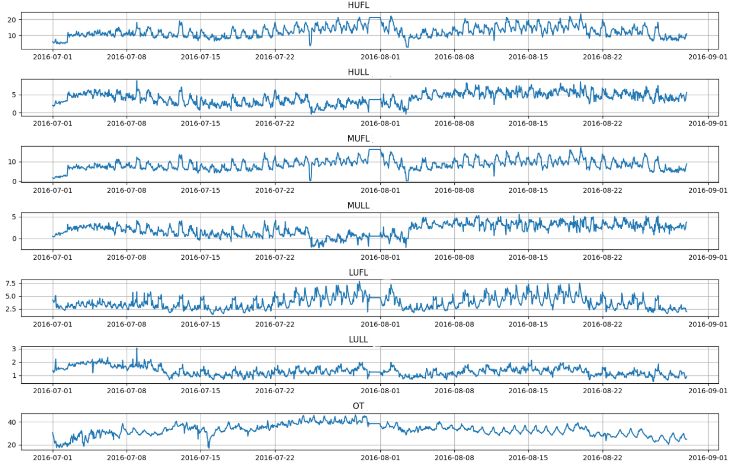
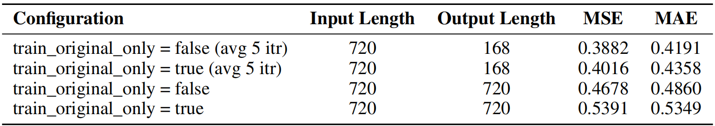
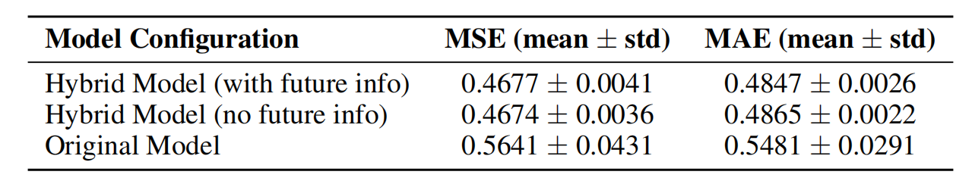
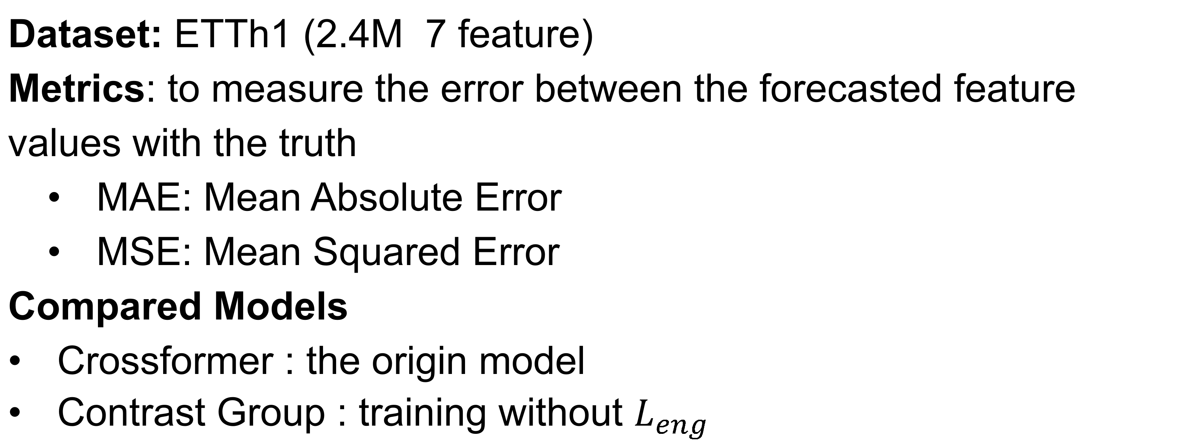
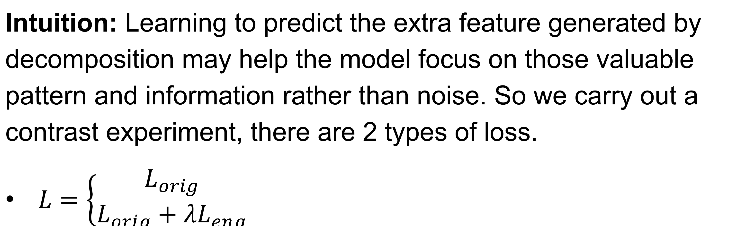
Fulfilling the Potential of Crossformer with Feature
Engineering: Integrate Decomposition Method
Chenyuan Zhou
Background
Seasonal Decomposition
Drift Window Method for Local Decomposition
Crossformer
Feature Fine Tune
Smoothing: apply a Savitzky-Golay filter to smooth the extracted trend components, reduce the impact of noise
Time Features: help the model learn the time information, including sin representation of:
day of week
hour
month
Task
Hybrid Training Strategy: Multitask Learning
Intuition: Learning to predict the extra feature generated by decomposition may help the model focus on those valuable pattern and information rather than noise. So we carry out a contrast experiment, there are 2 types of loss.
$L=\left\{\begin{aligned}L_{orig} \\ L_{orig}+λL_{eng}\end{aligned}\right.$
Efficient Feature Extraction
Generate: use drift window with fixed step size to pre-generate the trend and seasonal feature before training.
Evaluation: use online STL Decompostion to generate .
Forecast the ETTh dataset, with 7 related features.
Experiments
Challenges
Setup
Serial Prediction: strong noise and uncertainty cause overfitting, especially training transformer based model with limited data.
Data Feature: seasonal cyclical fluctuations are complex and there
are multiple periods which is hard for model to analyse.
Unstable Training Process: we find crossformer’s training process on this kind of dataset is unstable with a rather big variance
Dataset: ETTh1 (2.4M 7 feature)
Metrics: to measure the error between the forecasted feature values with the truth
MAE: Mean Absolute Error
MSE: Mean Squared Error
Compared Models
Crossformer : the origin model
Contrast Group : training without $L_{eng}$
Our Approach
Results
Decomposition Method Analysis
STL decomposition:get the trend and seasonal features
Period: we tried out two kinds of seasonal periods—one day and one week—and found that decomposition with a period of one day is less likely to overfit.
2-Step decomposition*: for some with complex
seasonal features, we use 2-step decomposition (first by period of one day, then one week).
Apex Data & Knowledge Management Lab
http://apex.sjtu.edu.cn

