Slide 1
V8 RISCV： Performance evaluation and enhancement
first step: find performance baseline
qiuji@iscas.ac.cn
2021/01/07

Slide 2
Outline
01 Goal：Performance evaluation and enhancement of V8-RISCV
02 Evaluation method
03 Counterpart selection：ARM64 CorextA53
04 Current Performance Statistics
05 TODO

Slide 3
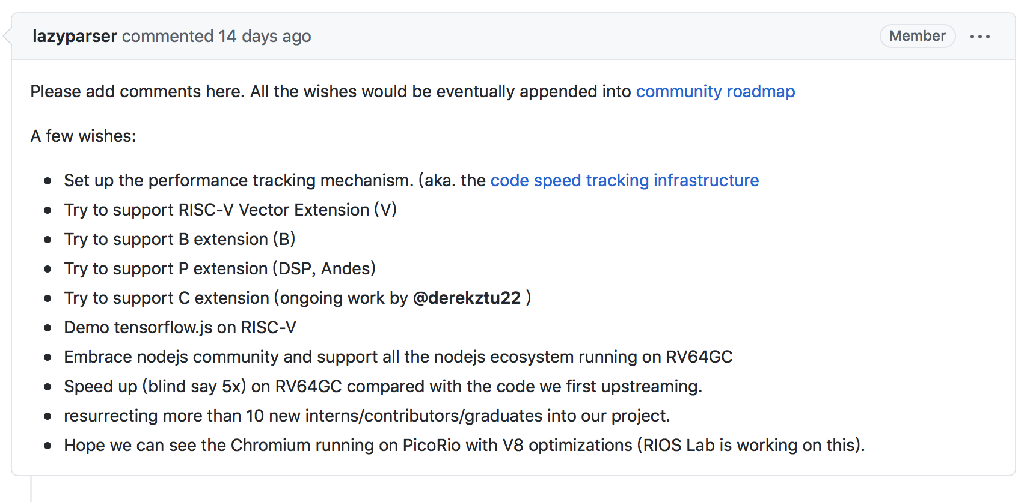
1 Goal：performance->how? why? what to do?
the 2021 Wishlist
www

Slide 4
2 Current evaluation method
Platform:
Simulation run: measure count of instructions
Native run: measure time (on HiFive Unleashed board)
benchmark:
Synthesis : SunSpider
Micro-bench: simple code snippet from https://jsben.ch/browse

Slide 5
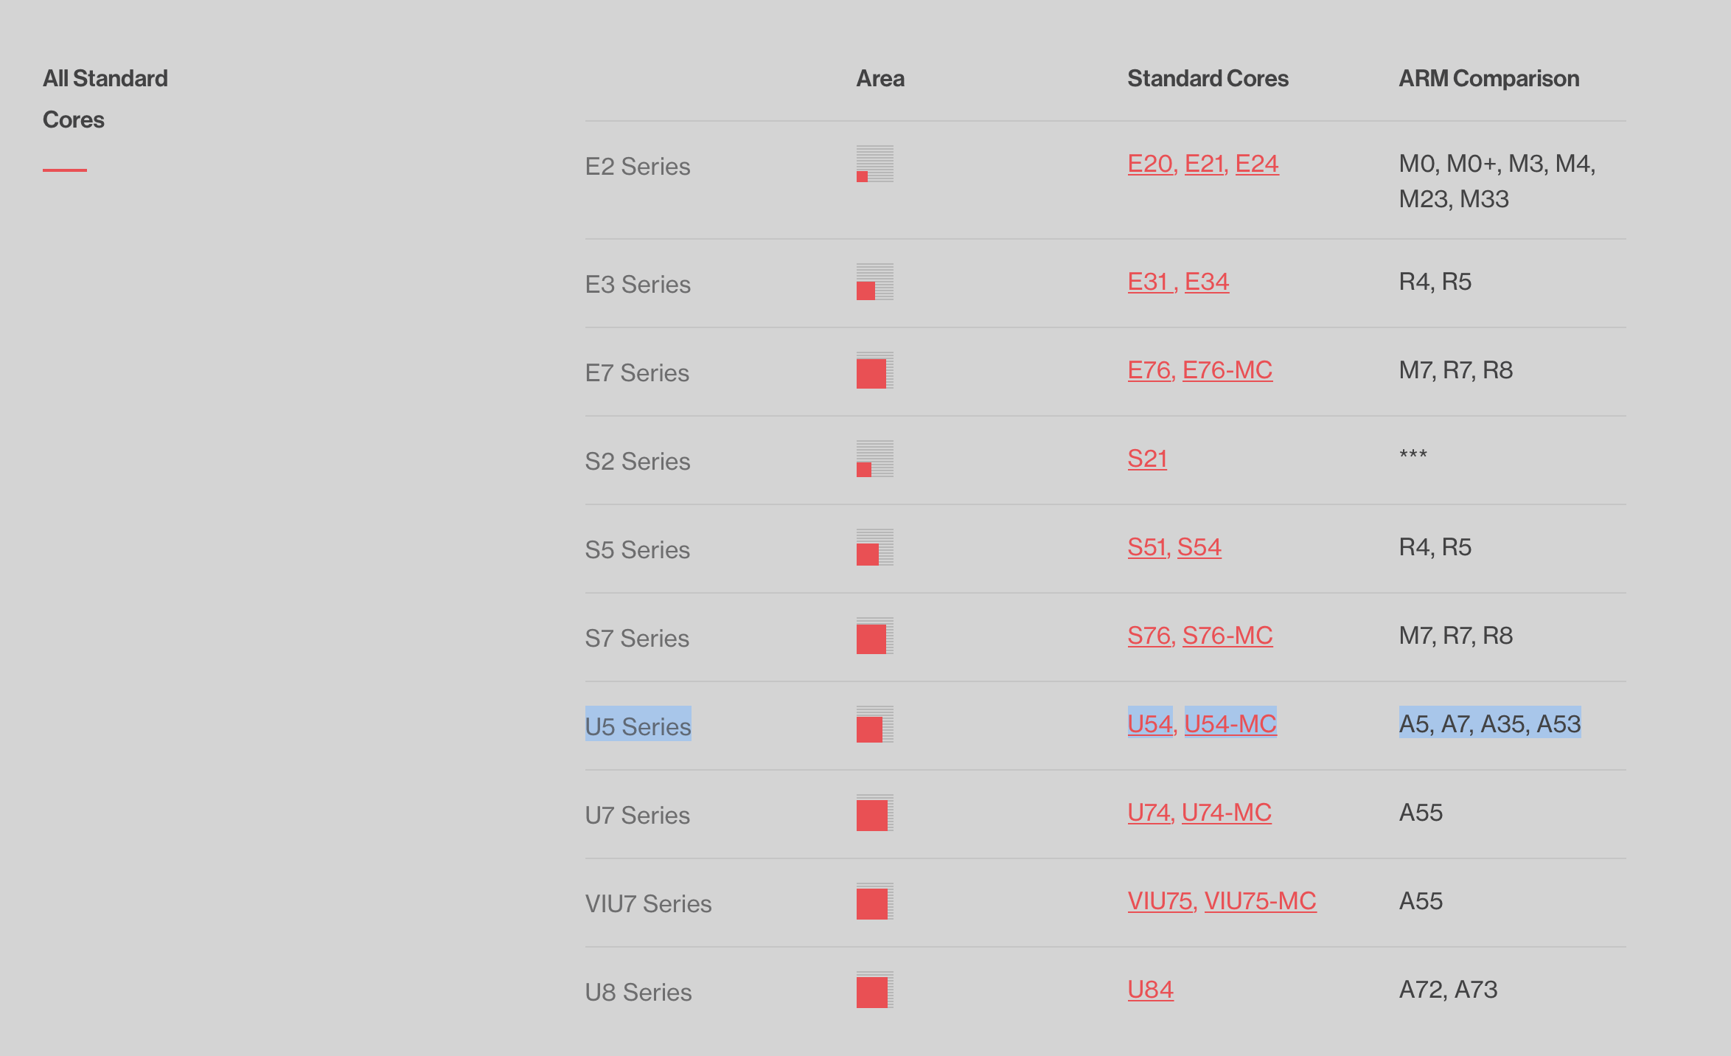
3 Counterpart selection
Final usage scenario: native run embedded in Chrome
ARM64 SOCs are more popular than MIPS SOCs
We select A53 because it is the easiest one to get.
Also, ARM64 is a tier1 (or tier2) platform supported by Google.
https://www.sifive.com/cores/u54

Slide 6
4 Performance statistics- SunSpider native run
RV64 release build d8 has almost the same result. (need to checked )
The RV64/ARM64 ratio is from 7x to 20x with an average 14x.

Slide 7
4 Performance statistics- SunSpider simulation run
Dynamic instruction count from the icount_ variable (add the same var to the ARM64 simulator)
 | ARM64 | RISCV64
3d-cube.js | 3.13E+08 | 4.84E+08
3d-morph.js | 1.89E+08 | 2.97E+08
3d-raytrace.js | 2.73E+08 | 4.23E+08
access-binary-trees.js | 8.01E+07 | 1.21E+08
access-fannkuch.js | 2.57E+08 | 4.11E+08
access-nbody.js | 7.47E+07 | 1.13E+08
access-nsieve.js | 1.92E+08 | 3.01E+08
bitops-3bit-bits-in-byte.js | 3.65E+07 | 5.71E+07
bitops-bits-in-byte.js | 3.96E+07 | 6.24E+07
bitops-bitwise-and.js | 6.74E+07 | 9.63E+07
bitops-nsieve-bits.js | 1.91E+08 | 3.01E+08
controlflow-recursive.js | 7.00E+07 | 1.04E+08
crypto-aes.js | 3.16E+10 | 4.92E+10
crypto-md5.js | 1.87E+08 | 2.82E+08
crypto-sha1.js | 2.18E+08 | 3.28E+08
date-format-tofte.js | 1.50E+08 | 2.24E+08
date-format-xparb.js | 3.06E+08 | 4.65E+08
math-cordic.js | 1.03E+08 | 1.60E+08
math-partial-sums.js | 2.05E+08 | 3.17E+08
math-spectral-norm.js | 5.65E+07 | 8.79E+07
regexp-dna.js | 3.75E+08 | 5.76E+08
string-base64.js | 3.48E+08 | 5.08E+08
string-fasta.js | 2.59E+08 | 3.97E+08
string-tagcloud.js | 3.24E+08 | 4.82E+08
string-unpack-code.js | 5.91E+10 | 8.81E+10
string-validate-input.js | 2.30E+11 | 3.53E+11

Slide 8
4 Performance statistics- SunSpider simulation run
Dynamic instruction count ratio
RV64 has executed about 50% more instructions than ARM64.
Thera are huge gap between simulation run and native run.(need to be checked)

Slide 9
TODO
make the measurement more accurate, get reasonable result
build ARM64 d8 with same gn args and retry
profiling on Hifive to see why it takes so long time for the benchmarks
Try to find optimization potentials
find the benchmark which has a biggest performance gap (after solid measurement)
segment the binary code into reasonable unit, differentiate and analyze

Slide 10
Q & A
2020/01/07

