Slide 1
V8 Debugging Techniques
Brice Dobry

Slide 2
Basic Flags
--trace-sim Dump a trace of all instructions executed
--print-code Print out all instructions generated during JIT
--print-all-code Print out all instructions generated ahead of time and during JIT
--print-* Print out various stages: ast, wasm-code, bytecode, etc. (see --help)
Notes:
out/riscv64.sim/cctest --trace-sim test-simple-riscv64/RISCV_SIMPLE0
out/riscv64.sim/d8 --test --allow-natives-syntax --enable-inspector --print-code test/mjsunit/mjsunit.js test/debugger/test-api.js test/mjsunit/asm/poppler/poppler.js
out/riscv64.sim/cctest --print-all-code test-simple-riscv64/RISCV_SIMPLE0 &> all.out

Slide 3
analyze.py Script
Python script in v8-riscv-tools/
Parses output from a simulation run with --print-all-code and --trace-sim, tracks call/return and generates a call-tree
This tool has not been kept up to date and currently needs an update

Slide 4
GDB Functions
(gdb) source tools/gdbinit
job Print out a JavaScript object
jh Print out a v8::internal::Handle
jlh Print out a v8::Local
jst Print the current JavaScript stack trace
jss Print the JavaScript stack
And more…

Slide 5
Builtin Functions
Use flag --enable-natives-syntax to enable special builtin JS commands
%SystemBreak() Trigger a break in gdb
%OptimizeFunctionOnNextCall(f) Force a JIT on next call of f
%CollectGarbage() Manually trigger GC
%DebugPrint(obj) Print internal details of a JavaScript object
%IsArray(obj) Check for various builtin types
See src/runtime/runtime.h for the full list
See test/debugger/debug/ for examples

Slide 6
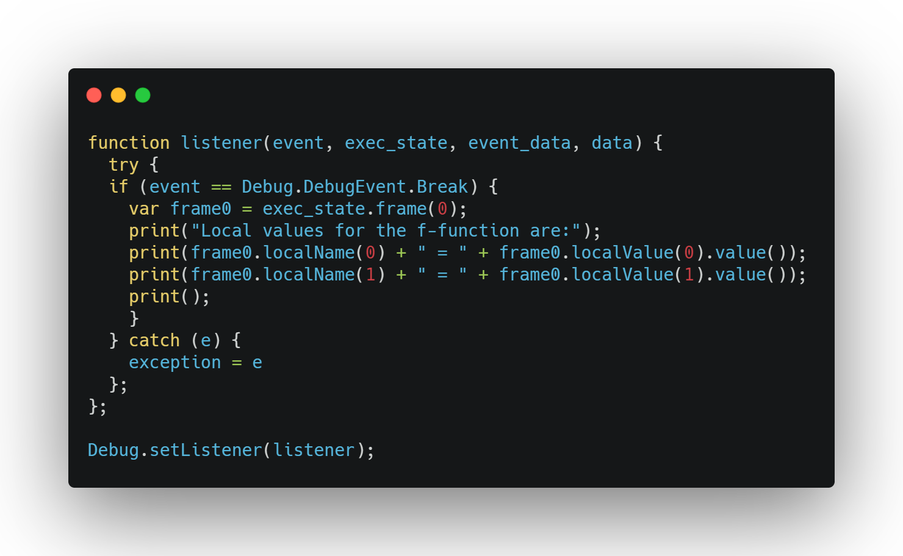
JavaScript-Level Debugging
Enable the inspector interface with the --enable-inspector flag
Include test/mjsunit/mjsunit.js and test/debugger/test-api.js
Define a listener to respond to various events
DebugEvent: Break, Exception, AfterCompile, CompileError, OOM
Insert debugger; into code to trigger a Break event
See tests in test/debugger/debug/ for examples
Notes:
OOM = Out of Memory
out/riscv64.sim/d8 --test --allow-natives-syntax --enable-inspector test/mjsunit/mjsunit.js test/debugger/test-api.js ../work/debug.js

