Slide 1
CAN301 MOBILE COMPUTING GROUP PROJECT
Cutofftime mobile application
Team member: Ning Wang
Qiuzhang Chen
Yifei Fan
Shengshuo Hua
Jisheng Li

Slide 2
Negative Impacts Of Late Submission:
Receive a poor mark
Terrible!
Fail the course
Delay graduation
Hard to apply to study in top schools/
Hard to look for good jobs

Slide 3
Introduction:
Target Users: University students
Functions:
1) Record deadlines
2) Edit recorded deadlines
3) Search recorded deadlines
4) Delete recorded deadlines
5) Send reminder to the users (When deadline is coming)
6) Data visualization (Pie chart)

Slide 4
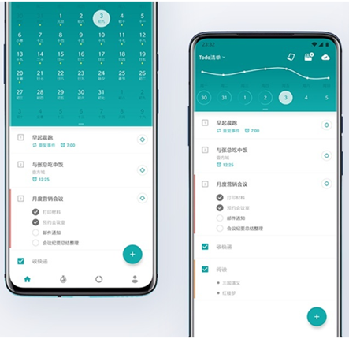
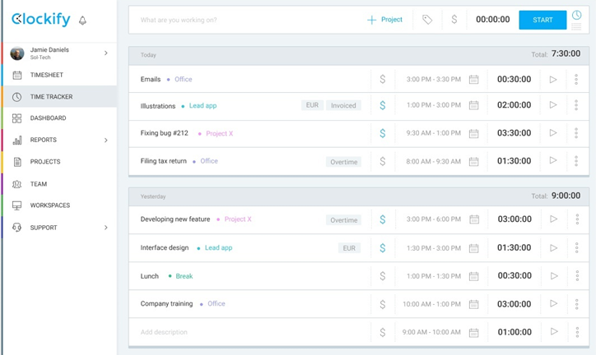
Related Work
TYPE: Schedule management APP, Time management APP
FEATURE: show to-do list, notification, record completion, planning time, etc.
Example: Todo, Clockify, memo

Slide 5
Comparison
 | Related work | Our job
Vision | Exquisite, interesting Cover the keyword of the to-do list | Concise ,no interferences Cover all information of the to-do list
Function | Generally, the task list is listed in units of days Analyze the percentage of completed/uncompleted tasks | List assignments due in the next period of time Analyze coursework distribution(chart) to user when users plan time
Target user | All people | University student

Slide 6
Overall infrastructure and key components
DDL management system
Key components:
Activity
Content provider

Slide 7
Methods to improve the usability of app
Graphical interface:
Intuitive and clear
Prompt function:
Format of input information
Show the specific message
Simple and flat page design:
Reduce the learning cost

Slide 8
Any findings identified during the project
1.The boundaries of the system should be identified
2.Consider for users
3.the developmental quality is as important as the development speed

Slide 9
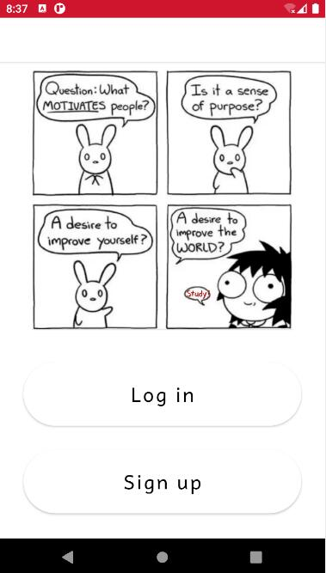
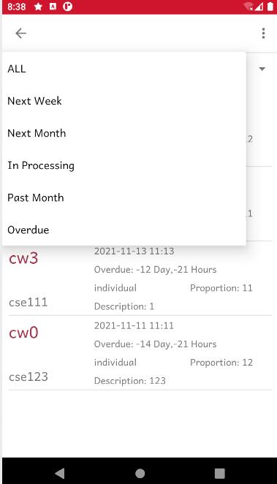
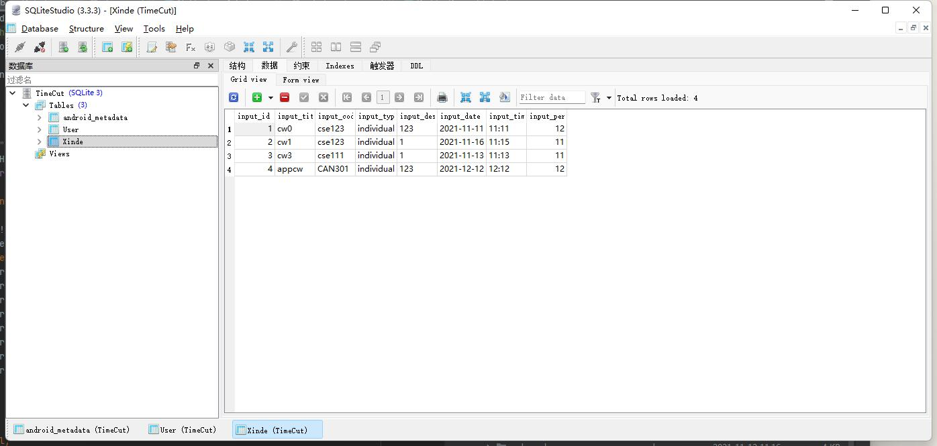
Challenges:
Display of different events
Distinguish between different users
Database operations

Slide 10
Percentage of the contribution of each group member
fair workload
student name | user interface design and logic implementation
Ning Wang | login, logout, signup, and time addition features of the system
Qiuzhang Chen | viewing features of the deadline management
Yifei Fan | edition and deletion features the deadline management
Shengshuo Hua | push notification when the deadlines are coming
Jisheng Li | data analysis and chart representation

Slide 11
THE END
Thanks for watching

